Slide 1
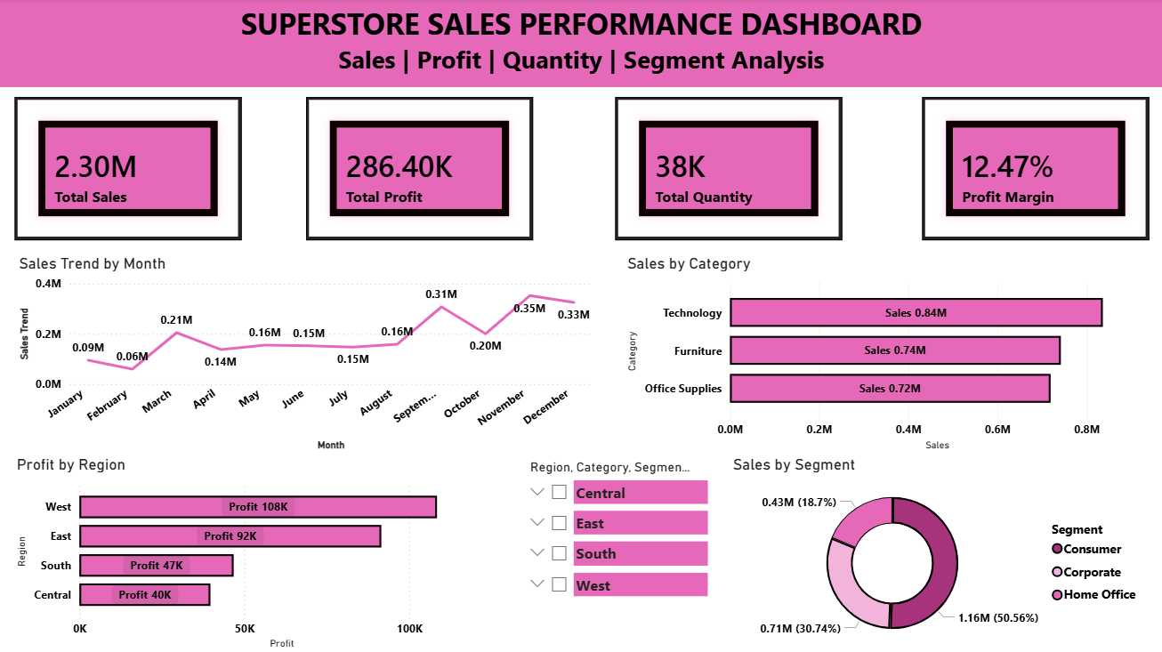

Slide 2
Dashboard Insights
Total Sales reached $2.30M. Total Profit generated was $286.40K.
Overall Profit Margin is 12.47%.
Technology category generated the highest sales ($0.84M).
West region generated the highest profit ($108K).
Consumer segment contributed 50.56% of total sales.
Sales peaked during November and December.

Slide 3
Recommendations
Focus marketing efforts on Technology products.
Expand successful sales strategies in the West region.
Increase engagement with Consumer segment customers.
Monitor seasonal peaks to maximize year-end revenue.
Outcome: The dashboard enables stakeholders to monitor sales performance, identify profitable regions and segments, and make data-driven business decisions.

