Slide 1
Telecom Customer Churn Analysis using Python, SQL & Power BI
Prepared By
Rowthu Kalyani

Slide 2
Problem Statement
Problem
Telecom companies experience customer churn, leading to revenue loss.
Objective
Analyze customer churn.
Identify key churn factors.
Build a predictive model.
Provide business recommendations.

Slide 3
Dataset
IBM Telco Customer Churn Dataset
7032 Customers
21 Features Target
Variable: Churn
important features:
Contract Internet
Service Payment
Method Monthly
Charges Tenure

Slide 4
Project Workflow
Dataset ↓ Data Cleaning ↓ EDA ↓ SQL Analysis ↓ Machine Learning ↓ SHAP ↓ Power BI Dashboard ↓ Business Recommendations

Slide 5
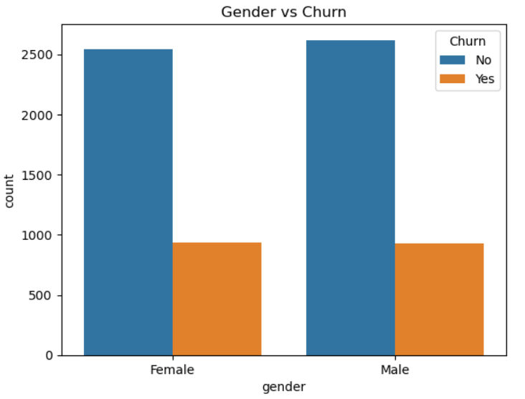
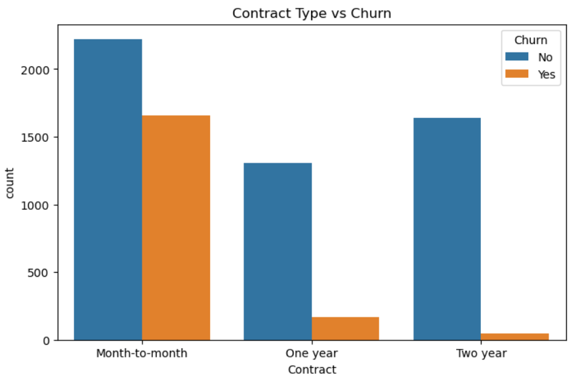
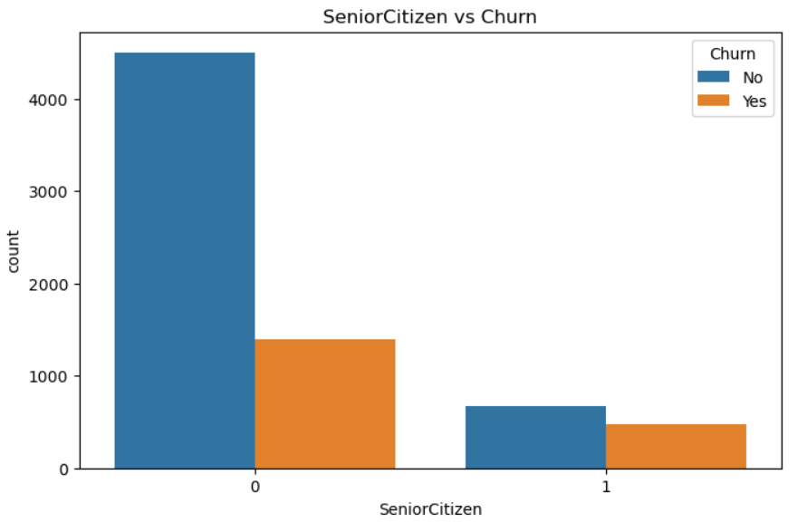
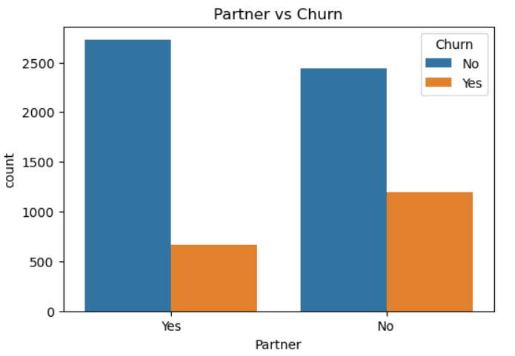
EDA Insights

Slide 6
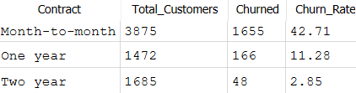
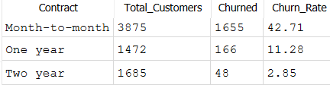
SQL Analysis
SELECT Contract , COUNT(*) AS Total_Customers,SUM(CASE WHEN Churn='Yes' THEN 1 ELSE 0 END) AS Churned , ROUND(SUM(CASEWHEN Churn='Yes' THEN 1 ELSE 0 END)*100.0/COUNT(*),2) AS Churn_Rate FROM telecom_churn GROUP BY Contract ORDER BY Churn_Rate DESC
SELECT PaymentMethod,COUNT(*) AS Churn_Count FROM telecom_churn WHERE Churn='Yes’ GROUP BY PaymentMethod ORDER BY Churn_Count DESC;

Slide 7
Machine Learning
Models Used:
Logistic Regression
Decision Tree
Random Forest
Results:
Model | Accuracy
Logistic Regression | 78.75%
Random Forest | 78.54%
Decision Tree | 72.49%

Slide 8
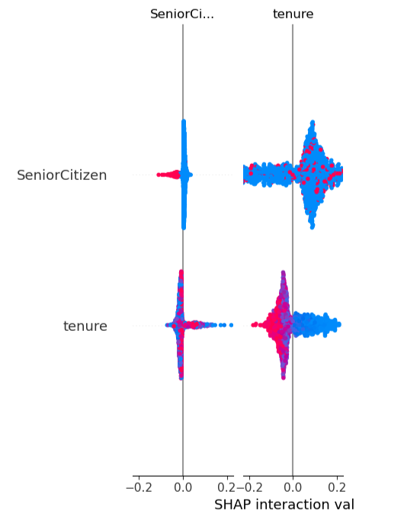
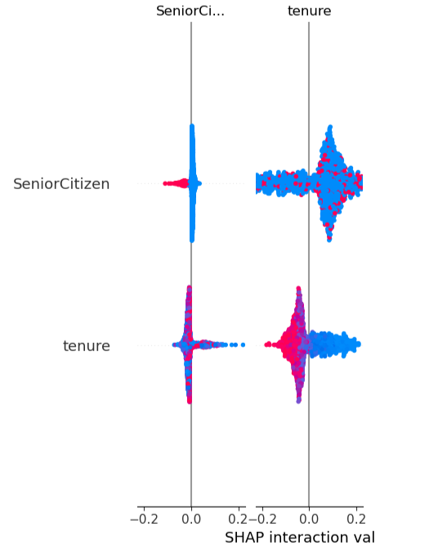
SHAP Explainability

Slide 9
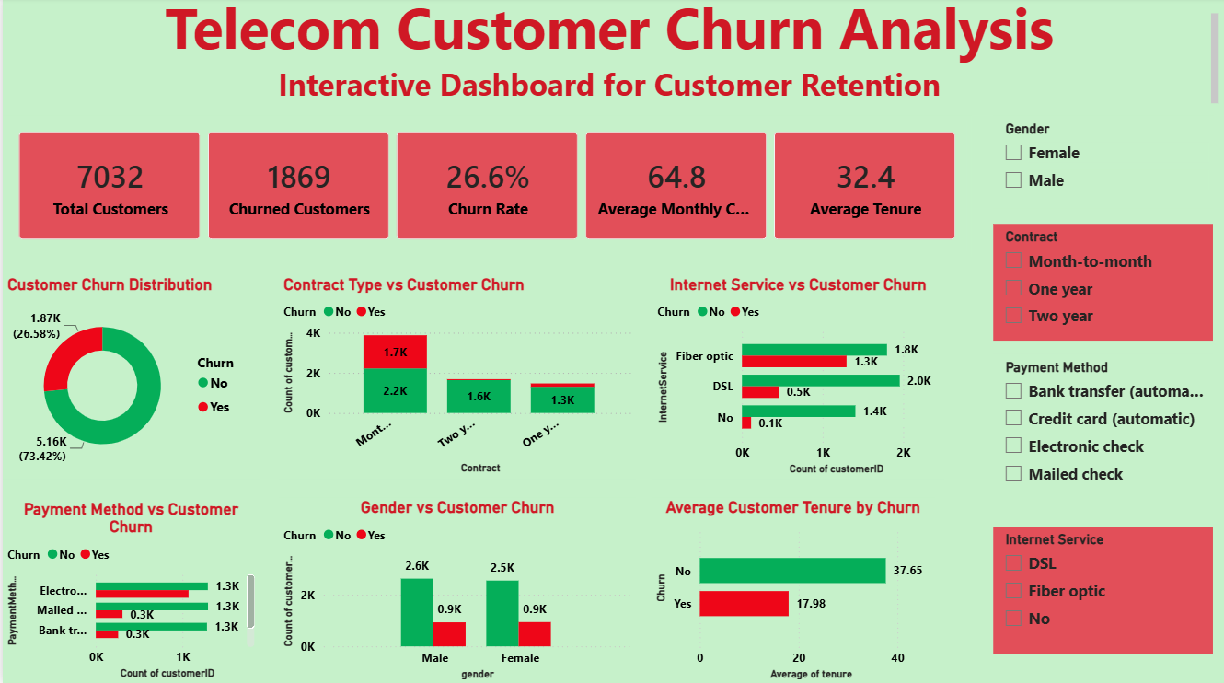
Power BI Dashboard

Slide 10
Business Recommendations
Encourage long-term contracts.
Improve Fiber Optic service.
Promote automatic payments.
Reduce pricing for high-value customers.
Target new customers with retention campaigns.

Slide 11
Conclusion
The project successfully identified the primary drivers of customer churn using Python, SQL, Machine Learning, SHAP, and Power BI. Logistic Regression achieved the best performance (78.75% accuracy), while the dashboard provides business users with an interactive tool for monitoring churn and supporting customer retention strategies.
Thank You

