Slide 1
Secure Data Hiding In Images Using Steganography
CAPSTONE PROJECT
Presented By : GADU KALYANI
Student Name : GADU KALYANI
College Name & Department : NRI INSTITUTE OF TECHNOLOGY &
INFORMATION TECHNOLOGY

Slide 2
OUTLINE
Problem Statement
Technology used
Improvements
End users
Result
Conclusion
Git-hub Link
Future scope

Slide 3
Problem Statement
In today's digital world, safeguarding data security and privacy is crucial. Traditional encryption techniques can often be detected and intercepted, making them vulnerable. Our project addresses this issue by leveraging steganography to conceal secret messages within images. This approach provides a discreet communication channel, ensuring data confidentiality while avoiding suspicion.

Slide 4
Technology used
Programming Language: Python
Libraries:
OpenCV for the processing of image
Tkinter (with ttk) for the better GUI for users
NumPy for efficient array and bit manipulation
Platform: Cross-platform (Windows/Linux)
Tools: Visual Studio Code

Slide 5
Improvements
Improved UI: Added file selection dialogs, drag-and-drop support, and a better layout for easy navigation.
Passcode Protection: Ensures only authorized users can decrypt the message, with error handling for incorrect passcodes.
Secure Encryption: Stores message length and passcode in a structured format for reliable extraction.

Slide 6
End users
Security professionals and cybersecurity enthusiasts.
Journalists, activists, and government agencies needing secure communication channels.
Students and researchers interested in data privacy and steganography.
General users looking for enhanced digital security.

Slide 7
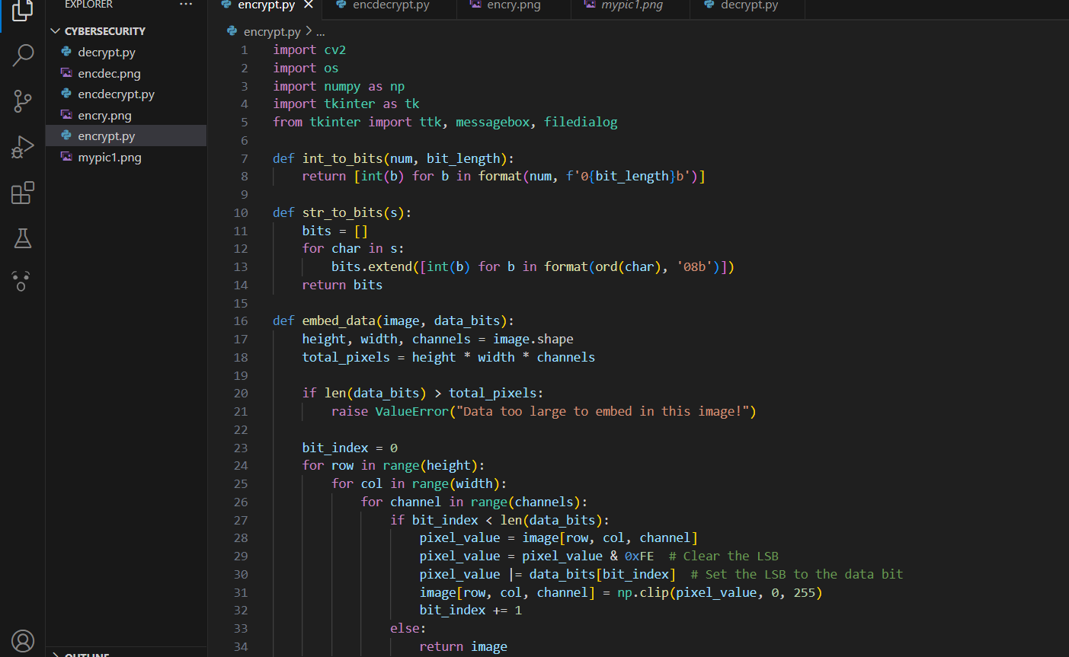
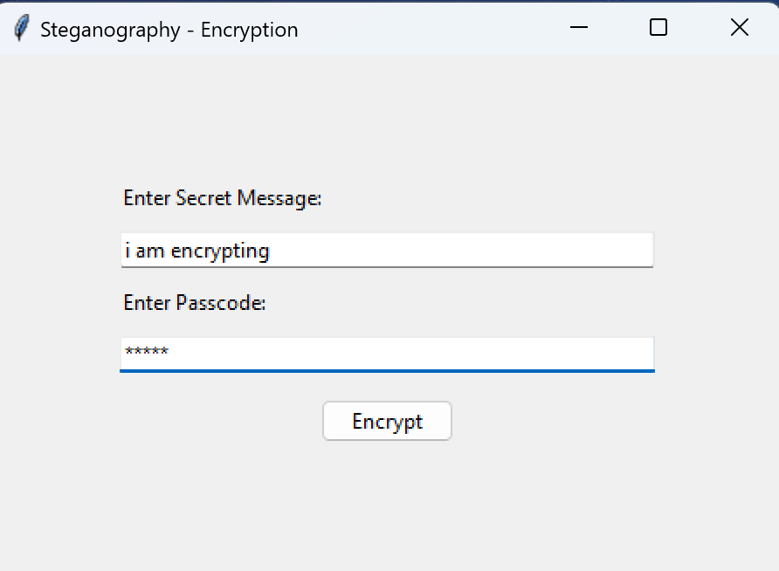
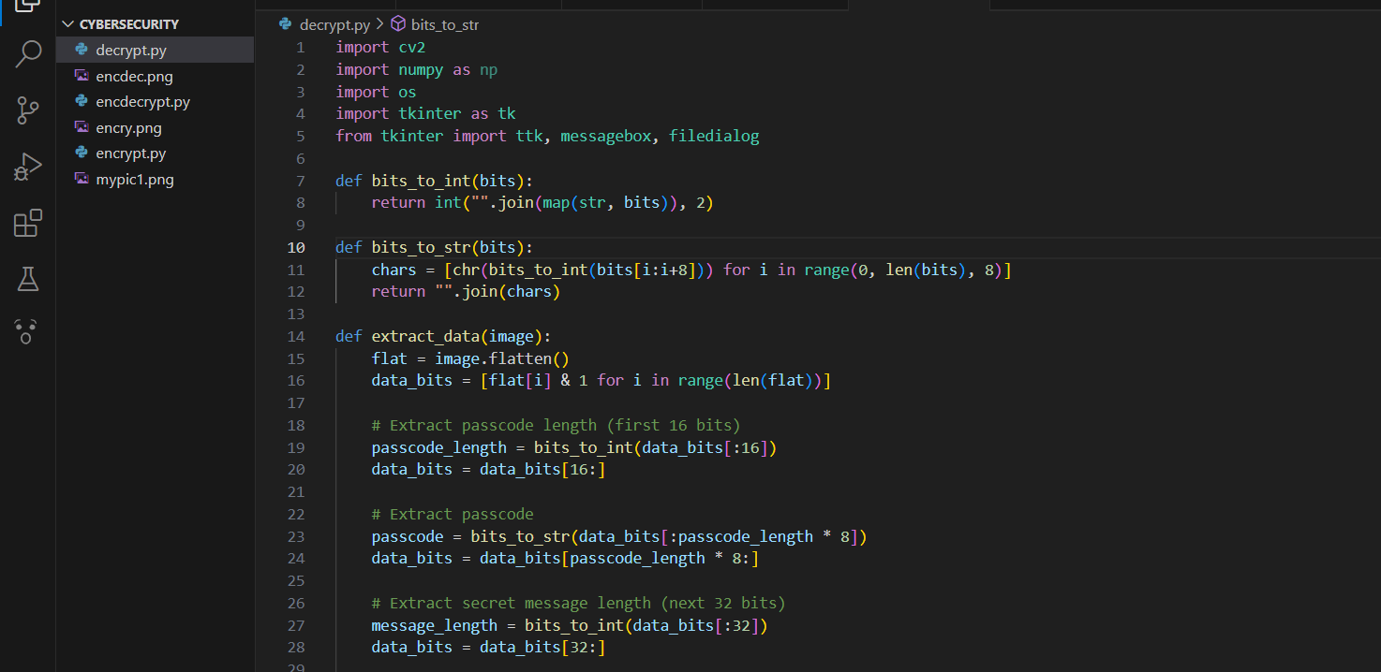
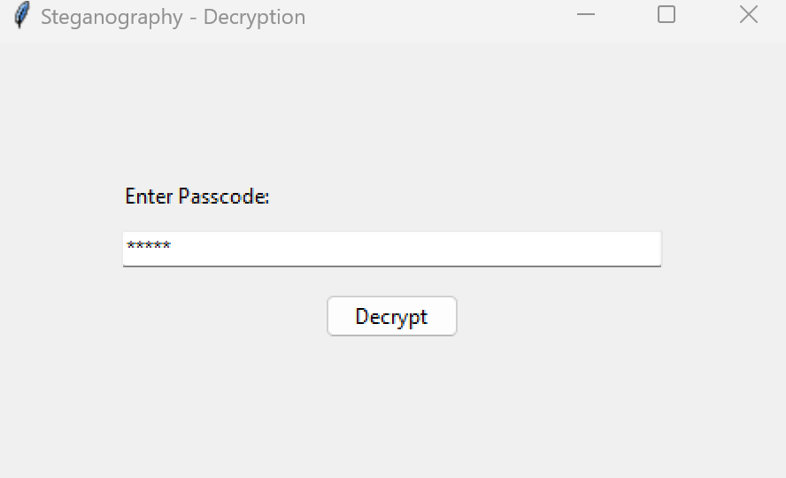
Results

Slide 8
Conclusion
Our project successfully demonstrates a novel approach to data security by hiding information within an image using LSB steganography.
The technique is both secure and undetectable, thanks to embedding critical header information such as passcode and message lengths.
The user-friendly GUI enhances the accessibility of the method, making it a practical tool for secure communication.
This project contributes to the broader field of digital privacy and secure data transmission.

Slide 9
GitHub Link
https://github.com/kalyani2223/steganography

Slide 10
Future scope(optional)
Support for multiple image formats and higher resolution images.
Extend the approach to video steganography for dynamic data hiding.
Incorporate advanced encryption algorithms to further secure the hidden message.
Develop a web-based or mobile application for broader accessibility.
Explore automated detection and extraction tools for steganographic content.

Slide 11
THANK YOU

