Slide 1
Flowchart for Kalyani
13th Dec, 2019

Slide 2
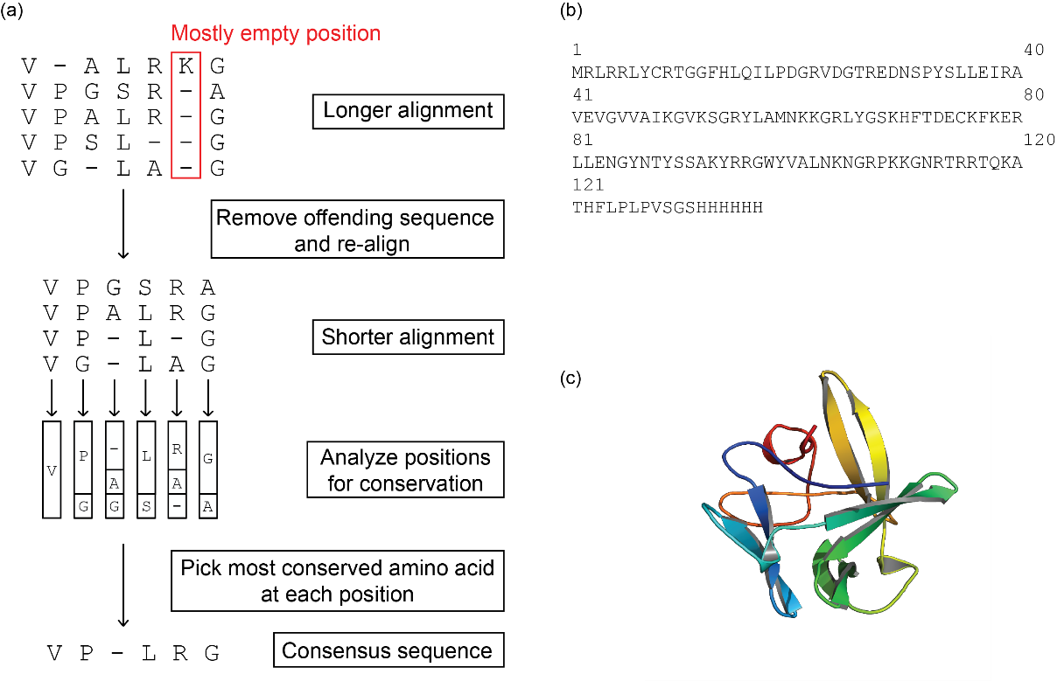
Flowchart
Start with a full protein alignment
Repeat till number of sequences is lower than a cutoff
Filter the sequences and remove the ‘bad’ sequences.
Realign (ClustalO/MAFFT/MUSCLE)
Design a consensus sequence from the refined alignment.

Slide 3
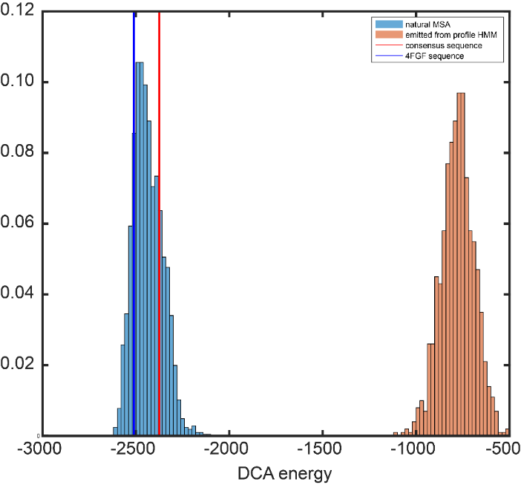
Consensus design obeys coevolutionary constraints
With Martin Weigt; Mandalaparthy, et al., Unpublished data.

