Slide 1

College Placement & Internship System
A Web-Based Solution for Campus Recruitment
25203001- Kalyani Gadade
25203002- Rahul Jadhav
25203004- Shrihari Mane
25203009- Vedika Yadav

Slide 2


Abstract
Centralized Platform
Automated Process
Connects students, companies, and administrators in one integrated system
Eliminates manual record-keeping and reduces errors
Real-Time Updates
Instant notifications and job postings for all stakeholders

Slide 3
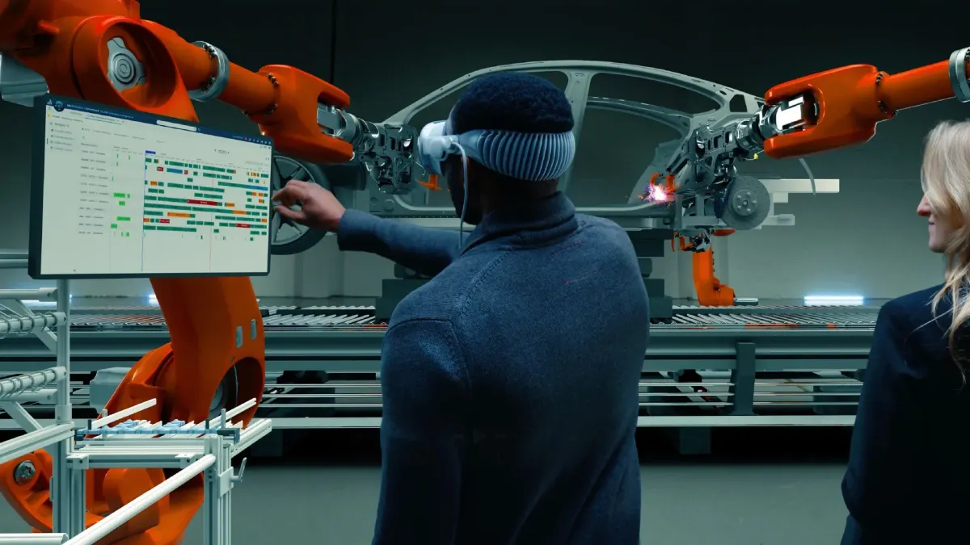
Introduction
Traditional System
No Integration
Manual process
Time-consuming
Paper-based
No unified platform
Poor communication
Disconnected users
Data Issues
Hard to manage records
Difficult tracking
Error-prone

Slide 4
Project Objectives
01
02
03
Automate Placement
Centralize Records
Easy Access
Streamline the entire recruitment workflow
Maintain comprehensive student database
Provide seamless job opportunity discovery
04
05
Reduce Errors
Enhance Communication
Eliminate paperwork and human mistakes
Connect students and recruiters effectively

Slide 5
Scope of project
Mobile App
Better accessibility on smartphones
AI Features
Automated resume filtering and recommendations
Cloud Deployment
Improved scalability and performance

Slide 6
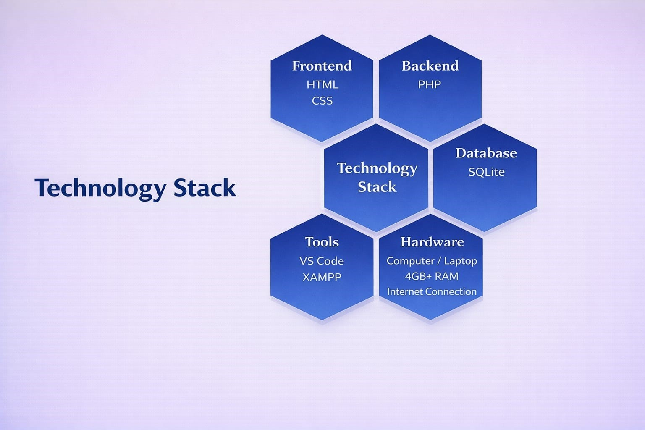
Hardware-Software
Used
Frontend
Backend
Tools
Hardware
Database

Slide 7
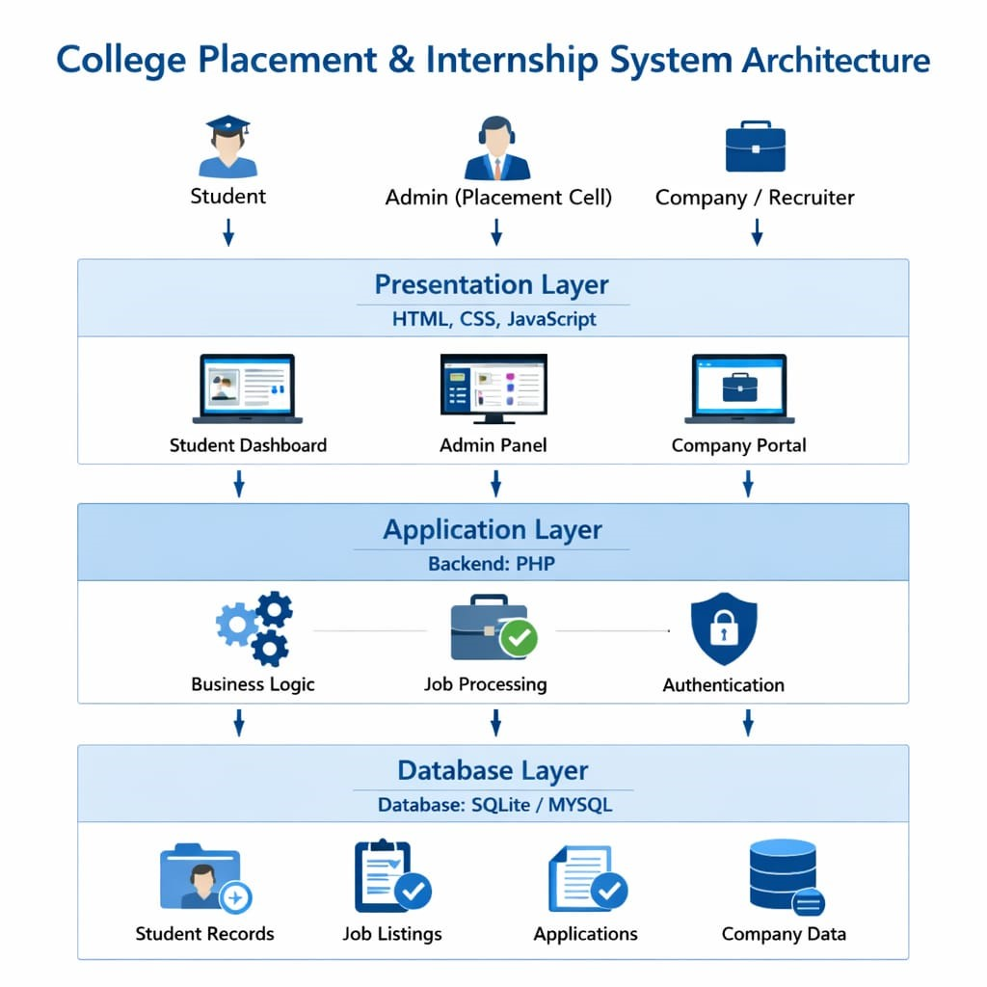



System Architecture
Presentation Layer
User Interface (HTML, CSS)
Application Layer
Business Logic (PHP)
Database Layer
Data Storage (SQLite)

Slide 8
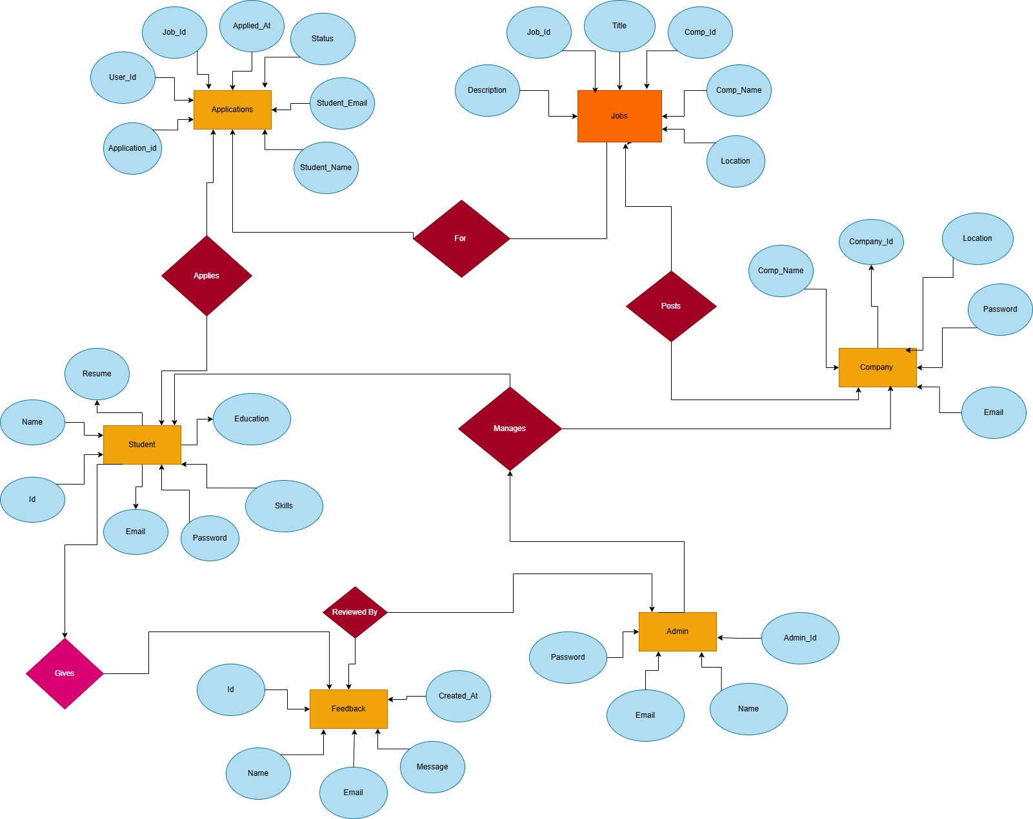
ER Diagram

Slide 9
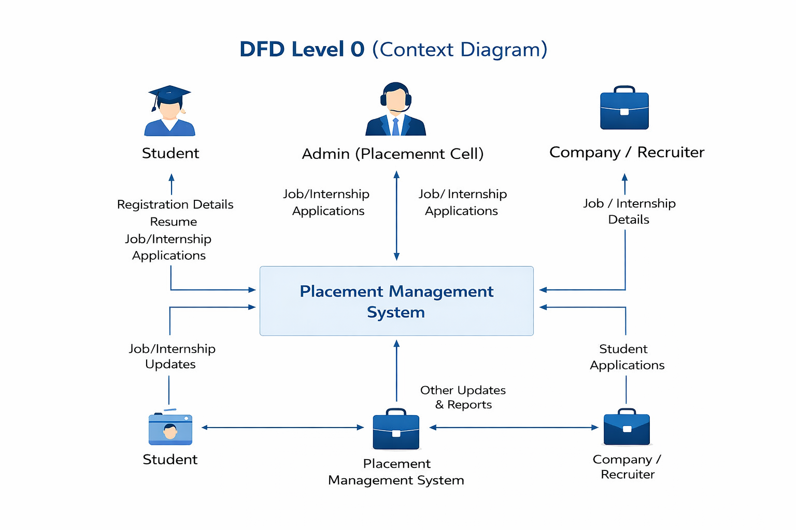
Data Flow Diagram: Level 0

Slide 10
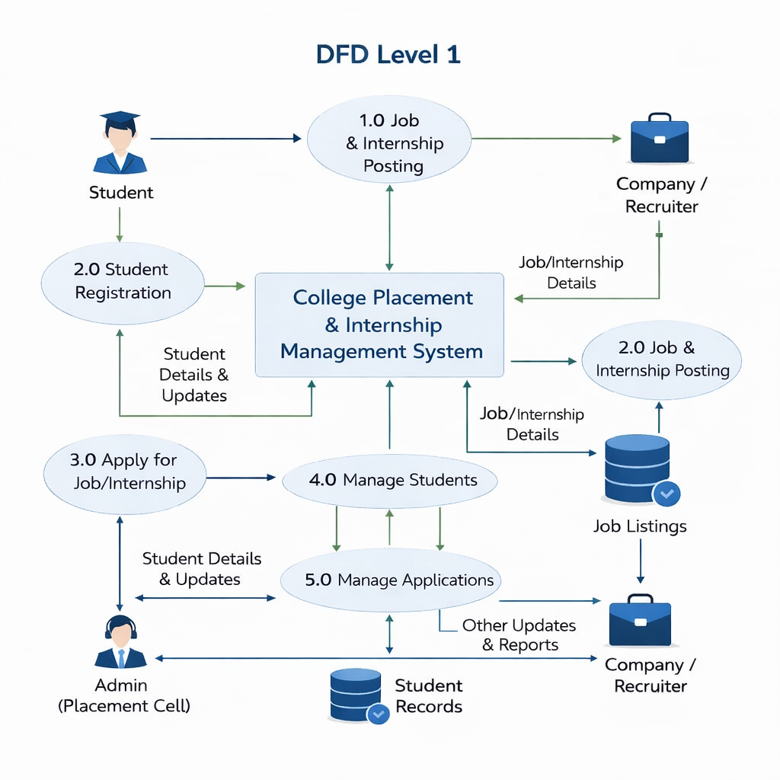
Data Flow Diagram: Level 1

Slide 11

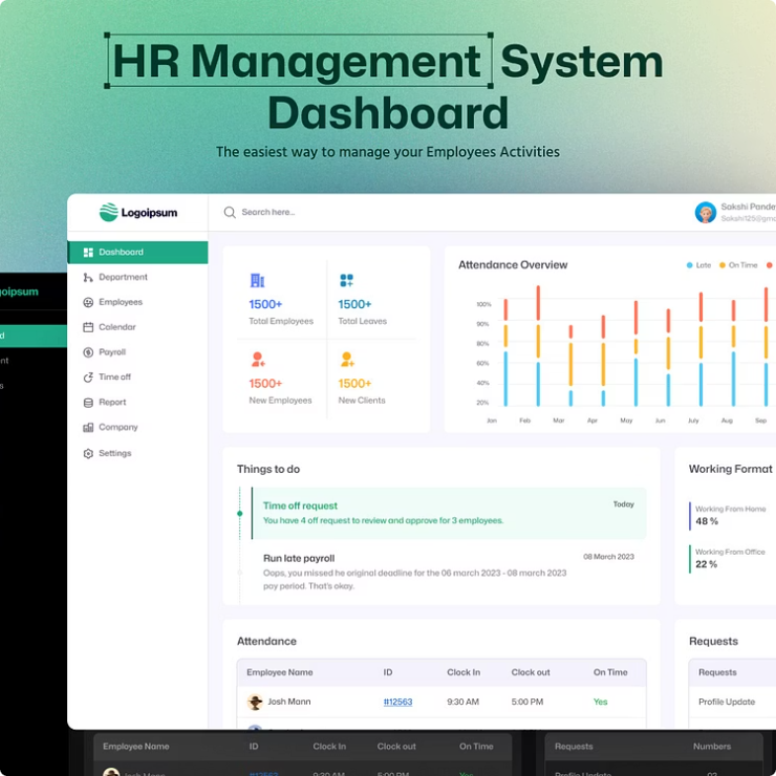

Core Modules
Student Module
Register, view jobs, apply,
track status
Admin Module
Manage users, approve
companies, generate reports
Company Module
Post jobs, view applicants,
select candidates

Slide 12
Thank You

