Slide 1
Title "IOT-Based Industrial Plant Safety Gas Leakage System"
Subtitle:- Ensuring safety in industrial environment
Subtitle:

Slide 2
SUBMITTED BY Akanksha Pathak Kalyani Gadade Shruti Nimbalkar Srushti Suryawanshi
UNDER GUIDANCE BY
Prof. V.B. Bhambure.

Slide 3
Content
Abstract
Introduction
Motivation
Objective
Literature Survey
Problem Statement
Block Diagram
Hardware & Software Requirement
Action plan
Future Scope
Conclusion
References

Slide 4
Abstract
Most of the fire-breakouts in industries are due to gas leaks. These cause dreadful damage to the equipment, human life leading to injuries, deaths, and environment. Currently available leakage detectors warn the people around using on-site alarms. So, this project proposes a leakage detector which sends the warning to the concerned people through SMS . This detector senses the presence of harmful gases particularly, LPG, Methane and Benzene.
LPG and Methane gases catch fire easily resulting in blasts. Benzene is carcinogen effecting the health of workers, if inhaled in higher concentrations. Hence, detection of these gases is essential. This low cost project includes MQ6, MQ4 and MQ135 gas sensors which detect LPG, Methane and Benzene gas leaks respectively.The concentration levels of the above mentioned gases are uploaded in the cloud .
The prototype of the proposed system generates a sound alert using buzzer on detection of a dangerous leakage and sends an SMS to the concerned person using IFTTT web service. Different color LEDS are used to specify the gas leaked for example, RED LED indicates the presence of LPG.

Slide 5
Introduction
The number of gas leaks that happen every year on industrial plants is obscure.
The majority of these leakages, regardless of whether recognized, go unreported when they do not straightforwardly prompt tangible mishaps. Environmental
Protection Agency (EPA) reports evaluate that in the United States alone, these
plants discharge close to one billion cubic meters of methane (not taking some
other gas into account).
The majority of these misfortunes (around 80%) appear to originate from flawed compressors, valves, seals, and connectors. In 2012, around 2200 million metric tons of CO2 were inadvertently discharged from oil frameworks and other synthetic procedures vital for the creation of iron, bond, plastics and steel.

Slide 6
Motivation
This detector senses the presence of harmful gases particularly, LPG, Methane and Benzene. LPG and Methane gases catch fire easily resulting in blasts. Benzene is carcinogen effecting the health of workers, if inhaled in higher concentrations. Hence, detection of these gases is essential.

Slide 7
OBJECTIVES:-
Real-Time Monitoring
Automated Alerts
Preventive Maintenance
Environmental Protection
Workers Safety

Slide 8
LITERATURE REVIEW
Literature survey
Evolution of IOT technology in industrial safety
Challenges and limitations
Future directions

Slide 9
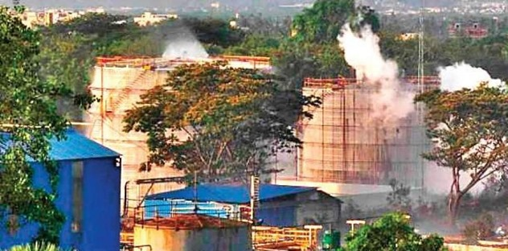
Problem statement:
Most of the fire-breakouts in industries are due to gas leaks. These Cause dreadful damage to the equipment, human life leading to Injuries, deaths and environment.
Fire can be deadly, destroying homes, wildlife habitat and timber, and polluting the air with emissions harmful to human health. Fire also releases carbon dioxide a key greenhouse gas into the atmosphere.
SO PROPOSED:-
IOT Based Industrial Plant Safety Gas Leakage.

Slide 10
Block Diagram
Cloud
NOD MCU
MQ-6
Buzzer
MQ-4
LED
Mobile
App
Wi-Fi
MQ-135
LCD

Slide 11
Hardware and Software requiremnt
Hardware Requirements
NOD MCU
MQ-4 Sensor.
MQ-6 Sensor.
MQ-135 Sensor.
Buzzer.
LED.
LCD.
Software Requirements
Arduino IDE.
Proteus & Blynk App.

