Slide 1

SMART LIBRARY MANAGEMENT SYSTEM
PYTHON FINAL PROJECT
DONE BY:
NAME:TUPPATHI KALYANI
COLLEGE:RAGHU ENGINEERING COLLEGE
BRANCH:COMPUTER SCIENCE ENGINEERING(DATA SCIENCE)

Slide 2

INTRODUCTION
The Smart Library Management System is a Python application used to manage books and library members. It provides functions such as adding, searching, issuing, returning, saving, and loading books.

Slide 3

PROJECT PROBLEM
Manual library management takes more time and can cause errors in maintaining book records. Our project provides a simple computerized solution.

Slide 4

OBJECTIVES
Manage books
1
Search books
2
Issue books
3
Return books
4
Calculate fines
5
Save and load data
6
Demonstrate Python concepts
7

Slide 5

FEATURES
Add Book
View Books
Search Book
Issue Book
Return Book
Fine Calculation
Save Data
Load Data

Slide 6

TECHNOLOGIES USED
Python
JSON
datetime
abc
Git
GitHub
Git Bash

Slide 7

PYTHON CONCEPTS
Variables & Data Types
Input & Output Operators
Type Casting Conditional Statements
Loops& Functions
Lists & Dictionaries
File Handling& Exception Handling
Classes & Objects Constructors
Inheritance &Polymorphism
Encapsulation &Abstraction

Slide 8
PROJECT WORKFLOW
Start
↓
Member Details
↓
Menu
↓
Select Operation
↓
Book Management
↓
Issue / Return
↓
Save / Load
↓
Exit

Slide 9

IMPORTANT CODE
class Book(libraryitem):
def __init__(self, book_id, title, author, copies, cost):
self.book_id = book_id
self.title = title
self.author = author
self.__copies = copies
self.cost = cost

Slide 10
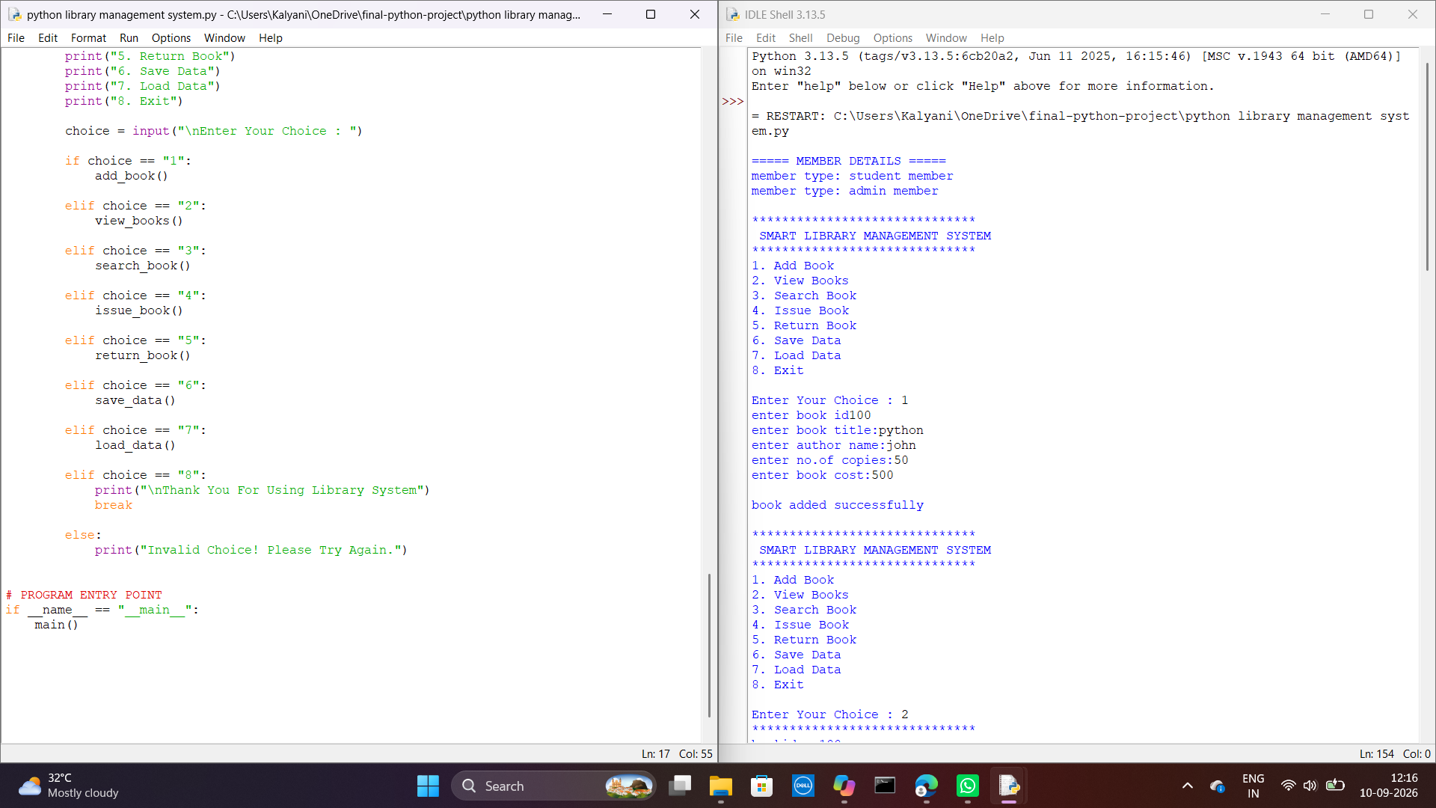
OUTPUT

Slide 11

CHALLENGES FUTURE IMPROVEMENTS
Challenges
Understanding OOP
File handling
Exception handling
Git/GitHub
Organizing project files
Future Improvements
GUI
Database
Login system
Online library
Reports

Slide 12

CONCLUSION
The project successfully demonstrates the Python concepts learned during the internship and provides a basic computerized solution for library management.

Slide 13

THANK YOU

