Slide 1
WeedSense - Empowering Precision Agriculture with Computer Vision
A Capstone Project
By
Kalyan – Roll No
Master of Science in Data Science
University of Maryland, Baltimore County

Slide 2
Introduction
Enhanced Agricultural Management - Implementing deep weed detectors allows for real-time monitoring of weed populations, enabling early detection of emerging infestations and proactive intervention to prevent crop yield losses.
Precision Weed Management - Leveraging computer vision technology, these detectors swiftly and accurately identify weeds amidst crops, facilitating targeted management strategies. This reduces reliance on costly and inefficient traditional methods like manual labor and blanket herbicide application.
Cost Reduction and Efficiency - By precisely identifying and targeting weed-infested areas within fields, farmers can optimize resource allocation, minimize herbicide use, and reduce labor costs. This leads to significant cost savings and improved overall efficiency in crop production.
Environmental Sustainability - The adoption of image-based weed detection systems promotes environmentally sustainable farming practices by minimizing chemical inputs and mitigating the risk of herbicide resistance in weed populations. This shift towards precision weed management supports long-term ecological health while enhancing agricultural productivity.

Slide 3
Objective and Dataset
The main aim of this study is to build an image classifier capable of detecting the weed species when weed plant is provided as an input.
For my study 2 datasets have been chosen. They are DeepWeeds dataset and CottonWeedID15 dataset. This has been done to increase the richness of the data.
The DeepWeeds dataset comprises 17,509 distinct color images sized at 256x256 pixels, categorized into 9 classes. The images were captured on-site from eight diverse rangeland environments situated across northern regions of Australia.
Dataset size of DeepWeeds dataset – 494 MB.
The CottonWeedID15 dataset comprises 5187 RGB images capturing 15 common weed species typically found in cotton fields across the southern United States.
Dataset size of CottonWeedID15 dataset – 11.35 GB. Since dataset size is huge, I have considered 50% of its size by taking 50% images from each of the 15 class labels.
The total dataset size would be 494 MB (or 0.494 GB) + 5.675 GB (50% of 11.35 GB) = 6.169 GB.

Slide 4
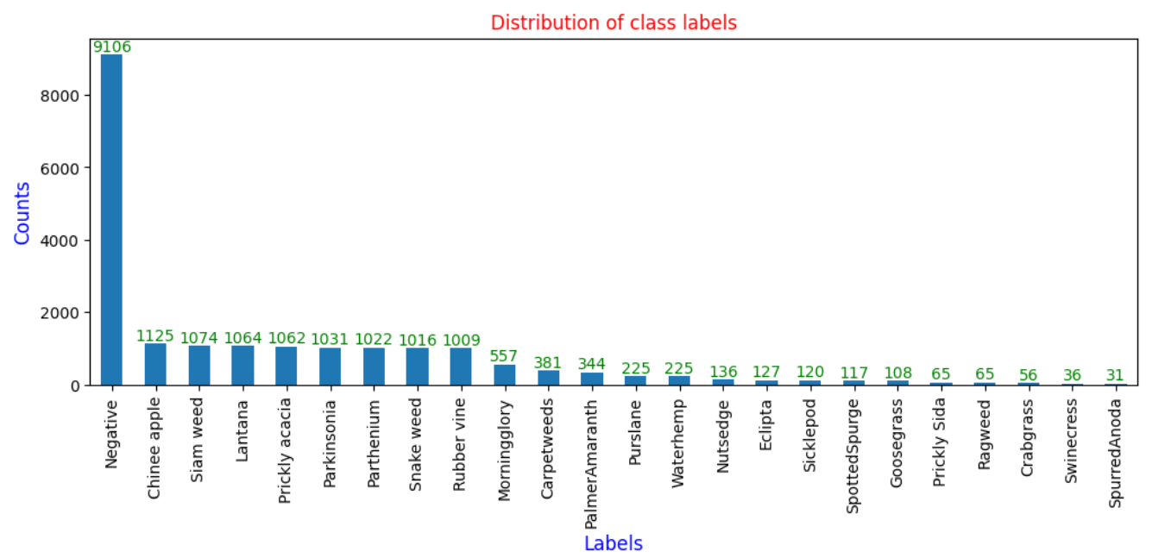
Exploratory Data Analysis
Class label - Negative has the highest number of images while SpurredAnoda has the least number of images. Therefore, there is a huge imbalance in the dataset.

Slide 5
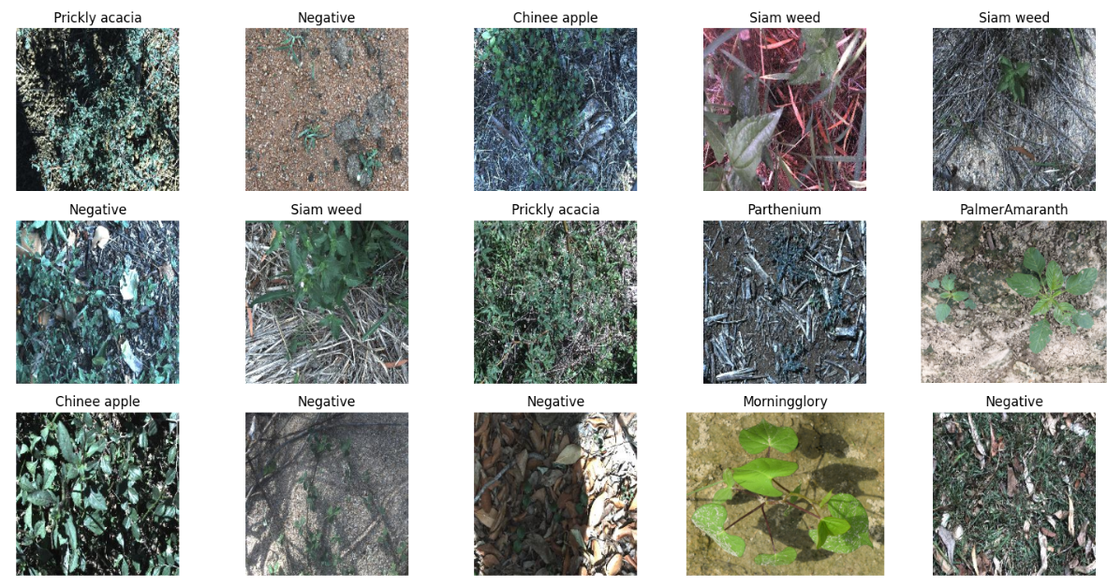
Exploratory Data Analysis
Fig – Sample Images from the dataset

Slide 6
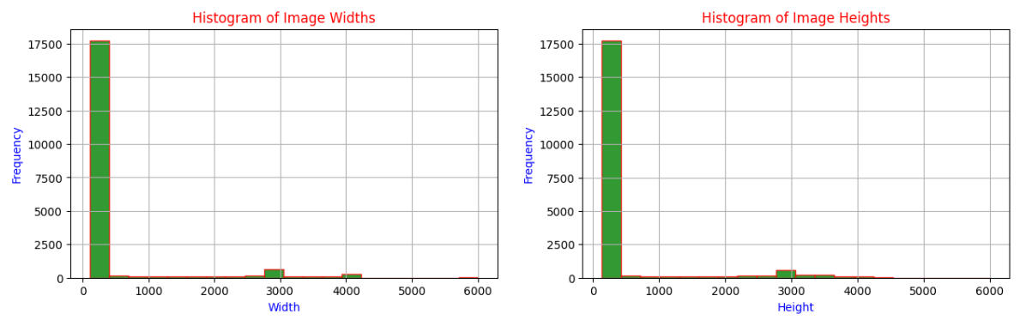
Exploratory Data Analysis
Observation - Most of image heights and widths approximately lie in the range of 200-500.

Slide 7
Transfer Learning Approach
Utilizing Pre-trained VGG16 Model - Incorporating a pre-trained VGG16 and InceptionV3 models without the top layers as the foundation for weed species classification.
Customizing Architecture - Tailoring the model by adding additional fully connected layers to adapt it for precise weed species identification.
Fine-tuning for Optimization - Fine-tuning parameters such as learning rate and optimizer to enhance the model's accuracy and efficiency in classifying weed species.
Effective Evaluation Metrics - Assessing model performance using metrics like categorical cross-entropy loss and area under the ROC curve (AUC) to ensure accurate weed species classification.
Efficiency in Training - Leveraging transfer learning expedites the training process by utilizing pre-trained weights, leading to faster convergence and efficient resource utilization.

Slide 8
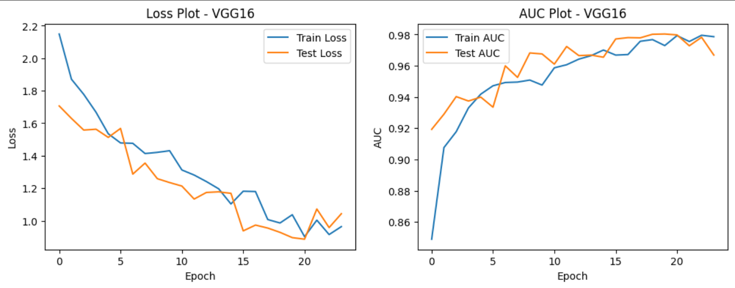
Results
At the convergence, @24 epochs
Initial Learning Rate – 0.0001
Optimizer – Adam
Total params - 15799192 (60.27 MB)
Trainable params - 15799192 (60.27 MB)
Non-trainable params - 0 (0.00 Byte)

Slide 9
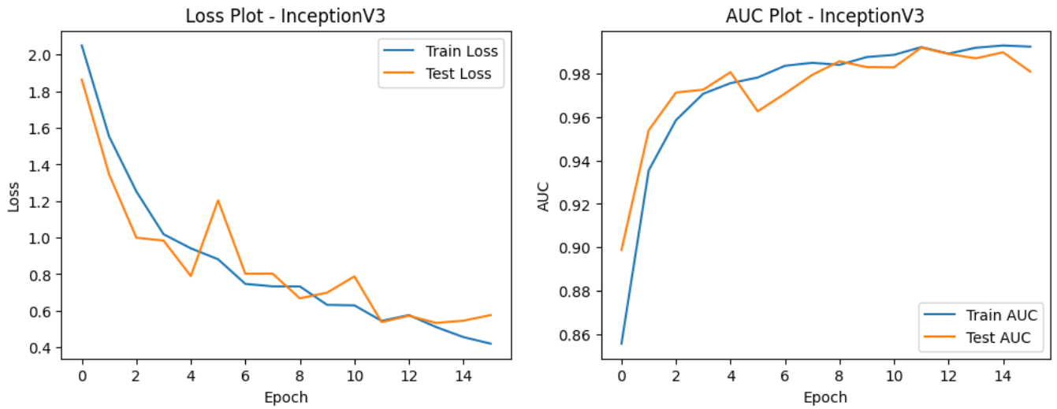
Results
At the convergence, @16 epochs
Initial Learning Rate – 0.0001
Optimizer – Adam
Total params: 24460152 (93.31 MB)
Trainable params: 24425720 (93.18 MB)
Non-trainable params: 34432 (134.50 KB)

Slide 10
Results
Model | Train Loss | Test Loss | Train AUC | Test AUC
VGG16 | 1.0369 | 0.896 | 0.9729 | 0.9803
InceptionV3 | 0.5444 | 0.5382 | 0.992 | 0.9918
From the above results, it is observed that AUC Score for test data obtained using InceptionV3 model is better than other model considered. Therefore, InceptionV3 model can be used for predictions.

Slide 11
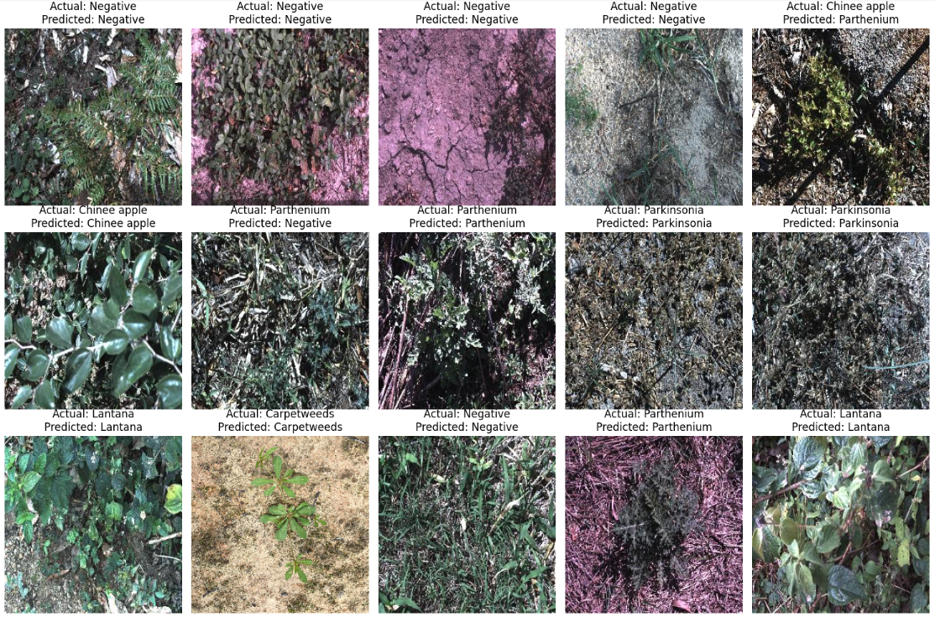
Predictions on sample test data

Slide 12
Conclusion
Incorporating InceptionV3 into image classification systems offers a multitude of benefits. Its state-of-the-art architecture, high accuracy, and efficient feature extraction capabilities make it a top choice for developers seeking to build robust and accurate image classification models.
By utilizing transfer learning with InceptionV3, developers can adapt the network to various classification tasks with minimal data requirements, saving time and computational resources.
Overall, integrating InceptionV3 enhances the effectiveness and efficiency of image classification systems, providing businesses and researchers with powerful tools for solving complex classification challenges.

