Slide 1

Advanced Software Paradigms Computer Programming Language
By
Jainee Gohil,
Kalyan Kollepara,
Mahesh Kumar Gudumala,
Prashanth Kumar Manji

Slide 2
Contents
About TypeScript
What is Typescript? And to use it over JavaScript?
Set up TypeScript environment
Variables in TypeScript

Slide 3
About TypeScript
Open-Source Object-Oriented Language
Developed and Maintained by: Microsoft
Introduced by: Anders Hejlsberg, a core member of the development team of C# language
First Released: October 2012

Slide 4
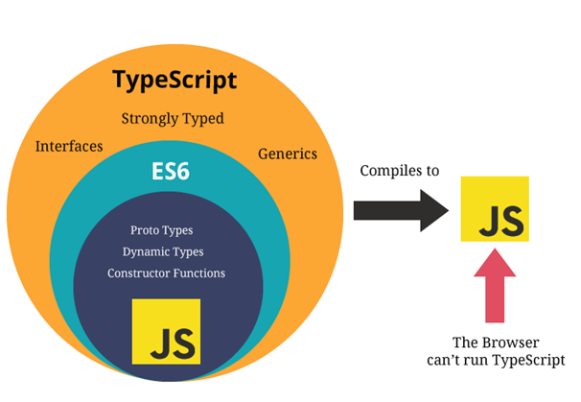
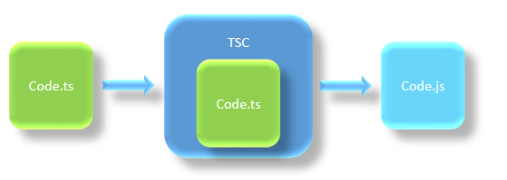
What is TypeScript?
Strongly typed superset of JavaScript
Which complies the code into plain JavaScript
Designed for: large-scale JavaScript application development
File extension: .ts

Slide 5



Why need TypeScript over JavaScript?
JavaScript
TypeScript
Warns us about possible bugs that can happen from simple edge cases, such as forgetting null checks, type errors

Slide 6
Pre-requisite for TypeScript
Any IDE (Most preferred Visual Code)
Install Node.js Package Manager (npm)
Set up package.json
Prepresent your project configuration
Install Typescript

Slide 7



Variable in TypeScript
Example:
Var name1
Var 1name
Var name_1
Var name-1
Rules:
Variable name must be an alphabet or numeric digits.
Variable name cannot start with digits.
Variable name cannot contain spaces and special character, except the underscore(_) and the dollar($) sign

Slide 8
Variable Declaration in TypeScript
Variables can be declared using:
Var
Let
Const
Each of the variable declaration keyword has similar declaration and initialization.
Those vary with each other in terms of their scope and usage.
Scope essentially means where these variables are available for use
Example:
Keyword name: type = value;
Var age: number = 50;
Keyword name: type;
Var age:number;
Keyword name = value;
Var age = 50;
Keyword name;
Var age;

Slide 9
Scope for “Var”
Global:
If variable is declared outside a function.
This means that any variable that is declared outside a function block is available for use in the whole window.
Function:
If variable is declared within a function.
This means that it is available and can be accessed only within that function.
var variables can be updated and re-declared within its scope
Example:
var course= “Computer Science";
function Main() {
var subject= “Software Paradigm";
Console.log(course);
Console.log(subject);
}
Console.log(course);
Console.log(subject); //Error
course: Global scoped
subject: Function scoped

Slide 10
Scope for “Let”
Example:
let course= “Computer Science";
let point = 4;
function Main() {
If(point > 9){
let subject= “Software Paradigm";
Console.log(subject);
}
Console.log(subject); //Error
}
Block:
A block lives in curly braces “{}”. Anything within curly braces is a block.
let has scoped to the nearest enclosing block which can be smaller than a function block.
So a variable declared in a block with let is only available for use within that block.
let variables can be updated but not re-declared.

Slide 11
Scope for “Const”
Example:
Not possible:
const course= “Computer Science";
course= “Computer Engineering";
Not possible:
const course= “Computer Science";
const course= “Computer Engineering ";
Block:
Like “Let”, Const also has a block scope.
But difference between “let” and “const” is that:
const variable cannot be updated or re-declared.
const variable must be initialized at the time of declaration.

