Slide 1

Advanced Software Paradigms Computer Programming Language
By
Jainee Gohil,
Kalyan Kollepara,
Mahesh Kumar Gudumala,
Prashanth Kumar Manji

Slide 2
Contents
About TypeScript
What is Typescript? Why to use it over JavaScript?
Set up TypeScript environment
Variables and its scope
Data Types
Assignment Statements
Support to OO Programming
Components of TypeScript
Concurrency
Exception and Event Handling
Functional Programming

Slide 3
About TypeScript
Open-Source Object-Oriented Language
Developed and Maintained by: Microsoft
Introduced by: Anders Hejlsberg, lead architect of C# and creator of Delphi and Turbo Pascal, has worked on the development of TypeScript
First Released: October 2012

Slide 4
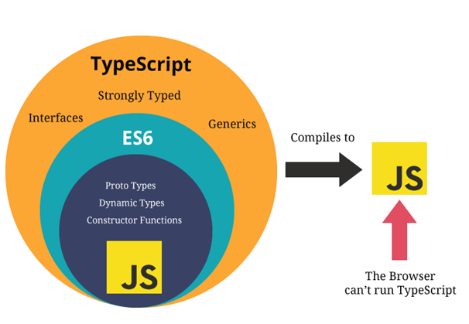
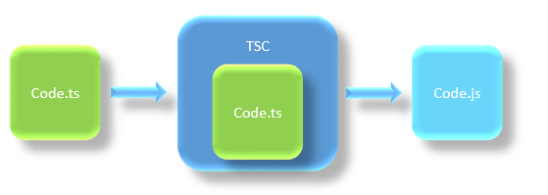
What is TypeScript?
Strongly typed superset of JavaScript
Which complies the code into plain JavaScript
Designed for: large-scale JavaScript application development
File extension: .ts

Slide 5



Why need TypeScript over JavaScript?
JavaScript
TypeScript
Warns us about possible bugs that can happen from simple edge cases, such as forgetting null checks, type errors

Slide 6
Pre-requisite for TypeScript
Any IDE (Most preferred Visual Code)
Install Node.js Package Manager (npm)
Set up package.json
Prepresent your project configuration
Install Typescript

Slide 7



Variable in TypeScript
Example:
Var name1
Var 1name
Var name_1
Var name-1
Rules:
Variable name must be an alphabet or numeric digits.
Variable name cannot start with digits.
Variable name cannot contain spaces and special character, except the underscore(_) and the dollar($) sign

Slide 8
Variable Declaration in TypeScript
Example:
Keyword name: type = value;
Var age: number = 50;
Keyword name: type;
Var age:number;
Keyword name = value;
Var age = 50;
Keyword name;
Var age;
Variables can be declared using:
Var
Let
Const
Each of the variable declaration keyword has similar declaration and initialization.
Those vary with each other in terms of their scope and usage.
Scope essentially means where these variables are available for use

Slide 9
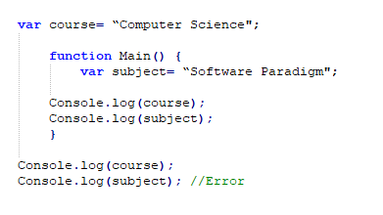
Scope for “Var”
Example:
course: Global scoped
subject: Function scoped
Global:
If variable is declared outside a function.
This means that any variable that is declared outside a function block is available for use in the whole window.
Function:
If variable is declared within a function.
This means that it is available and can be accessed only within that function.
var variables can be updated and re-declared within its scope

Slide 10
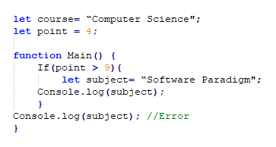
Scope for “Let”
Example:
Block:
A block lives in curly braces “{}”. Anything within curly braces is a block.
let has scoped to the nearest enclosing block which can be smaller than a function block.
So a variable declared in a block with let is only available for use within that block.
let variables can be updated but not re-declared.

Slide 11


Scope for “Const”
Example:
Not possible:
Not possible:
Block:
Like “Let”, Const also has a block scope.
But difference between “let” and “const” is that:
const variable cannot be updated or re-declared.
const variable must be initialized at the time of declaration.

Slide 12

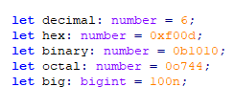
Data Types in TypeScript
Example:
Boolean:
Number:
Boolean:
Basic datatype is the simple true/false call a Boolean.
Number:
TypeScript are either floating point values or BigIntegers. These floating point numbers get the type number, while BigIntegers get the type bigint

Slide 13

Data Types in TypeScript
Example:
String:
Fundamental part of creating programs in TypeScript is working with textual data. As in other languages, we use the type string to refer to these textual datatypes. TypeScript also uses double quotes (") or single quotes (') to surround string data.

Slide 14

Data Types in TypeScript
Example:
Array:
TypeScript allows you to work with arrays of values. Array types can be written in one of two ways.
In the first, you use the type of the elements followed by [] to denote an array of that element type:
The second way uses a generic array type, Array<elemType>:

Slide 15
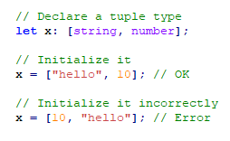
Data Types in TypeScript
Example:
Tuple:
Tuple types allow you to express an array with a fixed number of elements whose types are known, but need not be the same.
For example, you may want to represent a value as a pair of a string and a number:

Slide 16

Data Types in TypeScript
Example:
Enum:
A helpful addition to the standard set of datatypes from JavaScript is the enum. As in languages like C#, an enum is a way of giving more friendly names to sets of numeric values.
Even manually set all the values in the enum:

Slide 17

Data Types in TypeScript
Example:
Unknown:
To describe the type of variables that we do not know when we are writing an application. These values may come from dynamic content.
e.g. from the user – or we may want to intentionally accept all values in our API.
In these cases, we want to provide a type that tells the compiler and future readers that this variable could be anything, so we give it the unknown type.

Slide 18
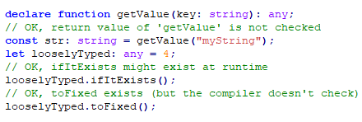
Data Types in TypeScript
Example:
Any:
In some situations, not all type information is available or its declaration would take an inappropriate amount of effort. These may occur for values from code that has been written without TypeScript or a 3rd party library. In these cases, we might want to opt-out of type checking. To do so, we label these values with the any type.
The any type is a powerful way to work with existing JavaScript, allowing you to gradually opt-in and opt-out of type checking during compilation.
Unlike unknown, variables of type any allow you to access arbitrary properties, even ones that don’t exist. These properties include functions and TypeScript will not check their existence or type:

Slide 19
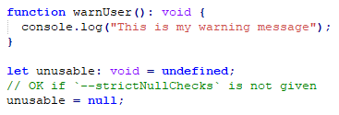
Data Types in TypeScript
Example:
Void:
void is a little like the opposite of any: the absence of having any type at all. You may commonly see this as the return type of functions that do not return a value.
Declaring variables of type void is not useful because you can only assign null (only if --strictNullChecks is not specified, see next section) or undefined to them:

Slide 20
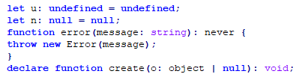
Data Types in TypeScript
Example:
Null and Undefined
Never
Object

Slide 21
Assignment Statements in TypeScript
Assignment operators are used to assign values to variables.
This type of statement consists of a variable name, an assignment operator, and an expression.
When appropriate, you can declare a variable and assign a value to it in a single statement.
In assignment expressions, the right-hand expression is contextually typed by the type of the left-hand expression.

Slide 22
Assignment Statements in TypeScript
The Assignment operators are summarized in the following table.
Operator | Same AS | Description
x = y | x = y | Simple assignment operator; assigns the value from the right side operand to the left side operand
x += y | x =x + y | Add AND assignment operator; it adds the right operand to the left operand and assigns the result to the left operand
x -= y | x =x - y | Subtract AND assignment operator; it subtracts the right operand from the left operand and assigns the result to the left operand
x *= y | x =x * y | Multiply AND assignment operator; it multiplies the right operand with the left operand and assigns the result to the left operand
x /= y | x =x / y | Divide AND assignment operator; it divides the left operand by the right operand and assigns the result to the left operand
x %= y | x =x % y | Modulus AND assignment operator; it divides the left operand by the right operand and assigns the remainder to the left operand

Slide 23
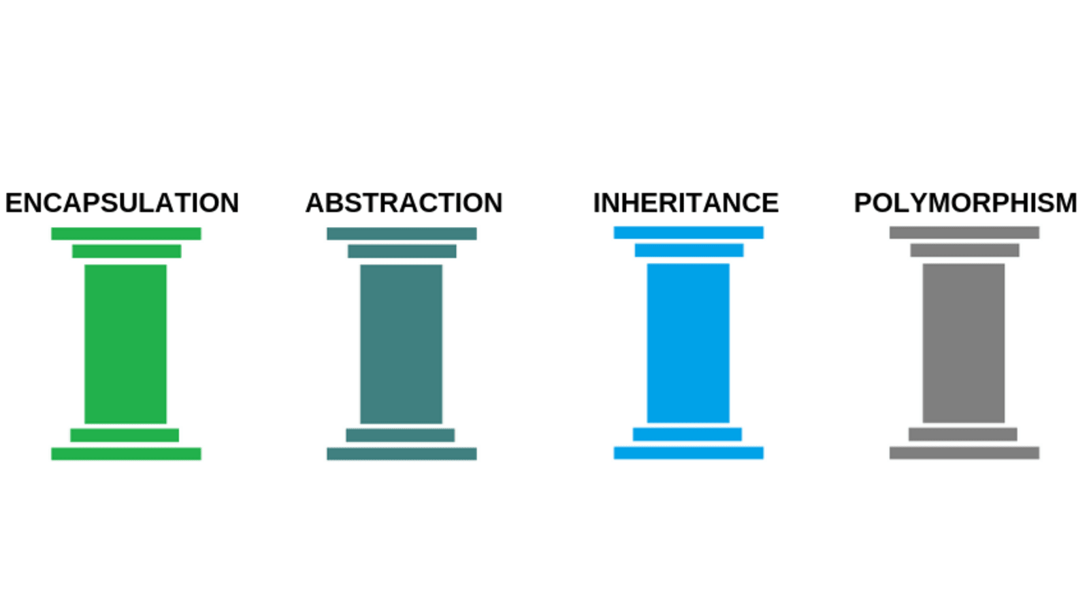
Support to OO Programming
TypeScript enables you to code using object-oriented principles and techniques more efficiently and easily.
The four main pillars of object-oriented Programming are

Slide 24
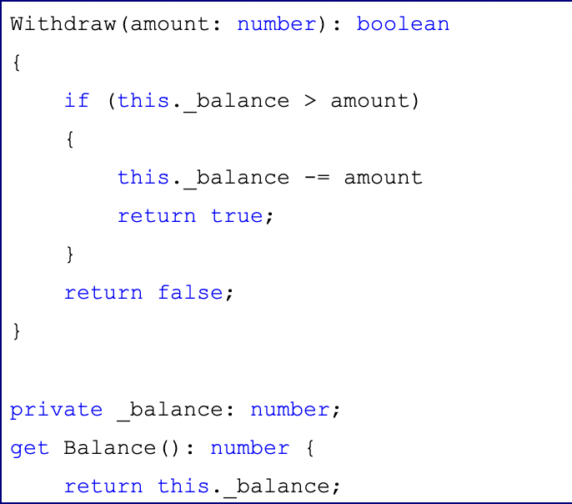
Encapsulation
Example:
In object-oriented computer programming languages, the notion of encapsulation refers to the bundling of data, along with the methods that operate on that data, into a single unit.
In TypeScript, we enforce encapsulation with methods and properties that only allow access to data that we control.

Slide 25
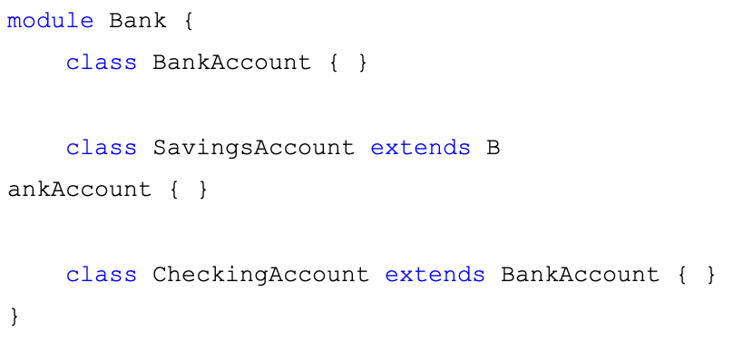
Inheritance
Example:
Inheritance is a mechanism in which one class acquires the property of another class.
It’s quite easy to create an object model and inheritance chain with TypeScript. The ‘extends’ keyword causes the child class to inherit from the denoted base class.

Slide 26
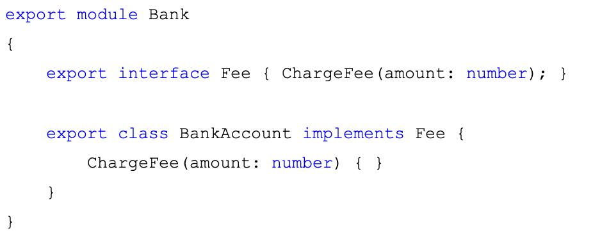
Abstraction
Example:
Abstraction is the concept of object-oriented programming that “shows” only essential attributes and ‘hides’ unnecessary information.
You can use the implements keyword to implement an interface in TypeScript, it’s syntactically like the extends keyword.

Slide 27
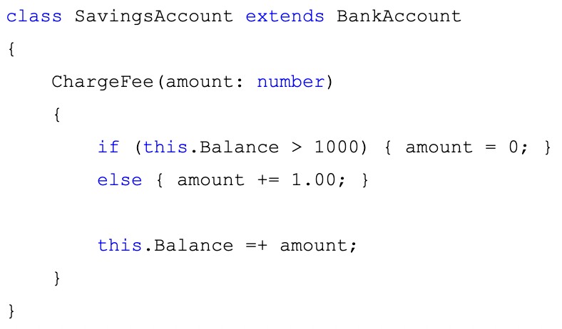
Polymorphism
Example:
Polymorphism is a feature of object-oriented programming languages that allows a specific routine to use variables of different types at different times.
TypeScript enables polymorphism via method overrides.

Slide 28
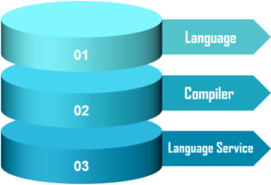
Components of TypeScript
Notes:
Image credits: https://d1jnx9ba8s6j9r.cloudfront.net/blog/wp-content/uploads/2019/11/components.png

Slide 29
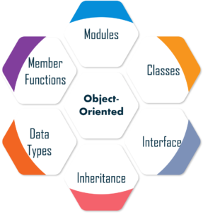
Object-Oriented Terms

Slide 30
Concurrency
Concurrency is the execution of the multiple instruction sequences at the same time.
It is defined as one which uses the concept of simultaneously executing processes or threads of execution as a means of structuring a program.
Concurrency in software execution can occur at four different levels:
Instruction level
Statement level
Unit level
Program level

Slide 31
Concurrency
Running of Multiple Applications
Better Resource Utilization
Better Average Response Time
Better Performance

Slide 32
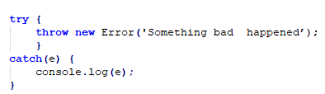
Exception Handling
Example:
The Exception Handling is one of the powerful mechanism to handle the runtime errors so that the normal flow of the application can be maintained.
TypeScript has an Error class that you can use for exceptions. You throw an error with the throw keyword. You can catch it with a try / catch block pair

Slide 33
Error Sub Types
Beyond the built in Error class there are a few additional built-in error classes that inherit from Error that the TypeScript runtime can throw:
RangeError
ReferenceError
SyntaxError
TypeError
URIError

Slide 34
Event Handling in TypeScript
Events provide a channel of communication between different parts of an application. There are several techniques for creating and handling events, each with its own advantages and disadvantages.
Event handling reduces coupling between components to increase maintainability, flexibility and decoupling

Slide 35
Event Handling in TypeScript
Below are some techniques for creating events and event handlers in JavaScript:
1. Event Property Handlers
2. Event Listeners with EventTarget
3. Event Listeners with EventEmitter

Slide 36
Functional Programming in TypeScript
Functional programming (often abbreviated FP) is the process of building software by composing pure functions, avoiding shared state, mutable data, and side-effects.
Functional programming is declarative rather than imperative, and application state flows through pure functions.
TypeScript is not a purely functional language but offers a lot of concepts which are in line with functional languages

Slide 37
Functional Programming in TypeScript
Some of the important concepts of functional programming are:
First-class and higher-order functions.
Pure functions
Recursion
Lazy evaluation

Slide 38
Functional Programming in TypeScript
First-class and higher-order functions
First-class functions(function as a first-class citizen) means you can assign functions to variables, pass a function as an argument to another function or return a function from another.
Pure functions
a pure function should return values only based on the arguments passed and should not affect or depend on global state.
Recursion
Functional programming favors recursion over looping. The downside of the recursive approach is that it will be slower compared to an iterative approach most of the times.
Lazy evaluation
Lazy evaluation or non-strict evaluation is the process of delaying evaluation of an expression until it is needed.

