Slide 1
Credit Card Fraud Detection Using Machine Learning
SID: 2022774

Slide 2
Table of contents
Introduction and Literature Review
Analysis of the Problem
Outline of the solution
Required solution and layout of architecture
Evaluation
References

Slide 3
Introduction
Credit card fraud is a growing concern in the present world with the growing fraud in government offices, corporate industries, finance industries, and many other organizations. In the present world, the high dependency on the internet is the reason for an increased rate of credit card fraud transactions but the fraud has increased not only online but also offline transactions. Though data mining techniques are used the result is not accurate to detect these credit card frauds. The only way to minimize these losses is the detection of fraud using efficient algorithms which is a promising way to reduce credit card fraud. As the use of the internet is increasing, a credit card is issued by the finance company. Having a credit card means that we can borrow funds. The funds can be used for any of the purposes. When coming to the issuance of the card, the condition involved is that the cardholder will pay back the original amount they borrowed along with the additional charges they agreed to pay

Slide 4
Analysis of the problem
As the globe moves faster and faster toward online and card-based payment systems, the market for digital payments is exploding. Such a change brings with it the escalating problem of cybersecurity and fraud, which is more prevalent than ever. A recent study predicted that during the next five years, credit card theft will cost the world around $43 billion. According to different research, up to 80% of presently used US credit cards have had their security breached. All banks and financial institutions place a high premium on improving the detection of credit card fraud. Machine learning (ML) has made it simpler and more effective to detect credit card fraud. Solutions for fraud detection that uses machine learning can spot trends and stop unusual transactions.

Slide 5
Outline of the solution
This paper investigates the comparative performance of Random forest, xgboost, and Adaboost classifier models in the binary classification of imbalanced credit card fraud data. The rationale for investigating these three techniques is due to less comparison they have attracted in past literature. However, a subsequent study to compare other single and ensemble techniques using our approach is underway. Our main goal of this research is to define appropriate predictive machine learning models for the dataset to detect fraud in using a credit card.

Slide 6
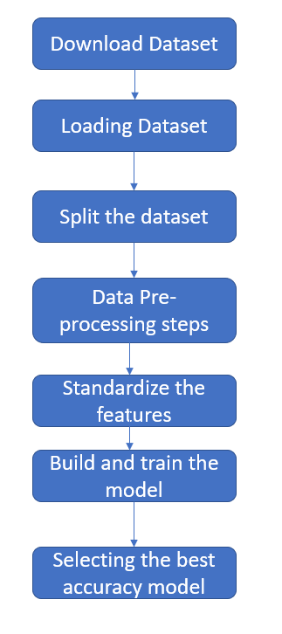
Anomaly detection approaches may be divided into three primary groups based on the kind of processing associated with the "behavioral" model of the target system: statistical, knowledge-based, and machine learning-based. In the statistically based scenario, the system’s behavior is shown as random. The asserted behavior, however, is attempted to be captured using knowledge-based approaches using the given system data (protocol specifications, network traffic instances, etc.). Last but not least, machine learning methods are founded on the creation of an explicit or implicit model that enables the classification of the patterns examined.

Slide 7
Layout Architecture
The use of machine learning in fraud detection has been an interesting topic nowadays. A credit card fraud detection algorithm consists in identifying those transactions with a high probability of being fraudulent, based on historical fraud patterns. Machine learning has three types, from that also the supervised and hybrid approach is more suitable for fraud detection. Here, recent algorithms that are suitable for credit card fraud detection are explained and compared in the section on existing classification techniques.
The dataset contains transactions made by credit cards in September 2013 by European cardholders. This dataset presents transactions that occurred in two days, where we have 492 frauds out of 284,807 transactions. The dataset is highly unbalanced, the positive class (frauds) accounts for 0.172% of all transactions. For the analysis stage, the feature selection and reduction are already carried out on the dataset using PCA. The training stage is where the classifier algorithms are developed and fed with the processed data. The experiments are evaluated using True Positive, True Negative, False Positive, and False Negative rates metrics. The performance comparison of the classifiers is analyzed based on accuracy, sensitivity, specificity, precision, Matthews correlation coefficient, and balanced classification rate.

Slide 8
Evaluation
We investigated the data, checking for data unbalancing, visualizing the features, and understanding the relationship between different features. We then investigated two predictive models. The data was split into 3 parts, a train set, a validation set, and a test set. For the first three models, we only used the train and test sets. We started with RandomForrestClassifier, for which we obtained an AUC score of 0.85 when predicting the target for the test set. We followed with an AdaBoostClassifier model, with a lower AUC score (0.83) for the prediction of the test set target values. We then experimented with an XGBoost model. In this case, we used the validation set for the validation of the training model. The best validation score obtained was 0.984. Then we used the model with the best training step, to predict the target value from the test data; the AUC score obtained was 0.974. We then presented the data to a LightGBM model. We used both train-validation split and cross-validation to evaluate the model effectiveness to predict the 'Class' value, i.e., detecting if a transaction was fraudulent. With the first method, we obtained values of AUC for the validation set around 0.974. For the test set, the score obtained was 0.946. With cross-validation, we obtained an AUC score of for the test prediction 0.93.

Slide 9
Algorithms
SNO | MODEL | SCORE
1 | Random Forest | 85%
2 | Adaboost classifier | 83%
3 | XGboost | 97%
4 | LightGBM | 97%

Slide 10
References
I. SADGALI, N. SAEL and F. BENABBOU, 2019. Fraud detection in credit card transaction using machine learning techniques. IEEE.
Khatri, S., Arora, A. and Prakash Agrawal, A., 2020. Supervised Machine Learning Algorithms for Credit Card Fraud Detection: A Comparison; Supervised Machine Learning Algorithms for Credit Card Fraud Detection: A Comparison.
Kulatilleke, G.K., 2022. Challenges and Complexities in Machine Learning based Credit Card Fraud Detection. [online] Available at: <http://arxiv.org/abs/2208.10943>.
Misra, S., Matthews, V.O., Adewumi, A., Covenant University (Ota, O.S., IEEE Nigeria Section and Institute of Electrical and Electronics Engineers, 2017. Credit card fraud detection using machine learning techniques: A comparative analysis. IEEE.
O. Adepoju, J. Wosowei, S. lawte and H. Jaiman, 2019. Comparative Evaluation of Credit Card Fraud Detection Using Machine Learning Techniques.
R. R. Popat and J. Chaudhary, 2018. A Survey on Credit Card Fraud Detection Using Machine Learning. IEEE.
R. Sailusha, v. Gnaneswar, R. Ramesh and G. R. Rao, 2020. Credit Card Fraud Detection Using Machine Learning. IEEE.
S. Mittal and S. Tyagi, 2019. Performance Evaluation of Machine Learning Algorithms for Credit Card Fraud Detection.

Slide 11
Thank you

