Slide 1
Zomato Analysis
Group 6
Names | Mail ID's | Contact No:
M ALISHA PATRO | alishapatro2589@gmail.com | 9776454321
KOMIRISETTY KALYAN KUMAR | kalyankumar1207@gmail.com | 9502871917
JIDNAYASA AVINASH PATIL | patiljidnyasa18@gmail.com | 8356814406
SHEETAL DATTATREYA KULKARNI | sdkji1993@gmail.com | 9049553223
REVENTH A | latha1978reva@gmai.com | 9361769500

Slide 2
Objective
Discover patterns in Zomato’s data to enhance operations and customer experience.
Analyze Zomato's global restaurant data to:
Understand performance across countries and cities.
Explore cuisine preferences and pricing trends.
Provide actionable business recommendations.
Analyze restaurant distribution, customer preferences, and operational trends to provide actionable insights.

Slide 3
Key Analysis and Insights
Country Wise Analysis
India has the highest number of restaurants, followed by the UAE and USA.
Zomato’s services are highly concentrated in India, which accounts for over [X%] of restaurants. Opportunities exist for growth in underserved regions.
Cuisine Preference:
Indian, Chinese, and Italian cuisines are the most popular.
Majority of restaurants offer these cuisines, highlighting their demand across regions. Opportunity to diversify cuisines in growing markets.
Pricing and Ratings Correlation:
Higher-priced restaurants receive better ratings.
Restaurants in the premium price range tend to have higher customer satisfaction, signaling quality service.
Delivery and Table Booking Trends
Restaurants with online delivery options get more customer votes.
Delivery services drive engagement and improve ratings, suggesting that expanding delivery options is crucial.

Slide 4
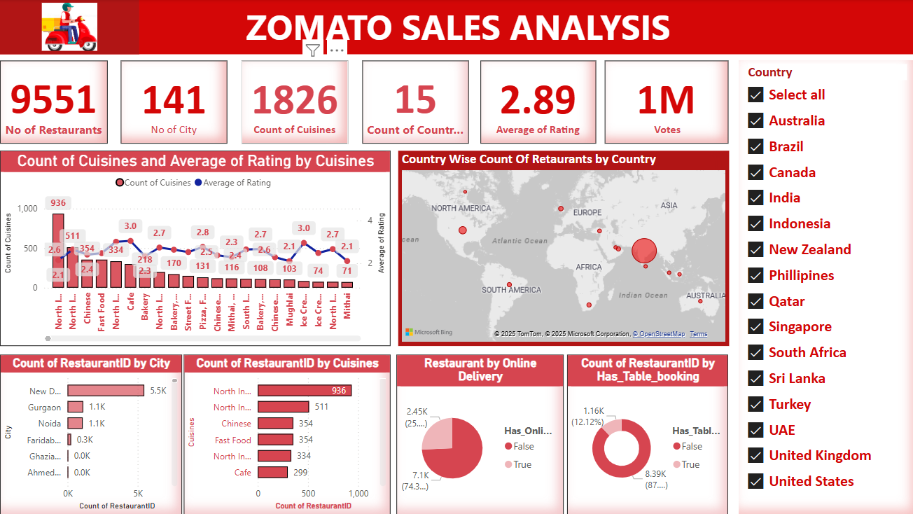
Visualization Using Power BI

Slide 5
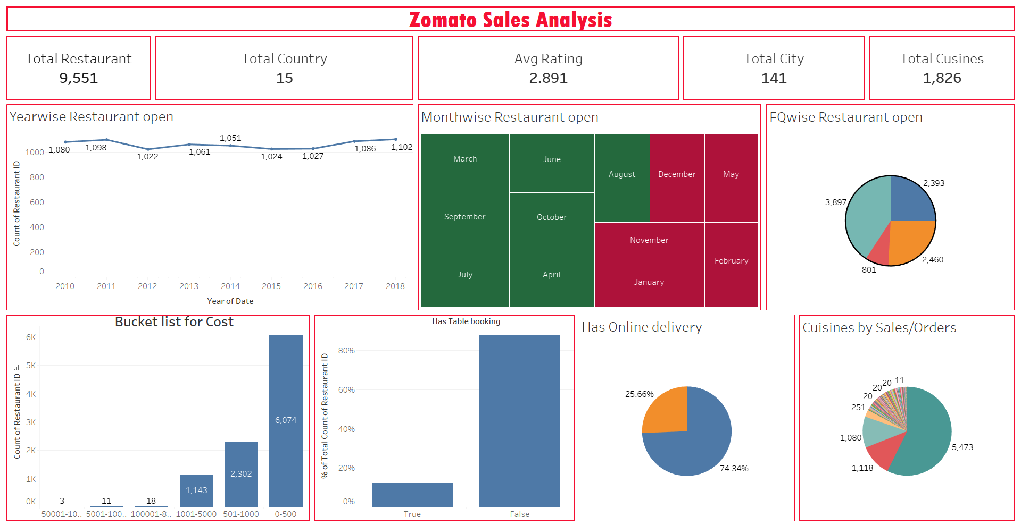
Visualization Using Tableau

Slide 6
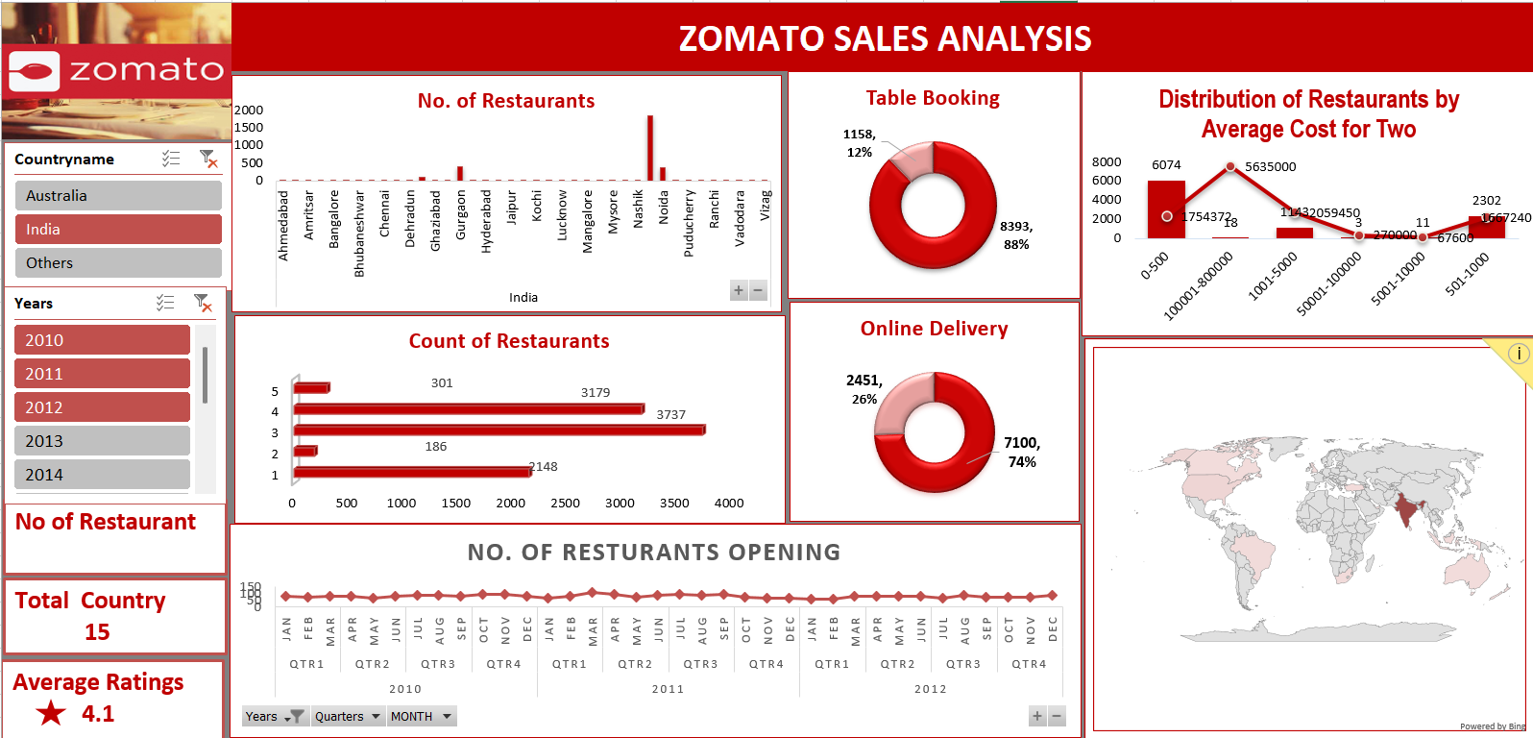
Visualization Using Excel

Slide 7
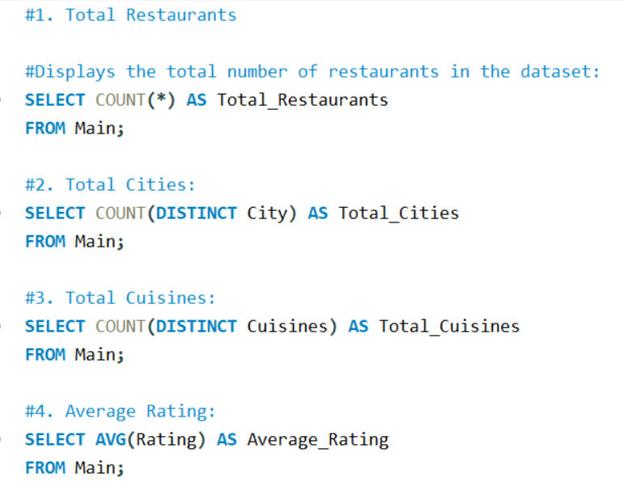
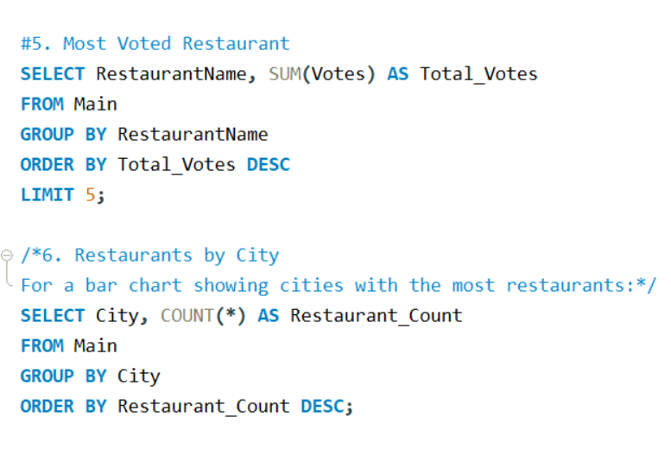
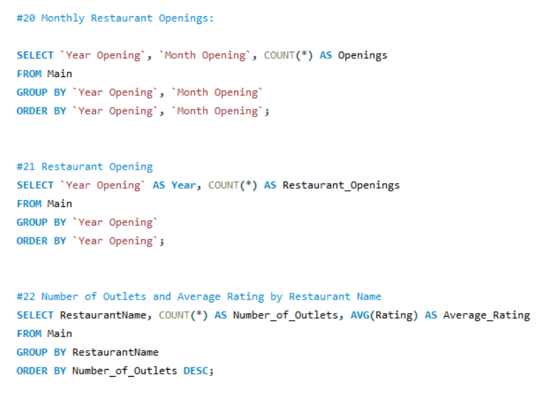
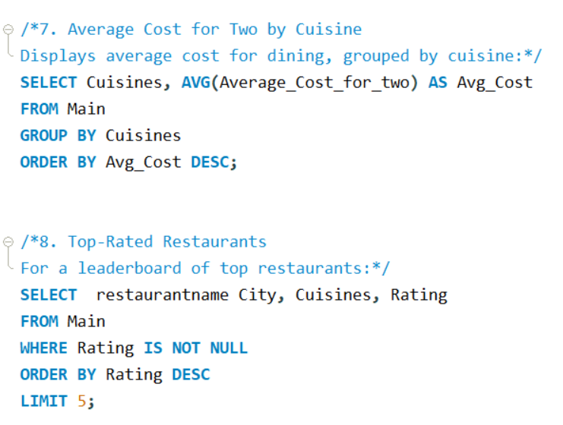
SQL QUERIES

Slide 8
Recommendations & Improvements Needed
For Zomato:
Expand Service in underserved regions to grow market share.
Highlight trending cuisines in marketing campaigns.
Promote restaurants offering online delivery for higher engagement.
For Restaurants:
Introduce table booking and delivery options.
Focus on quality for higher ratings, especially in premium pricing segments.
Operational Improvements:
Streamline table booking systems for better customer experience.
Train staff in cities with lower ratings for service consistency.
Data Improvements:
Collect more data on customer demographics for targeted marketing.
Add fields for operational hours and peak customer times.

Slide 9
Conclusion
Zomato can leverage insights from data analysis to:Expand strategically.
Improve customer satisfaction.
Enhance operational efficiency.
Data-driven insights to enhance customer satisfaction and business growth.

Slide 10


