Slide 1
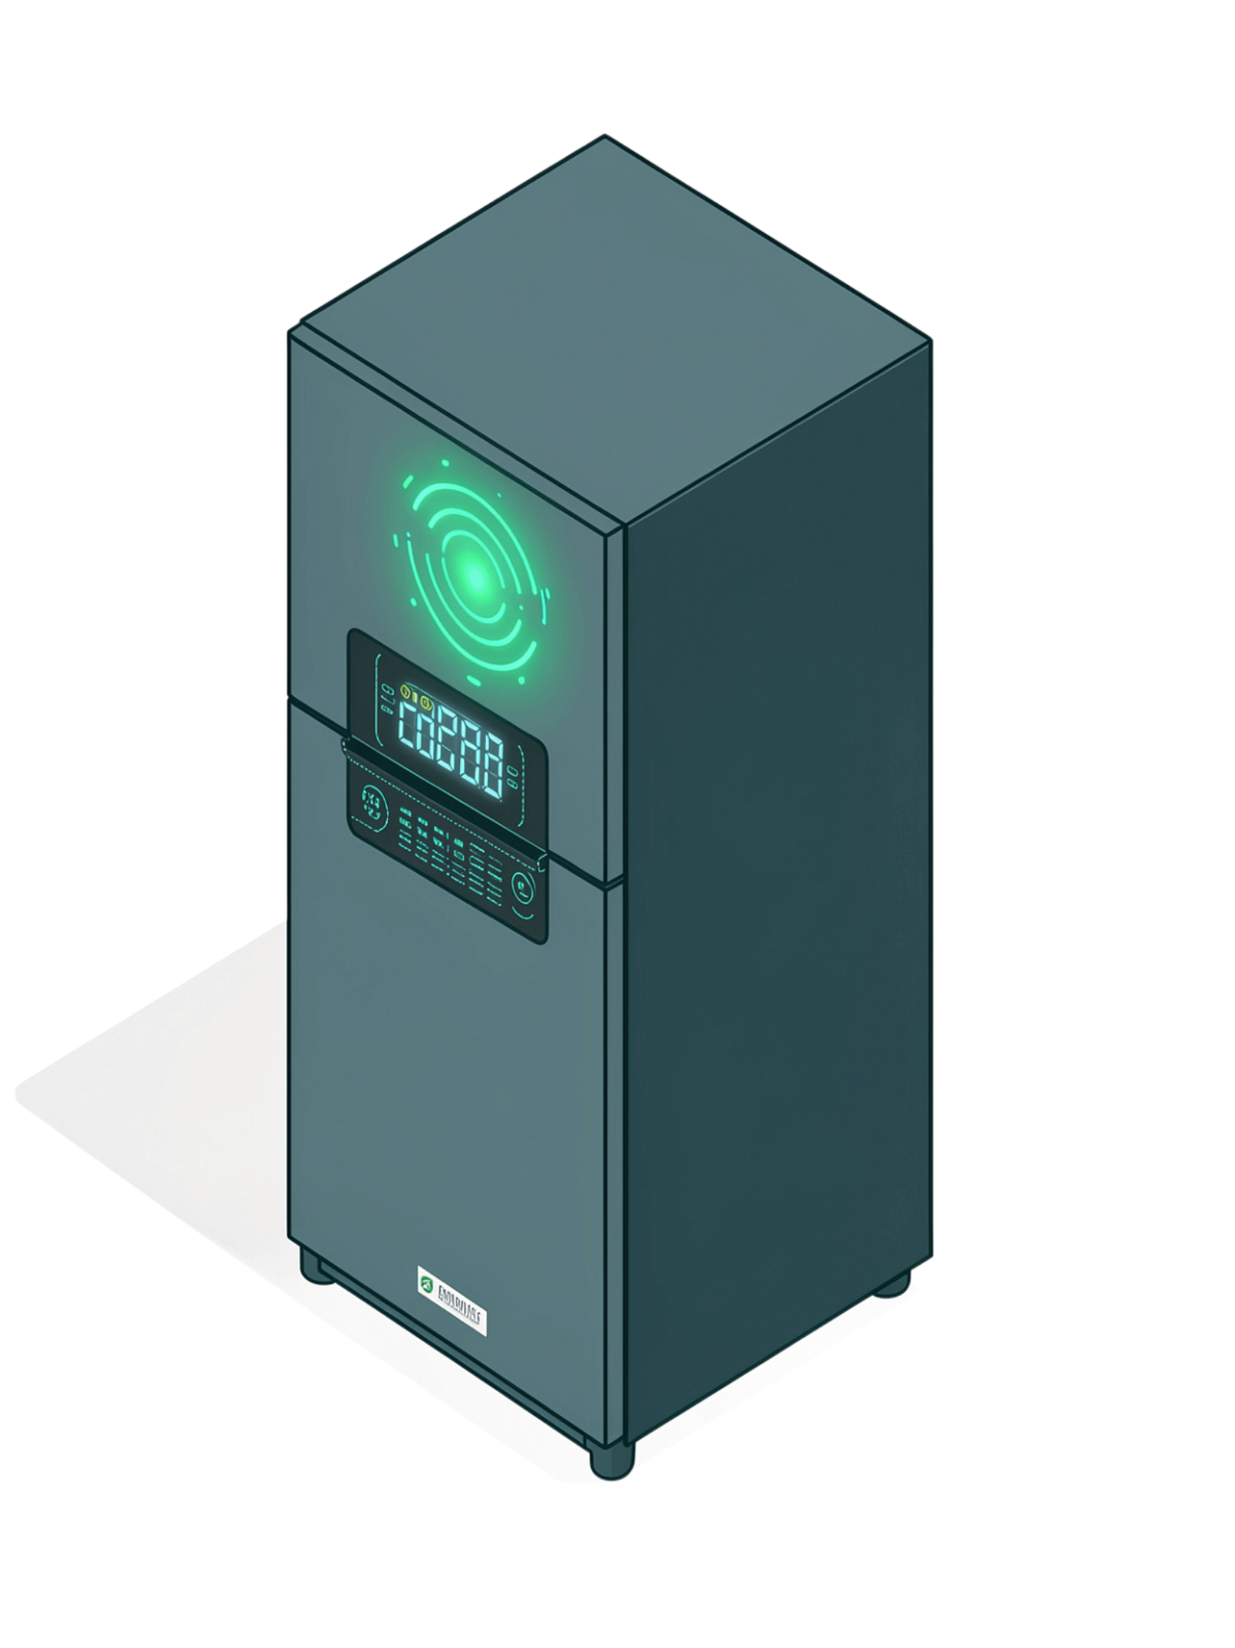
IoT-Based Smart Refrigerator Monitoring System for Food Freshness Tracking and Inventory Management
An intelligent, IoT-powered solution for continuously monitoring food storage conditions, tracking freshness, and managing food inventory — reducing wastage and ensuring food safety through cloud-based monitoring.
PANCHADARLA KALYAN
323129520103

Slide 2
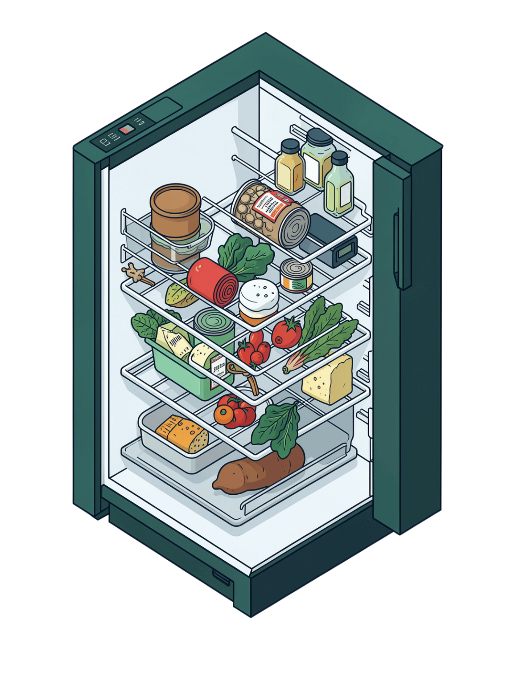
Problem Statement
No Real-Time Visibility
Traditional refrigerators do not provide real-time information about food conditions or inventory status.
Expiry Monitoring Challenges
Users find it difficult to monitor food expiry dates and track stock availability manually.
Food Wastage
Lack of continuous monitoring contributes to food wastage and inefficient inventory management.
Need for Intelligent Systems
Users require intelligent systems capable of monitoring storage conditions and managing inventory efficiently.

Slide 3
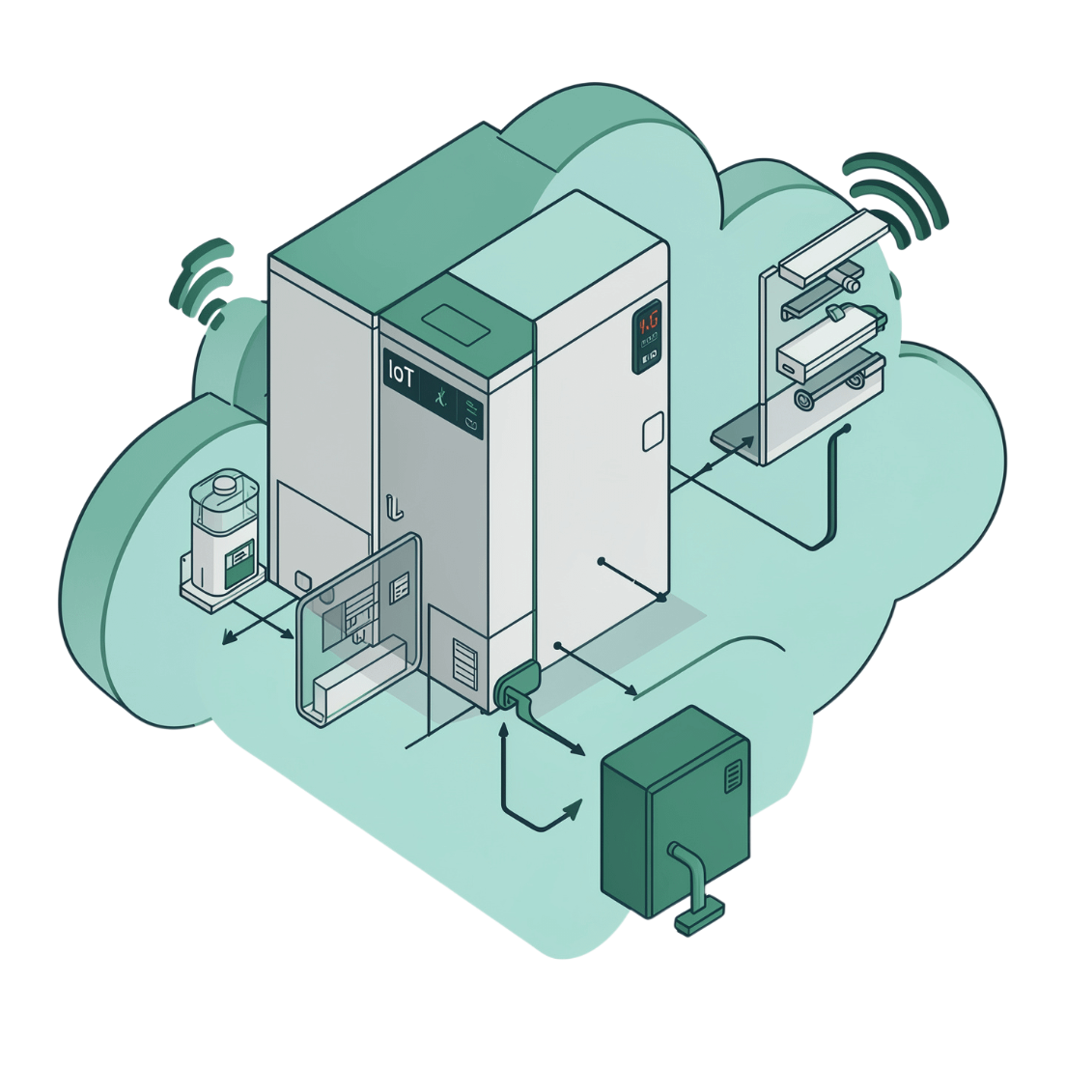
Proposed Solution
IoT-Based Smart Refrigerator Monitoring System
A comprehensive system that leverages IoT sensors and cloud-based monitoring to deliver centralized, real-time access to refrigerator information.
IoT sensors monitor refrigerator conditions and food inventory continuously
Cloud-based platform enables centralized access from anywhere
Secure and user-friendly interface for easy interaction
Continuous tracking of storage conditions, food freshness, expiry dates, and inventory levels

Slide 4
Sensors and Technologies
The system integrates a suite of complementary technologies to deliver comprehensive monitoring and inventory management.
Temperature Sensors
Humidity Sensors
Monitor refrigerator temperature in real time to ensure optimal storage conditions.
Track storage humidity levels to preserve food freshness and quality.
RFID Technology
Barcode Technology
Identify and track individual food items automatically within the refrigerator.
Scan and manage food inventory entries efficiently.
IoT Communication Modules
Cloud Connectivity
Transmit collected sensor data securely to the cloud platform.
Enable centralized monitoring and data management accessible from any device.

Slide 5
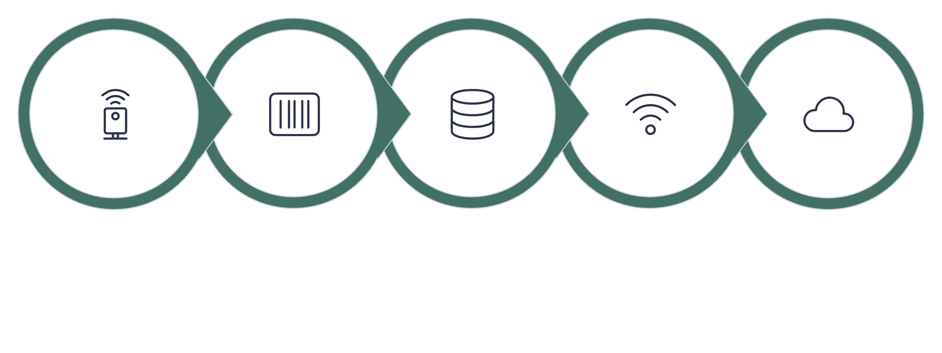
System Working Process
Sensor Monitor
Inventory Update
IoT Transmission
Cloud Platform
Item ID
The end-to-end workflow ensures that every stage — from sensor data collection to alert generation — operates continuously and automatically, keeping users informed at all times.

Slide 6
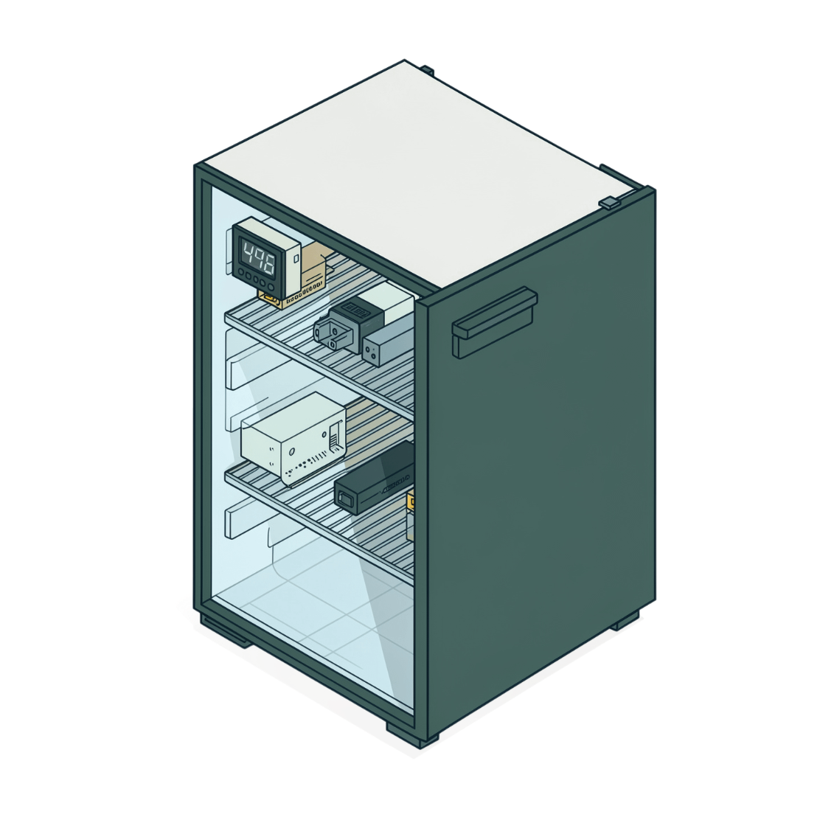

Food Freshness and Storage Monitoring
What the System Monitors
Temperature
Humidity
Food Freshness & Expiry
Continuous real-time temperature monitoring of the refrigerator environment.
Ongoing humidity tracking to maintain optimal storage conditions.
Tracks freshness status and expiry dates, identifying expired food items promptly.
Storage Condition Alerts
Generates alerts when storage conditions deviate from safe thresholds.
Continuous monitoring helps users maintain optimal storage conditions and improve food safety.

Slide 7
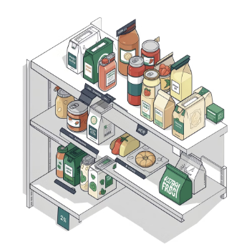

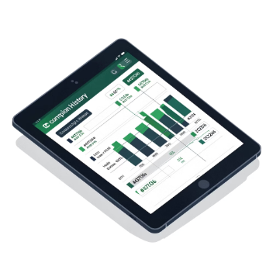
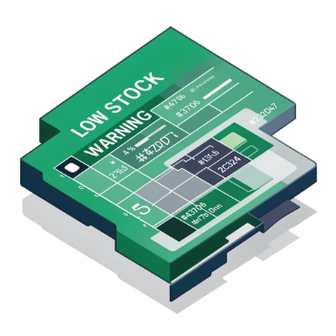
Inventory Management
Automated monitoring helps users manage food stock efficiently and minimize unnecessary waste.
Item Identification & Stock Monitoring
Expiry Tracking & Alerts
Consumption History & Updates
Low-Stock Detection
Food expiry dates are monitored and expired-item alerts are generated automatically to prompt timely action.
The system detects low-stock conditions and notifies users before items run out completely.
Each food item is identified and stock availability is tracked continuously using RFID and barcode technology.
Consumption history is recorded and inventory is updated in real time, providing centralized food inventory information.

Slide 8
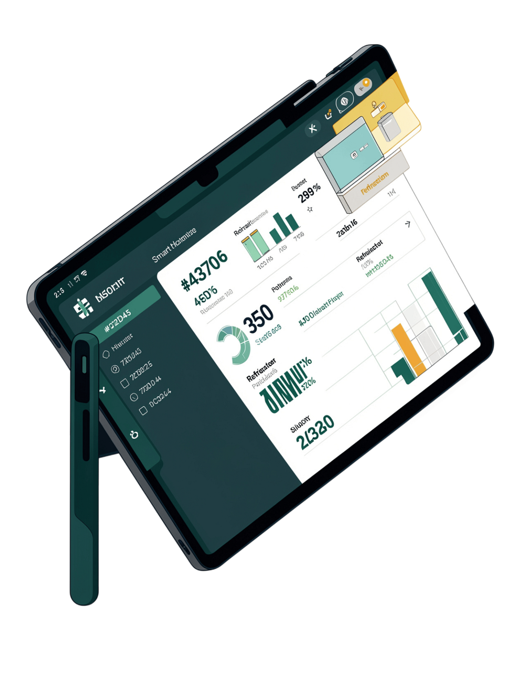
Dashboard and Alert System
An interactive, centralized dashboard provides users with a unified view of all refrigerator and inventory information at a glance.
Temperature & Storage Conditions
Live refrigerator temperature and storage-condition information displayed in real time.
Expiry Dates & Stock Availability
Food expiry dates and current stock levels visible at a glance for quick decision-making.
Consumption History & Inventory
Historical consumption data and full inventory information accessible from the centralized dashboard.
Alert Notifications
Timely alerts for expired food items, low-stock conditions, and any storage conditions requiring user attention.

Slide 9
Benefits and Applications
Major Benefits
Application Areas
Improved Food Safety
Reduced Food Wastage
Homes
Restaurants & Hotels
Personal food freshness and inventory management for households.
Continuous storage-condition monitoring ensures food is kept in safe conditions at all times.
Expiry tracking and low-stock alerts help users act before food is wasted.
Large-scale food storage monitoring for commercial kitchens.
Supermarkets
Hospitals & Food Storage Facilities
Inventory and freshness tracking across large food retail environments.
Enhanced Inventory Management
Critical food safety monitoring in healthcare and dedicated storage environments.
Automated tracking delivers more efficient food-stock management and supports smart kitchen automation.

Slide 10
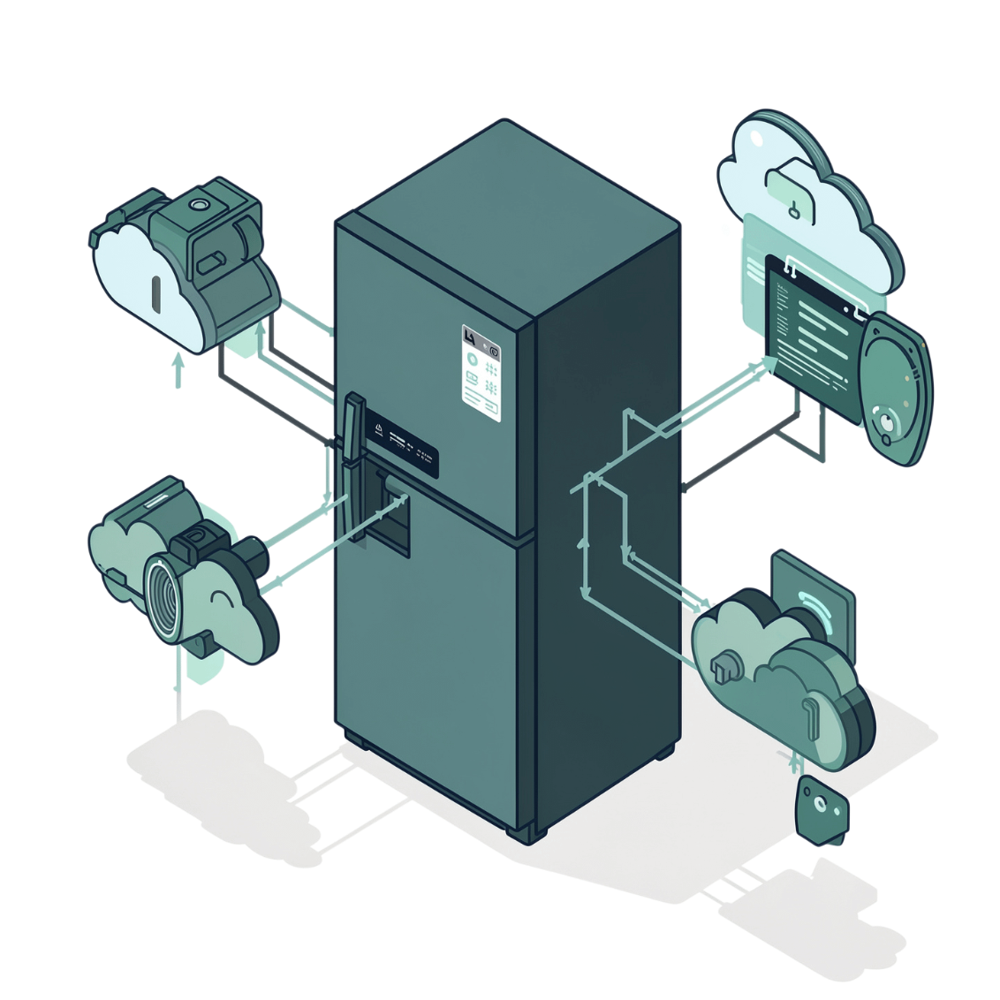
Conclusion
A Smarter Way to Store Food
The IoT-Based Smart Refrigerator Monitoring System delivers a comprehensive, automated solution for modern food storage challenges.
01
02
03
04
Continuous Monitoring
RFID & Barcode Tracking
Timely Alerts
Smarter Outcomes
Temperature, humidity, food freshness, and inventory are monitored without interruption.
Reliable identification and cloud-based management of all food inventory items.
Expiry and low-stock alerts empower users to take timely, informed action.
Improved food safety, reduced wastage, enhanced inventory management, and support for smart kitchen automation.

