Slide 1

Remote Cloud Storage Project Proposal – BSc CSIT 7th Semester
Submitted by:
Kalyan Kandel
Aayush Subedi
Albert Baral
Submitted to:
Department of Computer Science
Birendra Multiple Campus, Bharatpur, Chitwan

Slide 2

Introduction
We generate lots of data daily: notes, videos, projects, photos.
Local storage is risky in Nepal: limited space , data loss from power cuts, viruses, accidents.
Remote cloud storage lets us upload files to a server and access them from anywhere with internet.

Slide 3

Our project: Build a simple, private cloud storage prototype (like personal Dropbox) running on our laptops.
Why important for us:
Applies Web Technology, Networking, Software Engineering skills from syllabus.
Helps share group projects/notes without WhatsApp/email limits.
Low-cost, privacy-focused solution for Nepali students.

Slide 4
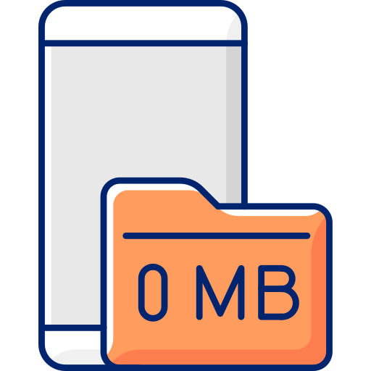
2. Problem Statement
Limited local storage: Phones/laptops fill up fast with lecture videos, notes, projects.
High risk of data loss: Device damage, formatting, viruses, power cuts.
Difficult file sharing: Email size limits (25 MB), WhatsApp compression, USB loss.
Commercial clouds: Costly for extra space, slow in Nepal, privacy concerns (data on foreign servers).
No simple, free, private alternative for students in Chitwan/Nepal.

Slide 5
3. Objectives
General Objective : To build a simple remote cloudstorage prototype for file upload, storage, access, and sharing – demonstrated on local computers.
Specific Objectives
Enable file upload, download, list, and delete (core features).
Create user-friendly registration and login interface
Add basic folder organization.
Implement simple file sharing via links.
Build responsive frontend with HTML/CSS/JS, upgrading to React.js.
Connect frontend to backend APIs.
Prepare working demo on laptops within 3 months.

Slide 6
4. Methodology
We use client-server model: browser (frontend) ↔ local server (backend).
Team roles:
Kalyan Kandel: Frontend UI development, Component design, API integration, Responsive layouts, User experience
Aayush Subedi: Backend API development, Database design, Core file operations, User management, Bonding system logic
Albert Baral: Security implementation, Encryption (at rest & in transit), Penetration testing, Unit testing, Integration testing, Performance testing
Tools :
Frontend: HTML, CSS (or Tailwind CSS), JavaScript, React (planned), Axios
Backend: Node.js, Express.js, JWT (authentication), bcrypt (password hashing), Helmet.js
Database: MongoDB (with Mongoose) or SQLite
Security: HTTPS/TLS, JWT, bcrypt, Input validation
Testing: Jest (unit testing), Supertest (API testing), Postman
Development: VS Code, Git/GitHub, Localhost testing, (Optional) Docker

Slide 7
4.a Requirement Identification
Existing Systems Review
Reviewed Google Drive, Dropbox, Microsoft OneDrive
Strengths: cross-device access, auto-sync, collaboration, free storage (15GB typical)
Weaknesses: subscription costs, privacy concerns, slower speeds in Nepal, vendor lock-in
Studied Nextcloud (open-source)
Advantages: self-hosted, full data ownership, no recurring cost, customizable security
Insight: Commercial = scalable but costly; Open-source = flexible but technical setup
Requirement Analysis
Core Features:
Secure authentication (hashed passwords)
File upload (≤100MB), preview, download, rename, delete
Folder organization system
Shareable file links
Storage usage dashboard
Responsive design
Non-Functional:
Easy to use
Reliable on local networks

Slide 8
4.b Feasibility Study
Technical Feasibility
Built using modern, open-source web technologies within a 3-month timeline
Cloud-based client–server architecture ensuring remote accessibility
Frontend: React (JavaScript, JSX, CSS) for responsive user interface
Backend: Node.js & Express for RESTful API services
Database: SQLite/PostgreSQL for secure metadata management
Remote server file storage with encryption (at rest & in transit)
Secure authentication using JWT and password hashing (bcrypt)
Scalable architecture allowing future cloud deployment and feature expansion
Economic Feasibility
All development tools are free (Node.js, Express, React, SQLite, VS Code,
Git)
Prototype hosted on free/low-cost cloud platforms
No major infrastructure investment required
Future deployment possible via free tiers (Render/other providers)
Cost-effective alternative to commercial cloud storage subscriptions

Slide 9
4.b Feasibility Study
Operational Feasibility
Accessible remotely via browser (no installation required)
User-friendly interface for students
Centralized storage accessible from multiple devices
Secure login and controlled file access
Easy maintenance and future scalability
Suitable for low-to-moderate bandwidth environments

Slide 10
Schedule
Sprint-Based Timeline (12 Weeks)
Sprint | Weeks | Focus Area | Key Deliverables | Team Member Focus
Sprint 1 | 1-2 | Foundation | Project setup, DB design, security architecture | All: Planning
Sprint 2 | 3-4 | Authentication | Working login/register, JWT, secure auth | Aayush: Backend auth, Kalyan: Auth UI, Albert: Security review
Sprint 3 | 5-6 | File Operations | File upload/download APIs, encryption | Aayush: File APIs, Albert: Encryption, Kalyan: Basic UI
Sprint 4 | 7-8 | CRUD Complete | Full file management, UI integration | Aayush: Updates/deletes, Kalyan: File UI, Albert: Testing
Sprint 5 | 9-10 | Collaboration | Bonded spaces, group functionality | Aayush: Group backend, Kalyan: Group UI, Albert: Access testing
Sprint 6 | 11-12 | Sharing & Polish | Link sharing, testing, documentation | All: Integration and finalization

Slide 11
4.c High Level Design of System ( How it works ? )
Simple flow :
User opens browser → Frontend shows login page
Enter credentials → Frontend sends to Backend
Backend checks → returns success.
Dashboard loads → User uploads file → Backend saves to local folder.
User generates share link → others download.

Slide 12





5. Expected Outcome
Working prototype on laptops (localhost demo).
User login/registration interface (frontend).
Upload, download, list, delete files.
Basic sharing via links.
Responsive frontend (HTML/CSS/JS → React).
Live demo: Upload file on one laptop, access/share from another.
Foundation for future improvements (security, online hosting).

Slide 13

6. References
Google Drive – Official Website & Documentation
Dropbox – Official Website
Microsoft OneDrive – Official Website
Nextcloud – Official Documentation
React – Official Documentation
Node.js – Official Documentation
Express.js – Official Documentation
MongoDB / SQLite – Official Documentation
JSON Web Token (JWT) – Official Documentation
bcrypt – Official Documentation

