Slide 1

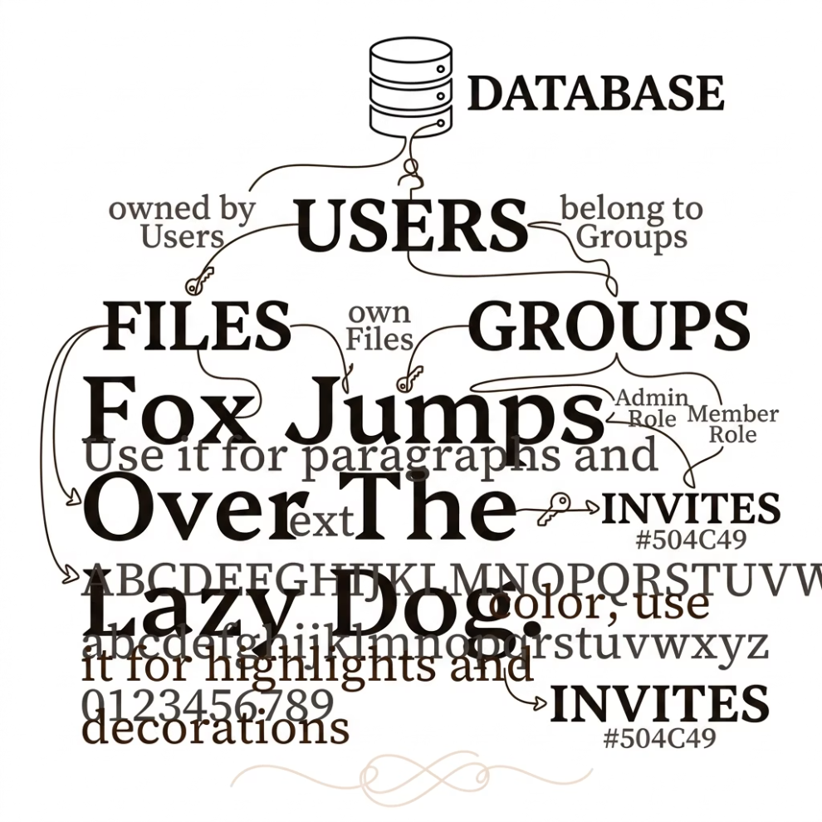


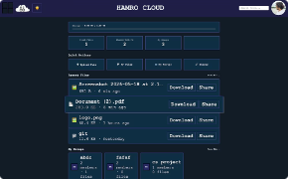
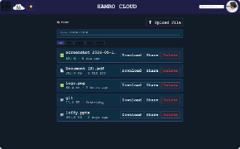
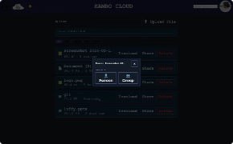
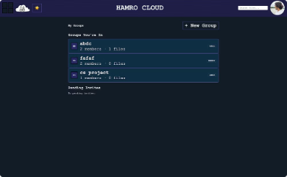
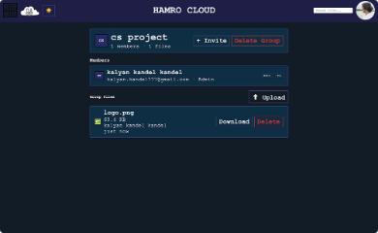
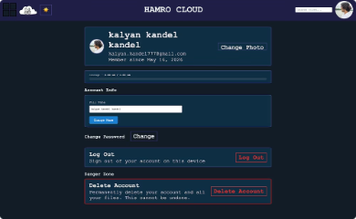
Hamro Cloud — Remote Cloud Storage System
Team: Kalyan Kandel · Aayush Subedi · Albert Baral | Supervisor: Bindu Aryal | Birendra Multiple Campus, CSIT, Tribhuvan University | May 2026
Problem Statement
Objectives
File sharing over WhatsApp and email is messy and disorganized
No single place to store and access files from anywhere
No control over who can access what
Files get lost or duplicated across devices
Secure user authentication with JWT and bcrypt
Upload and download files remotely from any device
Group-based collaboration through Bonds with Admin and Member roles
Share files directly with a person by email or with an entire group
Responsive and intuitive web interface
Standard API communication between frontend and backend
Proposed Solution
Web-based remote cloud storage platform
Upload, manage, share, and organize files securely from anywhere
Secure login, personal storage, group collaboration through Bonds
File sharing with individuals or groups via a clean responsive interface
System Features
User Features
Group Features (Bonds)
Security
Register and login
Upload and download files
Delete own files
View storage usage
Admin: Create group, invite/remove members, delete any file
Member: Upload/download files, delete own files, leave group
JWT token authentication
bcrypt password hashing
Protected API routes
Input sanitization
Byte-level file type validation
Technology Stack
Frontend
Backend
Database
Auth
File Upload
HTML, CSS, JavaScript
Node.js, Express.js
SQLite
JWT, bcrypt
Multer
Email
Version Control
Nodemailer
Git, GitHub
System Architecture
User
Frontend UI
Express API
Auth Middleware
Requests flow from the user through the frontend UI to the Express API server, where authentication middleware validates tokens before routing to the appropriate handler and persisting data in SQLite.
Database Design
Seven tables form the data layer of Hamro Cloud, managing users, files, groups, invitations, and direct shares.
API Endpoints
Category
Endpoints
Description
Auth
register, login, forgot-password, reset-password
User authentication and password recovery
Files
upload, download, delete, share-with-person
Personal file management and direct sharing
Groups
create, invite-member, list-members, upload-to-group, leave-group, accept-invite, decline-invite
Bond group creation, membership, and collaboration
User
get-profile, update-profile, upload-avatar, get-storage, delete-account
Account management and storage overview
Working Mechanism
01
02
03
User registers and logs in
JWT token stored in browser
User uploads file via drag-and-drop or browse button
04
05
06
Backend validates token and checks file type
File saved on server; metadata saved in database
User shares file with a person by email or to a Bond group
07
Group members see shared files in their dashboard
UI Screenshots
Core Screens
Login Page
Dashboard
My Files Page
Share Modal
Groups & Profile
Groups / Bonds Page
Group Detail Page
Profile Page
Challenges Faced
Future Enhancements
Managing JWT tokens across multiple pages
File type security and preventing spoofed extensions
Handling Admin and Member role permissions inside groups
Building responsive UI for both desktop and mobile
Connecting frontend to backend API
Handling cross-origin requests between frontend and backend
Real cloud storage integration with AWS or Firebase
End-to-end encryption for files
Dedicated mobile application
AI-powered file search
File versioning and revision history
Payment gateway integration with eSewa for premium plans
Real-time collaboration inside groups
Conclusion
Thank You
Hamro Cloud successfully demonstrates a secure and collaborative remote cloud storage platform
Features authentication, group-based file management through Bonds, and direct file sharing
Clean separation between frontend and backend
Ready for integration and deployment
Questions & Answers
Team: Kalyan Kandel · Aayush Subedi · Albert Baral
Supervisor: Bindu Aryal | Birendra Multiple Campus, CSIT, Tribhuvan University | May 2026

