Slide 1
Book1_Capstone_ModelData
File created on: 11/19/2020 8:02:02 PM

Slide 2
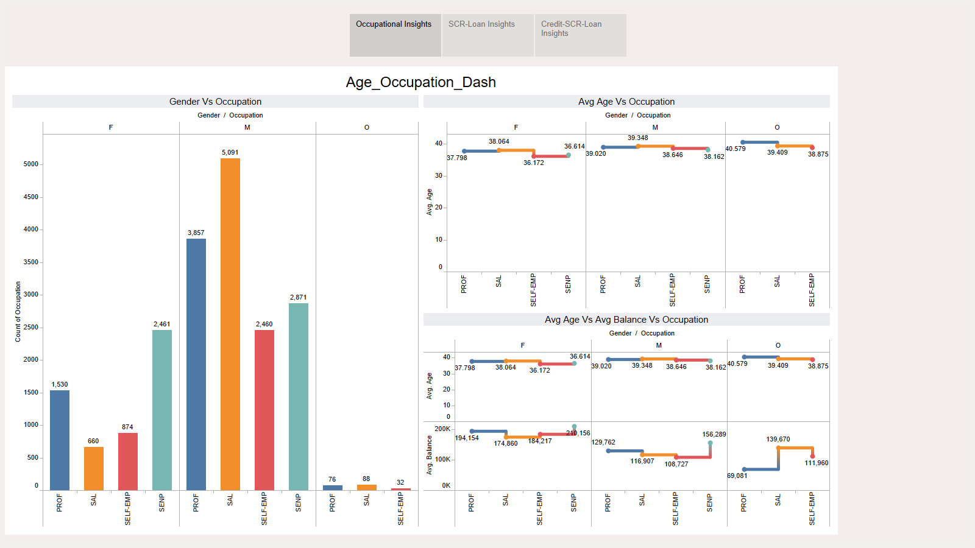

Slide 3
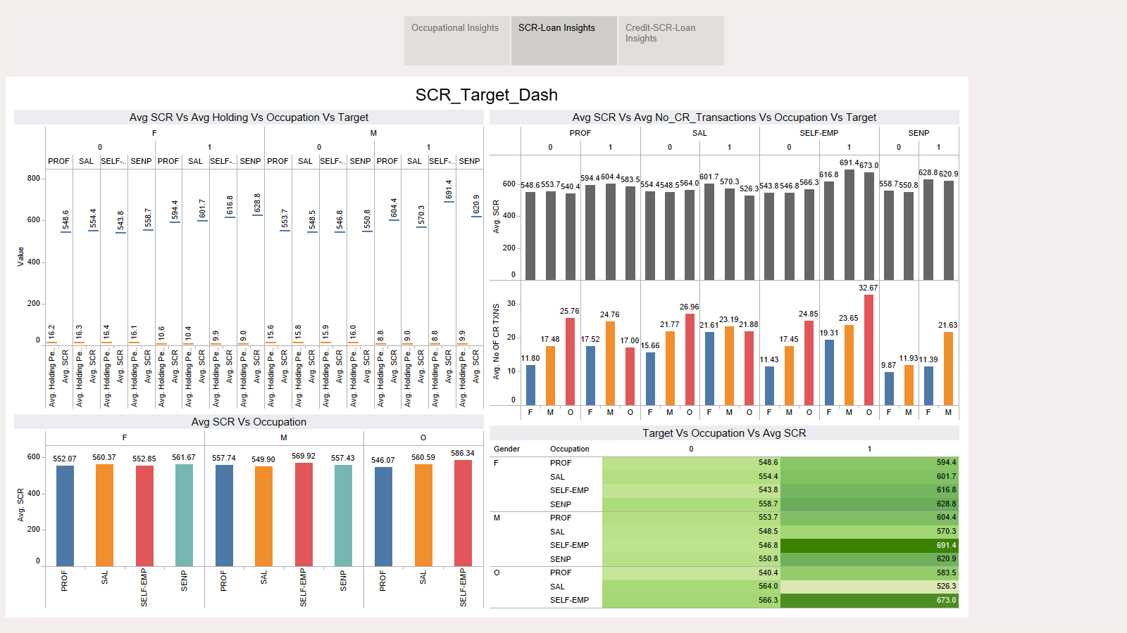
Add Age in this dash
RF AND LR

Slide 4
