Slide 1
Book1_Capstone_ModelData
File created on: 12/17/2020 8:07:58 PM

Slide 2
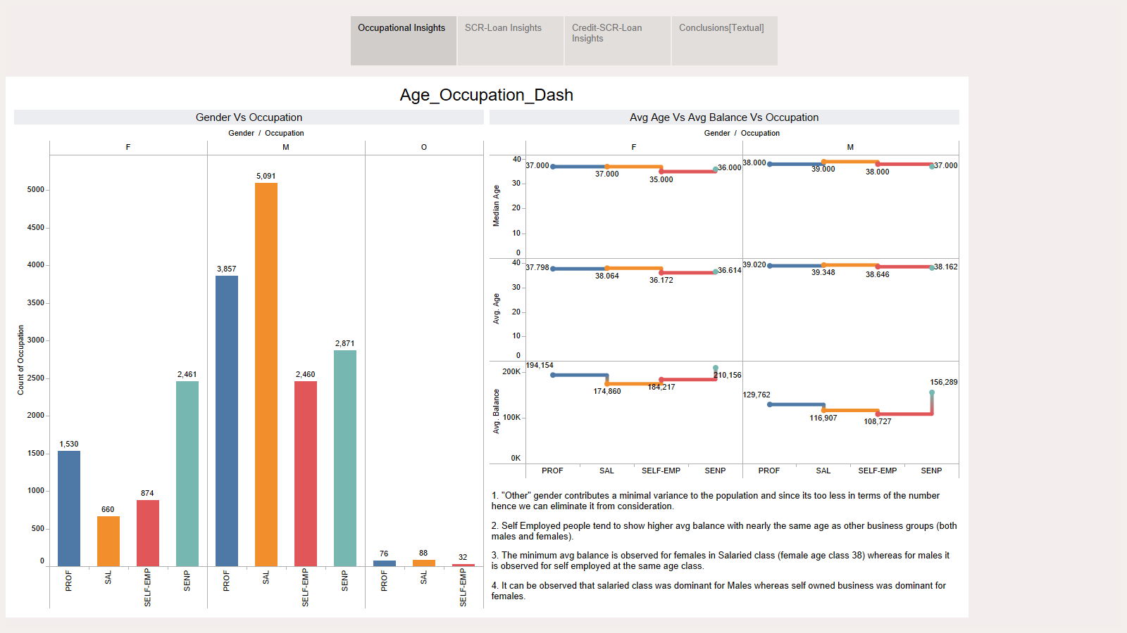

Slide 3
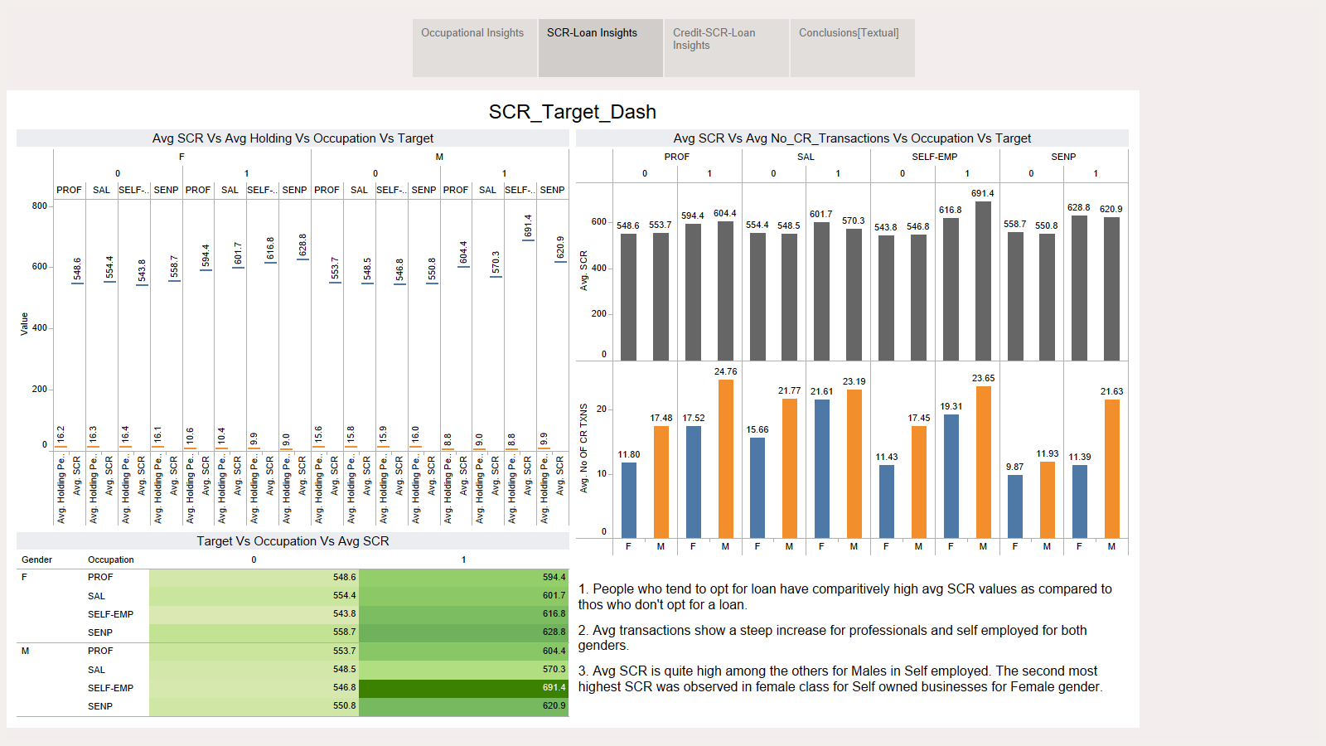

Slide 4
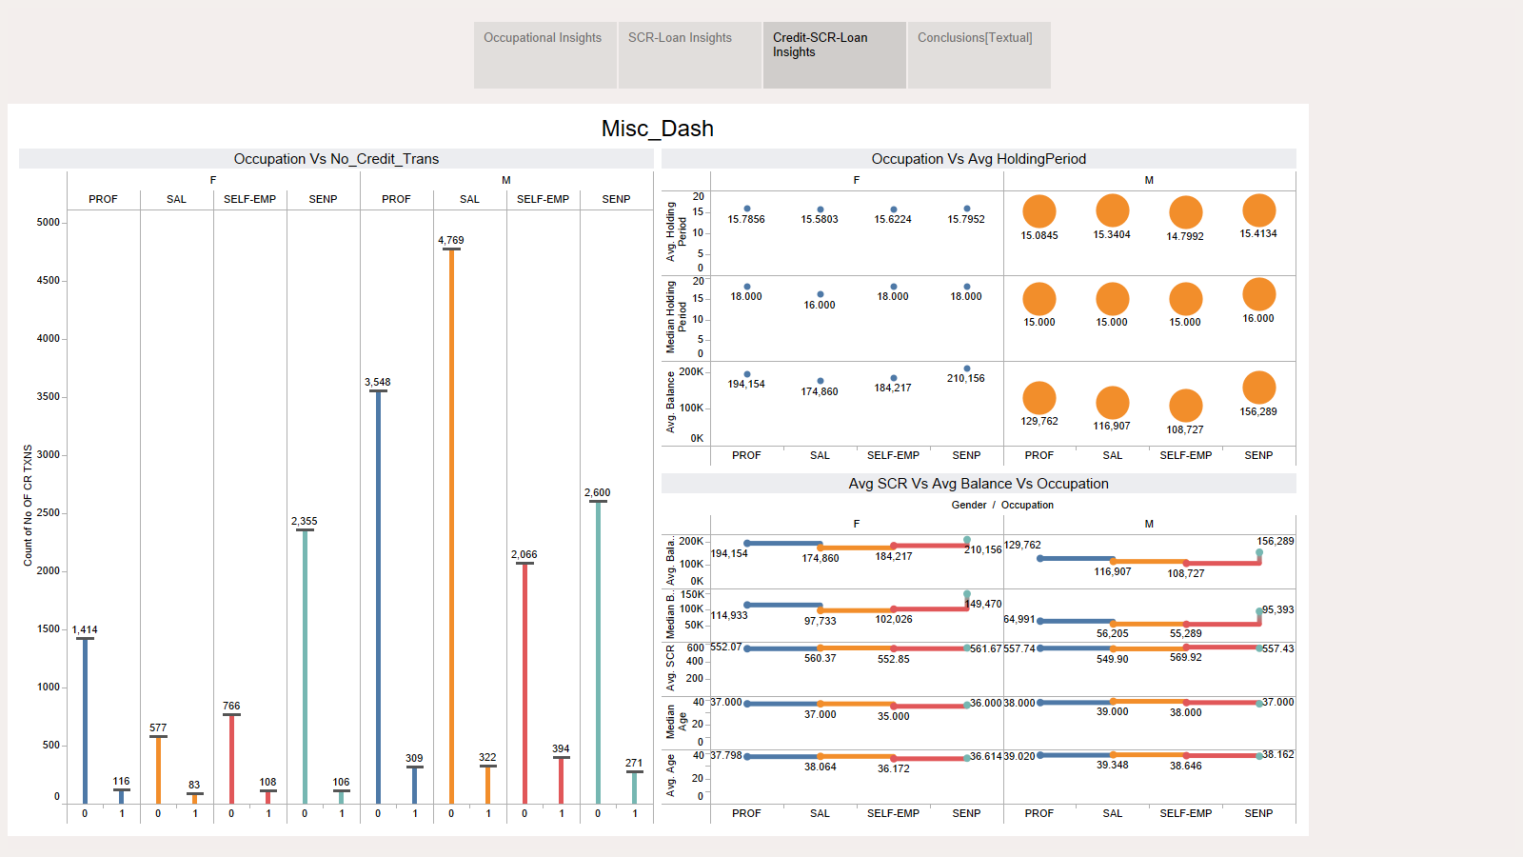

Slide 5
