Slide 1


The Second Annual Case Competition
Binny Kaur Kalyan Parimi
Rohith Mahadevan
Shrirang Rajguru

Slide 2





INTRODUCTION
Founded in 1859, Headquartered in Montreal, Quebec
6th largest bank in Canada
2.8 million clients
31,243 Employees
Business Segments
Personal & Commercial Banking
Wealth Management
Financial Markets
U.S Specialty Finance and International

Slide 3
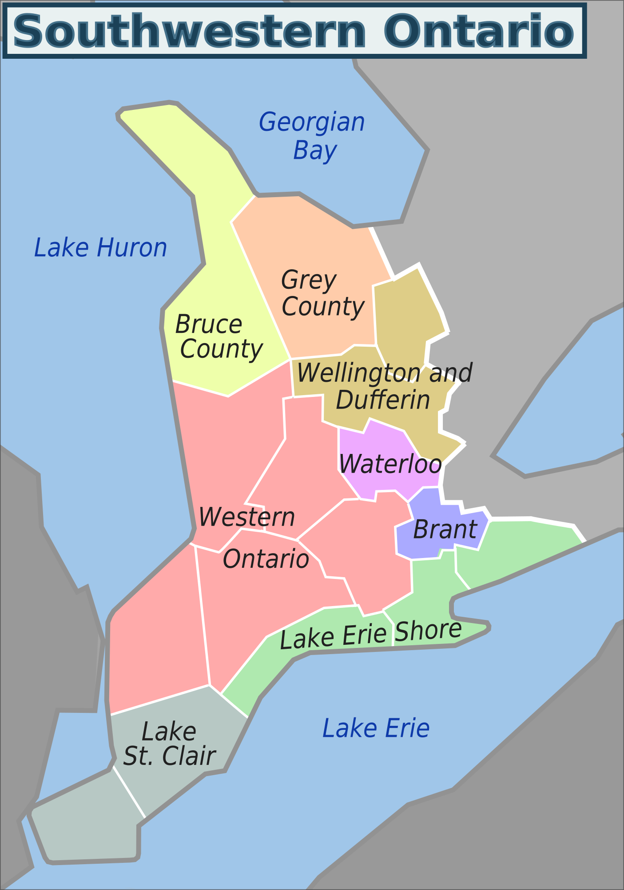
To enhance market share in Southwestern Ontario
Specifically, in
Windsor/Essex
Middlesex County
Region of Waterloo Markets

Slide 4
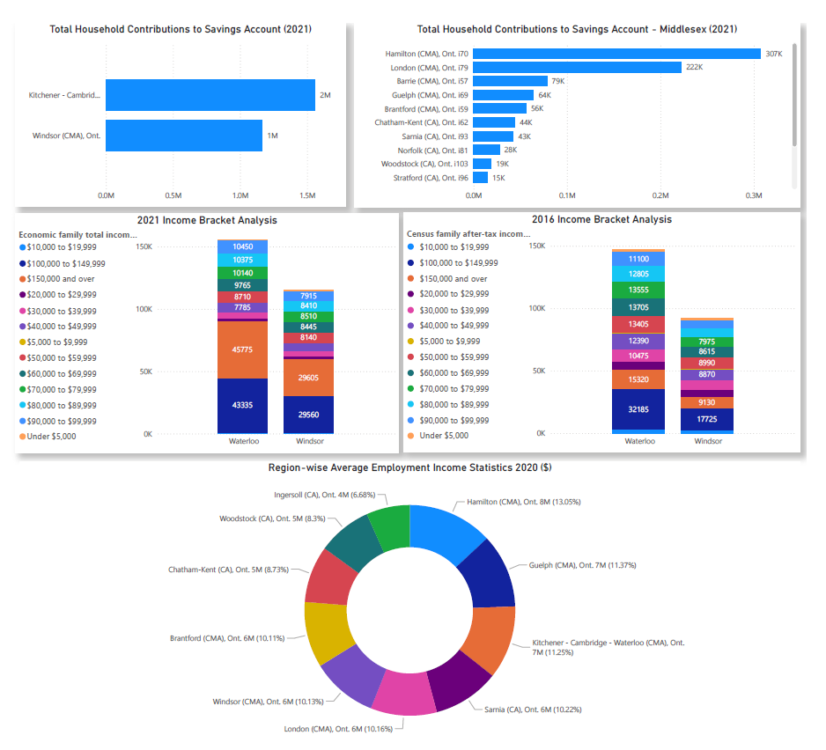
Current & Future Economic & Workforce Prospect

Slide 5
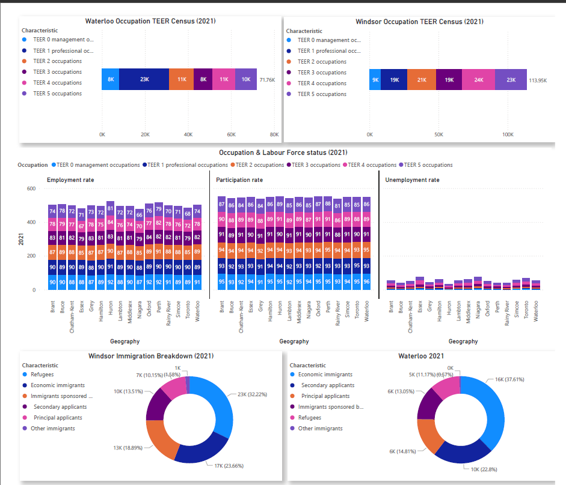
Current & Future Economic & Workforce Prospect

Slide 6
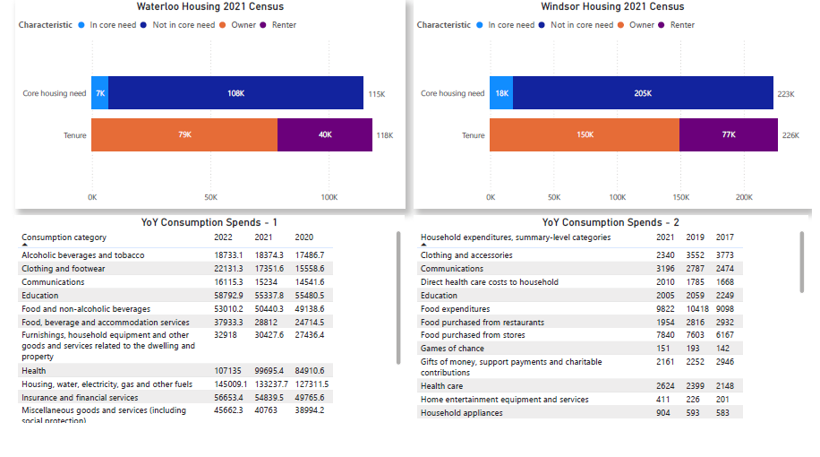
Current & Future Economic & Workforce Prospect

Slide 7
Workforce Demographics & Key Employment Sectors
Kitchener-Waterloo-Cambridge | Windsor CMA + Essex
Top 3 industries (NAICS): Professional, scientific and technical services Educational services Manufacturing | Top 3 industries (NAICS): Manufacturing Health care and social assistance (tags back to elder population dominance in Windsor) Retail trade
Employed: Unemployed ratio = 7.34 : 1 Comparatively, lower population resides in “Not in Labour force” indicating the Hustle culture. Shows higher employability index. | Employed: Unemployed ratio = 4.30 : 1 Higher population resides in “Not in Labour force” indicating a possibility for Windsor to be a retirement/laid-back town.
WFO:WFH ratio = 1.28 : 1 Indicating equal proportion of population working from both office and home. | WFO:WFH ratio = 4.10 : 1 Indicating higher proportion of population working from office. More people tend to work out of Windsor (possibly Detroit)
Employed (FTE/PTE): Did not work ratio = 1.90 : 1 There are comparatively more Full-time workers than Part-time. More employment opportunities can be seen. | Employed (FTE/PTE): Did not work ratio = 1.21 : 1 There are comparatively more Part time/Contract workers than Full-time. Lesser employability can be observed.
Top 5 Occupation Major Groups (NOC): Sales and service occupations. Business, Finance, Administration. Natural and applied sciences and related occupations. Education, Law and Social, Community and Government services Professional occupations in Natural and Applied sciences. | Top 5 Occupation Major Groups (NOC): Sales and service occupations. Trades, transport and equipment operators and related occupations Business, Finance, Administration. Occupations in manufacturing and utilities Sales and service support occupations

Slide 8
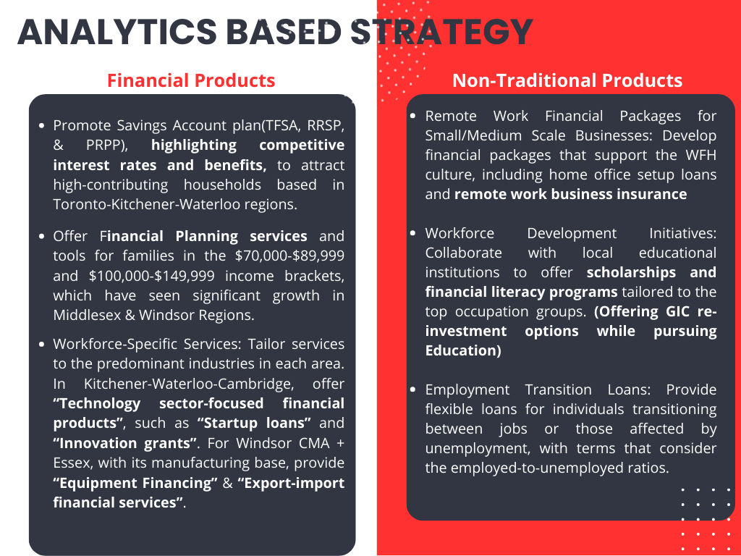

Slide 9
Professional Offers Analysis – Student Package
Banks | RBC | CIBC | Scotiabank | TD | BMO | NBC
Monthly Fee | $0 | $0 | $0 | $0 | $0 | $0
Debit Transactions | Unlimited, Avion Points, 1 NSF | Unlimited, no daily balance | Unlimited | Unlimited | Unlimited | Unlimited, Overdraft Protection
Interac Transfer | Free | Free | Free | Free | Free | Unlimited
ATM Fee to use another bank’s ATM | No Fee | 1 free withdrawal per month | No Fee | No Fee | No Fee
Credit Card | Upto $48 rebate | $400 Costco credit, Upto $139 rebate, $0.10 off/liter gas | 10% cash back for first 3 months, 3 Scene+ points /$1 | 1% in Cash Back Dollars on groceries and gas, 0.5% for other purchases | 3% cashback groceries,1% on re-bill payments | 0 annual fee first 3 years, Travel rewards, 1point – $1 spent, vehicle rental insurance, travel insurance.
Welcome Bonus | $100 | $100 + $50 for each friend referred | $100 | $125 | $100 + 6 months Dominos Pizza
Add-ons | Student Mobile App | SPC+ membership | Scene+, 20 free trades | Starbucks Reward, 10 commission rebated trades, webinars on investments | Medical +Dental Student credit limit 10,000 | Student line of credit extended up to 6 months of graduation

Slide 10
Professional Offers Analysis – Professional Packages (Chequing Accounts)
Banks | RBC | CIBC | Scotiabank | TD | BMO | NBC
Monthly Fee | $4-30/month | $0-30/month | $0-30.95/month | $0-29.95/month | $0-30.95/month | 3 accounts with no monthly fees
Debit Transactions | Varies | $0-1.25/transaction | 0-25 transactions free | 0-25 transactions free | Unlimited | Specialized as per profession
Interac Transfer | Free | $0-1.25/transaction | Free | $0-1/transaction | Free | Free
ATM Fee to use another bank’s ATM | $0-2/use | $0-2/transaction | No, fees apply and varies | $0-5/transaction | No Fee
Credit Card | Upto $120 rebate | $0-400 Costco Credit Card | $0-150 annual fee | Free rebates on select cards | 3% cashback groceries,1% on re-bill payments | 1 Eligible Mastercard
Overdraft Protection | $0-5/month | Yes | No to $5/use | $5/month | $0-5/month | Yes
Add-ons | Apple Watch | Costco credit, $0.10 on Gas | Scene+, iTrade | Aeroplan points, TD Reward points | BMO Rewards, Air Miles, Cashback | Personal and home equity lines of credit, financial advisor

Slide 11
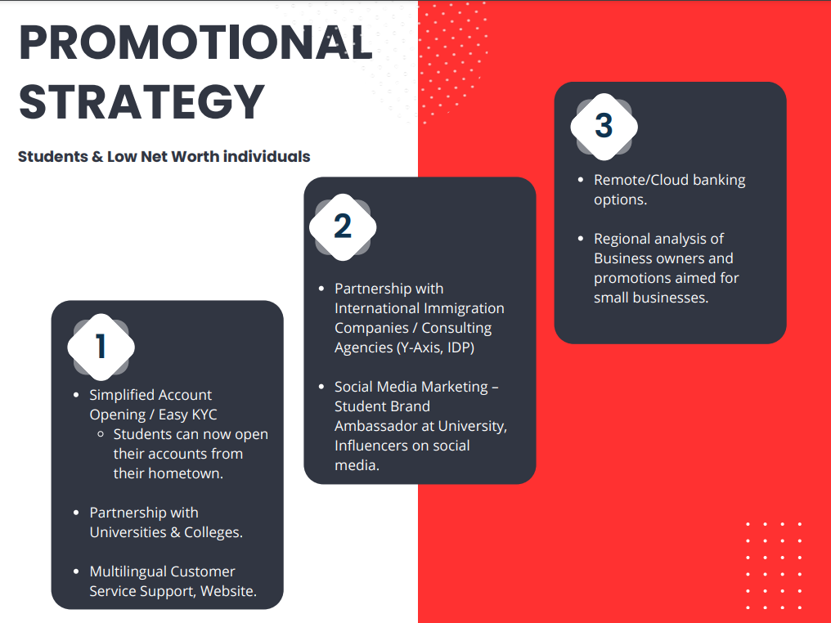

Slide 12
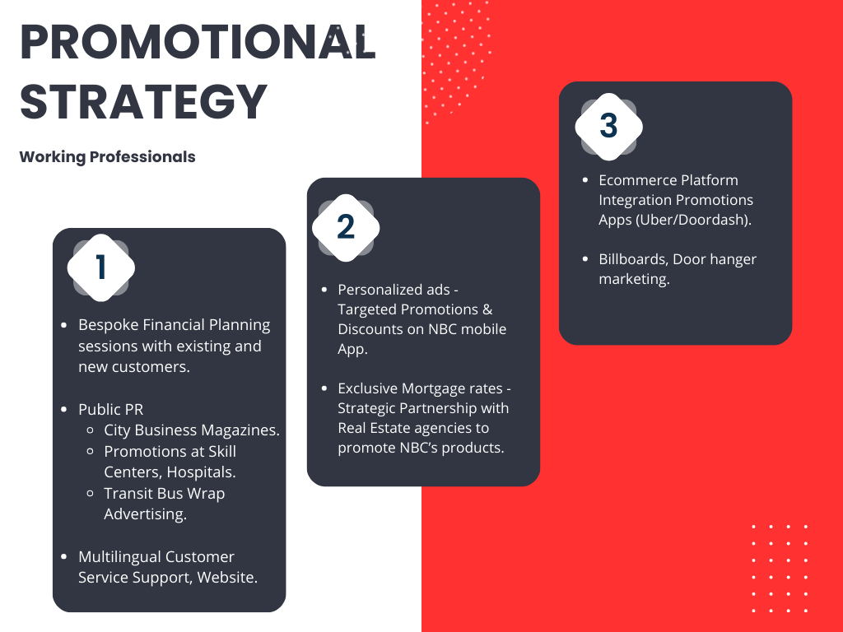

Slide 13


Slide 14
Current & Future Economic Prospect
High density areas include London, Kitchener-Waterloo, Windsor and Guelph.
Major Geographical categories based on analysis are Kitchener-Waterloo-Cambridge and Windsor
Kitchener-Waterloo-Cambridge | Windsor CMA + Essex
Higher household contributions towards all 3 accounts – TFSA, RRSP, RPP. | Higher contributions towards RPP in the income range of $20,000-$30,000.
Overall decrease in lower income groups in 2021 compared to 2016. Indicates higher incomes over the years with an approx. of 3.7x increase. | Overall decrease in lower income groups in 2021 compared to 2016. Indicates higher incomes over the years with an approx. of 3.5x increase.
Overall increase observed in higher income salary groups in 2021 from 2016. | Increase of 1000+ family groups in the income ranges of ($70,000-$80,000) and ($80,000-$89,999) in 2021 from 2016.
Increase of 11,000+ family groups in the income ranges of ($100,000-$149,999) | Increase of 10,000+ family groups in the income ranges of ($100,000-$149,999)
Increase of 2.8x of family groups with income range of $150,000 and more. | Increase of 3.2x of family groups with income range of $150,000 and more.
Top 3 Immigrant Categories: Economic immigrants (Skilled workers contributing to the economy) Secondary applicants (Dependents of the main applicant) Principal applicants (Main candidates meeting economic immigration criteria) | Top 3 Immigrant Categories: Refugees Economic immigrants Immigrants sponsored by family (Relatives sponsored by Canadian residents)
Asians are followed by Eastern and South-Eastern Asians with regards to population. (Indicates to celebrate and push promotional events for regional festivals) | Asians are followed by Middle East and Europeans with regards to population.

