Slide 1
Capstone project
Lending insights from lending club loan data

Slide 2
Three primary lending risks
Loan default risk
Loan prepayment risk
Interest rate risk

Slide 3
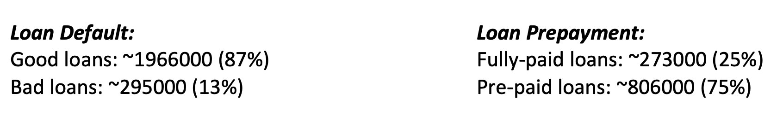

Slide 4
Exploratory data analysis

Slide 5
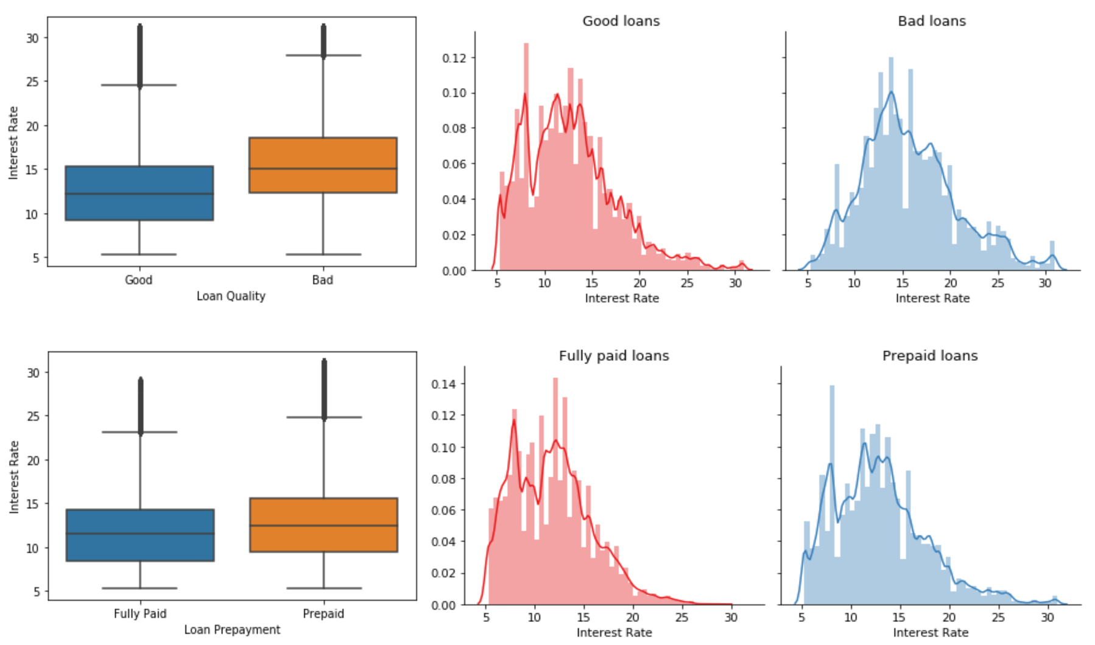
Interest rates

Slide 6
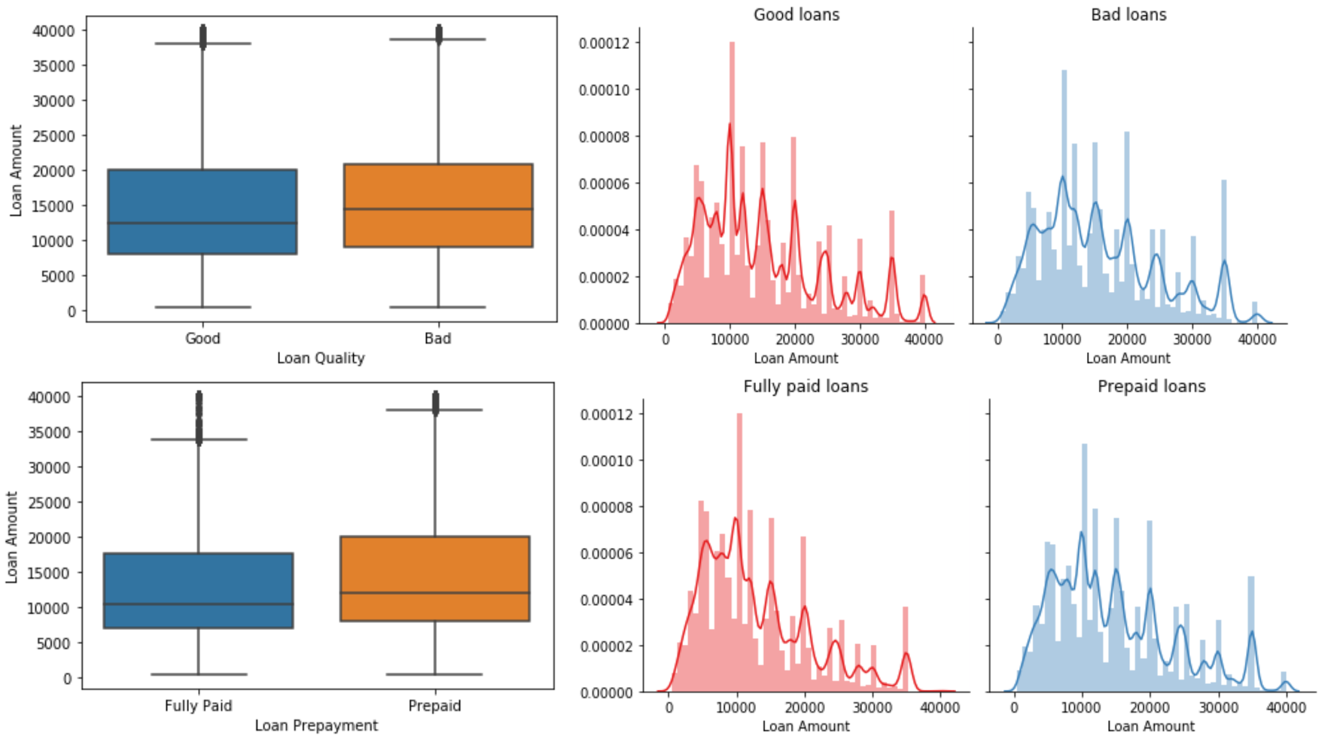
Loan amount

Slide 7
FICO Score

Slide 8
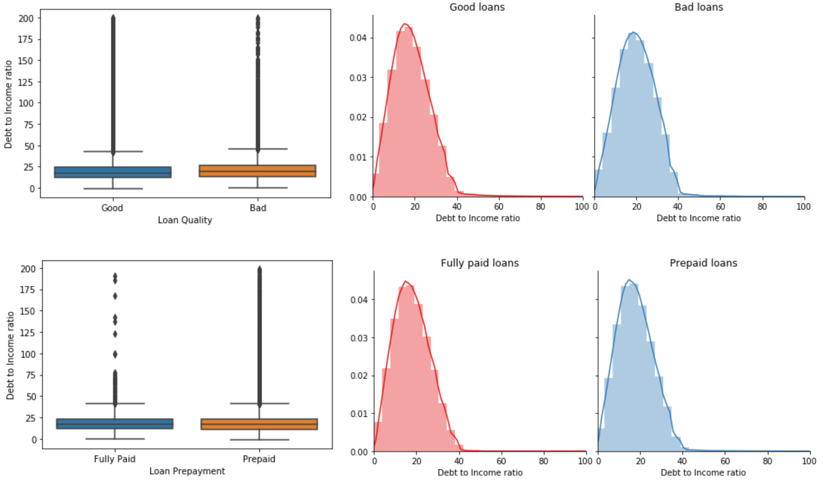
Debt-to-income ratio

Slide 9
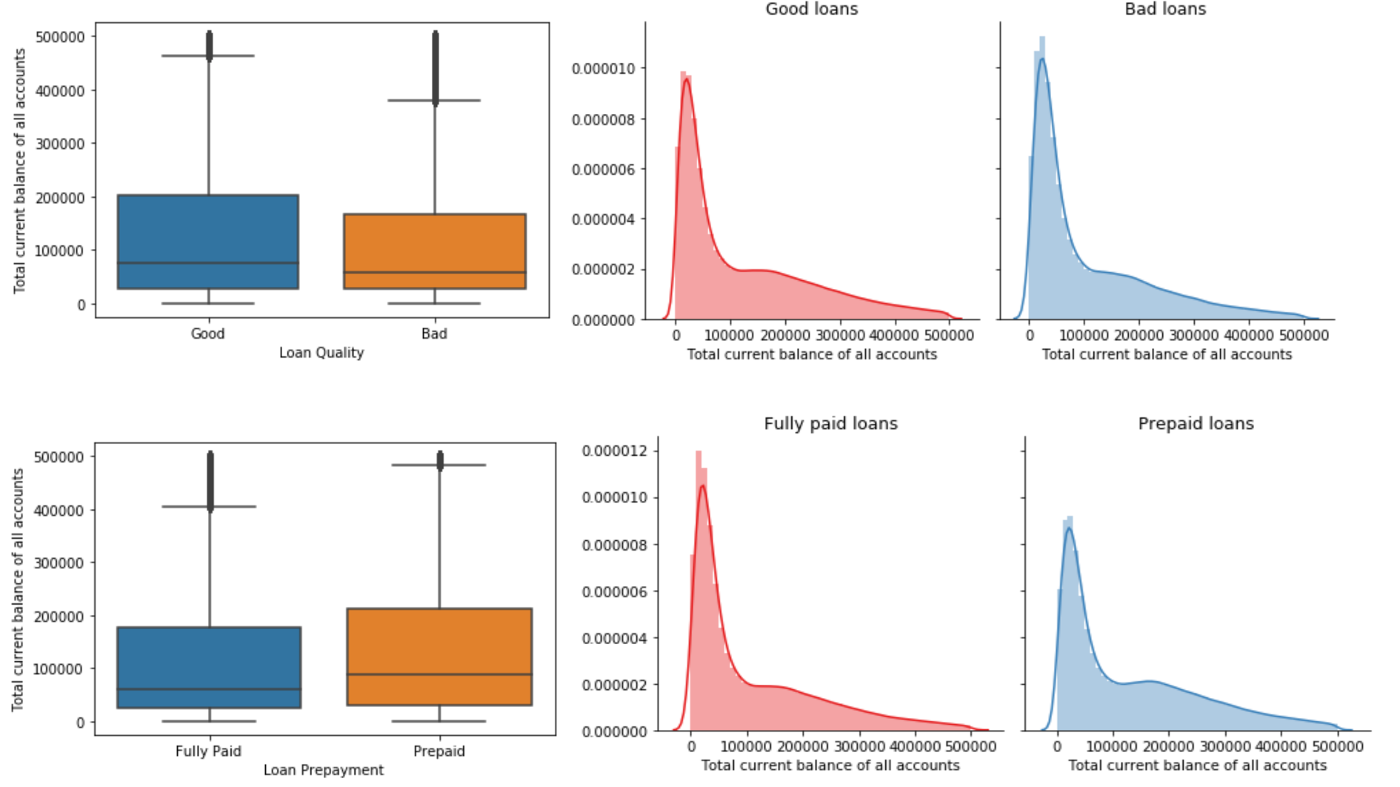
Total current balance of all accounts

Slide 10
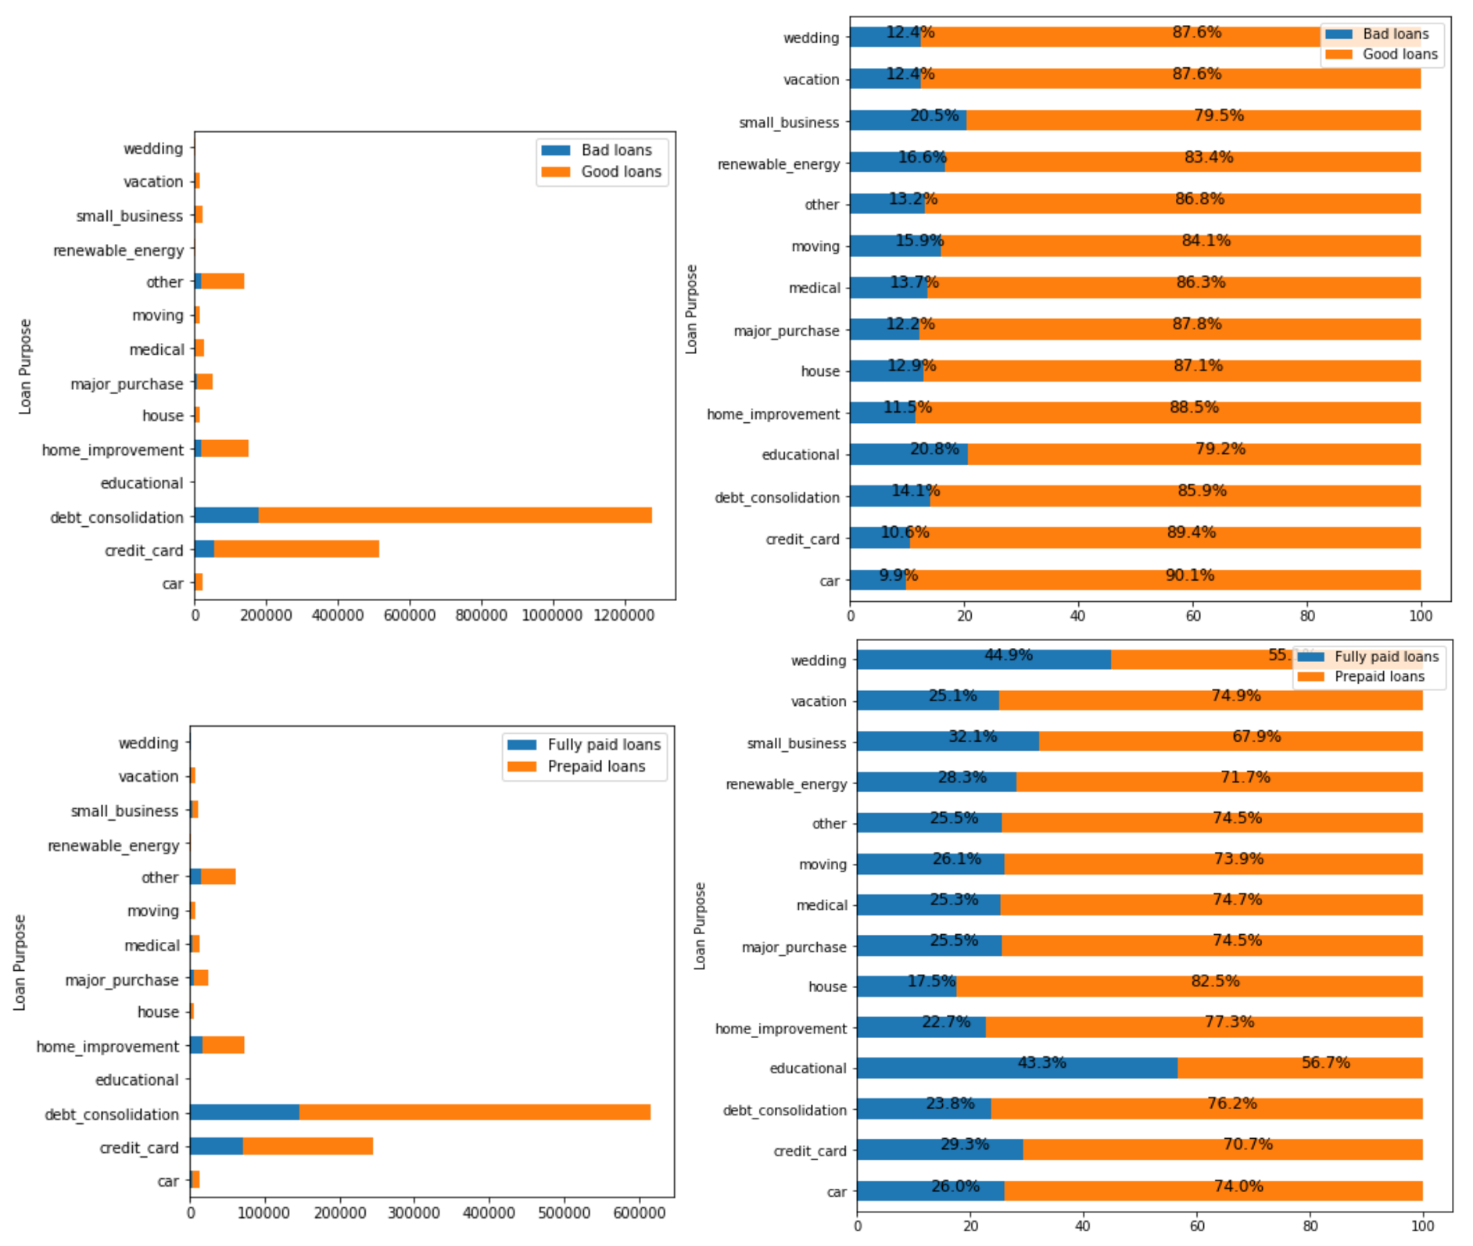
Loan purpose

Slide 11
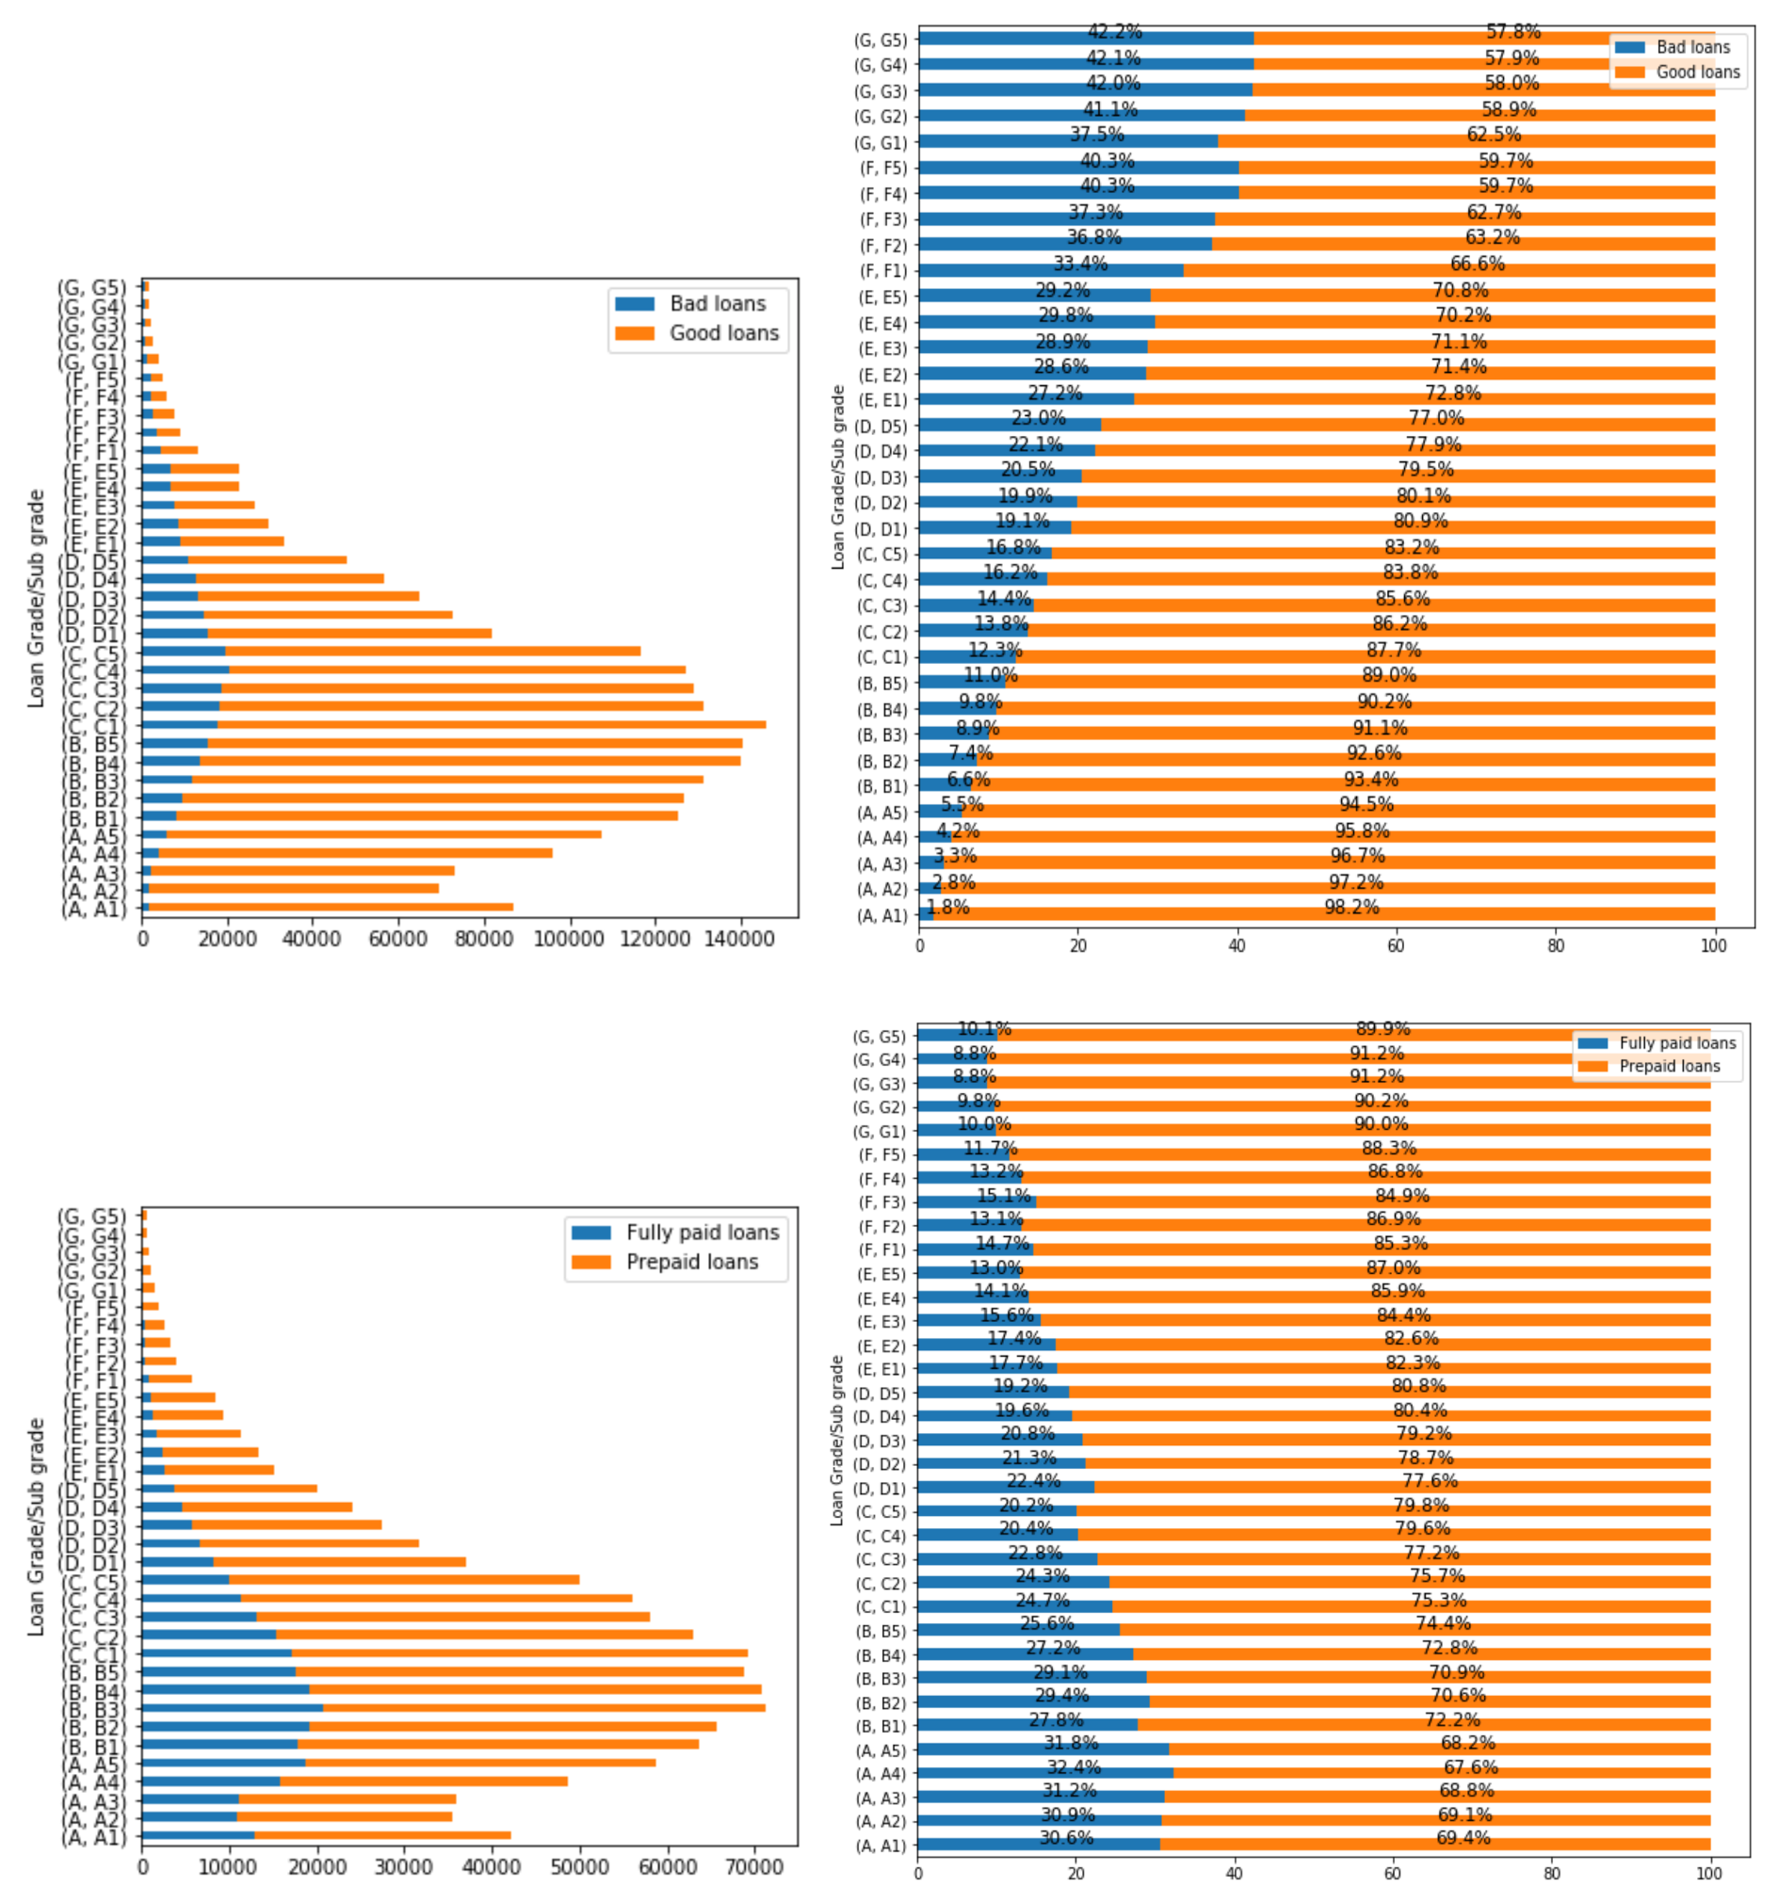
Loan grade/sub-grade

Slide 12
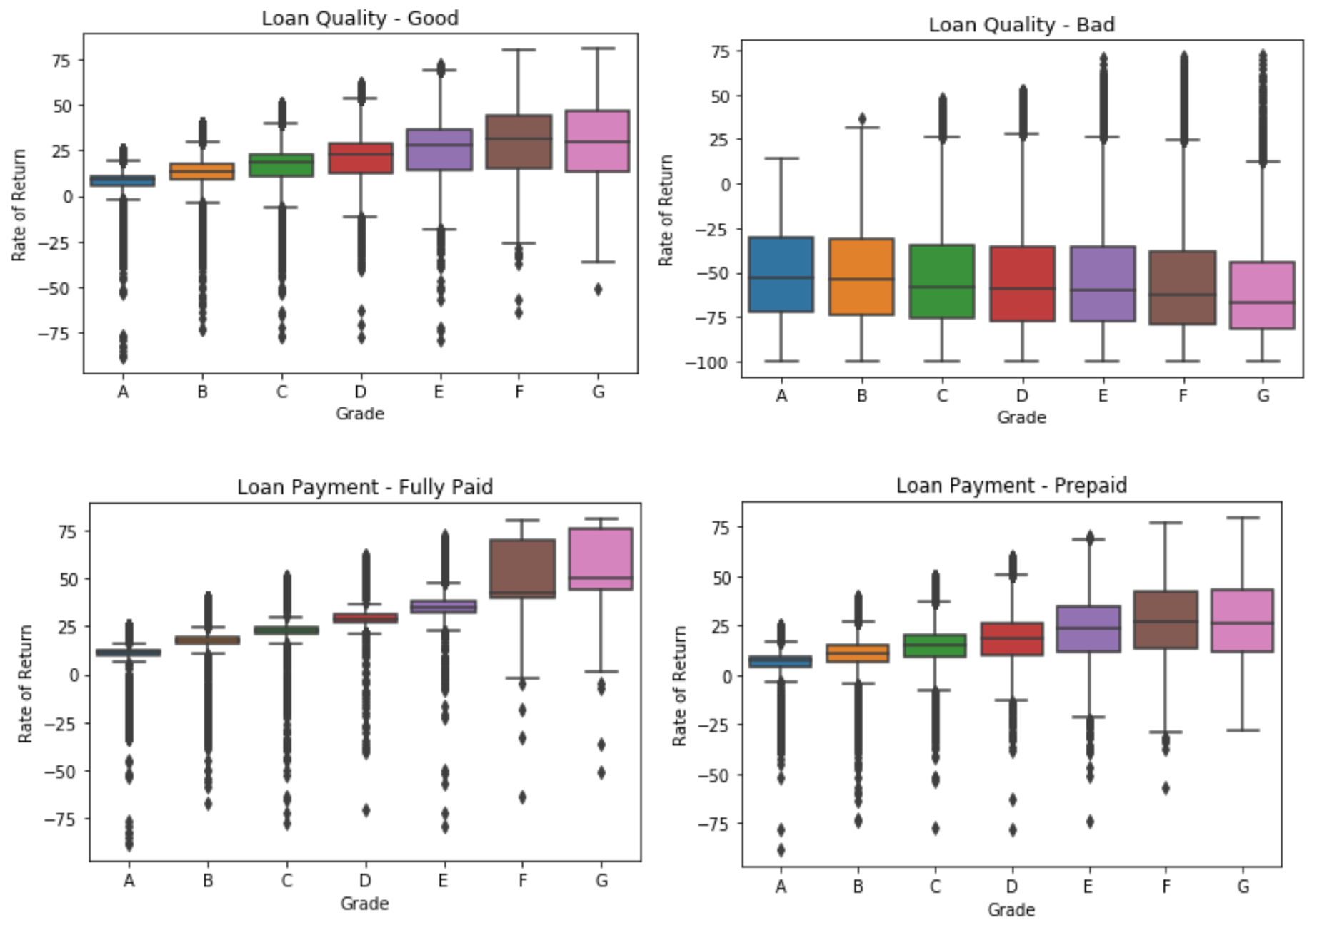
Rate of return

Slide 13
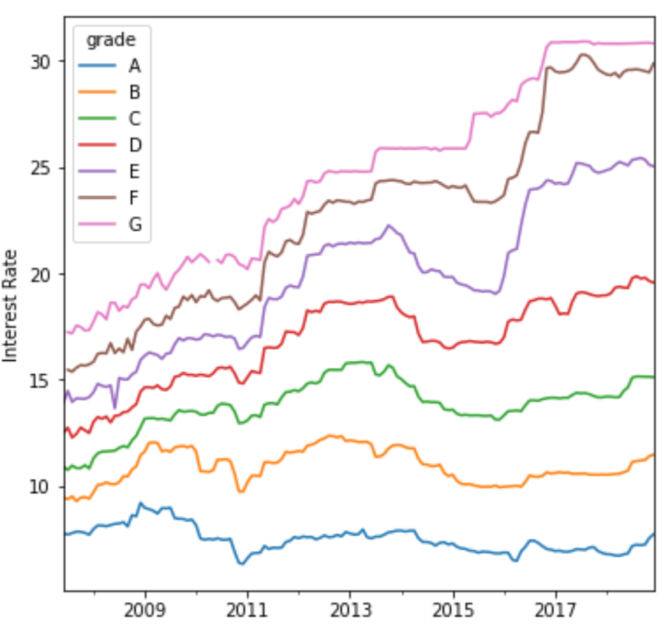
Interest rates evolution

Slide 14
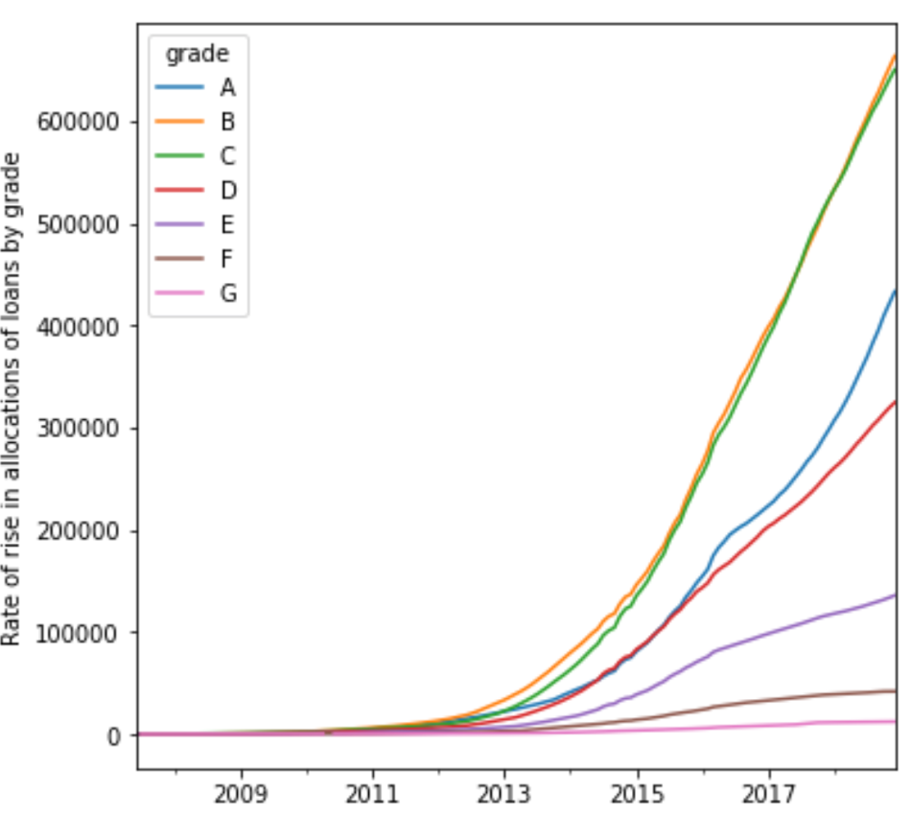
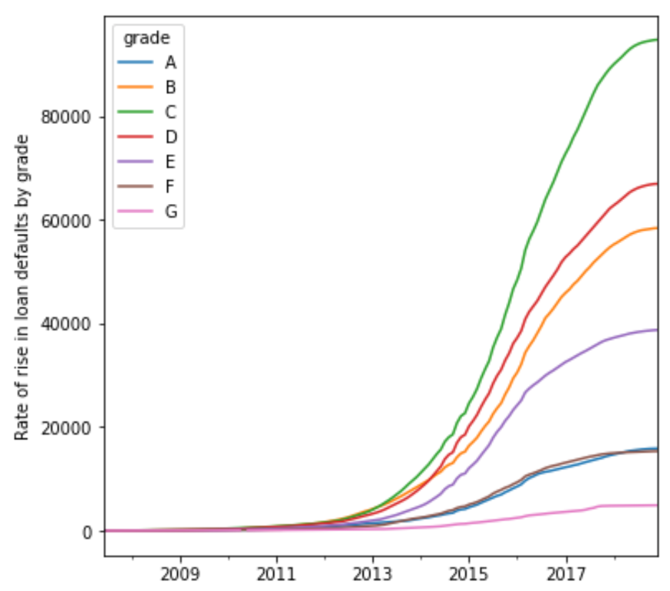
Relationship between rate of allocation of loans and rise in defaults

Slide 15
A machine learning approach

Slide 16
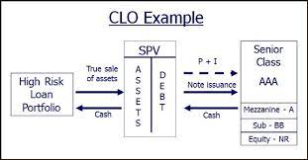
A Collateralized Loan Obligation application

Slide 17
Pool creation | Total no. of pools | Avg. pool size($mln) | Avg. pool interest rate(%) | Avg. DTI | Avg. Fico low | Avg. Fico high | Avg. total recovered principal($mln) | Avg. total recovered interest($mln) | Avg. senior tranche return(%) | Avg. subordinate tranche return(%) | Avg. equity tranche return(%) | WtAvg. pool return(%)
Random | 32 | 62.9 | 12.46 | 17.55 | 692.52 | 696.52 | 58.2 | 9.76 | 2.5 | 5 | 8.39 | 4.26
Xgb | 19 | 65.15 | 11.62 | 16.64 | 698.52 | 702.52 | 60.12 | 9.34 | 2.5 | 5 | 6.01 | 3.91
Neural Network | 20 | 65.3 | 10.28 | 16.43 | 700.82 | 704.82 | 62.2 | 8.62 | 2.5 | 5 | 8.57 | 4.29
Hybrid (Xgb+Nn) | 25 | 64.13 | 11.53 | 16.92 | 696.47 | 700.47 | 59.59 | 9.24 | 2.5 | 5 | 7.19 | 4.08

