Slide 1
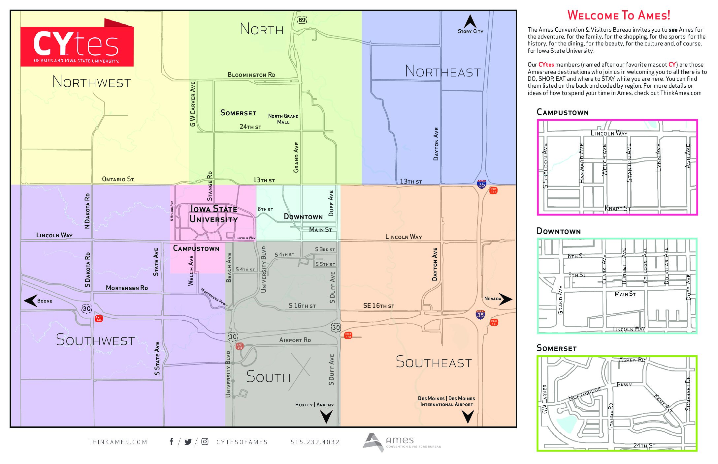
House Prices - Advanced Regression Techniques

Slide 2
Ames Housing Dataset
Variables | Number of | Purpose | Examples
Continuous | 20 | Various area dimensions | BsmtFinSF1, 1stFlrSF, 2ndFlrSF
Discrete | 14 | Number of occurences | Bedroom, Kitchen, TotRmsAbvGrd
Categorical - Nominal | 23 | Identify various types of items | Neighourhood, HouseStyle, BldgType
Categorical - Ordinal | 23 | Rate various items within property | OverallQual, PoolQC, Fence

Slide 3
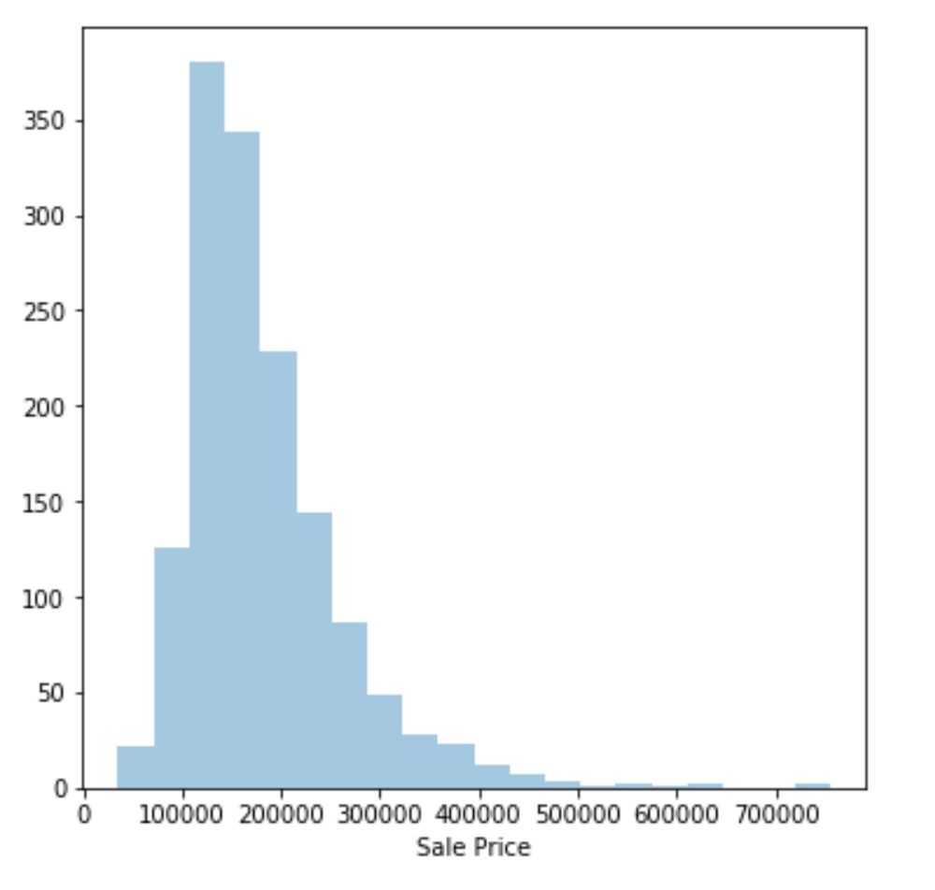
Target – Predicting Sale Price

Slide 4
EDA and Feature selection
SelectKBest
F_regression: Univariate linear regression tests. Linear model for testing the individual effect of each of many regressors.
Mutual_Info_Regression: Mutual information (MI) between two random variables is a non-negative value, which measures the dependency between the variables. It is equal to zero if and only if two random variables are independent, and higher values mean higher dependency.

Slide 5
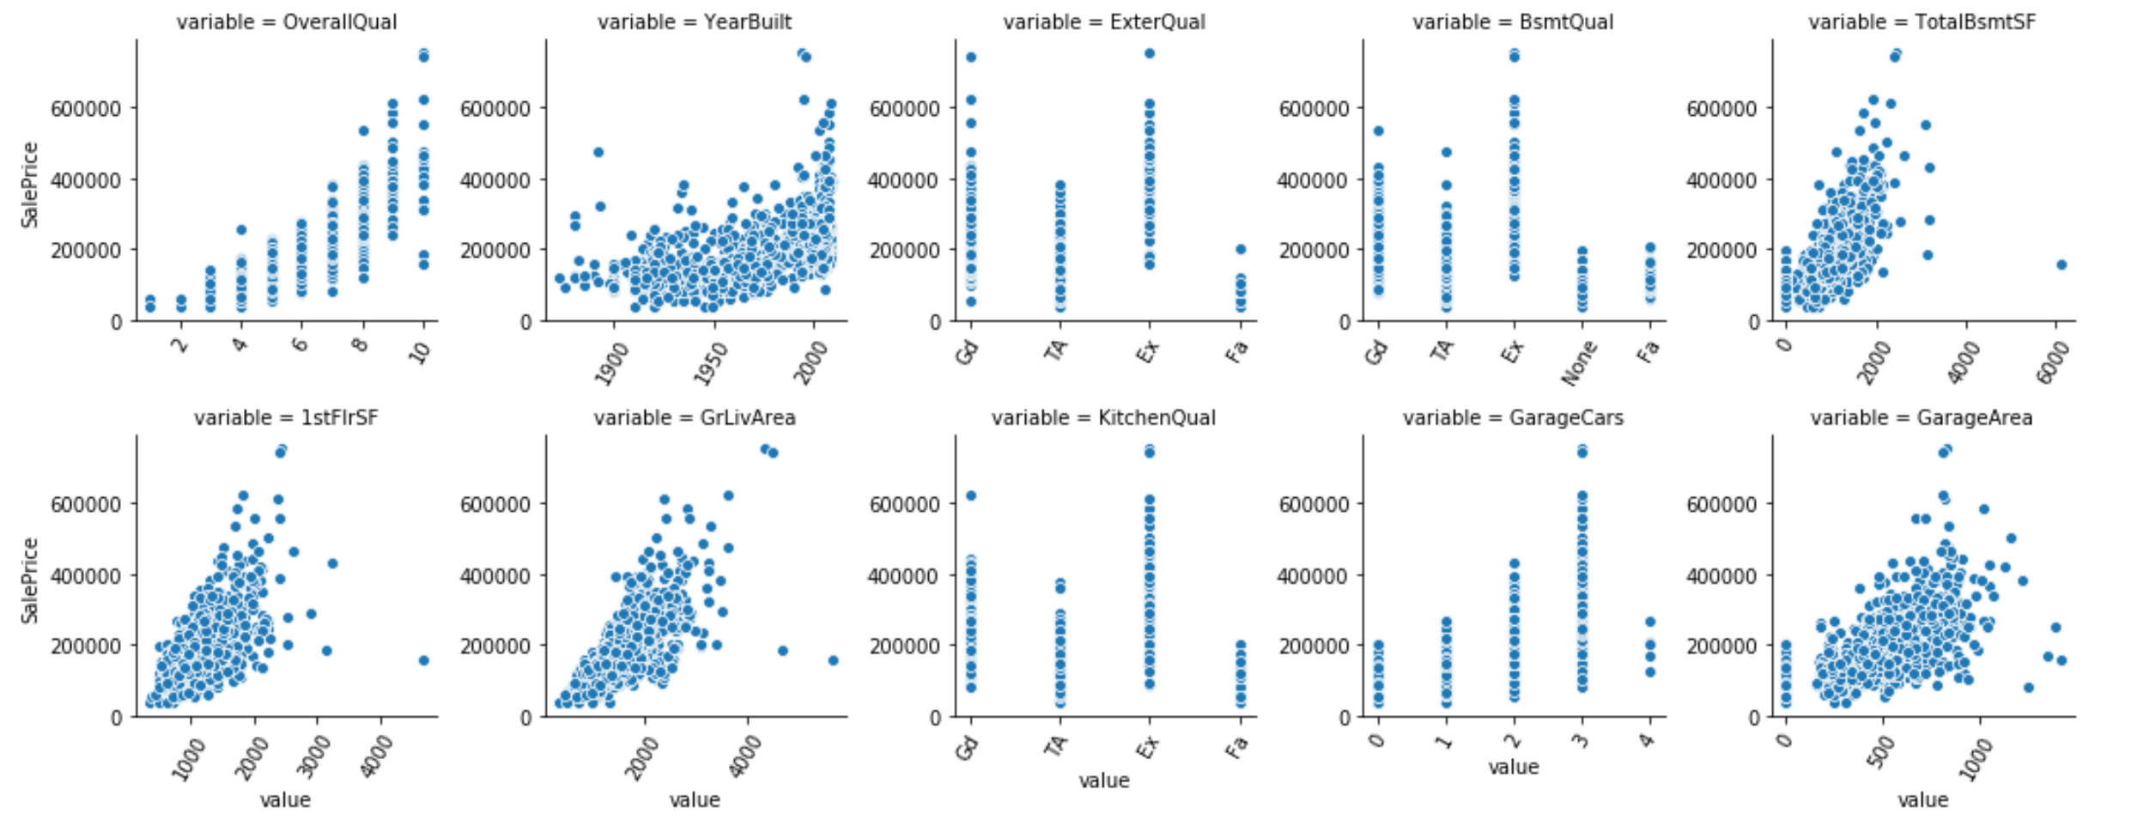
SelectKBest – F_regression

Slide 6
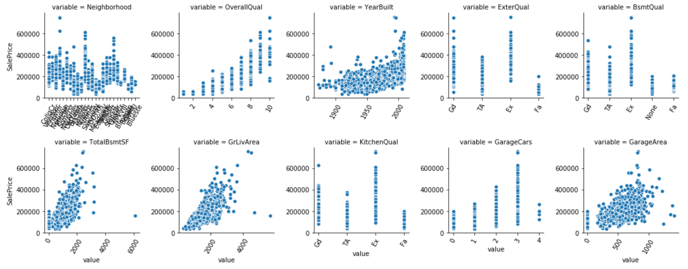
SelectKBest – Mutual_Info_Regression

Slide 7
Feature Comparison
F_regression |  | Mutual_Info_Regression
Features | Score | Features | Score
OverallQual | 2271.078037 | Neighborhood | 0.561490
YearBuilt | 1365.010950 | OverallQual | 0.508816
ExterQual | 1088.569431 | YearBuilt | 0.493831
BsmtQual | 906.479922 | ExterQual | 0.370663
TotalBsmtSF | 858.722738 | BsmtQual | 0.368770
1stFlrSF | 826.363181 | TotalBsmtSF | 0.363677
GrLivArea | 771.646539 | GrLivArea | 0.363104
KitchenQual | 726.321286 | KitchenQual | 0.325255
GarageCars | 713.963853 | GarageCars | 0.322886
GarageArea | 668.406649 | GarageArea | 0.313251

Slide 8
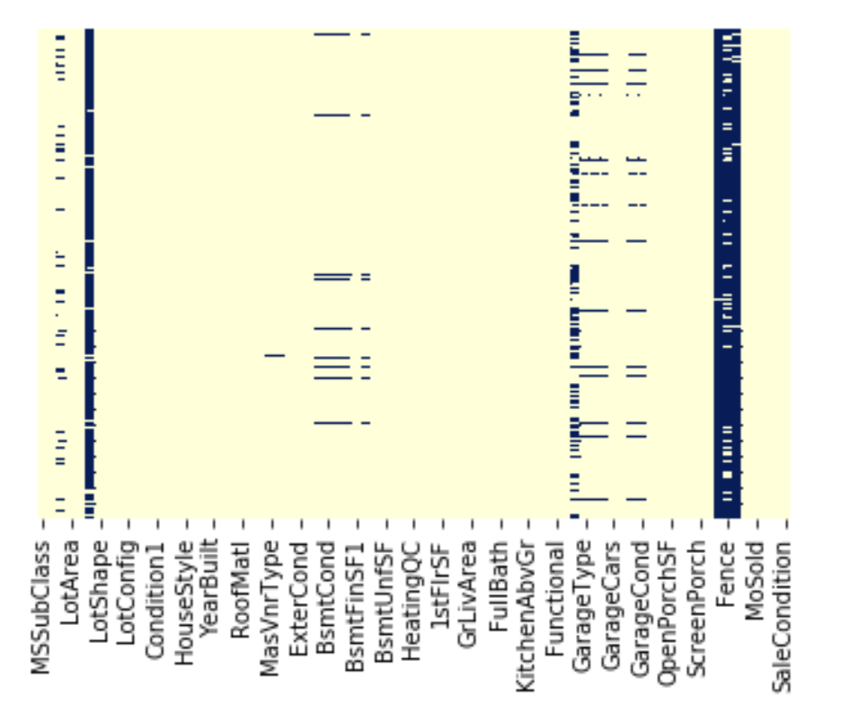
Data cleaning – Training dataset

Slide 9
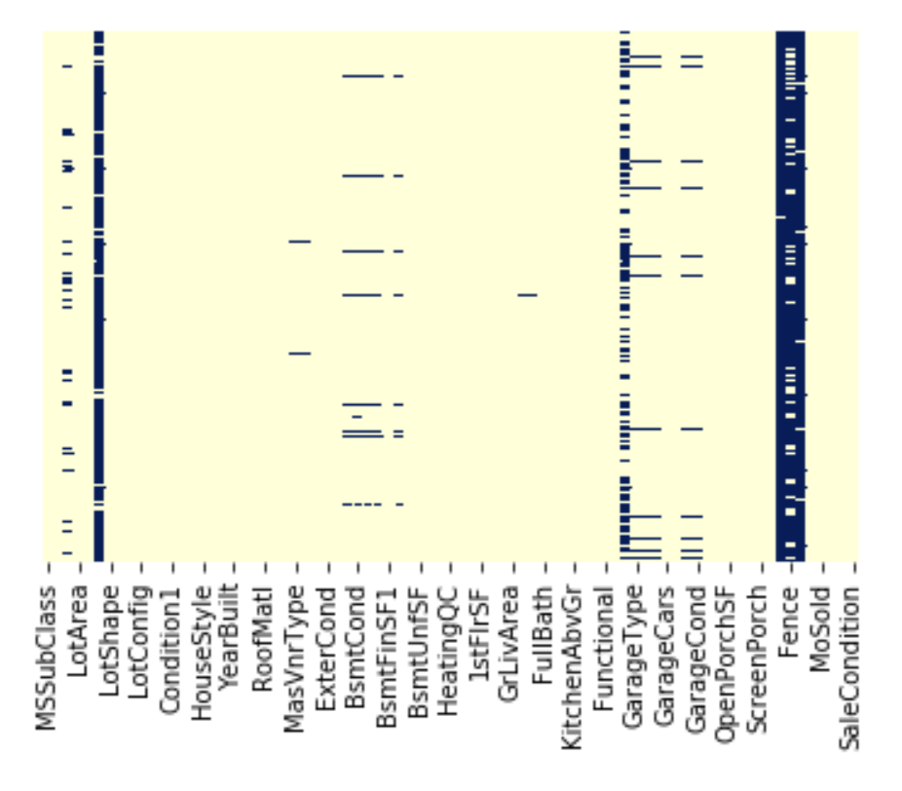
Data cleaning – Test dataset

Slide 10
Outliers
Features with outliers greater than 3 standard deviations in both training and test dataset
LotFrontage
LotArea
OverallQual
OverallCond
TotalBsmtSF
1stFlrSF
LowQualFinSF
GrLivArea
BsmtHalfBath
FullBath
BedroomAbvGr
KitchenAbvGr
TotRmsAbvGrd
GarageCars
GarageArea
3SsnPorch
ScreenPorch
PoolArea
MiscVal

Slide 11
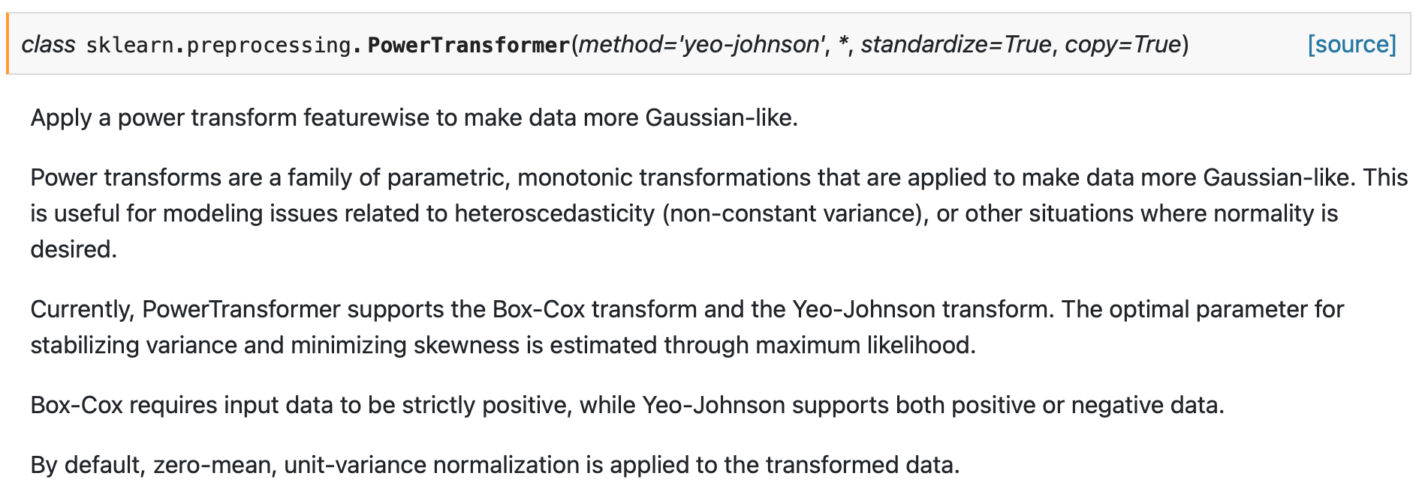
Data transformation
Dummify categorical variables in dataset for linear models
Ordinal encoding for categorical variables in dataset for non-linear models
Data normalization - PowerTransformer

Slide 12
Machine Learning
ElasticNet – SelectKBest, PCA
XGBoost
Neural Network
Support vector regression (SVR)
Stochastic gradient descent regression (SGD)

Slide 13
Results – Kaggle score
SelectKBest & ElasticNet |  |  |  | PCA (n_components=0.5) |  |  | PCA (n_components=0.90)
 | Total no.of features | F-Regression | Mutual Info Regression | Total no.of features | F-Regression | Mutual Info Regression | Total no.of features | F-Regression | Mutual Info Regression
K=50 | 50 | 0.17545 | 0.18548 | 103 | 0.17239 | 0.17654 | 211 | 0.15854 | 0.16233
K=100 | 100 | 0.16772 | 0.16741 | 150 | 0.16935 | 0.15890 | 243 | 0.16158 | 0.16080
K=200 | 200 | 0.16045 | 0.16421 | 238 | 0.16045 | 0.16105 | 292 | 0.16286 | 0.15911
Model | Score
XGB | 0.13262
Neural Network | 0.16364
SVR | 0.15758
SGD | 0.16502

