Slide 1
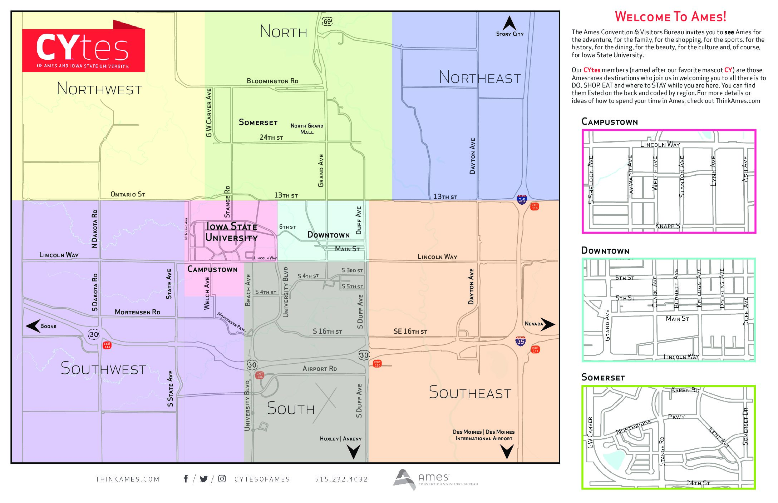
House Prices - Advanced Regression Techniques

Slide 2
Ames Housing Dataset
Variables | Number of | Purpose | Example
Continuous | 20 | Various area dimensions | BsmtFinSF1, 1stFlrSF, 2ndFlrSF
Discrete | 14 | Number of occurences | Bedroom, Kitchen, TotRmsAbvGrd
Categorical - Nominal | 23 | Identify various types of items | Neighourhood, HouseStyle, BldgType
Categorical - Ordinal | 23 | Rate various items within property | OverallQual, PoolQC, Fence

Slide 3
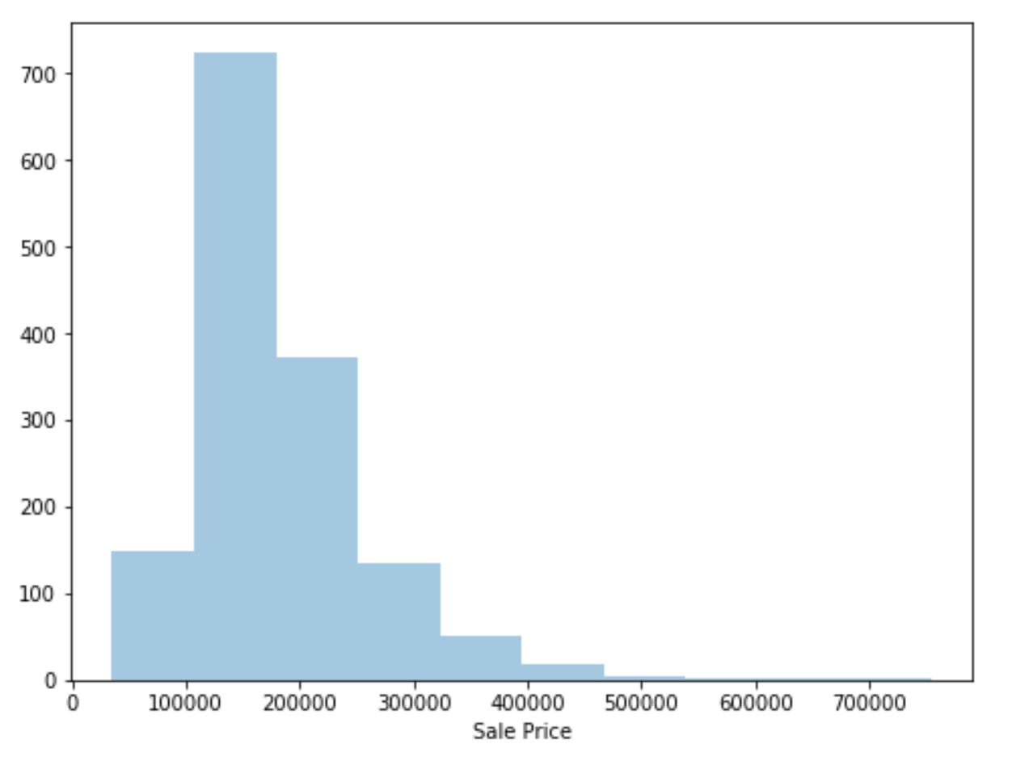
Target – Predicting Sale Price

Slide 4
Exploratory Data Analysis
In the next few slides we explore the top 10 features affecting sale price as per SelectKBest

Slide 5
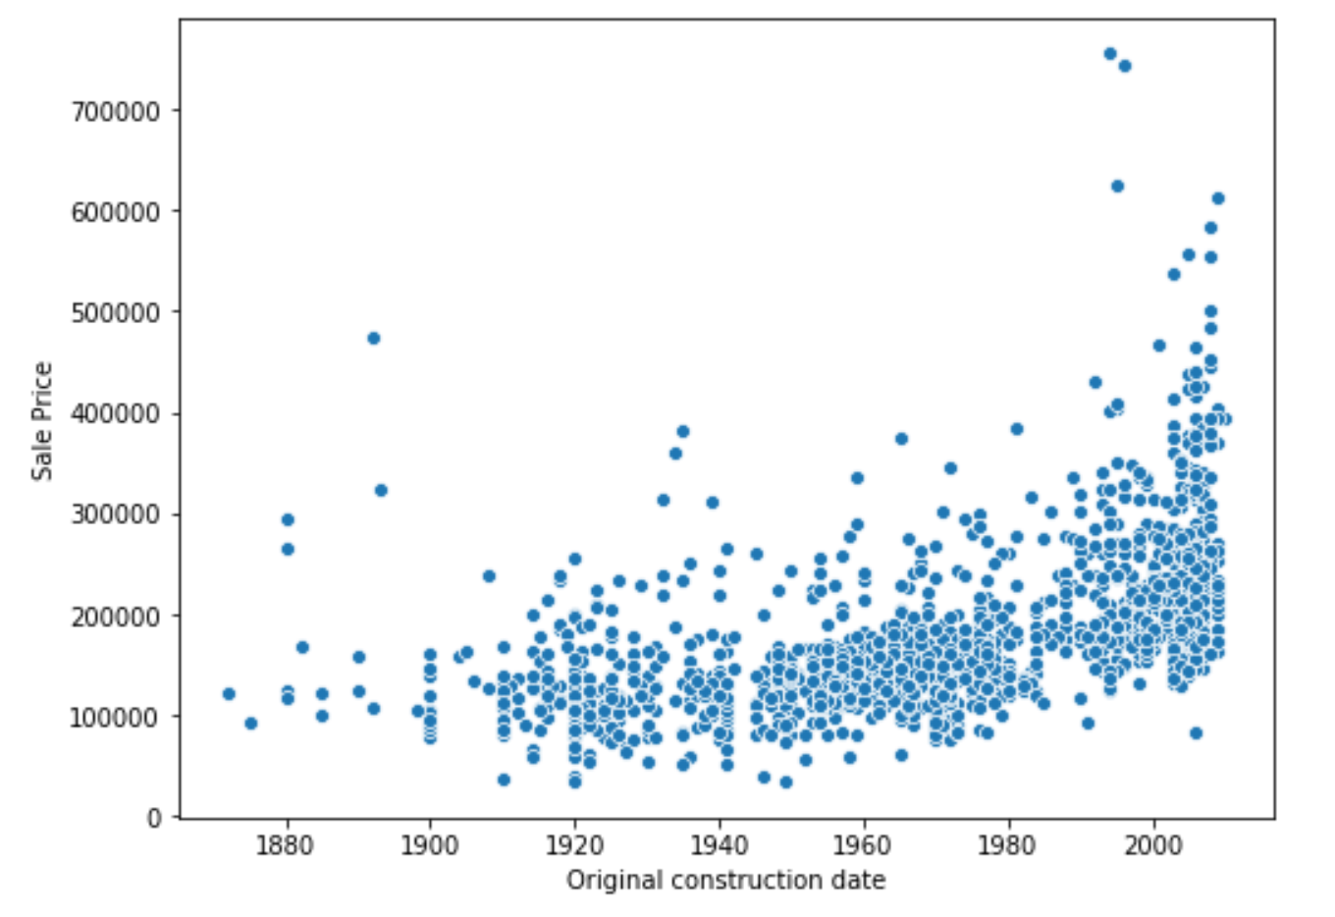
YearBuilt - Original construction date

Slide 6
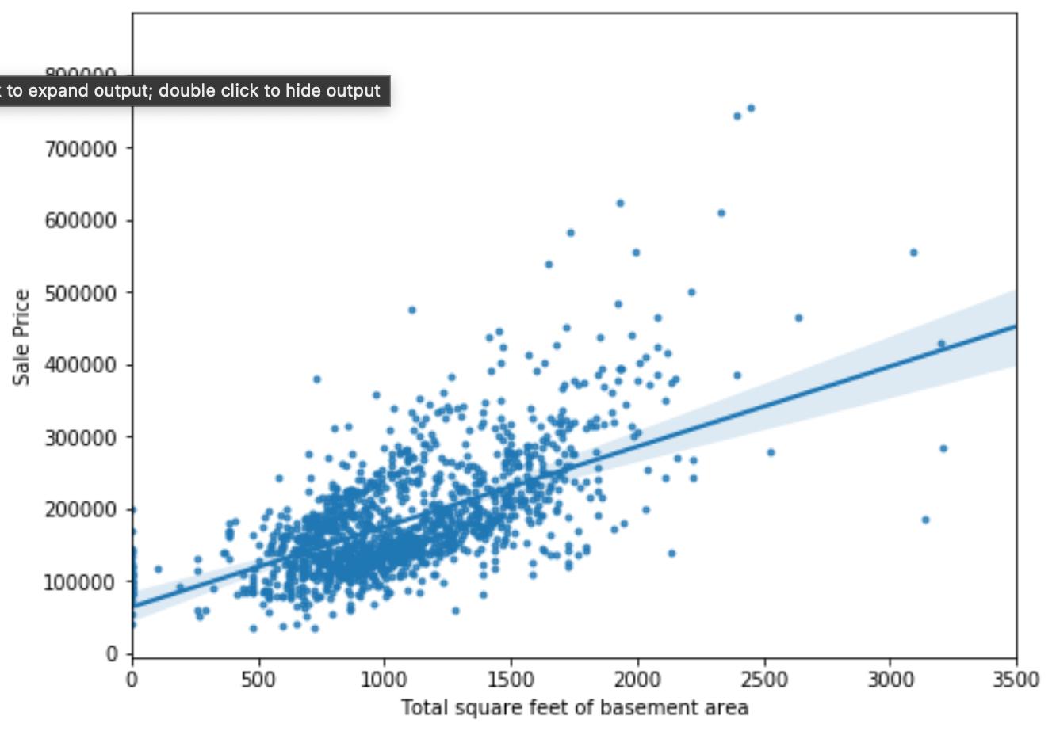
TotalBsmtSF - Total square feet of basement area

Slide 7
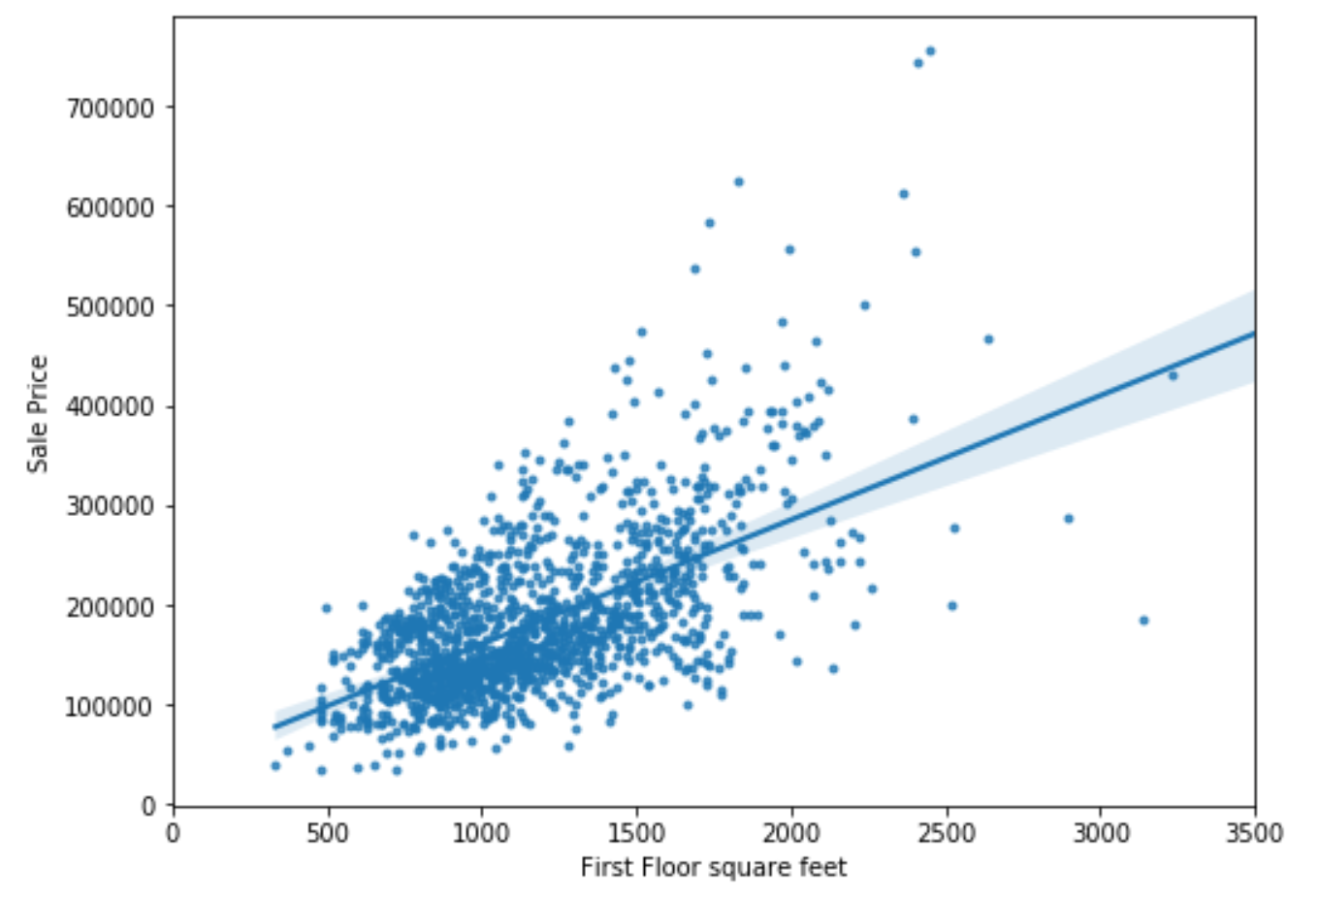
1stFlrSF - First Floor square feet

Slide 8
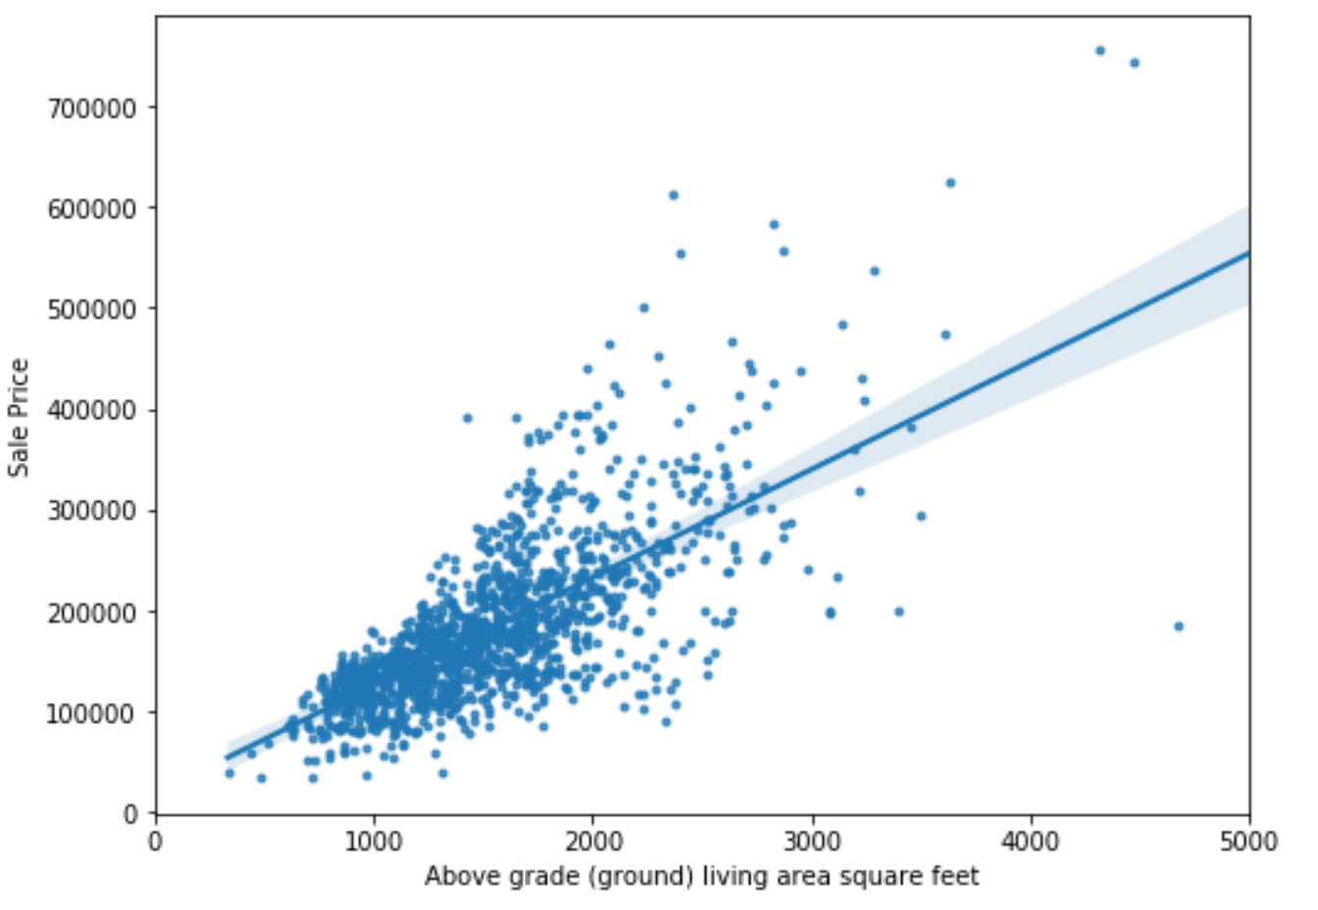
GrLivArea - Above grade (ground) living area square feet

Slide 9
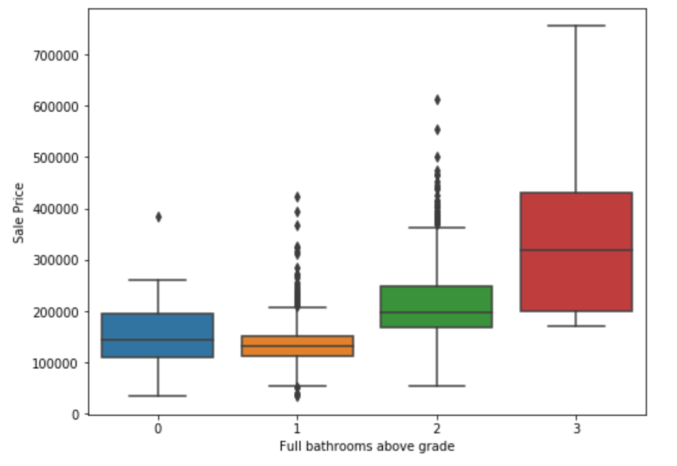
FullBath - Full bathrooms above grade

Slide 10
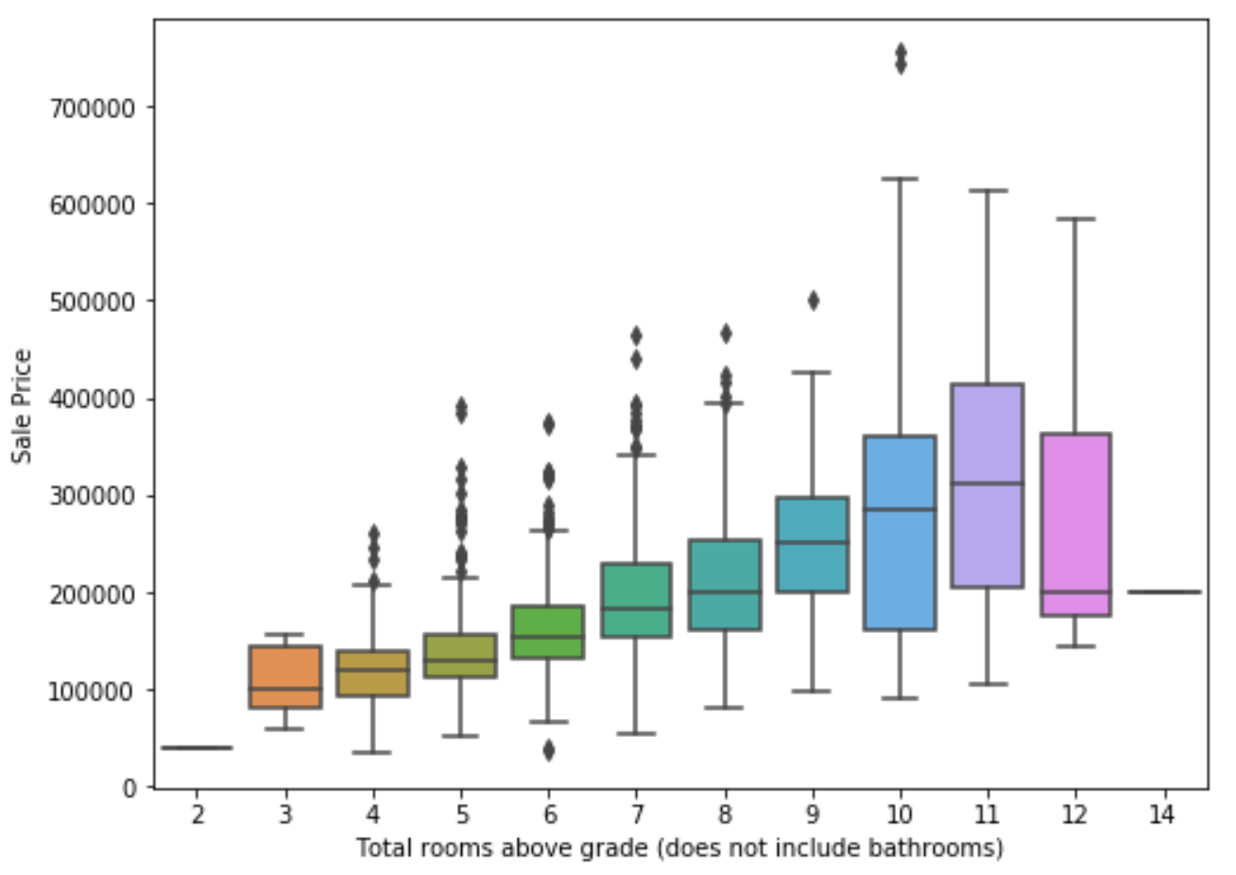
TotRmsAbvGrd - Total rooms above grade (does not include bathrooms)

Slide 11
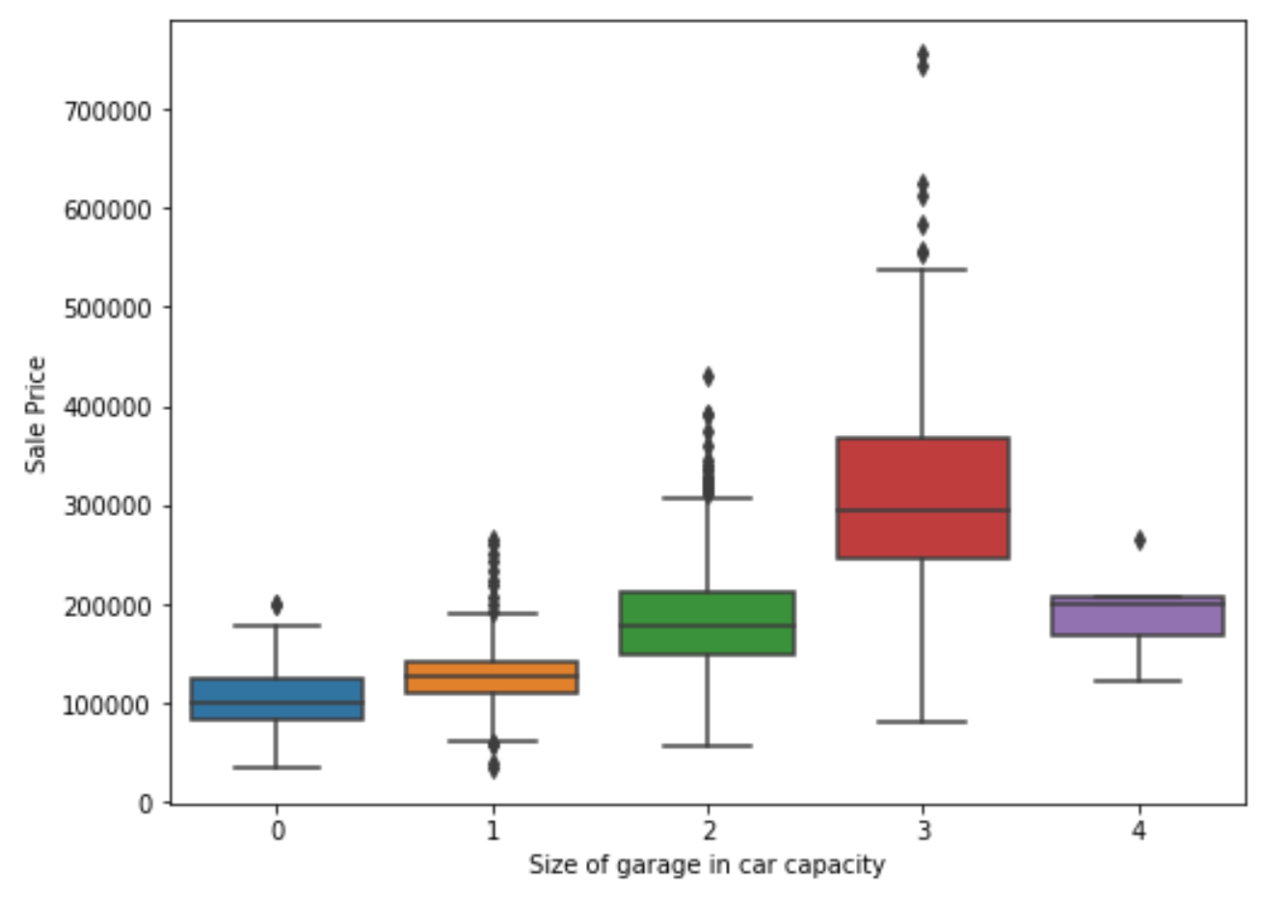
GarageCars - Size of garage in car capacity

Slide 12
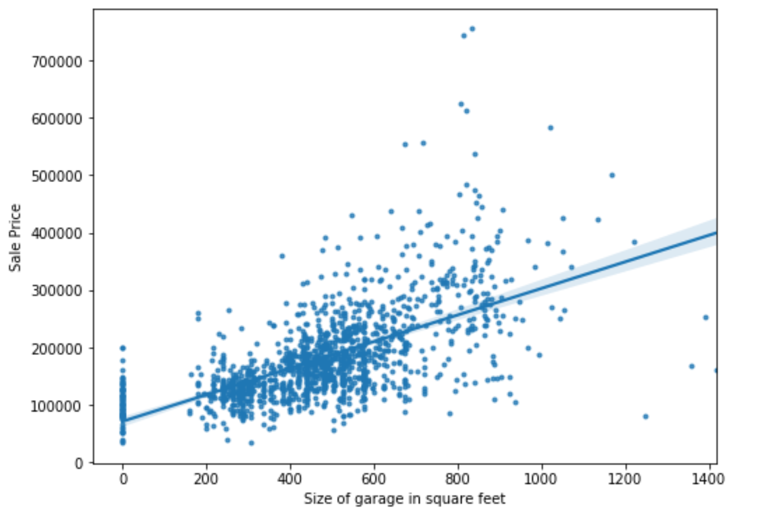
GarageArea - Size of garage in square feet

Slide 13
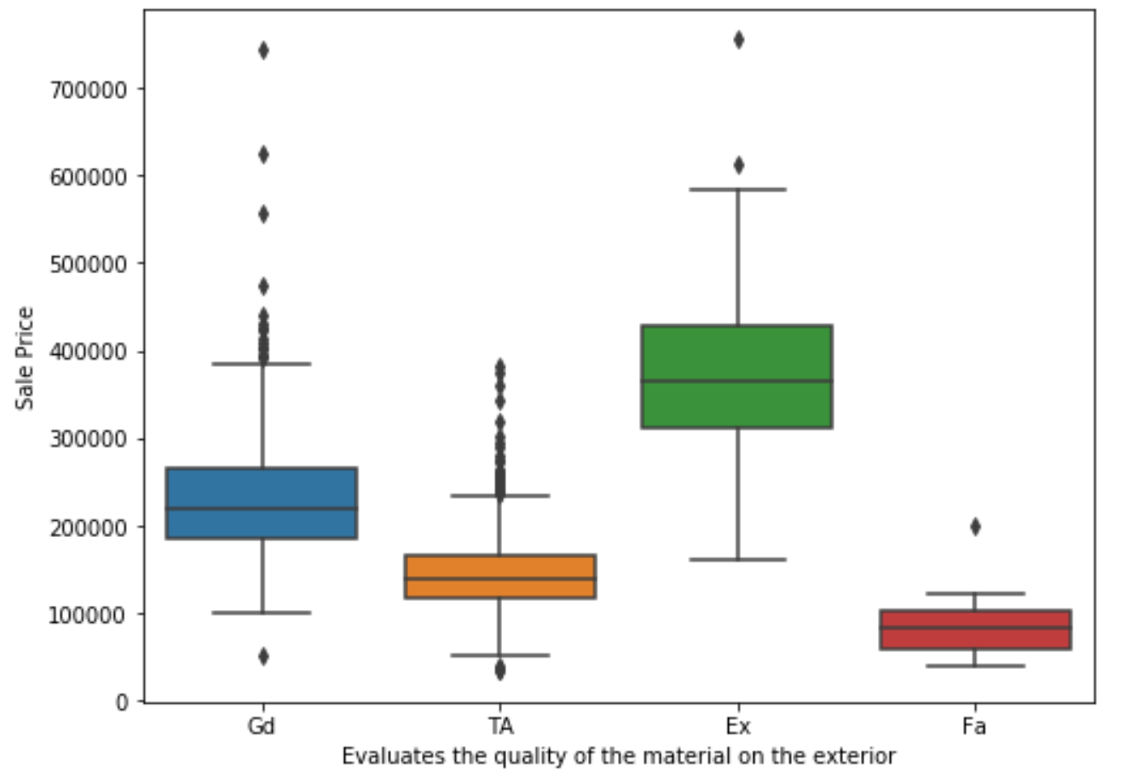
ExterQual - Evaluates the quality of the material on the exterior

Slide 14
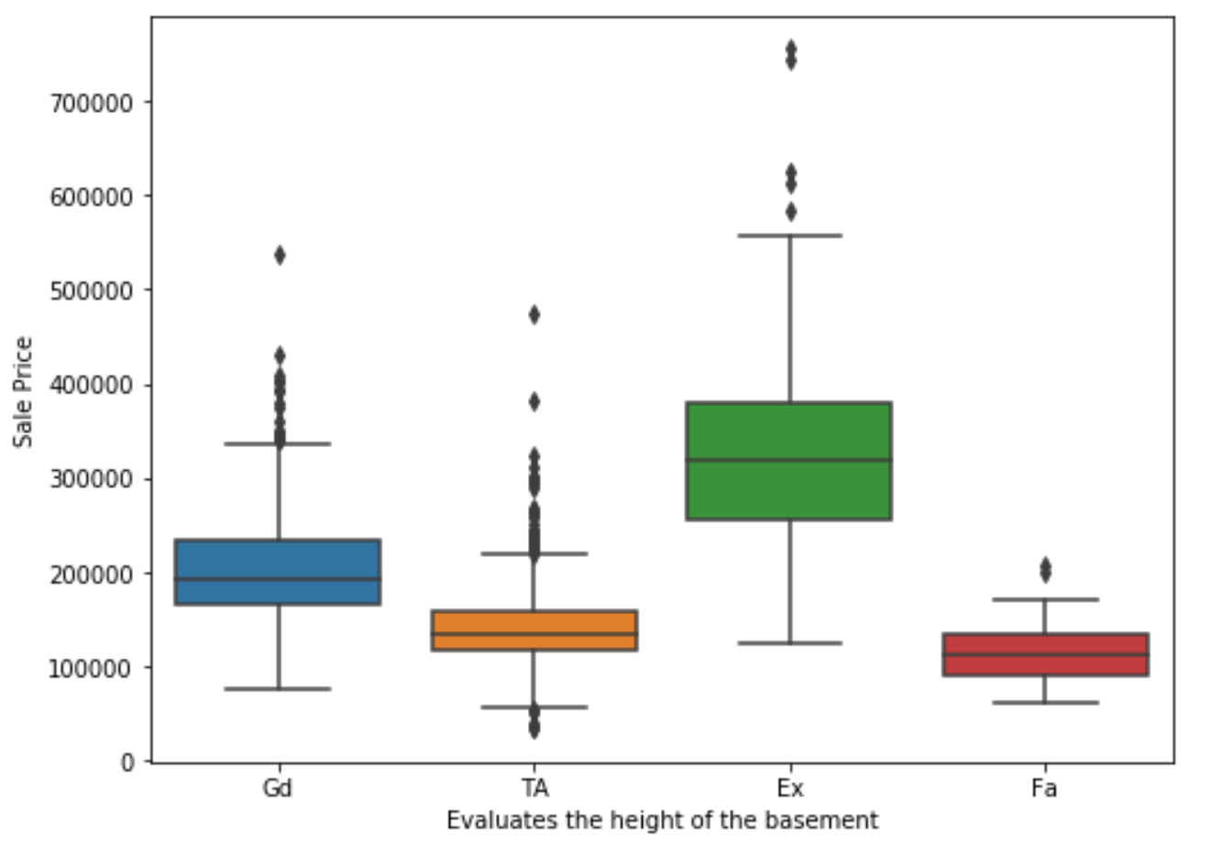
BsmtQual - Evaluates the height of the basement

Slide 15
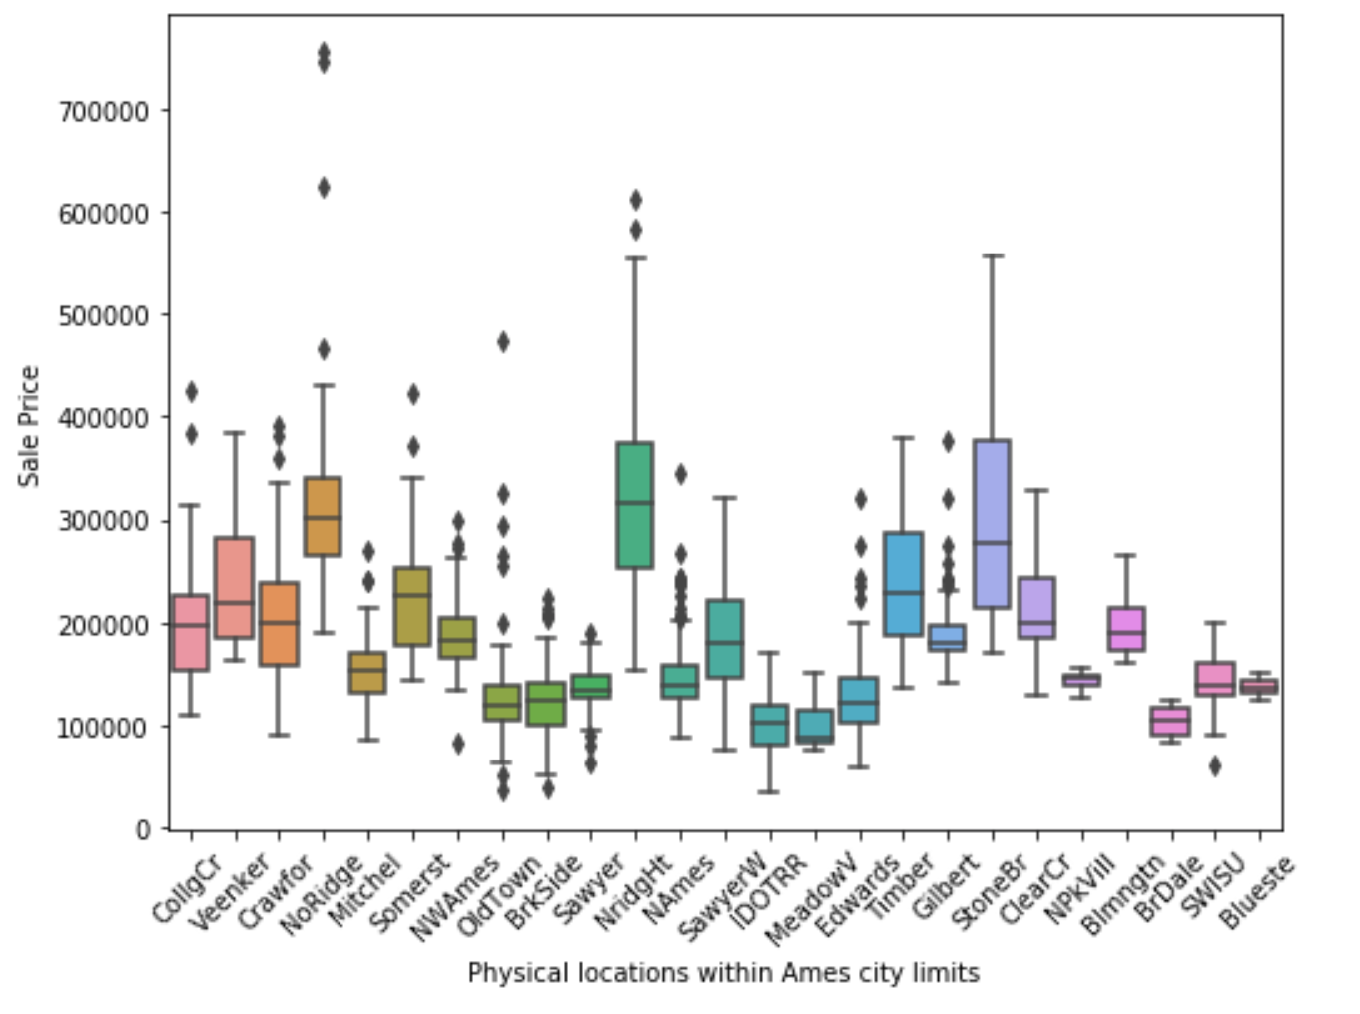
Neighborhood - Physical locations within Ames city limits

Slide 16
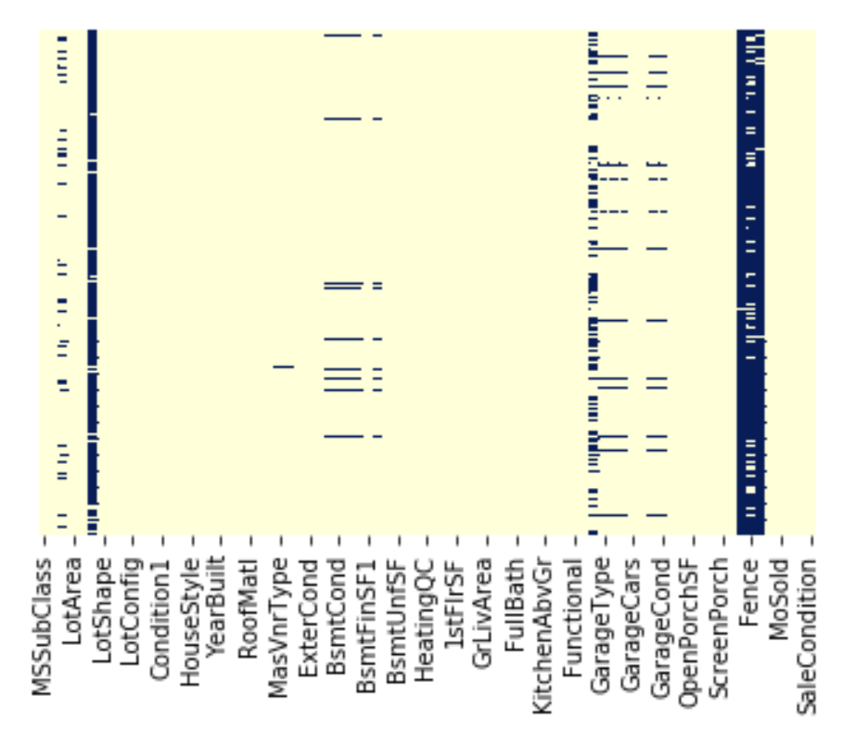
Data cleaning – Training dataset

Slide 17
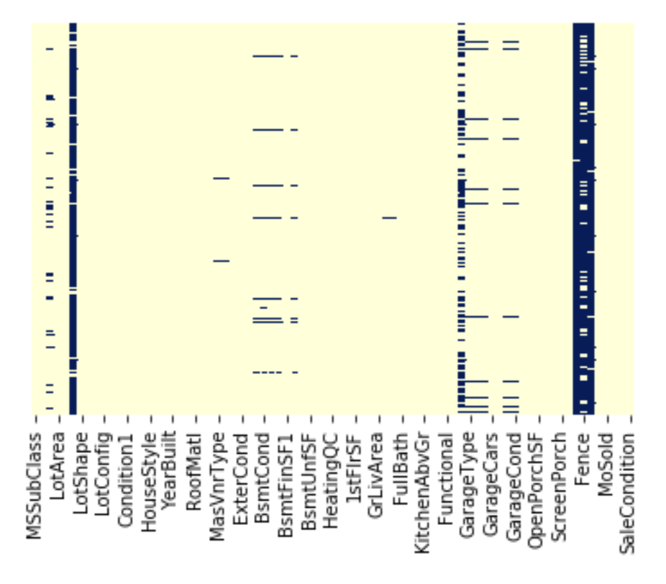
Data cleaning – Test dataset

Slide 18
Machine Learning
Dummify categorical variables
Data normalization - PowerTransformer
Feature selection – SelectKBest, PCA
XGBoost
Neural Network

Slide 19
Results – Kaggle score
 | Total no.of features | XGB | Neural Network
All | 331 | 0.14199 | 0.17159
SelectKBest |  |  |  | PCA (n_components=0.5) |  |  | PCA (n_components=0.90)
 | Total no.of features | XGB | Neural Network | Total no.of features | XGB | Neural Network | Total no.of features | XGB | Neural Network
K=50 | 50 | 0.15527 | 0.17962 | 68 | 0.14763 | 0.20869 | 132 | 0.14392 | 0.1882
K=100 | 100 | 0.14503 | 0.20495 | 118 | 0.14506 | 0.15935 | 175 | 0.13956 | 0.25393
K=200 | 200 | 0.14568 | 0.33725 | 209 | 0.14189 | 0.42776 | 245 | 0.14235 | 0.3308

