Slide 1
Building Ultra-Embedded Applications using SOM

Slide 2
Outline
Goals of the Hands-On Session
Introduction of the setup
Motivation
How to pace your hands-on
Ask for Assistance

Slide 3
Goal of this session
Help transition from cRIO to SOM
How to build and test simple embedded system
Ultimately Ultra-embedded system using COTS Hardware and reference designs

Slide 4
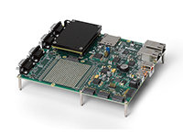
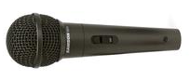


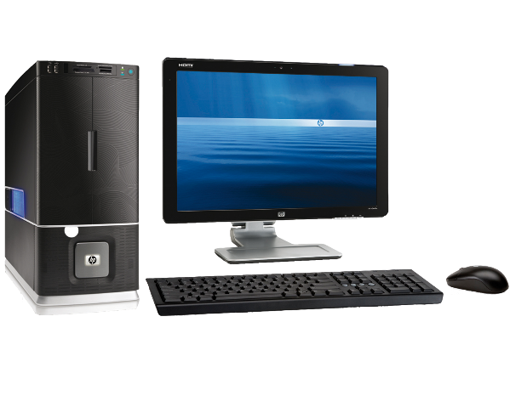
What will be you build?
Microphone
System on Module
(FPGA + RT)
Host Computer

Slide 5
Pacing your Hands-On
ADC Board
SPI Communication
Simulating I/O
RT Communication
Acquire Waveforms from FPGA
Transfer to Host
Host Communication
Setup Wireless
Acquire & Save from RT

Slide 6
Ask for Assistance
Just Raise your hand
Let us know if you have faulty hardware

