Slide 1
Building Ultra-Embedded Applications using System on Module (SOM)

Slide 2
Outline
Goals of the Hands-On Session
Introduction of the setup
Motivation
How to pace your hands-on
Ask for Assistance

Slide 3
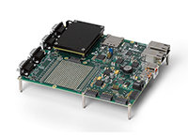
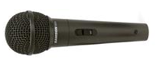


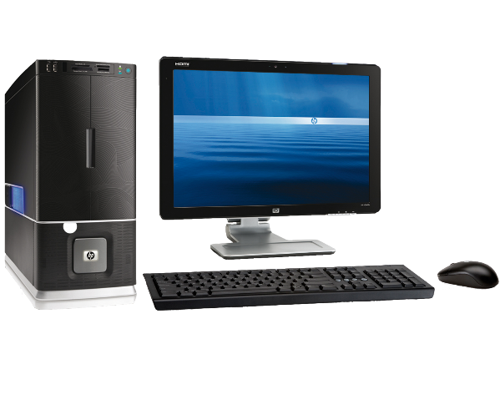
What you will build
Microphone
System on Module
(FPGA + RT)
Host Computer

Slide 4
Goal of this session
Build and Test Ultra-embedded system using COTS Hardware and reference designs
Help understand transition from CompactRIO to SOM
Understand FPGA Architecture for Embedded Systems

Slide 5
Pacing your Hands-On
ADC Board
SPI Communication
Simulating I/O
RT Communication
Acquire Waveforms from FPGA
Transfer to Host
Host Communication
Setup Wireless Connection
Acquire & Save from RT

Slide 6

Logistics
You will be working as Team of two people
Raise your hand for questions
Let us know if you have faulty hardware

