Slide 1
Scientific stream selection -map your tALENTS
By under the GUIDANCE OF
name : g . kalyan reddy K . VEERA JYOTHI MAAM
Roll no : 160118737028 ASST . PROFESSOR
name: : ch saiteja DEPARTMENT OF IT
Roll no : 160118737041 CBIT , HYDERABAD

Slide 2
contents
INTRODUTION
EXISTING SYSTEM
PROPOSED SYSTEM
SOFTWARE AND HARDWARE REQUIREMENTS
IMPLEMENTATION AND SCREENSHOTS
RESULTS
CONCLUSION AND FUTURE SCOPE

Slide 3
INTRODUCTION
The Mini Project titled "SCIENTIFIC STREAM SELECTION AND CAREER PLANNING" is for showing the Students career options that can be choosed on which their potentials are good.
As we are in the era of Modernisation , Education is the most important part of our life . Many Students who can Study well fail to choose the Right Path.
In Life you can become either a Passenger or a Pilot its your choice. Our Project focuses on showing them to choose Right Path.

Slide 4
Existing system
Existing system is a manual and is paper based this requirement for a lot of human effort. The question papers here are not secured. There can be redundancy of data. There can be errors in the preparations.
Maintainance is difficult process.
Guidance and counselling has been limited to few institutions therefore not all the students get the proper guidance.
Although some career guidance websites are present it charges huge fees which is not affordable by large group of society.
The students nowadays may find uncomfortable to approach a guide who is older in age this is due to generation gap.

Slide 5
Proposed system
In this system, questions can be stored and retrieved easily. The system checks the answer by matching the predefined answers in the database and user’s answers.
In this system, the students have to select the class and their branch, then the test is conducted, after the test they can check their marks. Based on their marks and branch selected branch we suggest them the best colleges priority wise.
3. The admin can see the details of all the users who are registered in to this system.
4. In this system, the students can ask for the queries and will be given by the admin in order to solve the problems of the students.

Slide 6
software and hardware requirements
LANGUAGE : C++
PLATFORM : DEV C++
OPERATING SYSTEM : WINDOWS 10 PRO – 64 BIT
PROCESSOR : INTEL® CORE™i7 8th GENERATION
MEMORY : 8192 MB RAM

Slide 7
implementation
Modules in our Project :
Student Register
Student Login
Admin Login
Ask a Query

Slide 8
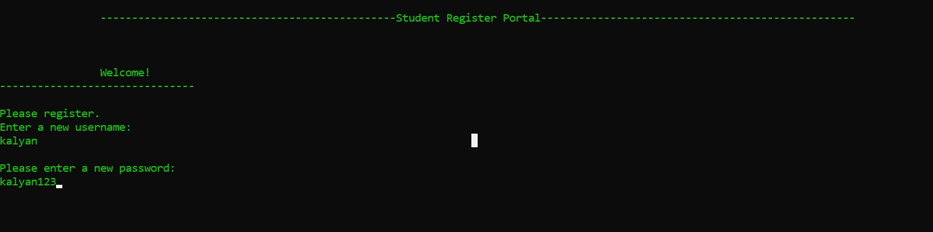
STUDENT REGISTER MODULE
We have given a choice for the student to register by a new Username and Password.

Slide 9
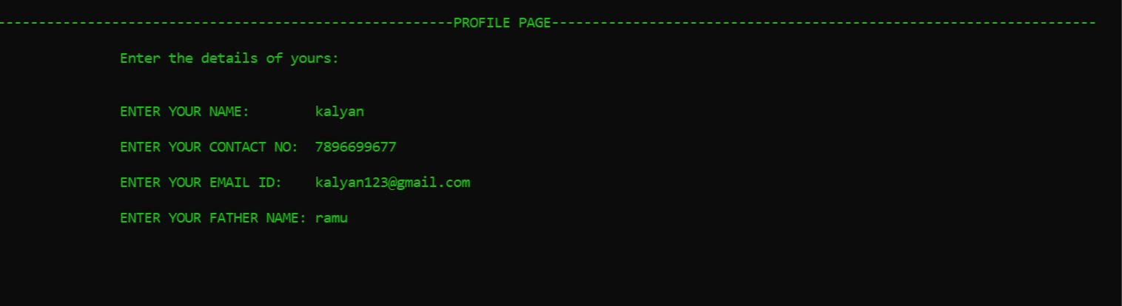
1. Student details like Name , Contact no , Email-id , Father Name are saved into a file after Registering . 2. Registered Username and Password are saved into another file.

Slide 10
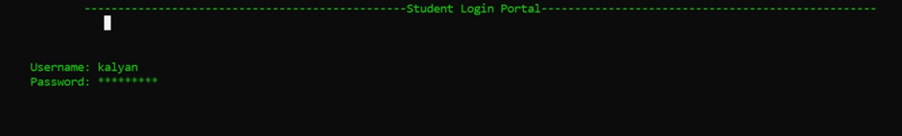
STUDENT LOGIN MODULE

Slide 11
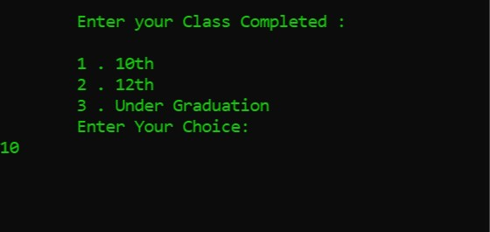
1. After logging in successfully student must enter the class completed

Slide 12
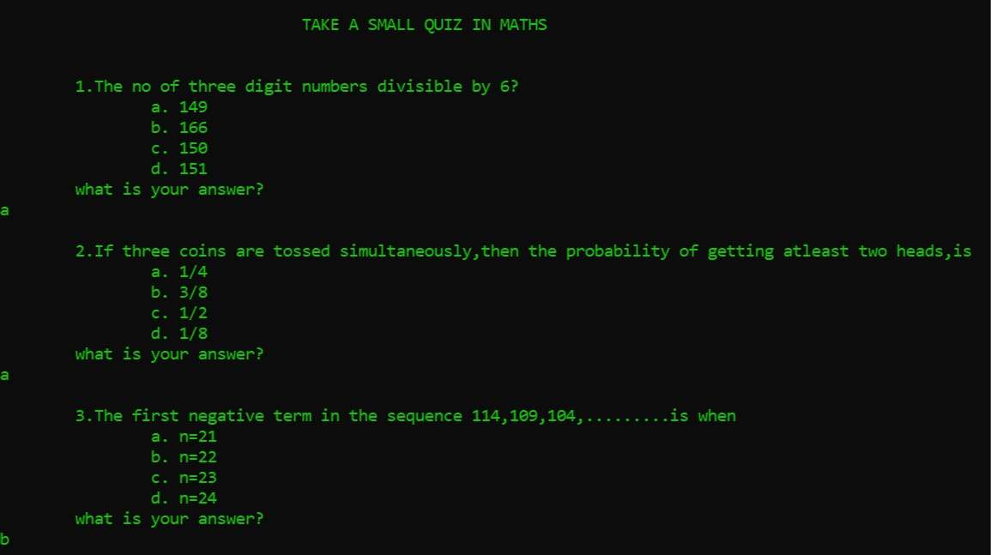
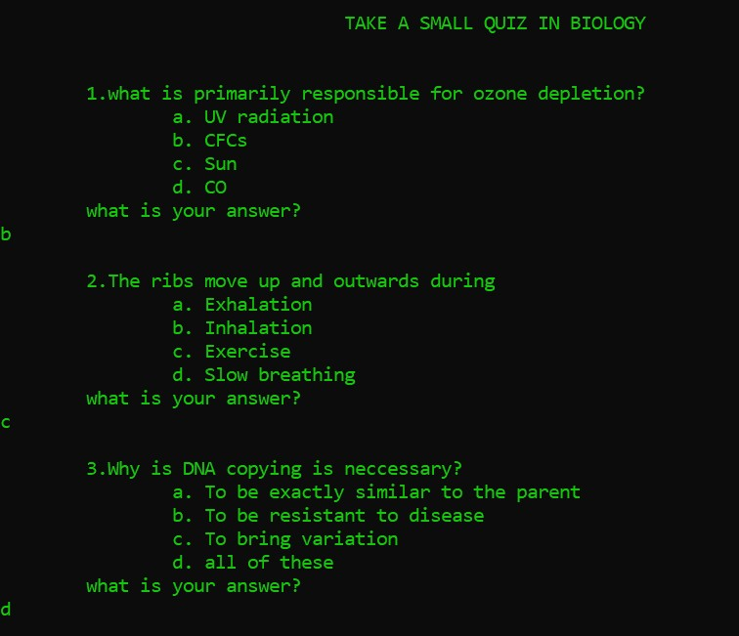
2.If the class completed by the user was 10 th , We conduct a simple test on maths and biology .

Slide 13
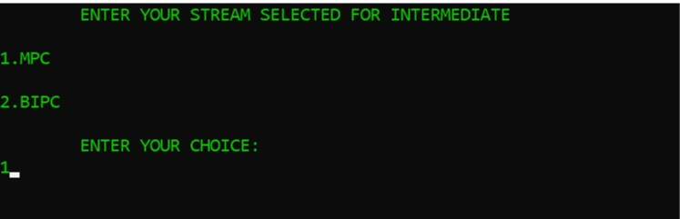
3.If the class completed by the user was 12 th We take the stream choosen by user for Intermediate. Student must choose their respective stream (mpc or bipc).

Slide 14
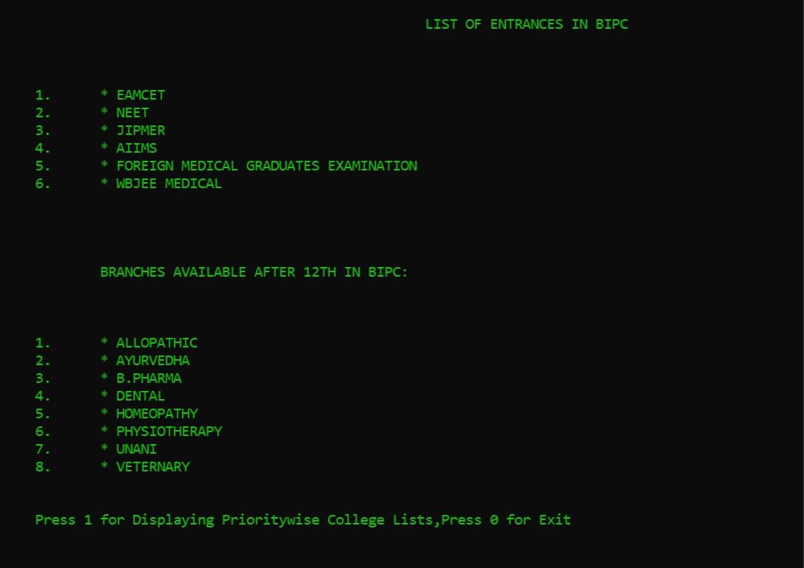
4.We display List of Entrances and their details in user’s selected stream. 5.We also display the branches available for BIPC students after 12 th.

Slide 15
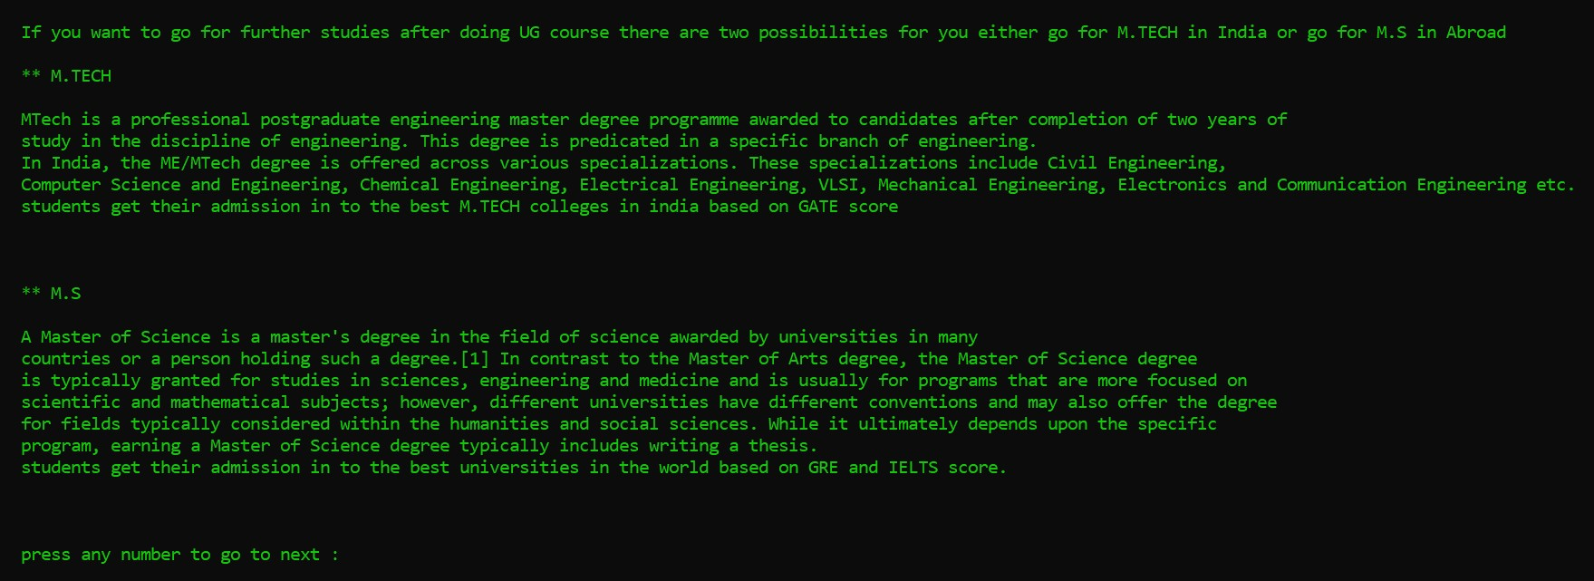
6.If the class completed by the user was Undergraduate. We suggest user, possibilities after Undergraduation (M.S, M.tech).

Slide 16
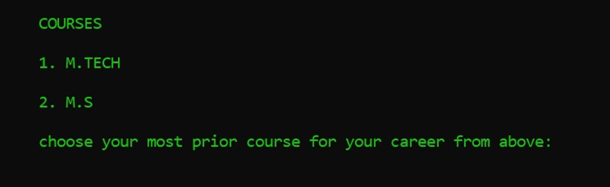
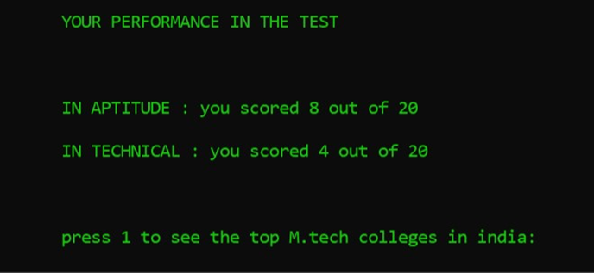
7.User need to choose in which he is willing to go. 8.A simple test is conducted to view their performance in respected stream.

Slide 17
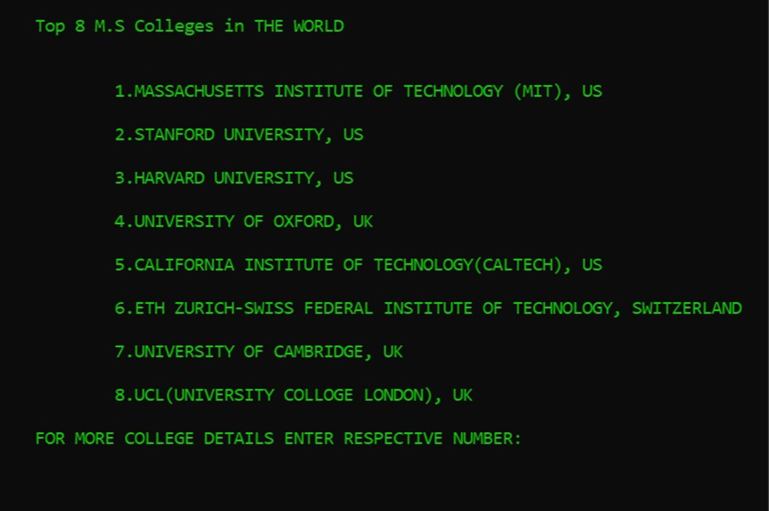
9.User performance is displayed and user can know top colleges in the respected stream. 10.College details can also viewed at a time.

Slide 18
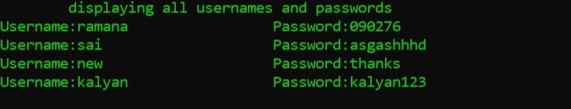
ADMIN LOGIN 1.Admin must login by his unique username and password. 2.Admin can access all details of registered users.

Slide 19
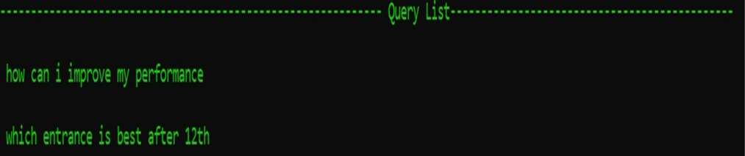
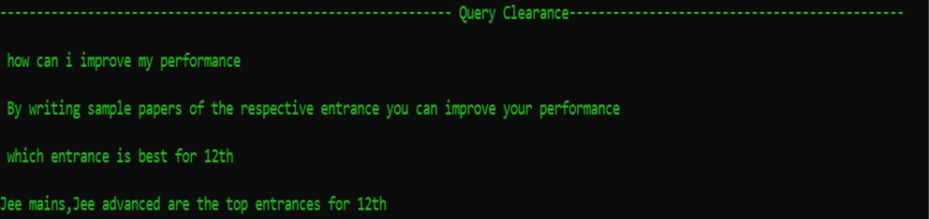
3. Admin can view all the queries asked by the users. 4.Admin can reply to the queries asked by the users.

Slide 20
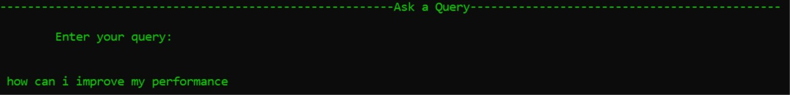
ASK A QUERY 1. Users can ask queries and get answer for those queries. 2.Queries asked are sent to admin and will be replied soon.

Slide 21
conclusion
Students bright future is crucial for development of the country. This is why in this paper we have tried to present a model for guiding the student to their best appropriate pathway. So, they can excel in their professional career.
The opportunities provided by the technology is immense and many students can make use of this platform to choose their career more appropriate to their skills.
Various challenges in manual career guidance system has been recognised to design effective online career guidance system. Implementing this system will help young ones to choose right career path that best suits them.
This system will fulfill the needs of fast and reliable access to information that is needed to make right career choice.
This system provides associated benefits ; making the student architect of their own career.

Slide 22
Future SCOPE
There is considerable scope for improvement, and many changes can be made to enhance this project. These includes:
A smoother user interface.
Adding the details of the colleges in each state and displaying them priority wise based on their selected stream and entrance.
Adding the new feature “Giving Feedback” which makes us to still work more on this project to make it Effiecient.
A permanent web portal that will allow a user to select the stream for the career, and a way to integrate the project with the HTML, CSS JAVASCRIPT.

Slide 23
RESULTS
Our Project helps many students as we have shown above.
Students can choose their appropriate stream which suits them.
Students will know their performance at present , and they will try to improve.
If users have any queries are also cleared by our project.

