Slide 1
Fraud Detection in Mobile Financial Transactions Using Machine Learning
- D. Kalyan Varma

Slide 2
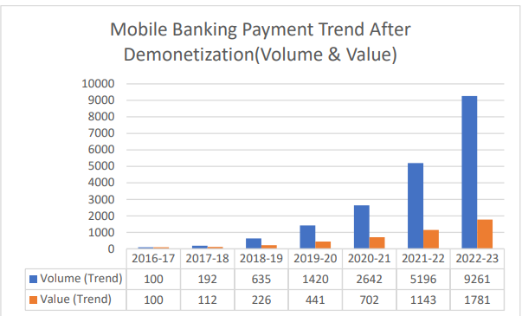
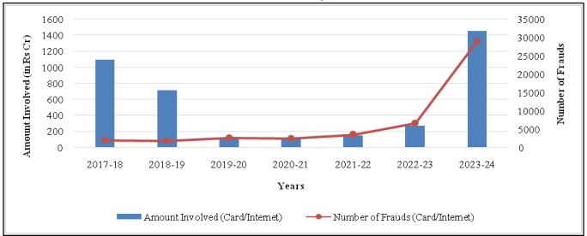
Introduction
Rapid growth of mobile banking has increased the need for advanced risk management.
Fraud threatens financial stability, customer trust, and institutional reputation.
Machine learning enables proactive fraud detection and prevention.
Objective:
The objective is to develop a real-time machine learning system to detect fraudulent transactions and minimize financial risk.
The challenge is detecting fraud accurately while avoiding false positives. since most transactions are legit
https://www.researchgate.net/publication/383921055_Growth_Of_Mobile_Banking_In_India_Comprehensive_Study
https://www.hansrajcollege.ac.in/uploads/researchinnovation/callforpapersposter/issue3_vol3/Paper%205.pdf

Slide 3
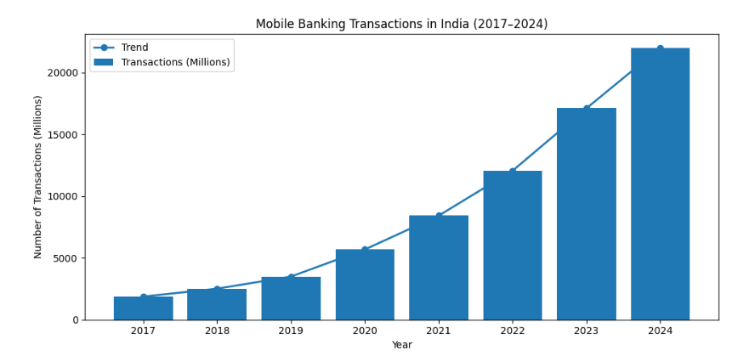
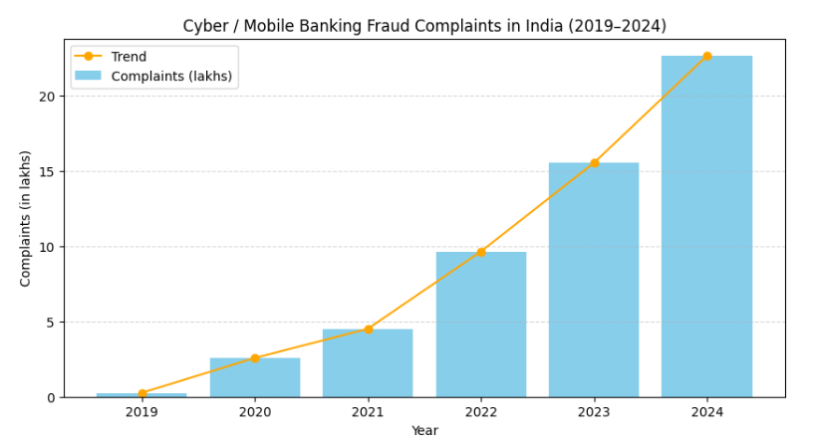
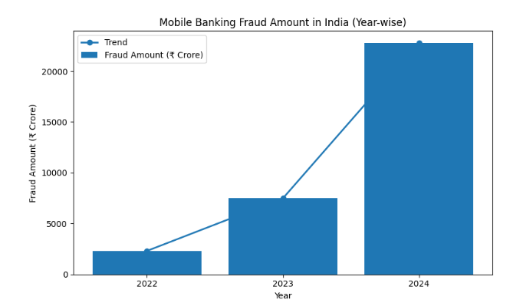
Problem Statement
Fraud transactions are difficult to distinguish from genuine ones
Manual review is inefficient and costly
High transaction volume requires automation
Need for fast, accurate, and scalable solution
These are not exact numbers.
Based on RBI-reported trends

Slide 4
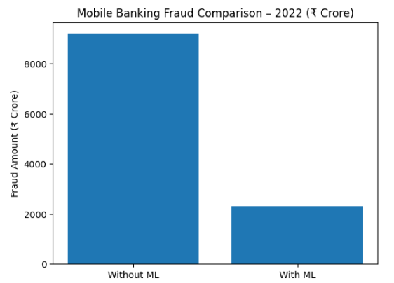
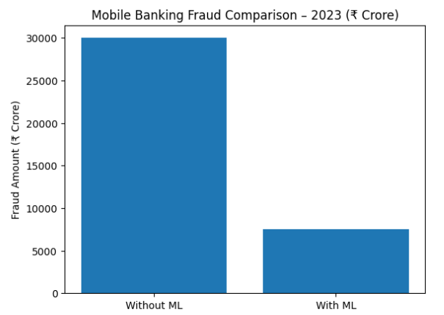
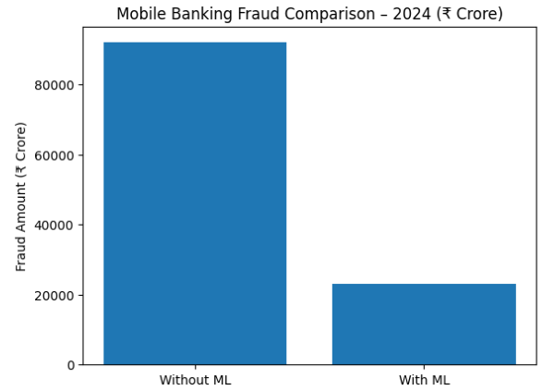
Motivation
Mobile banking growth has increased fraud risks.
Fraud losses are rising rapidly each year.
Conventional detection methods are no longer sufficient.
Machine learning helps significantly reduce fraud impact. (Assuming the machine learning model detects 75% of fraud transaction)
https://analyticsindiamag.com/ai-news-updates/india-lost-%E2%82%B922812-crore-to-cyber-fraud-in-2024-report/
https://rmaindia.org/indias-cyber-fraud-losses-soar-206-to-%E2%82%B922845-crore-from-2024/

Slide 5
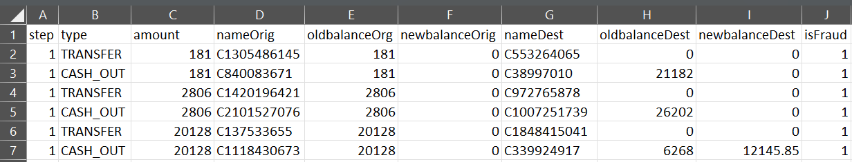
Dataset Overview
Historical mobile transaction dataset.
This dataset contains (11.14K transactions)
Each record represents one transaction.
Target variables: isFraud Binary indicator (1 for fraudulent, 0 for legitimate)

Slide 6
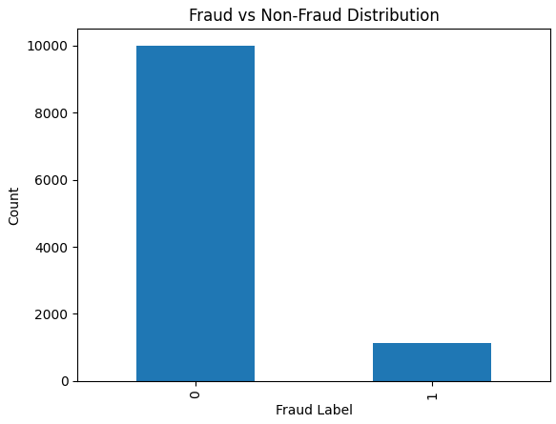
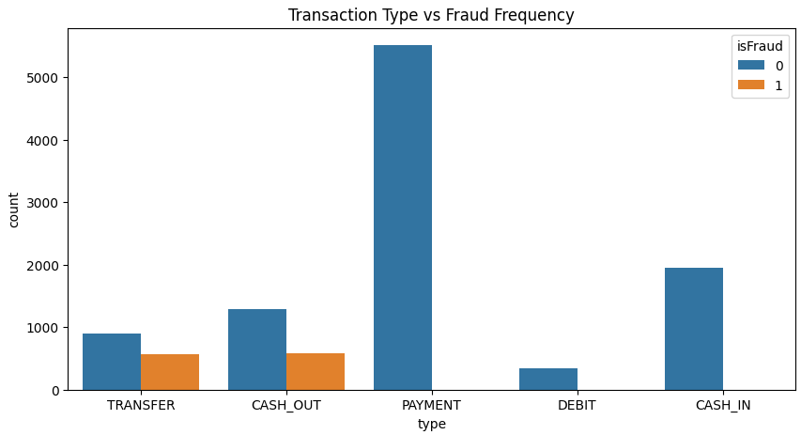
EDA Key Findings
In this data set as we can see that the class imbalance in feature variable.
zero indicate non-fraud transaction.
one indicate fraud transaction.
The fraud transaction are mainly occurred in TRANSFER and CASH_OUT transaction type in this data set.
CASH_OUT 578.
TRANSFER 564.
Fraud transactions mostly involve large amounts.
Total Fraud Amount: 1361982240.43.
Total Non_Fraud Amount: 1013397286.3799999.

Slide 7
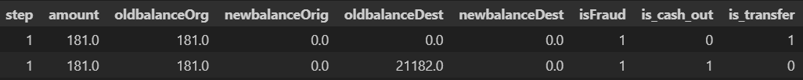
Data Pre-processing
Before
After
Handled missing and inconsistent data
Encoded categorical variables into numeric form
Normalized numerical features
Addressed class imbalance using resampling techniques

Slide 8
Feature Engineering
Machine learning algorithms work with numerical data. We need to convert categorical variables into numerical format using techniques like one-hot encoding (dummy variables).
According to Transaction Type vs Fraud Frequency visualization. we get to know that the fraud is happen only in TRANSFER and CASH_OUT type transaction.
since fraud transaction happens only in these two types of transaction, i will only use that data.
since Machine learning algorithms work with numerical data. We need to convert those two from categorical variables into numerical format.
df1['is_cash_out'] = (df1['type'] == 'CASH_OUT').astype(int)
df1['is_transfer'] = (df1['type'] == 'TRANSFER').astype(int)
Converting categorical labels into numerical labels

Slide 9
Model Development
Logistic Regression
Used as a baseline. A linear model providing high interpretability but often lower performance on complex, non-linear fraud patterns.
Decision Tree & Random Forest
The Decision Tree offers clear, rule-based decision paths, while the Random Forest leverages an ensemble of trees for increased robustness and variance reduction.
XGBoost (Extreme Gradient Boosting)
A high-performance boosting framework known for its speed and state-of-the-art predictive accuracy in structured data competitions.
K-Nearest Neighbors (KNN)
A non-parametric, distance-based classifier suitable for understanding local data structures and anomalies in the feature space.

Slide 10
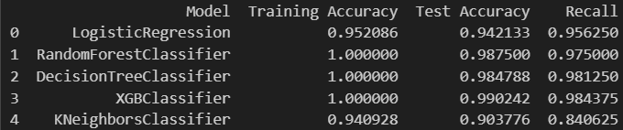
Best-Fit Model Selection
After training of 5 different models(Logistic Regression, Decision Tree, Random Forest, XGBoost and K-Nearest Neighbors)
Selected top 3 performing model by using performance metric like roc_auc and recall.
Selected models :
Models | Training Accuracy | Test Accuracy | Recall
RandomForestClassifier | 1.000000 | 0.987500 | 0.975000
DecisionTreeClassifier | 1.000000 | 0.984788 | 0.981250
XGBClassifier | 1.000000 | 0.990242 | 0.984375

Slide 11
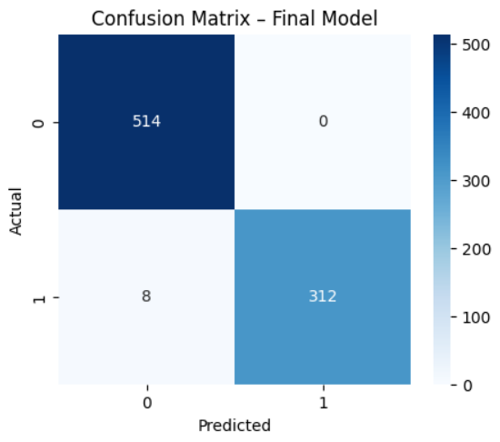
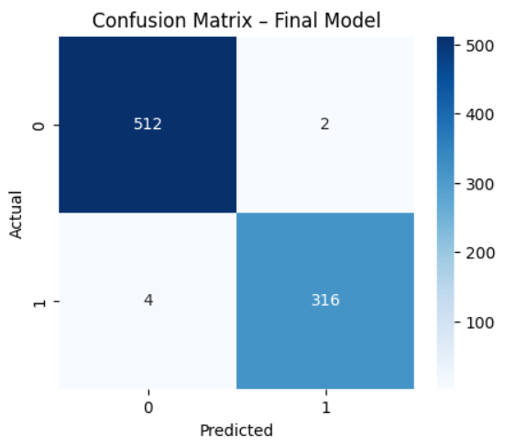
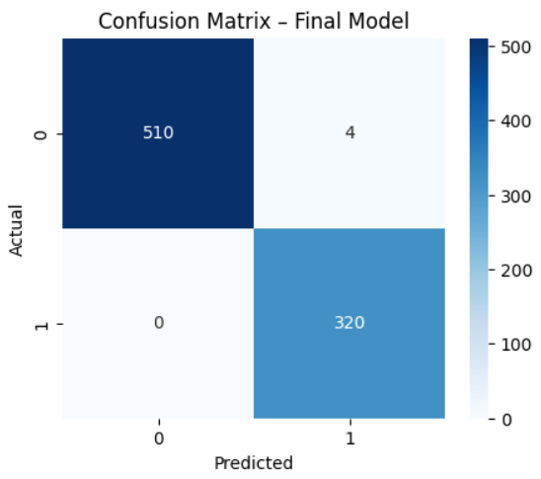
Model Evaluation: Performance Metrics
Evaluation of models by using confusion matrix
RandomForestClassifier
DecisionTreeClassifier
XGBClassifice
Based on the confusion matrix, the random forest model performs best as it achieves zero false negatives.
Ensuring no fraud transaction pass through undetected.

Slide 12
Financial impact
True Positive : The model predict it is positive, actual it is positive
True Negative : The model predict it is negative, actual it is negative
False Positive : The model predict it is positive, actual it is negative
False Negative : The model predict it is negative, actual it is positive
Assume:
Avg fraud loss per FN = ₹ 20000
Avg FP operational cost = ₹ 200
In fraud detection, False Positives are less costly than False Negative, as False Negative result in direct financial loss.

Slide 13
Key Insights & Findings
Fraud accounts for a small percentage of transactions
High-value and unusual behavior transactions are high risk
ML model detects fraud in near real-time
Significant reduction in potential financial loss

Slide 14
Limitations
Performance depends on historical data quality
New fraud patterns require retraining
Risk of false positives affecting customer experience
Requires continuous monitoring and updates

Slide 15
QUESTIONS?

Slide 16
Thank You!

