Slide 1

Data - Driven Ideas

Slide 2
What are our goals?
More Business Listings
More Search & Ad Optimization packages
More Social Networking

Slide 3
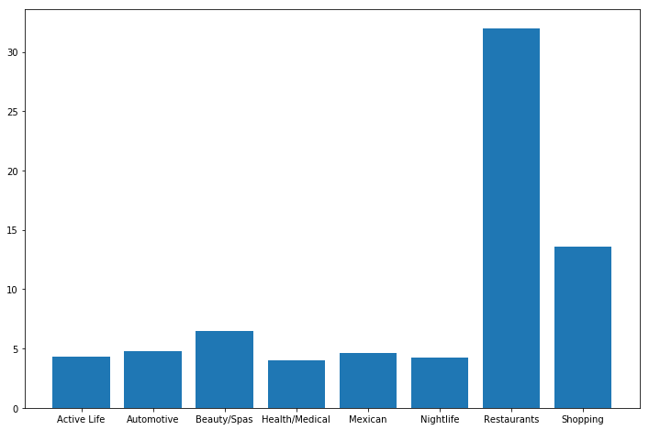
Reviewed Businesses

Slide 4
Usage
AZ: Active Users
Mexican Restaurants
Review Counts

Slide 5
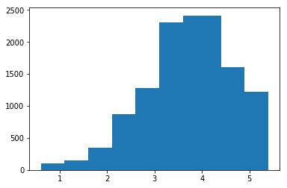
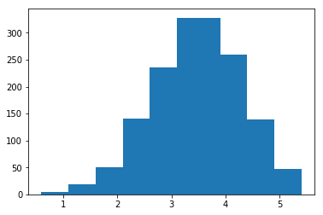
Ratings
Open
Closed

Slide 6
Next Steps

