Slide 1
6.S097 Project
Kevin Lyons
Subby Olubeko
Marwa Adbulhai
Mark Wang

Slide 2
Problem
Find clusters of crime within Boston and see how these areas are correlated to traffic patterns
By finding areas where crime is prevalent, will be able to identify places which needs more security

Slide 3
Algorithm and Implementation
Used the Boston crime data database provided on the 6.S097 website
Divide the data into categories: damage, disrupt, med, other, and violent
A hierarchichal clustering method to find clusters within the categories
Shave the clusters to find areas where crime is prevalent

Slide 4
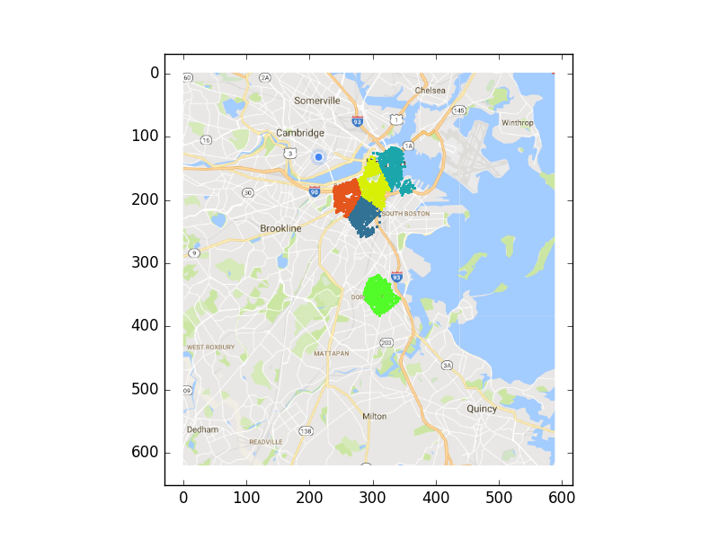
Damage

Slide 5
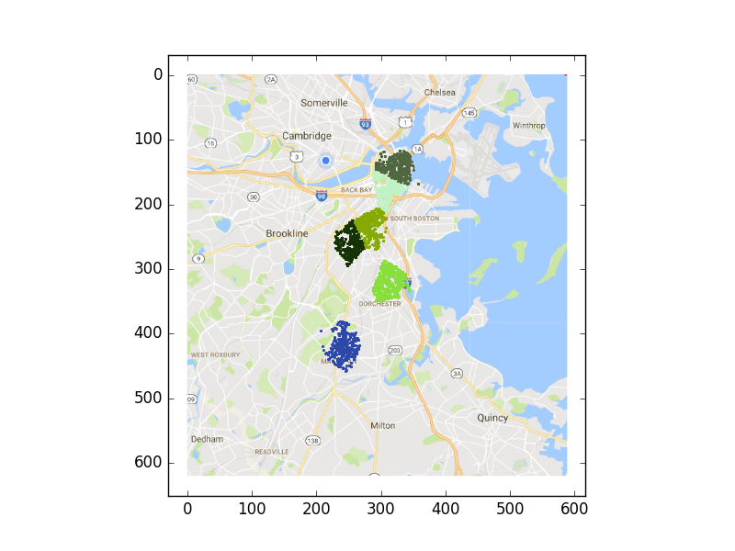
Disrupt

Slide 6
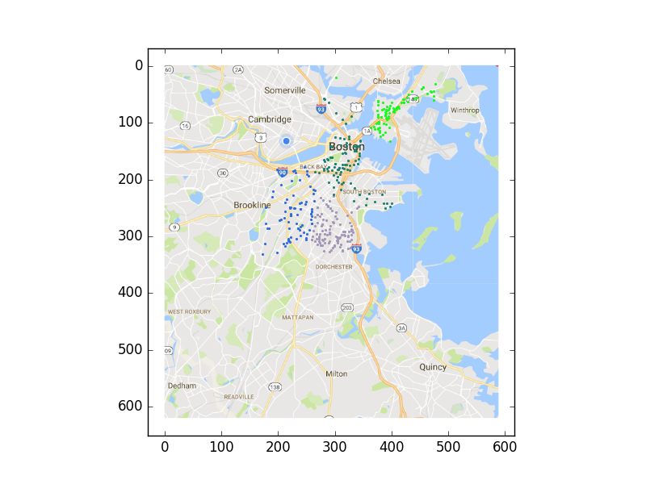
Med

Slide 7
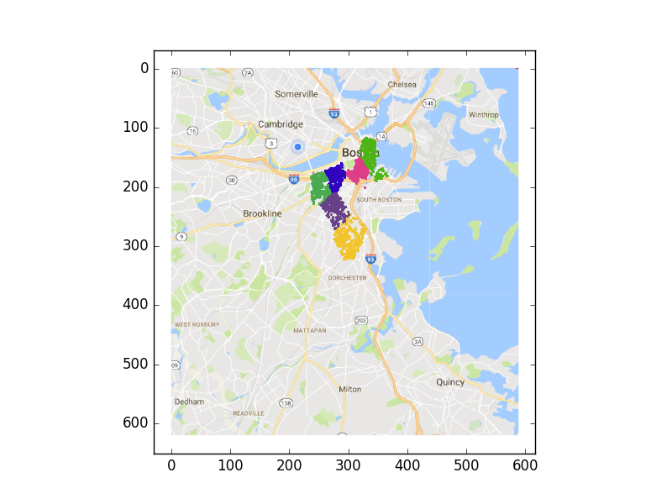
Other

Slide 8
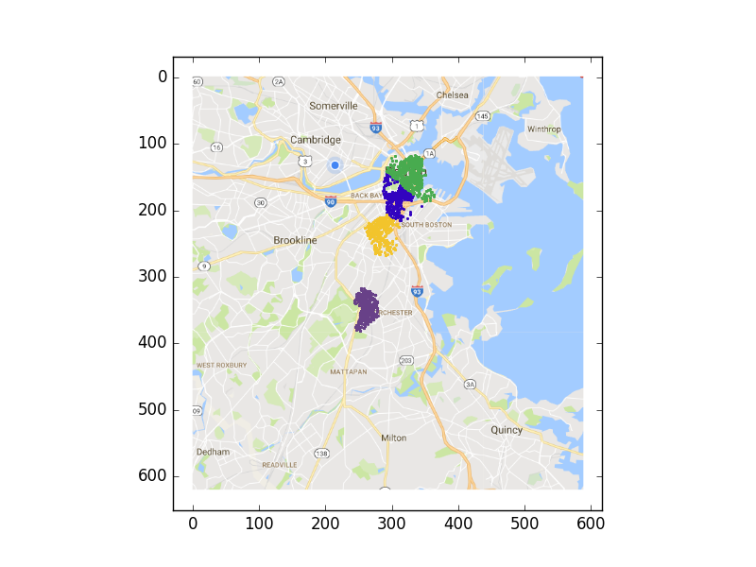
Violent

Slide 9
Performance

