Slide 1
6.S097 Project Understanding Crime & Traffic for Safer Urban Planning
Subby Olubeko
Marwa Abdulhai
Mark Wang
Kevin Lyons

Slide 2
Problem
Find clusters of crime within Boston and see how these areas are correlated to traffic patterns
By finding areas where crime is prevalent, will be able to identify places which need more security/enforcement/etc.

Slide 3
Algorithm and Implementation
Used the Boston crime data database provided on the 6.S097 website
Divided crime data into several categories, then ran K-Means clustering with various K
Shaved the clusters to find areas where crime is prevalent
Combined with public Boston traffic data to find patterns and inform rider safety

Slide 4
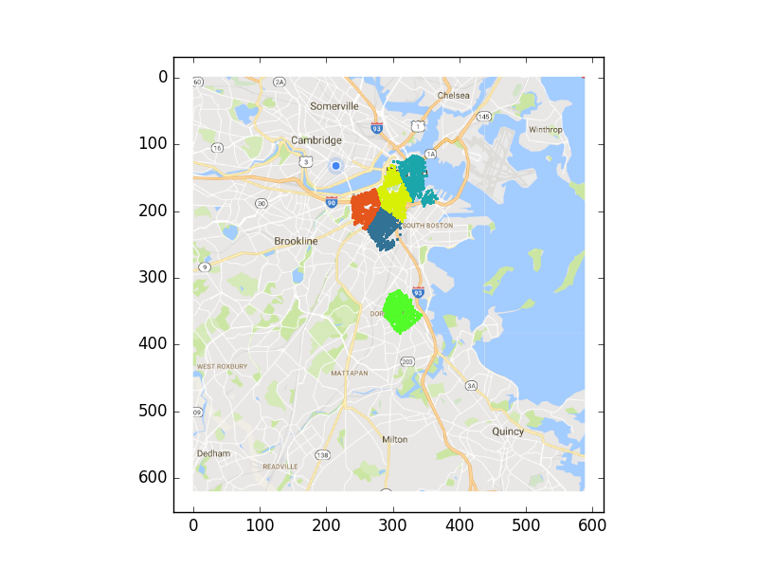
Damage

Slide 5
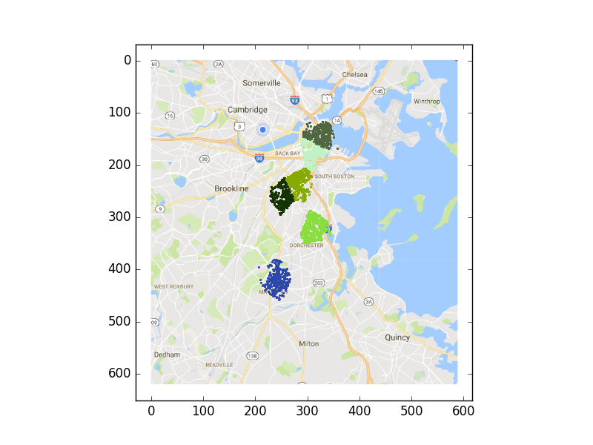
Disruptive

Slide 6
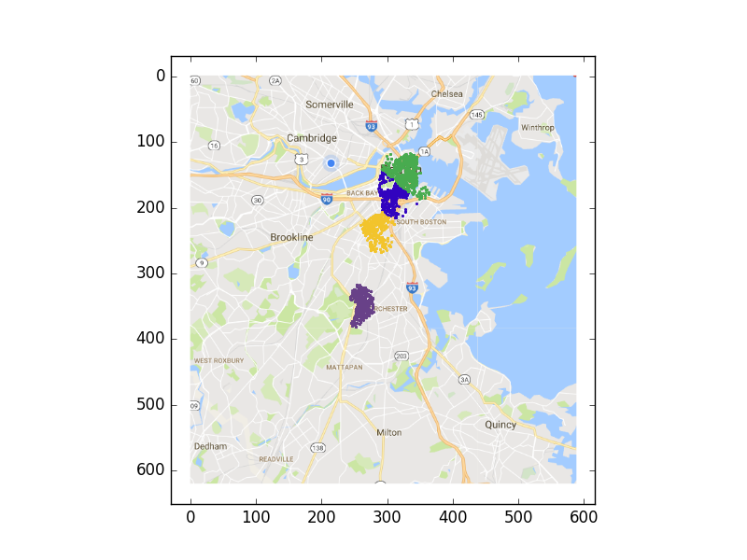
Violent

Slide 7
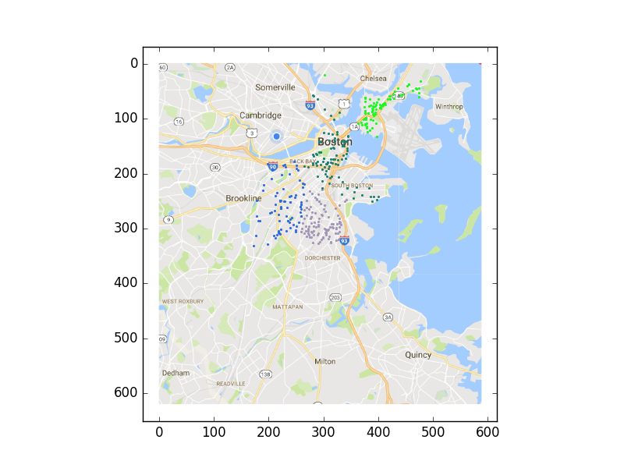
Medical

Slide 8
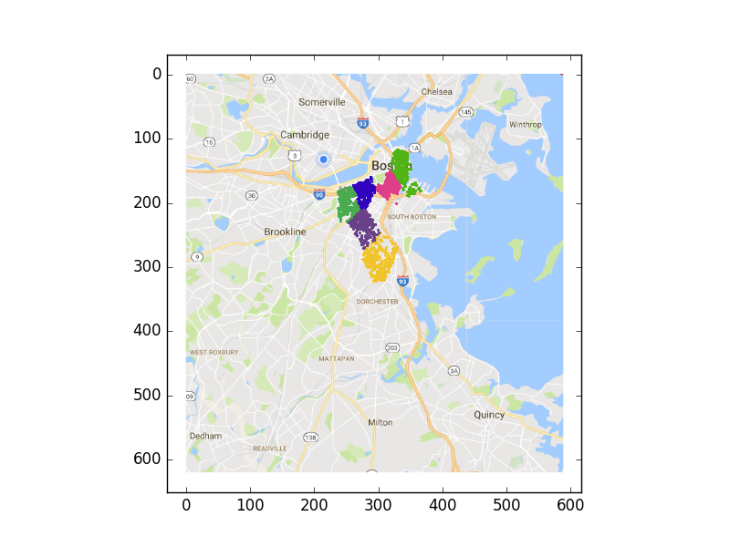
Other

Slide 9
Performance
Original goal was to use hierarchical clustering, but runtime up to O(n²)
Impractical for large sets n > 10,000
Went with focused K-means on crime set

Slide 10
Conclusions
High Traffic Areas
North End
Boston University/Kenmore
South Boston (near UMass, Boston)
South End
Roxbury

Slide 11
Combining Data

Slide 12
Results/Future
Seems to be a positive correlation between traffic volume and the crime rate in a given area
Could be due to number of factors – population density, lots of human interaction, economic activity
Could use additional datasets/clustering techniques
Eventually implement neural network to train

Slide 13
6.S097 Project Understanding Crime & Traffic for Safer Urban Planning
Subby Olubeko
Marwa Abdulhai
Mark Wang
Kevin Lyons

