Slide 1
6.S097 Project Understanding Crime & Traffic for Safer Urban Planning
Subby Olubeko
Marwa Adbulhai
Mark Wang
Kevin Lyons

Slide 2
Problem
Find clusters of crime within Boston and see how these areas are correlated to traffic patterns
By finding areas where crime is prevalent, will be able to identify places which need more security/enforcement/etc.

Slide 3
Algorithm and Implementation
Used the Boston crime data database provided on the 6.S097 website
Divided crime data into several categories, then ran K-Means clustering with various K
Shaved the clusters to find areas where crime is prevalent
Combined with public Boston traffic data to find patterns and inform rider safety

Slide 4
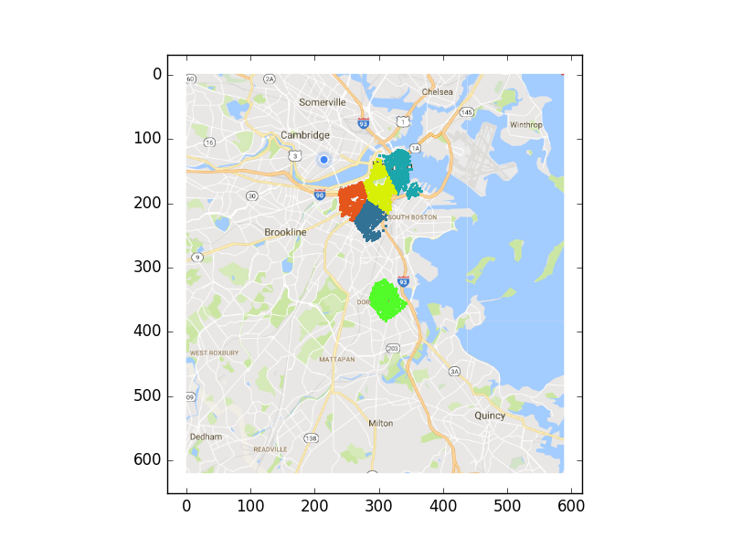
Damage

Slide 5
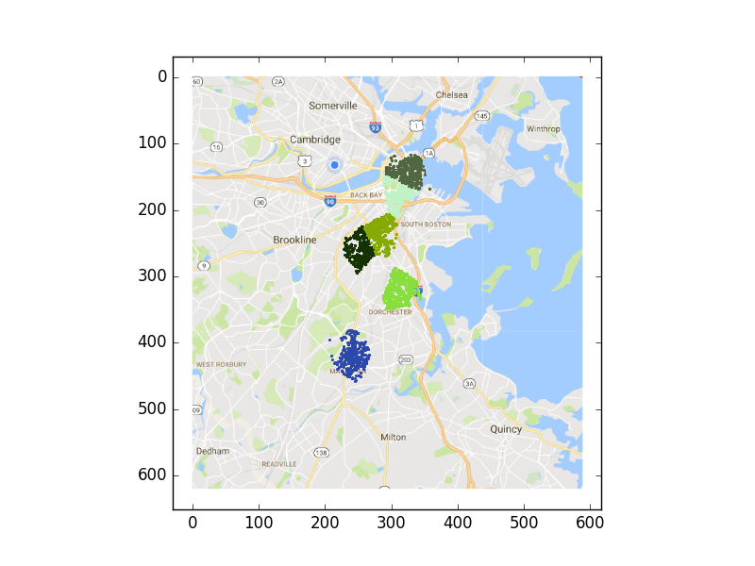
Disruptive

Slide 6
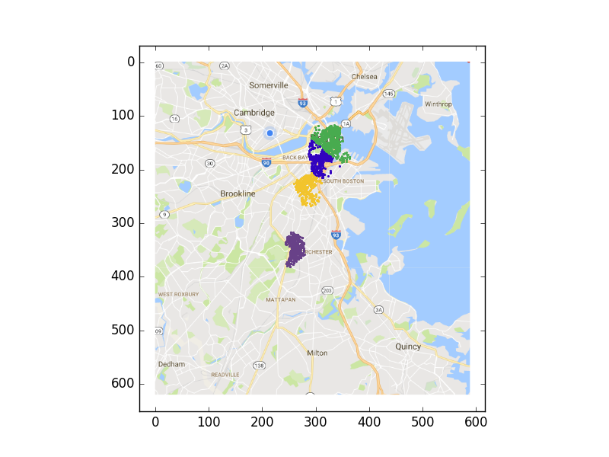
Violent

Slide 7
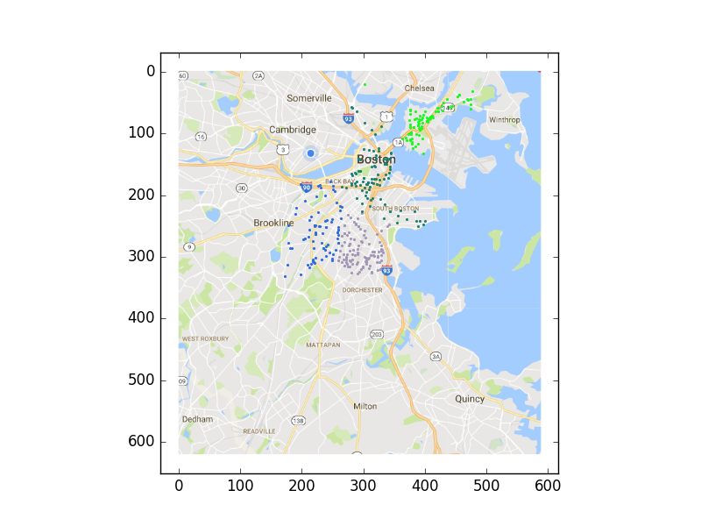
Medical

Slide 8
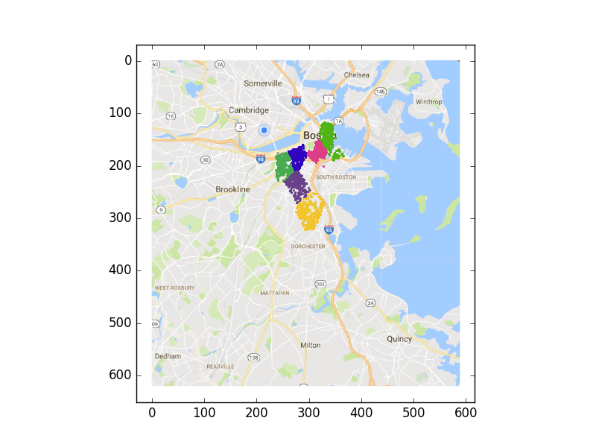
Other

Slide 9
Performance
Original goal was to use hierarchical clustering, but runtime up to O(n²)
Impractical for large sets n > 10,000
Went with focused K-means on crime set

Slide 10
Conclusions
Areas with the highest traffic volumes are
North End
Boston University/Kenmore
South Boston
South End
Roxbury
Consistent with clusters with high crime, showing traffic may be indication of areas of high crime

