Slide 1
S5 GEOGRAPHY · YEAR OVERVIEW
Welcome to S5 Geography
Four themes, four very different lenses on how the world works — from the rocks beneath your feet to the food on your plate.

Slide 2
The Big Picture
This Year's Four Themes
1. Dynamic Landscapes
• Weathering & erosion
• Coastal, fluvial, glacial, aeolian landforms
• ~15 lessons
2. Feeding the World
• Farming types & food inequality
• Globalisation & land-use conflicts
• ~15 lessons
3. Urban Studies
• Urbanisation & city structure
• Urban challenges & sustainable solutions
• ~15 lessons
4. Weather and Climate
• The atmosphere & weather systems
• Global climate zones compared
• ~15 lessons

Slide 3
How You'll Be Graded
The Evaluation Process
• Semester 1: one B-test (run in 1 or 2 periods), giving your first semester mark.
• Semester 2: one harmonised exam (same across all language sections), 2 periods long — covering the last two chapters we study this semester, weighted equally.
• What's tested: not just facts — knowledge, application of ideas, analysis of real sources (maps, graphs, photos), and clear written communication.
• Year 5 is a step up: expect to start writing short essays or extended paragraphs, not just short answers — this builds toward Years 6 and 7.

Slide 4
WHERE WE'RE STARTING
Theme 2: Feeding the World
We're starting here first — one of the most immediate, real-world themes in the whole syllabus.

Slide 5
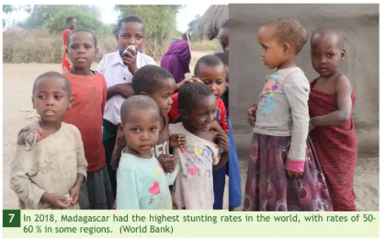
The Hook
Enough Food for Everyone — So Why Not?
• Global food production is, on paper, enough to feed every single person on Earth.
• And yet: around 645 million people faced hunger in 2025 — about 7.8% of the world's population.
• The pattern: that number has been falling (it was 8.6% in 2022) — but progress is slow and very unevenly spread.
The question this theme asks: if there's enough food, why isn't everyone fed — and what would it take to change that?

Slide 6
A Real Tool
Measuring Hunger: The Global Hunger Index
• The GHI scores every country from 0 (no hunger) to 100 (extreme hunger), combining four indicators:
• Undernourishment: the share of the population with insufficient caloric intake.
• Child wasting & stunting: low weight-for-height and low height-for-age in under-5s — signs of acute and chronic malnutrition.
• Child mortality: the death rate among under-5s, reflecting poor nutrition and unhealthy environments.
A map like this is exactly the kind of source you'll be asked to describe and analyse this year: what pattern do you notice, and why might it exist?

Slide 7
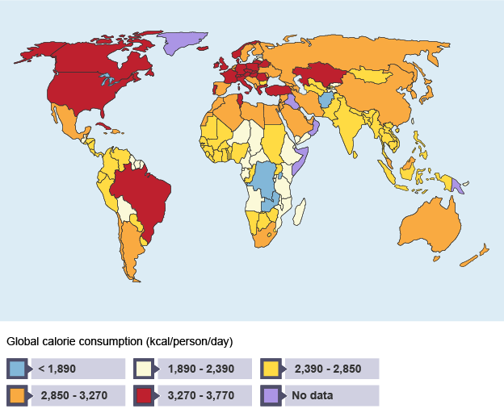
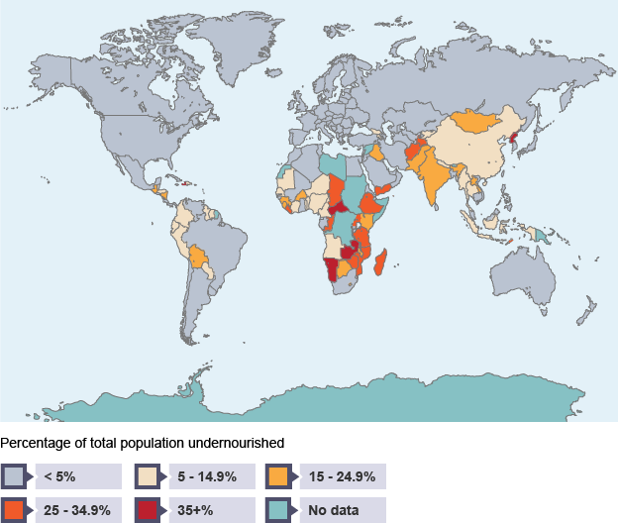
Two More Angles
Mapping Hunger, Two Ways
• These two world maps tell a similar story from different angles: how many calories people actually get, and how many people don't get enough.
Calorie consumption (kcal/person/day)
Population undernourished (%)

Slide 8
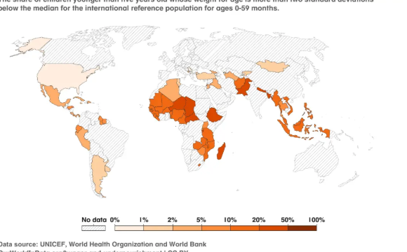

Slide 9
Roadmap
What We'll Cover: Farming Types
• Farming types: intensive, extensive, commercial, and subsistence — and why the same crop can be farmed completely differently in France, Tanzania, or Bangladesh.
• Real examples coming up: cattle farming in Wallonia, subsistence farming in Tanzania, vineyards in Alsace, and hydroponic greenhouses in Almeria, Spain.

Slide 10
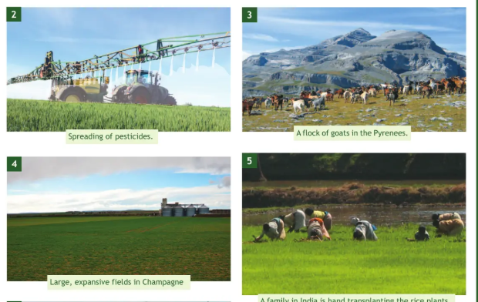

Slide 11
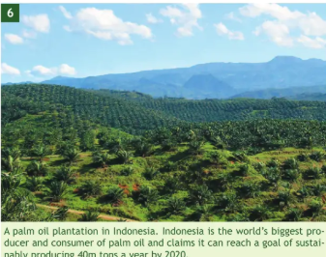
A Sneak Peek
The Globalisation Case Study: Palm Oil
• One option for our globalisation case study: palm oil — found in roughly half of all packaged supermarket products, from food to cosmetics.
• The tension: Indonesia and Malaysia produce ~85% of the world's palm oil — a huge economic opportunity, but also a major driver of rainforest deforestation.
• What you'll be asked to do: weigh real advantages (yield, jobs, versatility) against real costs (deforestation, habitat loss, labour conditions) — not just pick a side.

Slide 12
NEXT LESSON
Where Does Food Inequality Come From?
We'll map where hunger is concentrated in the world, and start unpacking why.

