Slide 1
UNIT 2 · FEEDING THE WORLD · LESSON 3
Types of Farming: Feeding the World, Differently
From hydroponic greenhouses in Spain to subsistence farming in Tanzania — how the same goal is reached in very different ways.

Slide 2
• Today's question: how is food actually produced? Not all farming looks the same — and the differences matter a lot.

Slide 3
The Big Picture
Two Questions Define Any Farm
• Intensive vs. extensive: how much labour, money, and technology are put into each hectare of land? Intensive farms use a lot per hectare (small area, high output); extensive farms use little per hectare (large area, lower output per hectare).
• Commercial vs. subsistence: what happens to what's grown? Commercial farming sells the produce for profit; subsistence farming grows food mainly to feed the farmer's own family.
• Why it matters: these two questions combine to create very different farms, in very different parts of the world — as we'll see in four real examples.

Slide 4
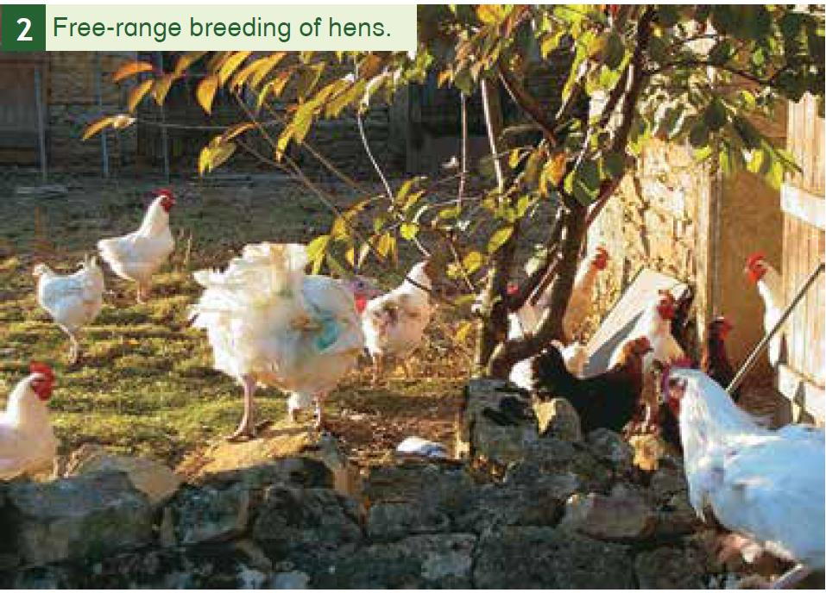
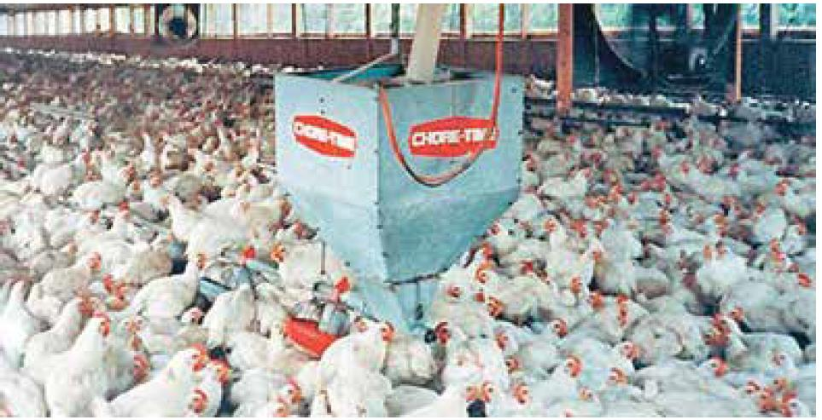
Seeing It For Real
Intensive vs. Extensive: Two Real Hen Farms
Extensive: free-range hens, low input per hectare, more space per bird.
Intensive: thousands of hens per shed, high output per hectare, mechanised feeding.

Slide 5
Putting It Together
Four Combinations, Four Realities
 | Commercial (sold) | Subsistence (eaten)
Intensive (high input/ha) | Hydroponic greenhouses — Almería, Spain | Rare — small, highly-worked market gardens
Extensive (low input/ha) | Cattle ranching — Wallonia, Belgium | Smallholder farming — rural Tanzania

Slide 6
Case Study 1
Cattle Farming in Wallonia, Belgium
• Wallonia's rolling, rain-fed pastures support large-scale cattle farming for beef and dairy, sold commercially across Belgium and the EU.
• Extensive: cattle graze over large areas of grassland — relatively low input per hectare, even though the overall farm can be large and well-capitalised.
• Commercial: almost all the output is sold, not consumed by the farming family — this is a business, tightly linked to EU markets and subsidies.

Slide 7
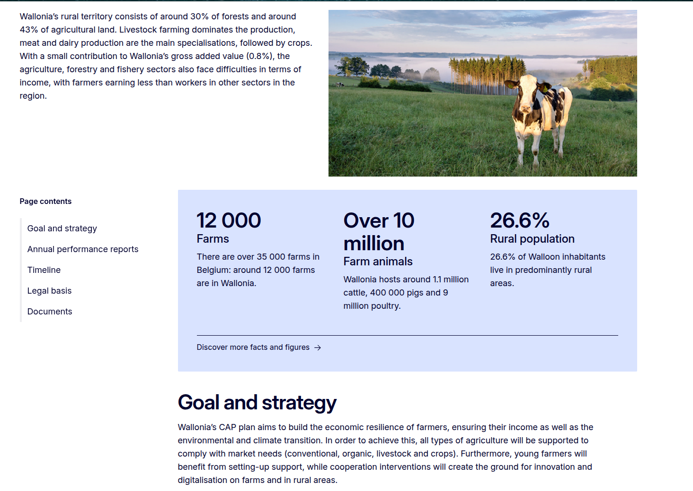

Slide 8
Case Study 2
Subsistence Farming in Rural Tanzania
• Many rural Tanzanian households farm small plots of maize, cassava, and vegetables, mainly to feed their own families.
• Extensive: low mechanisation and few bought inputs (fertiliser, irrigation) — yields depend heavily on rainfall and soil quality.
• Subsistence: most of what's grown is eaten by the household; any small surplus might be sold locally, but that's not the main purpose.
• The vulnerability: a single bad rainy season can threaten a family's food supply directly — very different from a commercial farm cushioned by markets and insurance.

Slide 9
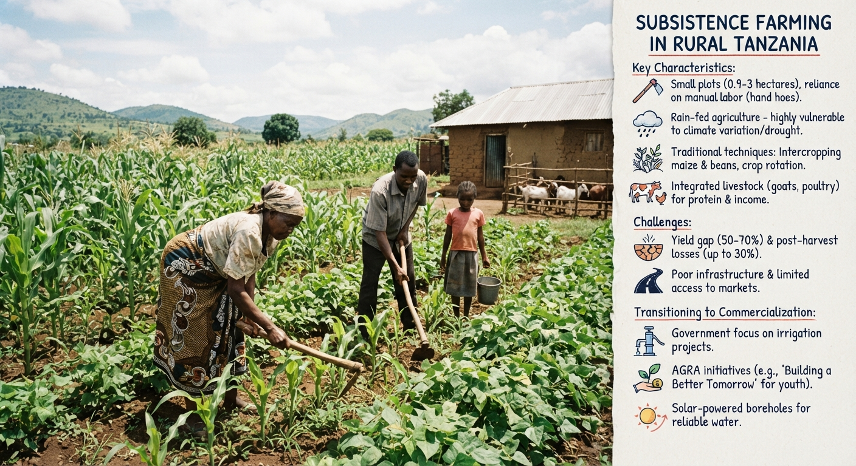

Slide 10
Case Study 3
Vineyards in Alsace, France
• Alsace's hillside vineyards produce some of France's best-known white wines, grown on carefully managed, labour-intensive plots.
• Intensive-leaning: vines need skilled, hands-on labour per hectare (pruning, harvesting) — a small area can represent a very high-value farm.
• Commercial: virtually all production is sold, often at a premium — Alsace wine is a global export product, not a subsistence crop.

Slide 11
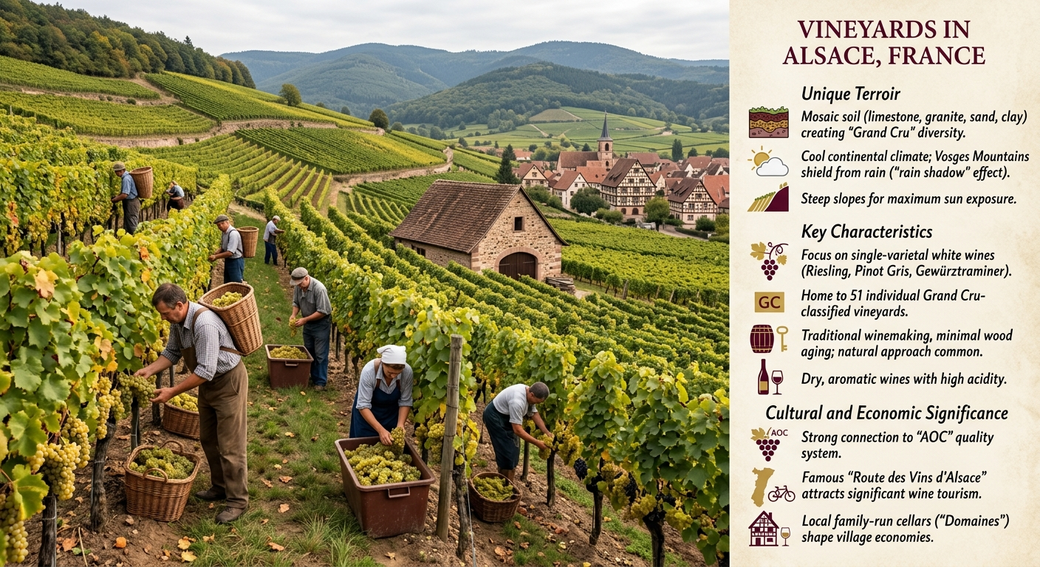

Slide 12
Case Study 4
Hydroponic Greenhouses in Almería, Spain
• Almería's "Sea of Plastic" — tens of thousands of hectares of greenhouses — grows tomatoes, peppers, and cucumbers for export across Europe.
• Intensive: hydroponics (growing in nutrient solution, not soil) lets farmers control water and nutrients precisely, producing enormous yields from a small area.
• Commercial: almost everything is sold — much of it exported — making this one of the most profitable farming systems in Europe, built in one of its driest regions.

Slide 13
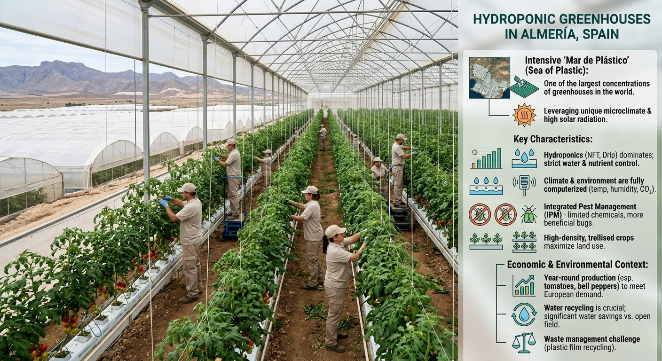

Slide 14
Did You Know?
The Trade-Offs Behind Every System
• More intensive usually means: higher yield per hectare, but more water, energy, chemical inputs, and often more environmental pressure (e.g. Almería's plastic waste and water stress).
• More extensive usually means: lower yield per hectare, but often lower input costs and sometimes gentler environmental impact — though it needs far more land.
• No system is automatically "better": each one is a response to the local climate, land, capital, and markets available — that's why the same goal (growing food) looks so different around the world.

Slide 15
Recap
Types of Farming, at a Glance
• Two questions define any farm: how intensive is it (input per hectare), and is it commercial (sold) or subsistence (eaten by the family)?
• Real examples: intensive+commercial (Almería greenhouses), extensive+commercial (Wallonia cattle), extensive+subsistence (rural Tanzania), and vineyards in Alsace (intensive-leaning, commercial).
• Every system trades off yield, cost, land, and environmental impact differently — shaped by local climate, capital, and markets.

