Slide 1
UNIT 2 · FEEDING THE WORLD · LESSON 4
Weighing Up Farming Systems
More types of farming, the real advantages and disadvantages of intensive and extensive agriculture — and what a sustainable alternative looks like.

Slide 2
Where We Are
Picking Up From Last Lesson
• Already done: the two questions that define any farm — intensive vs. extensive, commercial vs. subsistence — and four real examples.
• Today, three steps: more types of farming you haven't met yet, then the honest advantages and disadvantages of each system, then sustainable agriculture.
• Exam skill: “analyse the advantages and disadvantages of two different types of farming” — that is a real syllabus objective, so today's tables matter.

Slide 3
A Complication
Farming Types Overlap
• Categories are not watertight: a subsistence farmer may still sell a surplus at a local market, and extensive farms may still need heavy labour at peak times such as harvest.
• Sedentary farming: the farm stays in one permanent place — almost all farming you have studied so far.
• Nomadic farming: farmers move with their animals across regions in search of grazing. Historically widespread in Africa; many nomadic communities have now shifted to settled farming for socio-economic reasons.
• Extensive commercial pastoral farming: animals raised on large areas of land, for profit — the combination behind much of the world's beef and wool.

Slide 4
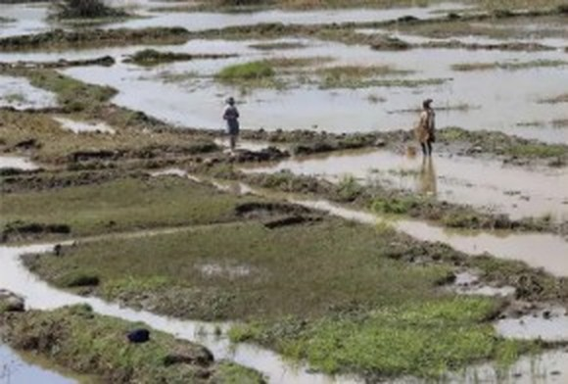
Type 1 · Asia
Rice Farming, Bangladesh
• A cornerstone of Bangladesh's agriculture: sustenance for millions and a major contributor to the economy.
• Many varieties grown across different agro-ecological zones, including flood-prone and high-salinity regions.
• Transplanting and direct seeding, with the monsoon irrigating the fields.
• Smallholders with relatively small plots form the backbone of cultivation — traditional techniques alongside modern practices.
Rice paddies, Bangladesh — the backbone of national food security.

Slide 5
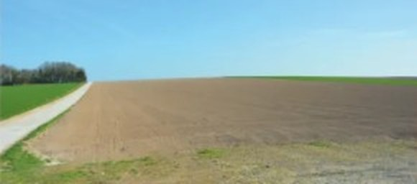
Type 2 · Europe
Open Field (Openfield) Farming
• Crops grown in open spaces with no structures such as greenhouses.
• Relies on natural sunlight, rainfall and soil fertility.
• Mechanised planting, cultivating and harvesting — highly efficient, suited to large-scale production.
• The trade-off: fully exposed to weather fluctuations, pests, disease and soil erosion.
Open field cultivation — no greenhouses, no hedgerows, just machinery and sky.

Slide 6
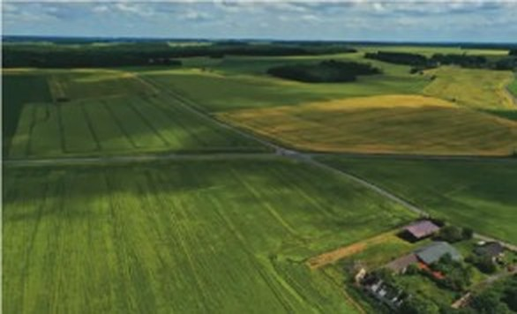
Type 3 · Worldwide
Arable Farming
• Cultivation of crops on suitable (arable) land, harvested each year.
• Wheat, maize, rice, barley and soybeans among others.
• Supplies both food and raw materials for industry — a key component of global agriculture.
• Changing fast: technology, seed breeding, fertilisation, pest control and irrigation have all raised productivity.
Arable land under annual crops — wheat, maize, rice, barley, soybeans.

Slide 7
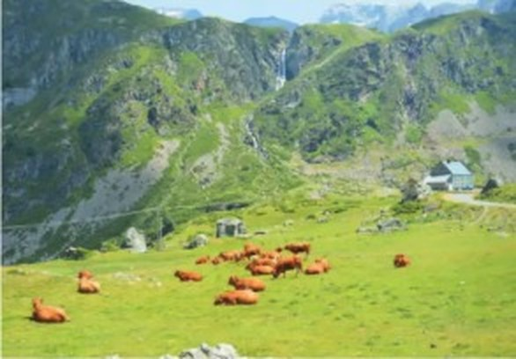
Type 4 · The Alps
Extensive Dairy Farming
• Milk and dairy production in mountainous regions, on nutrient-rich alpine pastures.
• Hardy cattle breeds, plus goats, suited to the terrain.
• Transhumance: seasonal movement of livestock between highland and lowland pastures.
• Supports local economies, rural livelihoods, cultural heritage and sustainable land management — but terrain and climate are a constant challenge.
Alpine pastures — low input per hectare, high-quality milk and cheese.

Slide 8
Putting It Together
Four More Systems, at a Glance
System | Where | Intensity | Mainly for
Rice farming | Bangladesh | Intensive labour, small plots | Subsistence + sale
Open field | Europe, N. America | Extensive, highly mechanised | Commercial
Arable | Worldwide | Varies — often intensive inputs | Food + industry
Extensive dairy | The Alps | Extensive — low input per ha | Commercial

Slide 9
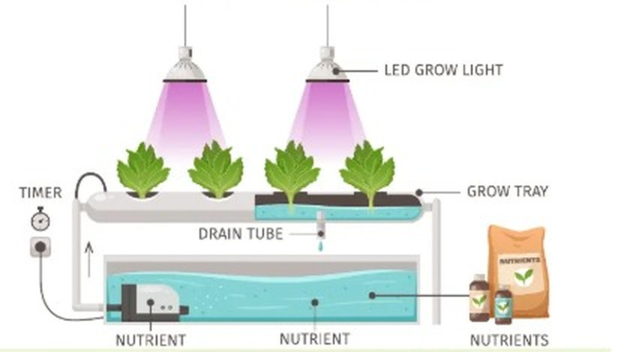
How It Actually Works
Hydroponics: Growing Without Soil
• No soil: roots sit in a nutrient solution — water plus dissolved minerals — on a grow tray.
• Full control: a timer and pump cycle the solution; LED grow lights and drain tubes let the farmer control light, water and nutrients precisely.
• Why Almería uses it: huge yields from a small area in a region with only ~200 mm of rain a year — water use per plant is far lower than in open fields.
Hydroponics has turned Almería into a hub of year-round, water-efficient production.

Slide 10
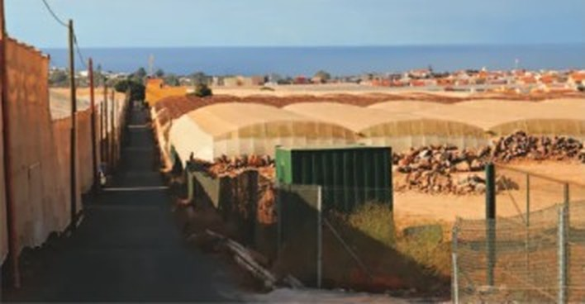
Intensive Agriculture
Almería, Spain — By The Numbers
• ~200 mm of rainfall a year — a landscape closer to desert than farmland.
• 260 km² of greenhouses, the largest concentration in the world, built up over 35 years.
• ~3,000 hours of sunshine a year and an average 20 °C — almost no heating needed.
• Over US$1.5 billion a year for the region; supplies over half of Europe's out-of-season fruit and vegetables.
Almería supplies much of Europe's winter fruit and vegetables.

Slide 11
Analyse It (1/2)
Almería: The Balance Sheet
Advantages | Disadvantages
Real advances in hydroponic growing techniques | Tension between immigrant communities from different countries
Reduced water use through drip irrigation and hydroponics | Undocumented workers with no control over their working conditions
Low energy costs — warm temperatures mean little heating | Low pay and poor living conditions for migrant workers
Jobs in packing plants and in factories supplying greenhouse materials | Ecosystems destroyed by the vast plastic covering

Slide 12
Analyse It (2/2)
Almería: The Balance Sheet
Advantages | Disadvantages
Regular supply of cheap, temporary migrant labour | Plastic dumped at sea, harming marine ecosystems
Year-round availability of fruit and vegetables across Europe | Increased health risks from pesticide use
Keeps a near-desert region economically productive | Aquifers depleted by excessive water extraction for agriculture
Notice: most advantages are economic, most disadvantages are environmental or social.

Slide 13
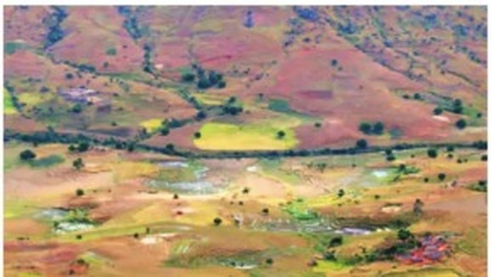
Extensive Agriculture
Madagascar: The Other Extreme
• 2.4 million farms, the vast majority smallholdings — most of the population works in agriculture.
• Rice is the main product and main export crop, grown on terraced paddies in the central highlands.
• Also grown: cassava, maize and sweet potato for subsistence; coffee, cloves and vanilla as cash crops for export.
• Livestock: zebu cattle dominate, with pigs, sheep, goats and poultry; fishing and aquaculture are growing.
Terraced rice paddies shape both the landscape and the livelihoods of most Malagasy people.

Slide 14
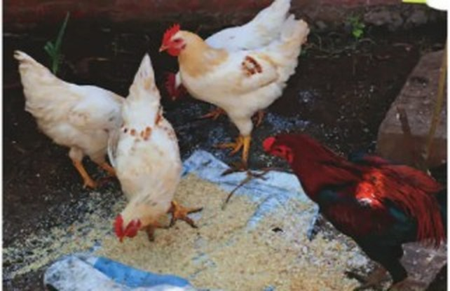
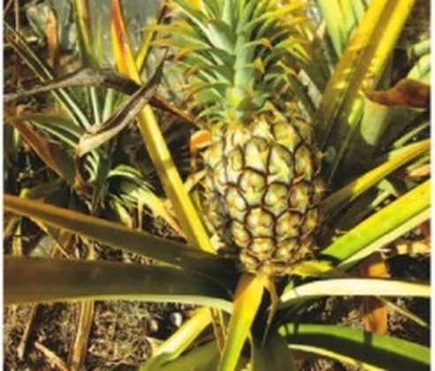
Why It Stays Extensive
Madagascar: Limits and Pressures
• Small farms impede mechanisation: traditional crop varieties, limited equipment and infrastructure — minimal surplus beyond subsistence levels.
• Rainfall varies hugely: abundant on the east coast, under 500 mm in the south and south-west; the growing season starts with the first rains in October or November.
• Slash-and-burn (tavy): used for centuries, but population pressure since the end of French rule has made it damaging — land fertility is falling. By 2006 wood, charcoal and grass for zebu grazing were among the primary products.
Free-range hens and pineapples: small-scale, diverse, locally traded.

Slide 15
Analyse It (1/2)
Extensive Farming: The Balance Sheet
Advantages | Disadvantages
Uses vast land resources efficiently | Soil degradation from overuse and erosion
Needs minimal initial investment in infrastructure | Vulnerable to climate variability and extreme weather
Provides livelihoods for rural communities | Limited crop diversity and monoculture practices
Supports traditional methods and cultural practices | Low productivity per unit area compared with intensive farming
Offers flexibility in crop rotation and land use | Encourages deforestation and loss of biodiversity

Slide 16
Analyse It (2/2)
Extensive Farming: The Balance Sheet
Advantages | Disadvantages
Maintains traditional agroecological knowledge | Poor market access and transport in remote areas
Buffers against food shortages in times of crisis | Potential for conflict over land tenure and resource use
Contributes to food security at household level | May perpetuate poverty cycles and income inequality in rural areas
Provides habitat for wildlife in open landscapes | Susceptible to pests and disease, leading to crop losses
Supports the livelihoods of pastoral communities | Needs careful management to prevent overexploitation

Slide 17
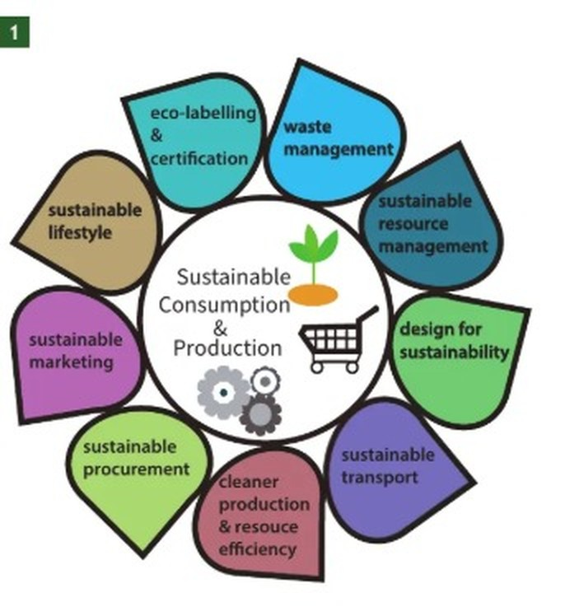
A Third Way
What Is Sustainable Agriculture?
• The objective: meet society's current food and textile demands without destroying the ability of future generations to meet their own.
• Three goals at once: a healthy environment, economic profitability, and social and economic equity.
• Everyone in the chain: growers, food processors, distributors, retailers, consumers and waste managers all have a role.
• In practice: enhance soil health, conserve water, reduce pollution on farms.
Sustainable consumption and production: nine linked practices.

Slide 18
Five Routes
Ways to a More Sustainable Food Supply
• Permaculture: farming designed around sustainability and self-sufficiency.
• Organic farming: natural fertilisers, animal slurry and natural predators instead of artificial chemicals — yields may be lower, but harm to ecosystems is minimised.
• Urban farming: food grown in and around cities, reducing farmland lost to urbanisation; urban plots often out-yield equivalent rural areas and cut food miles.
• Sustainable fish and meat: net designs that reduce bycatch, a return to traditional fishing, and grass-fed rather than grain-fed livestock.
• Seasonal eating: food in season cuts food miles and the energy used in greenhouse production and long-distance transport.

Slide 19
Case Study
Zaytuna Farm, Australia
• The farm: 66 acres at The Channon, northern New South Wales, founded by Geoff Lawton; home of the Permaculture Research Institute.
• Permaculture = “permanent agriculture” — sustainable, self-sufficient systems that mimic the natural environment.
• Objectives: demonstrate sustainable living and farming, educate others, build a self-sufficient resilient system, preserve biodiversity and regenerate degraded land.
Six design features
Water harvesting — swales and ponds catch rainwater
Food forests — layered canopy, shrubs and fruit
Animal systems — chickens, ducks, goats for pest control and fertilisation
Composting — organic waste builds soil fertility
Renewable energy — solar panels
Sustainable buildings — low-energy materials and design

Slide 20
Does It Work?
Zaytuna: Results & Challenges
What improved
• Biodiversity increased — a wider range of plant and animal species
• Improved soil health and water retention
• Higher productivity and real resilience against drought
• Thousands of students and visitors taught each year
What is still hard
• Climate variability
• Ongoing pest management
• Constant adaptation of practices to changing conditions
• 66 acres is small — can the model scale to feed cities?

Slide 21

Activity
Watch, Then Map It
As you watch, look for the six design features
1. Watch the video: Geoff Lawton, “Theory in Practice: A Tour of Zaytuna Farm” (2019) — youtube.com/watch?v=dcgHvYWLs-Q
2. In your notebook, create a mind map of Zaytuna Farm:
• outline the objectives of the farm
• explain the key concepts that contribute to sustainability
• evaluate the sustainable policies that have been put in place.
Scan to open the video.
Keep your mind map — the questions on it come back in the next worksheet, together with today's advantages and disadvantages tables.

Slide 22
Recap
What To Take Away
• Four more systems: rice farming (Bangladesh), open field, arable, and extensive alpine dairy — and the sedentary/nomadic distinction that cuts across them.
• Intensive (Almería): economic advantages, environmental and social costs — water, plastic, pesticides, labour conditions.
• Extensive (Madagascar): low investment and cultural continuity, but low productivity per hectare, erosion and poor market access.
• Sustainable agriculture aims at three goals at once — environment, profit, equity — through permaculture, organic, urban, seasonal and sustainable fish and meat.
• Zaytuna Farm shows the model works at 66 acres. Whether it scales is the real debate.

