Slide 1
GEOGRAPHY — THEME I: A COMPLEX GLOBAL WORLD — Lesson 2
Measuring & Classifying Development
Indicators, population pyramids, and income groups — how do we actually sort countries?

Slide 2
RECAP
Quick Recap
• Last lesson: development = economic + social wellbeing, measured with quantitative & qualitative indicators, summarised by the HDI.
• Today: the fuller toolkit of indicators, how population structure reveals development, and how the World Bank classifies countries by income.

Slide 3
INDICATOR TOOLKIT
More Development Indicators
Health
Life expectancy
Infant mortality rate
Maternal mortality
People per doctor
Access to safe water
Population
Birth rate
Death rate
Fertility rate
Dependency ratio
Society & Economy
Literacy rate
GDP / GNI per capita (PPP)
Poverty line ($1.90/day)

Slide 4
POPULATION CHANGE
The Demographic Transition Model (DTM)
Stage 1
High birth rate, high death rate — little natural change
Stage 2
Death rate falls rapidly — population grows fast
Stage 3
Birth rate starts falling — growth slows
Stage 4
Low birth & death rates — stable population
Stage 5
Birth rate falls below death rate — population may decline

Slide 5
READING PYRAMIDS
What a Population Pyramid Shape Tells You
LIC (e.g. Niger, Gambia)
Wide base — high birth rate
Concave sides
Many under-15s
Youthful population
NEE (e.g. UAE)
Unbalanced — gender imbalance
Large working-age bulge
Driven by migrant labour
HIC (e.g. Italy, Japan)
Narrow base — low birth rate
Bulge at over-60s
High life expectancy
Ageing population

Slide 6
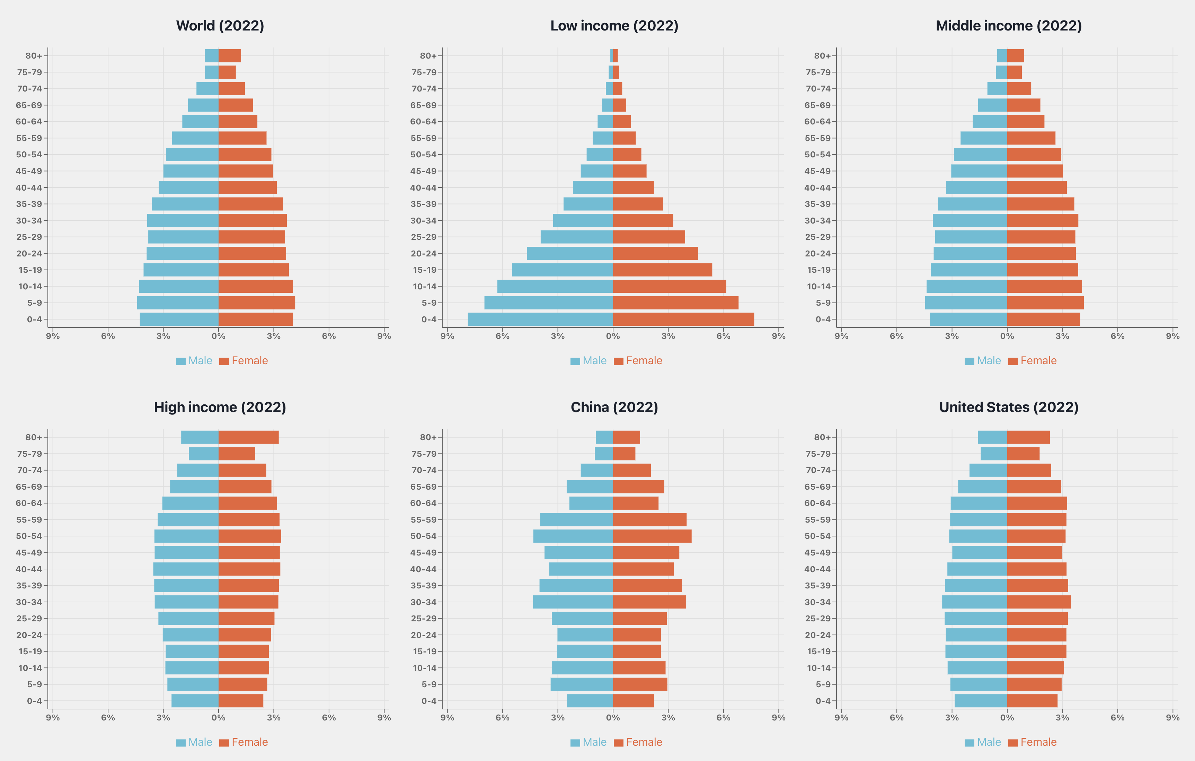

Slide 7
WORLD BANK CLASSIFICATION
Income Groups by GNI per Capita (2021)
Income Group | GNI per capita (current US$)
Low Income | < $1,045
Lower-Middle Income | $1,046 – $4,095
Upper-Middle Income | $4,096 – $12,695
High Income | > $12,695

Slide 8
TRY IT
Classify & Justify
Given a country's GNI per capita, birth rate, and population pyramid shape, classify it as LIC / NEE / HIC and justify your answer using at least two indicators.
(practice for data-interpretation exam questions)

