Slide 1
GEOGRAPHY — THEME I: A COMPLEX GLOBAL WORLD — Lesson 7
What Stands in the Way? Obstacles to Development
Four categories of obstacle, then six case studies: Haiti, Nigeria, the DRC, climate, Mexico, and the two Koreas.

Slide 2
RECAP
Quick Recap
• Last lesson: we looked at theories of development and the organisations trying to influence it.
• Today: what actually blocks development in the first place — and why the same regions keep showing up as 'least developed.'
• Then: six real places, to see the obstacles working together rather than one at a time.

Slide 3
THE CATEGORIES
Four Types of Obstacle
Historical
• Colonialism, wealth extraction
• Post-independence conflict
Physical
• Extreme weather, drought
• Landlocked status
• Natural disasters
Economic
• Unfair trade terms
• TNC (Transnational Corporations) dominance
• Raw-material dependency
Political
• Instability
• Corruption
• Weak institutions

Slide 4
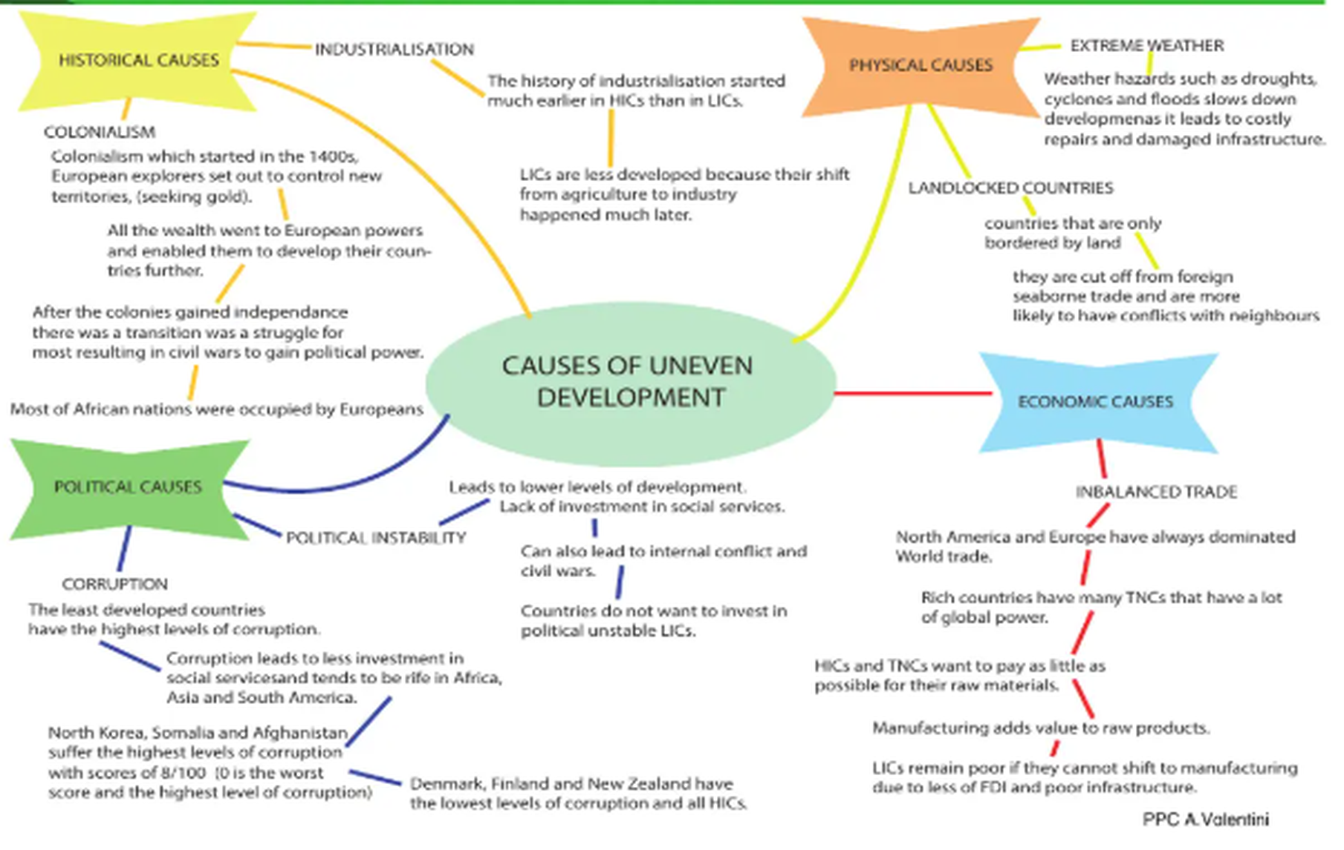
THE BIG PICTURE
The Causes of Uneven Development
Obstacles are rarely single causes — 'usually a combination of these factors leads to low levels of development.'

Slide 5
NATURAL CONSTRAINT
Landlocked Countries
• Being landlocked cuts a country off from direct sea trade — goods must cross a neighbour's territory, adding cost, delay, and political risk.
• Where: most of the world's landlocked countries are in Africa (e.g. Niger, Chad, Mali, Uganda).
• Effect: higher transport costs eat into export profits; disputes with transit neighbours can halt trade entirely; landlocked countries are statistically more prone to conflict.
• Link back: Mali (Lesson 5) is landlocked AND 80% primary-sector — the two disadvantages compound each other.

Slide 6
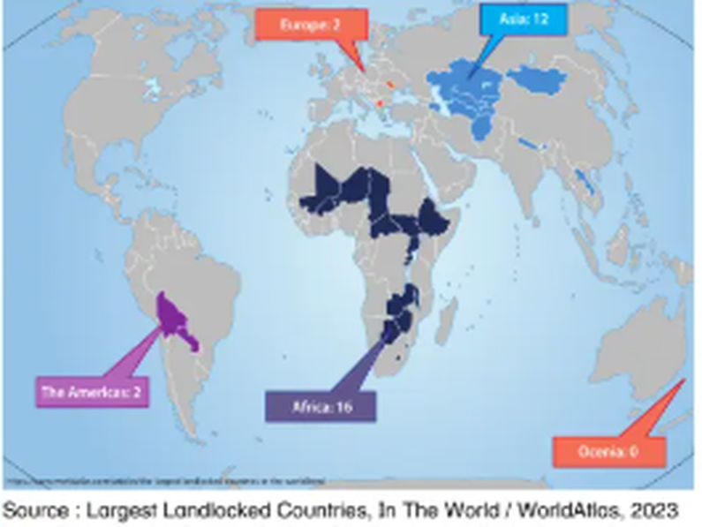
NATURAL CONSTRAINT
Where the Landlocked Countries Are
• Landlocked countries are surrounded by other countries and have no access to seas or oceans.
• They are cut off from seaborne trade, which limits their opportunity to develop their economies.
• Having more neighbouring countries also increases the risk of conflict over borders.
• Africa: 16 more of the world's largest landlocked countries than any other continent.
Source: Largest Landlocked Countries, WorldAtlas 2023. The figures count the largest landlocked states per continent, not every one.

Slide 7
HUMAN CONSTRAINT
Corruption & Bad Governance
• Recap: the Corruption Perceptions Index (Lesson 4) scores perceived public-sector corruption, 0-100 (higher = cleaner).
• Worst-perceived: Somalia, Syria, South Sudan, North Korea, Afghanistan. Best-perceived: Denmark, New Zealand, Finland.
• Effect: corruption diverts aid & tax revenue away from healthcare / education / infrastructure; investors avoid high-corruption countries, slowing growth.
• Link back: Nigeria (Lesson 3) — corruption is a key listed challenge despite being Africa's largest economy; growth hasn't reached most citizens partly because of governance failures, not just a lack of resources.

Slide 8
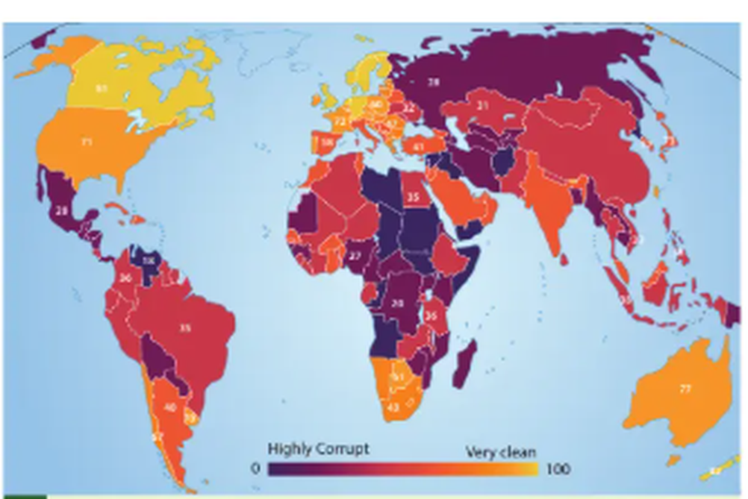
HUMAN CONSTRAINT
Corruption Perceptions Index, 2018
• The least developed countries tend to have the highest levels of perceived corruption.
• Corruption is reported as most widespread in parts of Africa, Asia and South America.
• Denmark, Finland and New Zealand score best — and all are HICs.
• DESCRIBE it: name the pattern, then quote a figure. Don't just say 'Africa is corrupt.'
Dark = highly corrupt, light = very clean (0-100 scale).

Slide 9
OBSTACLE IN FOCUS — 1
Disease as an Obstacle to Development
Textbook pp.25 — HIV, Ebola and COVID-19

Slide 10
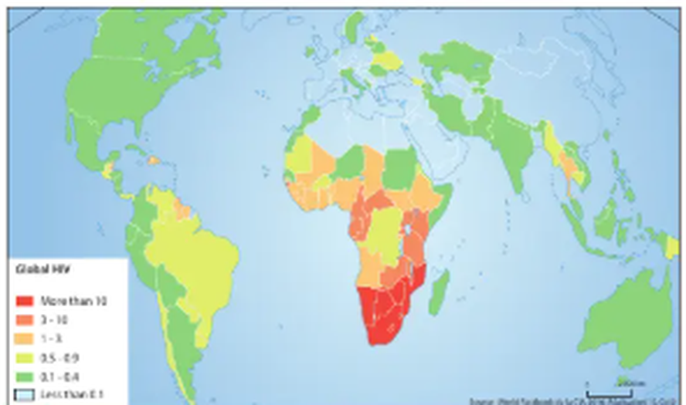
DISEASE
Global HIV Prevalence
• Disease removes working-age adults from the labour force, so output falls at the same time as healthcare costs rise.
• Children lose parents and often leave school — the damage carries into the next generation.
• Southern Africa carries by far the heaviest burden.
• Note: the map shows the percentage of the population affected, not case numbers — so small countries are not hidden.
Global HIV prevalence: the percentage of the population affected by the virus.

Slide 11
DISEASE
You Cannot Treat Anyone Without Doctors
Country | Doctors per 1,000 people
Cuba | 8.19
EU-15 | 3.7
Qatar | 2.78
USA | 2.59
China | 1.79
Syria | 1.22
India | 0.78
Haiti | 0.23
Tanzania | 0.04
Malawi | 0.02
Malawi has roughly one doctor for every 50,000 people — Cuba has about 400 times the provision. (The textbook table is headed 'per 100,000'; the figures are actually per 1,000 — a useful reminder to check units before you quote a statistic in the exam.)

Slide 12
DISEASE
2014: Ebola, a Disease of Poverty
In Europe, treatments are developed even for rare diseases, because patients or social security can pay. Where people have no money, there is no incentive — so Ebola became 'a disease of poor people, in poor countries.'
'The most urgent need to fight Ebola is first of all human. People are needed to support the local staff, to monitor and care for the sick. [...] In these countries, the health systems are extremely fragile, these are poor countries emerging from war. [...]'
Marie-Paule Kieny, Deputy Director General of the WHO, interviewed by Amandine Cailhol, Libération, 2014

Slide 13
DISEASE
2020: COVID-19 and Extreme Poverty
• 1990: about 1.9 billion people — nearly 36% of the world's population — lived in extreme poverty, defined as less than $1.90 a day.
• 2015: that figure had fallen to 734 million, roughly 10% of the world's population. A genuine success story.
• Then 2020: the World Bank expected COVID-19 to have a profound impact on poverty rates — job losses, disrupted education and healthcare, price increases, and a fall in remittances from migrant workers.
• The lesson: development progress is reversible. One shock can undo years of gains.
Source: Elizabeth Howton, 'Poverty', The World Bank, 2020.

Slide 14
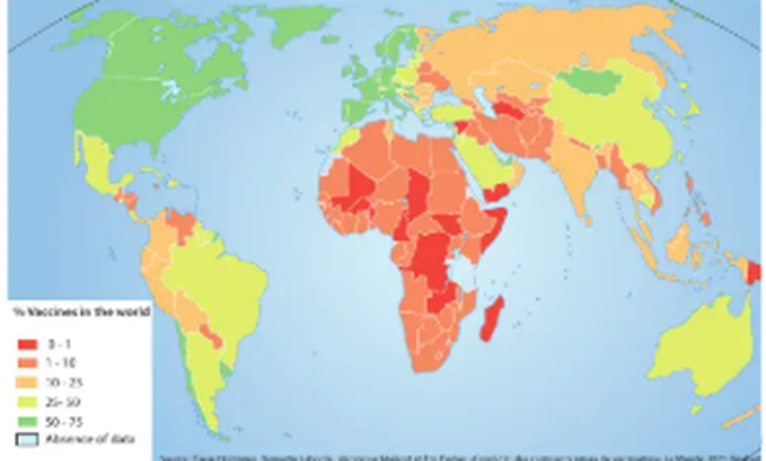
DISEASE
Who Got the Vaccine First?
• Share of each country's population with at least one dose of a COVID-19 vaccine, as of 15 July 2021.
• HICs had vaccinated large shares of their populations while much of sub-Saharan Africa was still near zero.
• EXPLAIN it: wealth bought early supply contracts and manufacturing capacity. The virus was global; the response was not.
• Caution: COVID-19 death data may be skewed by under-reporting, so compare vaccination shares rather than death counts.

Slide 15
OBSTACLE IN FOCUS — 2
Poverty as an Obstacle to Development
Poverty is both a symptom and a cause — textbook pp.27

Slide 16
POVERTY
The Global Poverty Picture
• $5.50 a day: 3.4 billion people live on less than this, according to the World Bank. The rate fell from 67% in 1990 to 46% in 2015.
• $1.90 a day: extreme poverty fell from around 30% in 1990 to 10% in 2015.
• East Asia & Pacific: incomes of the poorest 40% rose by an average of 4.7% between 2010 and 2015 — the best share of prosperity.
• Sub-Saharan Africa: in a third of countries the income of the poorest 40% actually FELL. 84.5% still live on under $5.50 a day.
• Who is poor: mostly rural, poorly educated, employed in agriculture, and under 18. All 43 of the highest-poverty countries are fragile, in conflict, or in sub-Saharan Africa.

Slide 17
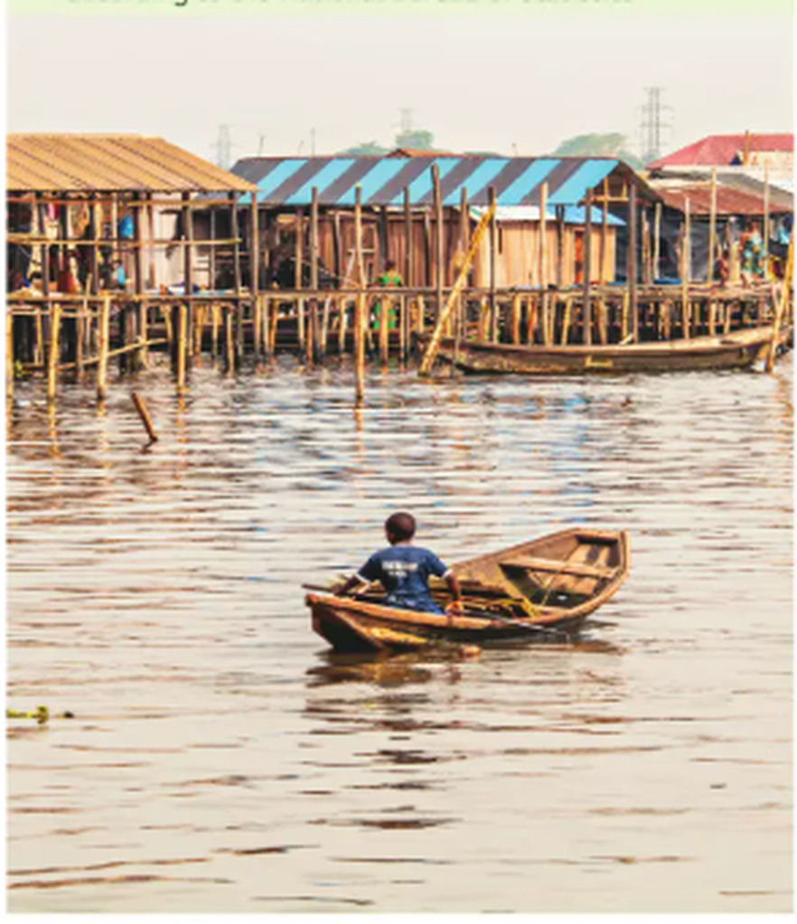
POVERTY
Poverty in Nigeria
• Poverty goes beyond not having money — Nigeria's problem is that millions cannot access basic resources, from food to shelter to medical services.
• Scale: more than 82 million Nigerians live on less than $1 a day (National Bureau of Statistics).
• Catalyst: poverty itself then feeds political instability, economic crises, corruption and insecurity.
• Causes listed: imbalance in the economic structure, poor access to credit, unemployment, untapped natural resources, debt, overpopulation and bad governance.
• Link back: Lesson 3 covered Nigeria's maternal and child mortality and its 20 million out-of-school children.

Slide 18
CASE STUDY — 1
Haiti
The poorest country in the Americas — textbook p.26

Slide 19
HAITI
Development Data
Indicator | Value
Area | 28,773 km²
Population | 11,120,000 inhabitants
Density | 384 inhabitants/km²
GNI per capita | $706 (2019) — falling since 2014
HDI | 0.503 (2018) — 207th of 228 countries
Life expectancy | 63 years (2019)
Wealth share | the richest 20% own 63% of national wealth
Poverty | 60% live on less than $2.40 a day
Source: World Bank; UNDP; Chaléard & Sanjuan, Geography of Development, 2017.

Slide 20
HAITI
Why Is Haiti Poor?
• 1804: Haiti wins independence — then carries a heavy burden of debt owed to France for that very independence.
• 1915-1934: American military occupation.
• 1957-1996: dictatorial rule of the Duvalier family. A series of predatory governments whose elites chose short-term gains from international trade over developing the country.
• Late 1980s: the Structural Adjustment Programme imposed by the World Bank and the IMF weakened public services without successfully fostering private companies.
• 12 January 2010: the earthquake. A disorganised state with failed governance systems was ill-equipped to handle the aftermath.

Slide 21
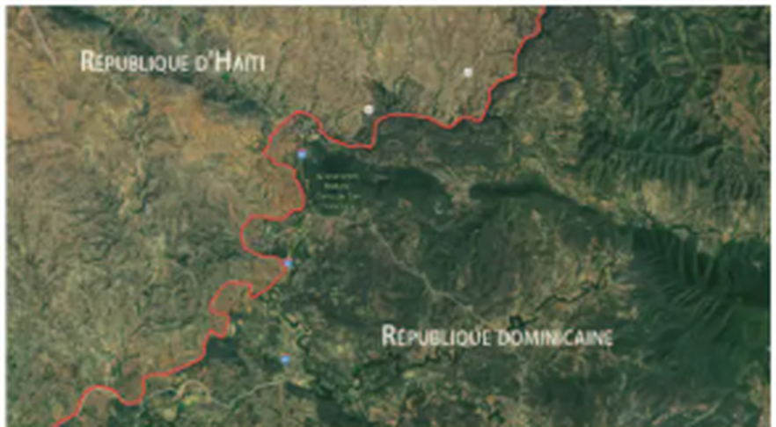
HAITI
A Border You Can See From Space
• The sharp line is the border between Haiti (left) and the Dominican Republic (right).
• Haiti's forest cover has been stripped, largely for charcoal — the fuel poor households can afford.
• The trap: poverty drives deforestation; deforestation causes soil erosion and landslides; those destroy farmland and deepen poverty.
• Compare: Madagascar, later in this lesson, shows the same spiral.
Satellite image showing the extent of deforestation between the Republic of Haiti and the Dominican Republic.

Slide 22
HAITI
Tectonic Hazards: 2010
• The earthquake: magnitude 7.2, it destroyed Port-au-Prince in 2010.
• Nearly 300,000 deaths and 1.2 million people made homeless — largely because of the rudimentary nature of the housing.
• Then cholera: an epidemic spread through the country. The lack of water treatment infected more than 800,000 people and caused 10,000 deaths.
• And again in 2016: the epidemic returned after Hurricane Matthew ravaged the south-west.
• The point: the hazard is natural; the scale of the disaster was human — poor housing, no water treatment, weak government.

Slide 23
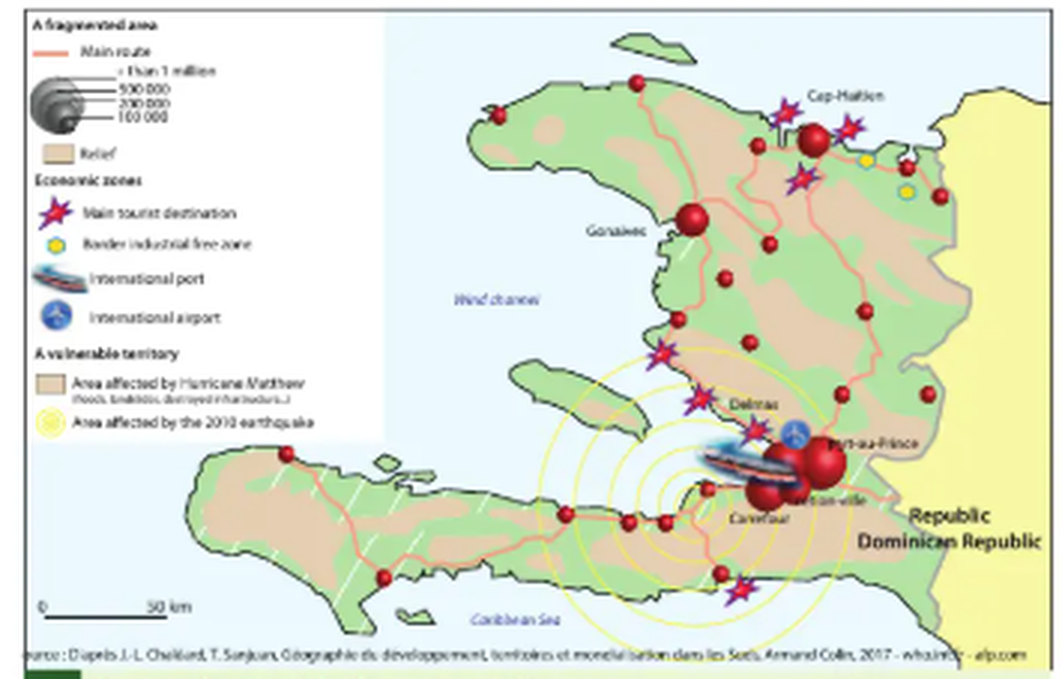
HAITI
A Vulnerable Territory
• The same small country is exposed to hurricanes AND earthquakes — the 2010 quake zone and the Hurricane Matthew zone overlap.
• Economic activity concentrates in a few coastal points: Port-au-Prince, Cap-Haïtien, the border industrial free zone.
• Fragmented: few main routes, so a single damaged road can cut off a whole region from relief.

Slide 24
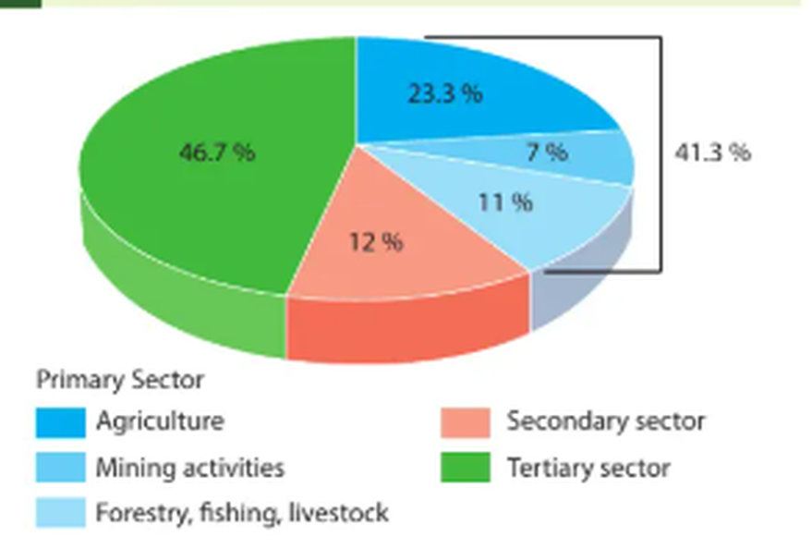
HAITI
An Economy Without a Middle Step
• Primary 41.3%: agriculture 23.3%, forestry/fishing/livestock 11%, mining 7%.
• Secondary 12%: almost no manufacturing — so raw products are never turned into higher-value goods at home.
• Tertiary 46.7%: large, but much of it is low-paid informal services, not banking or technology.
• Link back: Lesson 5 — the Clark-Fisher model expects a country to shift primary → secondary → tertiary. Haiti has skipped the secondary step, which is where most jobs and value are usually created.

Slide 25
CASE STUDY — 2
The Resource Curse
Why having the most valuable rocks on Earth doesn't make you rich — textbook p.28

Slide 26
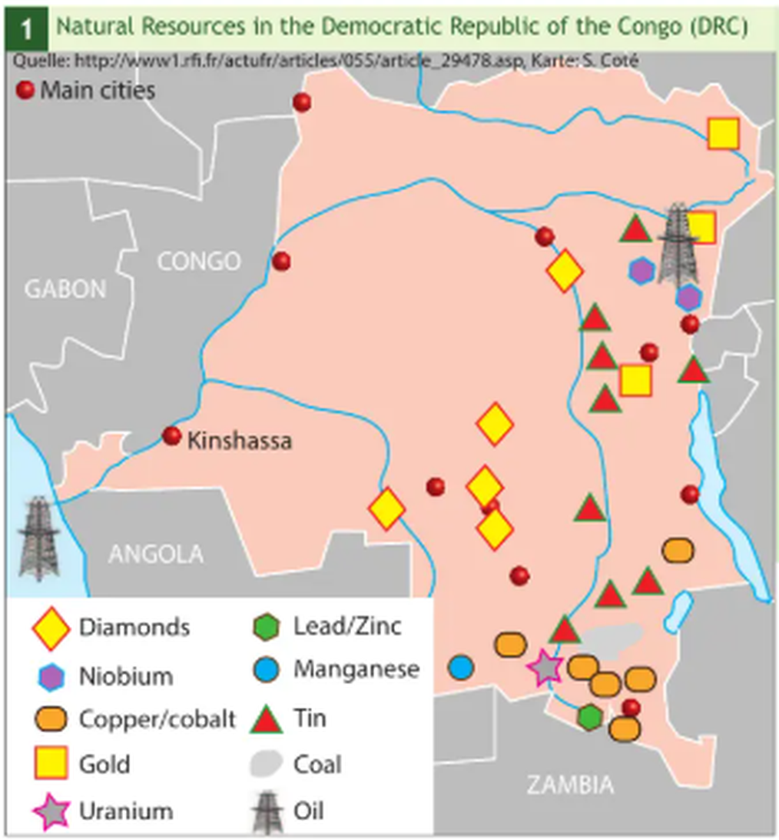
RESOURCE CURSE
The Democratic Republic of the Congo
• Diamonds, gold, uranium, tin, manganese, lead/zinc, coal, oil — and copper/cobalt, the metals every electric-car battery needs.
• By mineral wealth the DRC is one of the richest countries on the planet.
• And yet: it is consistently among the lowest-ranked countries for HDI.
• DESCRIBE it: the resources cluster in the south and east — the same regions with the longest history of armed conflict.

Slide 27
RESOURCE CURSE
How the Curse Works
• Conflict: valuable resources create something worth fighting for. Groups fight for control of resource revenues, which breeds corruption and concentrates power in the hands of a few elites.
• Volatility: heavy reliance on resource exports exposes the whole economy to swings in global commodity prices — boom-and-bust cycles.
• No diversification: the resource sector crowds out the others, so there are few alternative industries and few jobs.
• Weak institutions: poor governance, lack of transparency and ineffective institutions make all of the above worse.
• The headline: resource-rich countries tend to have MORE conflict and authoritarianism and LESS stability and growth than resource-poor neighbours.

Slide 28
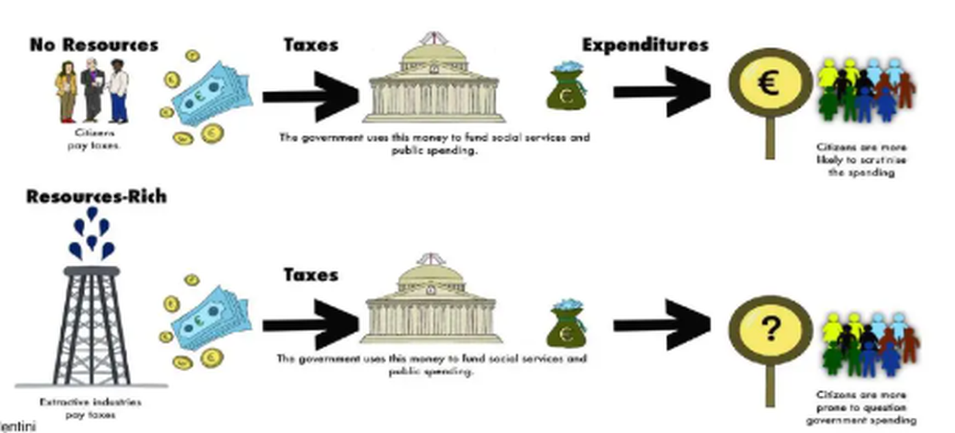
RESOURCE CURSE
Who Holds the Government to Account?
• No resources: citizens pay the taxes, so citizens expect to see where the money goes — and scrutinise the spending.
• Resource-rich: extractive industries pay instead. Citizens no longer fund the state, so that link of accountability breaks — hence the question mark.
• The principle: 'no taxation, no representation.' A government that does not need your money does not need your approval either.

Slide 29
CASE STUDY — 3
Development and Climate
The countries least responsible are hit hardest — textbook p.29

Slide 30
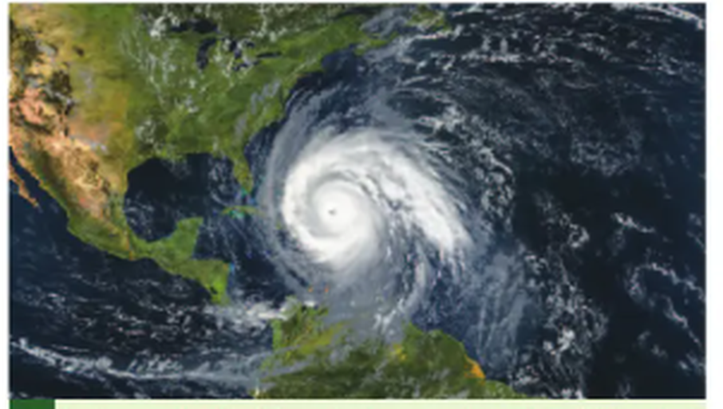
CLIMATE
Record-Breaking Storms
• The Caribbean recorded 30 tropical storms in a single season, including 6 major hurricanes. The World Meteorological Organisation says the region is still recovering.
• On islands like Antigua and Barbuda, many buildings simply could not withstand the intense winds.
• Why it blocks development: money that should build schools is spent rebuilding what already existed. Development runs to stand still.
Source: BBC.

Slide 31
CLIMATE
Adaptation That Isn't Enough
Uganda
• Communities in the Rwenzori region face landslides and floods.
• They dug trenches and planted trees to prevent soil erosion — genuine, local resilience-building.
• But rains are intensifying. Sudden floods overwhelm the defences and sweep the trenches away.
• Adaptation can be outpaced by the hazard it was built for.
Madagascar
• Deforestation has badly damaged the local environment and wildlife.
• Biodiversity has declined significantly.
• Lost forest cover has caused soil erosion, water pollution and higher greenhouse emissions.
• A LIC already suffering poverty and hunger: HDI 0.501 in 2021, 173rd in the world.

Slide 32
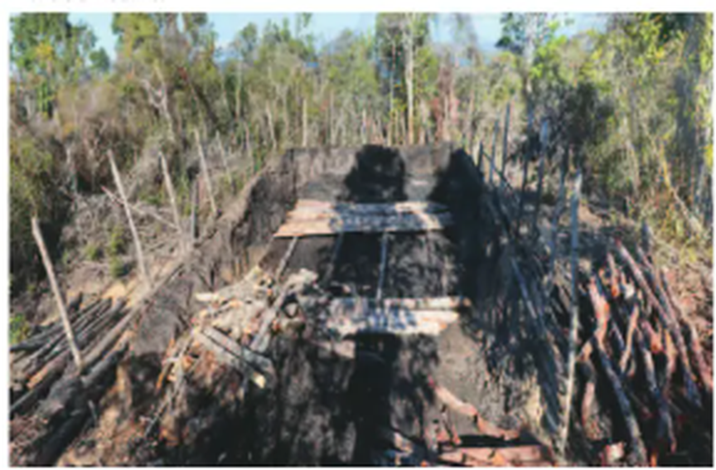
CLIMATE
Madagascar: Clearing the Forest
• Forest is cleared and burned for farmland and charcoal.
• The soil it held in place then erodes, so the new farmland fails within a few seasons — and more forest is cleared.
• Same spiral as Haiti: poverty forces short-term use of the environment, which destroys the long-term basis for development.
• EXPLAIN it: this is why 'environmental' and 'economic' obstacles cannot be separated.

Slide 33
CLIMATE
A Question of Speed
• 2020: the world recorded its highest temperatures since records began in 1880, attributed to human-induced greenhouse gas emissions.
• A shift: Europe and North America were historically the major contributors, but developing and emerging countries — including China — have now surpassed developed countries in CO₂ emissions. In Africa emissions have risen over 25 years while industrialised countries' emissions fell.
• The real risk: if the pace of climate change exceeds a society's ability to adapt, the result is an unsustainable crisis. Societies are slow — there is inertia in technology, politics and consumer habits.
• Syria, 2007-2010: drought is cited as a contributing factor to the tragedy since 2011. It drove massive rural-to-urban migration which, unsupported by the government, fed social unrest.

Slide 34
CASE STUDY — 4
Wealth and Social Inequality in Mexico
A middle-income country where growth has not been shared — textbook pp.30-31

Slide 35
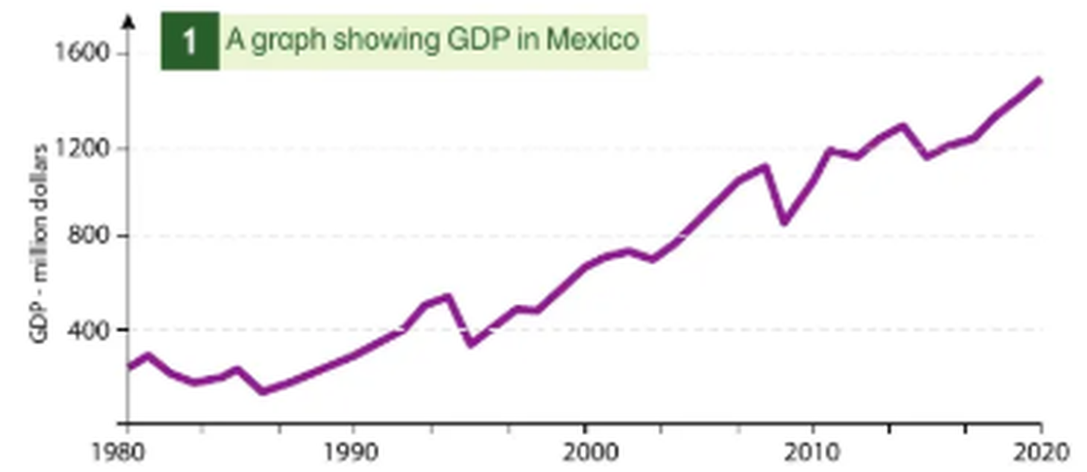
MEXICO
Forty Years of Growth
• Mexico's GDP has grown roughly five-fold since 1980.
• So: this is NOT a country short of money. By total output it is one of the world's larger economies.
• DESCRIBE it: overall upward trend, with sharp dips around 1995 and 2009 — the peso crisis and the global financial crisis.
• The question: if the economy grew this much, why are 44% of Mexicans still poor? That is a distribution problem, not a growth problem.

Slide 36
MEXICO
BRICS and MIST
BRICS
• Brazil, Russia, India, China, South Africa.
• Coined by Goldman Sachs; the better-known grouping.
• Almost four times the GDP of the MISTs.
• Nearly 3 billion potential consumers — 6 times the MIST market.
• Growth has been slowing.
MIST
• Mexico, Indonesia, South Korea, Turkey.
• Attracting investors with consistent growth and a more modest profile.
• Mexico: GDP growth around 4%, interest rates steady at 4% since 2008.
• Mexico's exports are diversified; Brazil still carries the weight of raw materials.
• But Mexico is heavily dependent on the United States.
Source: Paulo A. Paranagua, 'The rivalry between Brazil and Mexico', Le Monde, 2012.

Slide 37
MEXICO
Dominations and Imbalances
• The split: the richest 10% of Mexicans take 42.2% of all income; the poorest 10% receive 1.3%.
• Poverty: at least 44.2% of the population lives in poverty — 33.7% moderate, at least 10.5% extreme.
• Education, rural: 53.4% of the rural population has an education below 7th grade, and 18.9% has no formal education at all.
• Education, urban: 36.2% below 7th grade, 8.9% with no formal education — better, but a second kind of inequality inside the same country.
• Children first: 53.8% of children and adolescents (~21.4 million) were poor in 2010, against 46.2% of the population overall. 7 out of 10 indigenous children under 17 were poor.
• Hunger: child hunger rose from 25.7% to 29.5% between 2008 and 2010; Mexico lost 23 people a day to malnutrition.

Slide 38
MEXICO
Obesity: A Development Problem Too
• The scale: 73% of the population is overweight and 32.8% of adults are obese — up from just 10% in 1989. One child in three is affected.
• The cause: adoption of the North American diet model — fast food and industrially prepared meals — with high animal protein, fat, sugar, flour and salt, while fruit and vegetable consumption fell.
• Soft drinks: Mexico has the highest consumption in the world, averaging 120 litres per person per year.
• The cost: diabetes and hypertension strain the Ministry of Health's finances; today's 5- and 6-year-olds could lose 10 years of life expectancy.
• Why it belongs here: this is an obstacle created BY integration into a richer neighbour's economy — not by isolation from it.

Slide 39
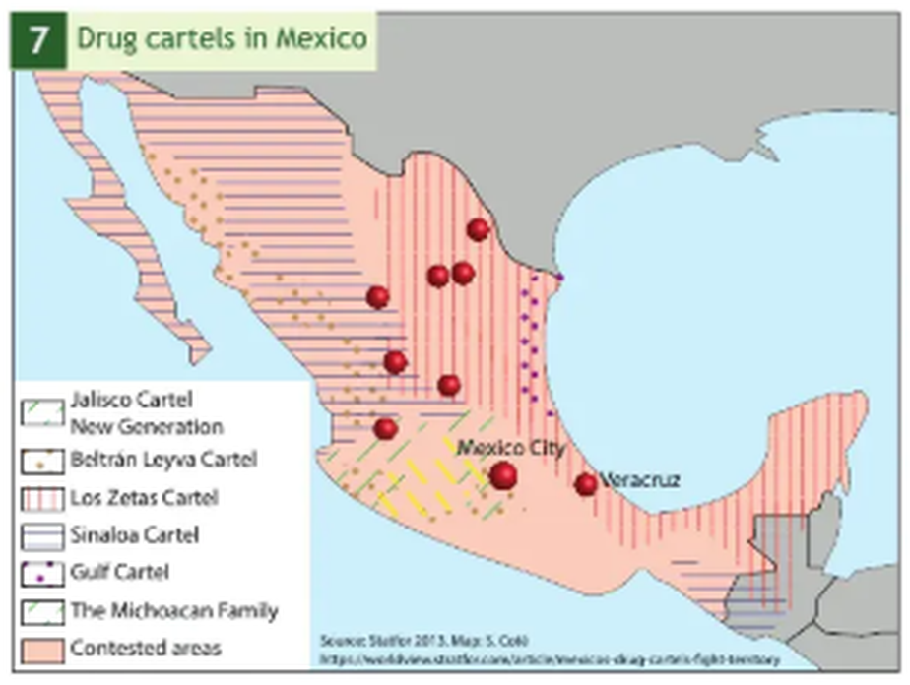
MEXICO
Dependence, Cartels and the Maquiladoras
• 1910-1980s: after the revolution Mexico pursued endogenous development, using internal resources.
• NAFTA, 1994: elites anchored the country to the United States instead. Mexico became a low-wage 'productive annex' in a continental division of labour.
• Maquiladoras: foreign-owned factories importing materials duty-free to produce goods for export — the symbol of that dependence.
• Cartels: with oil revenues declining, the drug trade became one more flow across the same border. Cartels exert significant influence over society, territory and the authorities.

Slide 40
CASE STUDY — 5
North and South Korea
One peninsula, two development models — textbook pp.32-33

Slide 41
KOREA
The Same Starting Point
 | North Korea | South Korea
Population | 25,250,000 | 51,500,000
Density | 209 hab/km² | 513 hab/km²
GDP (PPP) per capita | $1,700 (estimate) | $35,275
HDI | 0.765 | 0.901
Both states emerged from the same Cold War division of one peninsula. South Korea's GDP per capita is now roughly 20 times the North's. Health warning: North Korean figures are estimates — the state publishes very little reliable data, so treat them with caution in an exam answer.

Slide 42
KOREA
Two Models
North — autocentric
• Almost totally isolated; foreign relations limited to China.
• Followed the socialist economic model, turning towards the Chinese model only after 2002.
• Inward-looking: produce everything yourself, depend on no one.
• Development measured by self-sufficiency rather than by trade.
South — extroverted
• A NICA (newly industrialised country in Asia), following Japan, Taiwan, Singapore and Hong Kong.
• Import substitution, 1950-1960.
• Rise of exporting activities, 1960-1973.
• Formation of large industrial conglomerates, 1973-1980.
• Outward-looking: win by selling to the world.

Slide 43
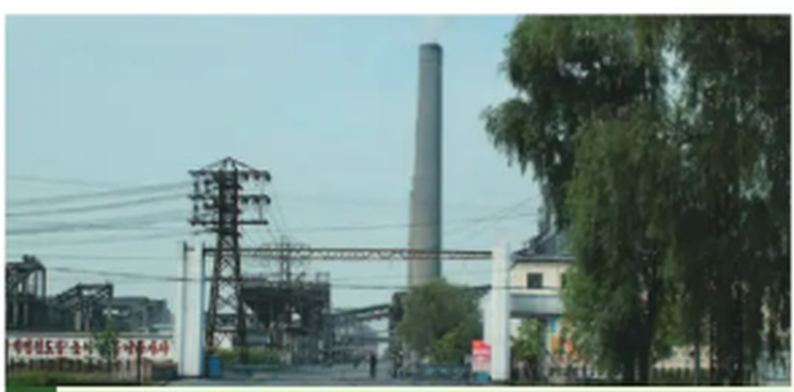
KOREA
Vinalon: Self-Sufficiency in Practice
• Vinalon is a synthetic fibre invented in the late 1930s, made from limestone and anthracite.
• North Korea is rich in both — and is the only country in the world that chose to produce vinalon on an industrial scale, from the 1960s.
• Why: a textbook example of a self-centred industry aiming at self-sufficiency. You can make it entirely from your own rocks.
• The catch: it is heat- and chemical-resistant, but stiff, uncomfortable, shiny and difficult to dye. Nobody else wants it.
• The lesson: independence from trade has a quality cost.

Slide 44
KOREA
Famine in the 1990s
• The limit: by the early 1990s the model built on heavy industry and self-centred development had reached its limits.
• Three shocks at once: the American embargo, the disappearance of the USSR, and natural disasters — drought and floods — after 1990.
• Energy: the end of Soviet oil deliveries at preferential prices worsened the energy shortage, so industry and agriculture both faltered.
• 1994-1998: the famine killed up to a million people out of a population of 20 million. Defectors testified to a UN commission that the struggle for survival eliminated the weakest, disabled, elderly and young children first.
• EVALUATE it: was this a natural disaster or a political one? The floods were natural; the absence of any alternative trade partner was a choice.

Slide 45
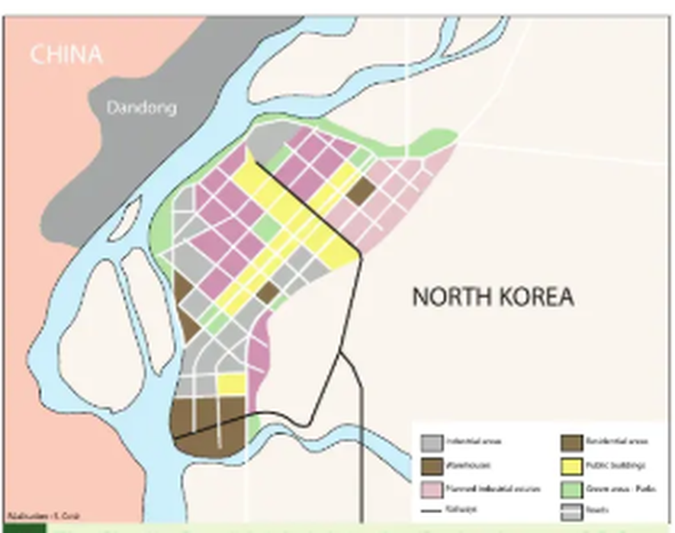
KOREA
Sinuiju: A Crack in the Model
• Sinuiju is one of three Special Administrative Regions in North Korea, created in 2002.
• A turning point: it attempts to reproduce the Chinese model. Companies gain autonomy and can reinvest profits to modernise their production facilities.
• Chinese partnership: Chinese companies are building economic partnerships here.
• The attraction: a disciplined workforce costing 3 to 6 times less than in China, and few taxes on profits.
• Note: the country that rejected trade is now selling the one thing it has — cheap, disciplined labour.

Slide 46
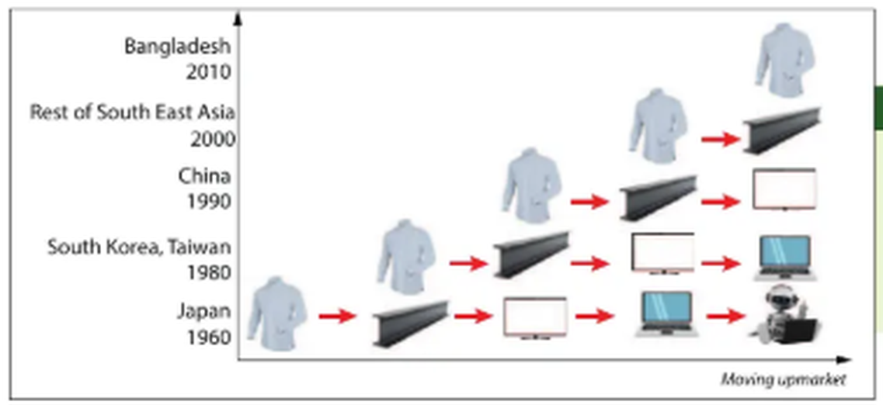
KOREA
The 'Flying Geese' Model
• South Korea industrialised by importing a low-tech product, then manufacturing it, then exporting it — then abandoning it for something with higher added value.
• The sequence: shirts → steel → televisions → laptops → robotics.
• Link back: compare with Rostow's stages (Lesson 6). Each country climbs the same ladder, but later — and passes the bottom rung down.

Slide 47
KOREA
Chaebols and Samsung
• A chaebol: a large Korean industrial group — a set of companies across many fields holding cross-shareholdings in each other, with very significant economic and probably political power. Samsung, LG, Hyundai.
• Why they exist: formed after the Korean War (1950-1953), copying the recipes that had made Japan successful. A few large groups, closely linked to the state, were to finance the country's development.
• Samsung's climb: in the 1980s only a little-known component manufacturer for Japanese brands. It took control of the entire chain, launched its own televisions in the 1990s, bet massively on LCD screens, and by 2012 was the world's largest seller of mobile phones — displacing Nokia.
• The threat now: Chinese firms — Huawei, Lenovo, ZTE — that are cheaper and control their own production chains. The next goose is already flying.

Slide 48
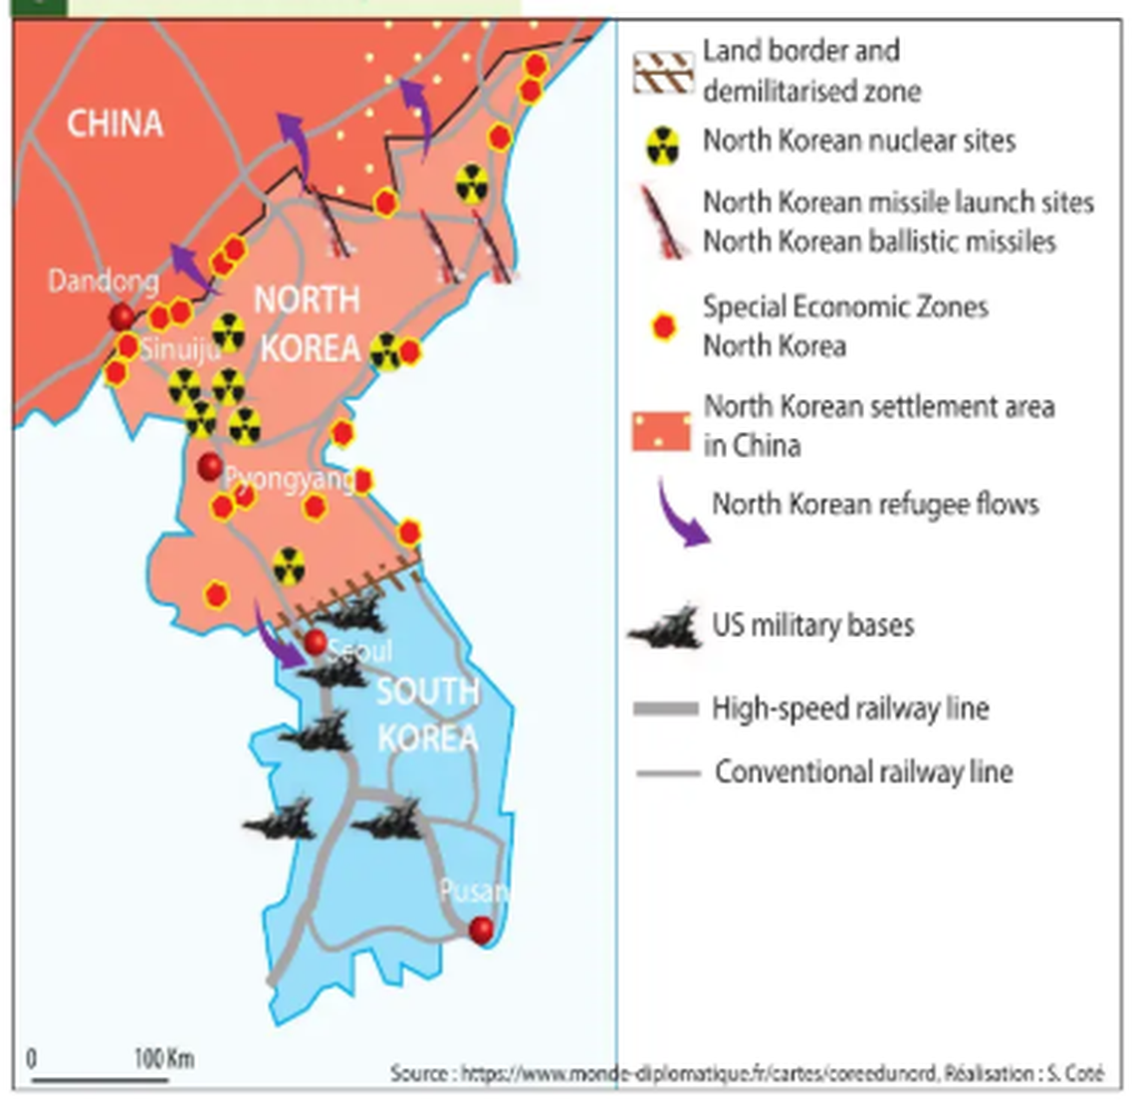
KOREA
The Two Koreas Today
• A militarised land border and demilitarised zone still splits the peninsula.
• North Korea: nuclear sites, missile launch sites, refugee flows towards China, and a handful of Special Economic Zones.
• South Korea: high-speed rail, dense conventional rail — and US military bases.
• EXPLAIN it: the North's spending goes into defence and self-reliance; the South's went into the infrastructure that moves exports to a port.

Slide 49
OTHER OBSTACLES
Worth Knowing (Briefly)
• Environmental: droughts and natural disasters, e.g. Madagascar's deforestation-linked soil erosion.
• Lack of education: fewer skilled workers, slower structural transformation (Lesson 5).
• Unfair trade terms: raw-material exporters often get a worse deal than manufactured-goods exporters — ties back to Dependency Theory (Lesson 6).
• Disease: e.g. Nigeria's under-resourced healthcare system (Lesson 3); COVID-19's uneven global impact.
• Debt: many LICs spend a large share of government revenue just servicing old loans — money that can't then go to health, education, or infrastructure.

Slide 50
SYNTHESIS
One Obstacle Each? Never.
Case study | Obstacles working together
Haiti | Historical (debt, dictatorship) + physical (quake, hurricane) + political (failed governance)
Nigeria | Economic (oil dependency, debt) + political (corruption) + poverty itself
DRC | Physical abundance + political (conflict, no accountability) = the resource curse
Madagascar / Uganda | Environmental (deforestation, floods) + poverty forcing short-term land use
Mexico | Economic (dependence on the USA) + political (cartels) + extreme inequality
North Korea | Political choice (isolation) + physical shocks (drought, floods) = famine
In the exam, never attribute underdevelopment to a single cause. Name two or three and show how they reinforce each other.

Slide 51
For Discussion
Is Inequality Natural?
"Inequality is natural — some people are brighter or more gifted, take more risks, and deserve higher rewards. That's what motivates people to work harder, so inequality actually makes society work better."
Discuss in pairs: build the case FOR this, then AGAINST — using today's obstacles (corruption, debt, being landlocked) as your evidence. No single correct answer.

Slide 52
EXAM PRACTICE
Evaluate It
EVALUATE which is the bigger obstacle to development: a natural constraint (e.g. being landlocked) or a human constraint (e.g. corruption). Use examples from this lesson.
(EVALUATE = weigh both sides, then reach a justified conclusion.)

Slide 53
EXAM PRACTICE
Two More, Using the Case Studies
• EXPLAIN why the Democratic Republic of the Congo's mineral wealth has not raised its HDI. Refer to at least two mechanisms of the resource curse.
• EVALUATE the claim that 'Mexico's problem is not growth but distribution.' Use figures from the case study on both sides.
• Reminder: EXPLAIN = give reasons, show the chain of cause and effect. EVALUATE = weigh both sides, then conclude. Always quote a figure or a named place.

Slide 54
https://www.youtube.com/watch?v=GleSOqThfJw

