Slide 1
S7 SCIENCE, TECHNOLOGY & SOCIETY · SEMESTER 1 · PERIOD 1
Weather, Climate, and
Earth's Energy Budget
Climate Change and Biodiversity — how our planet's climate system works, and what the evidence actually shows.
S7 STS · Climate Change & Biodiversity · Period 1

Slide 2
A CLAIM YOU'VE PROBABLY HEARD
“It snowed last week — so much for global warming.”
Is this actually a valid scientific argument?
Think about it before the next slide: what would you need to know to properly evaluate this claim?
S7 STS · Climate Change & Biodiversity · Period 1

Slide 3
DEFINITIONS
Weather vs. Climate
Weather
Climate
The state of the atmosphere at a specific place and moment: today's temperature, rainfall, wind, cloud cover. Changes hour to hour, day to day.
The average pattern of weather in a region over a long period — typically 30 years or more. It's the statistical summary, not any single day.
According to the World Meteorological Organization (WMO), the standard reference period for defining a region's climate is 30 years.
S7 STS · Climate Change & Biodiversity · Period 1

Slide 4
WHY THE CLAIM FAILS
One Snowy Week Tells You Nothing About Climate
• The error: confusing a single data point (one cold week) with a long-term trend (average conditions over decades).
• An analogy: weather is your mood today; climate is your personality — measured over years, not a single afternoon.
• The actual test: is the 30-year average shifting, not whether any one week or winter felt cold.
S7 STS · Climate Change & Biodiversity · Period 1

Slide 5
BEYOND A SINGLE REGION
Types of Climate
• Climates are grouped into broad categories based on typical temperature and precipitation patterns — this is the basis of the Köppen climate classification, the most widely used system in the world.
• The major groups: include Tropical, Dry (arid/desert), Temperate, and Continental climates, each covering very different regions of the globe.
• Why it matters here: different climate zones respond differently to climate change — this is part of why “biodiversity” is in this topic's title alongside “climate change.”
S7 STS · Climate Change & Biodiversity · Period 1

Slide 6
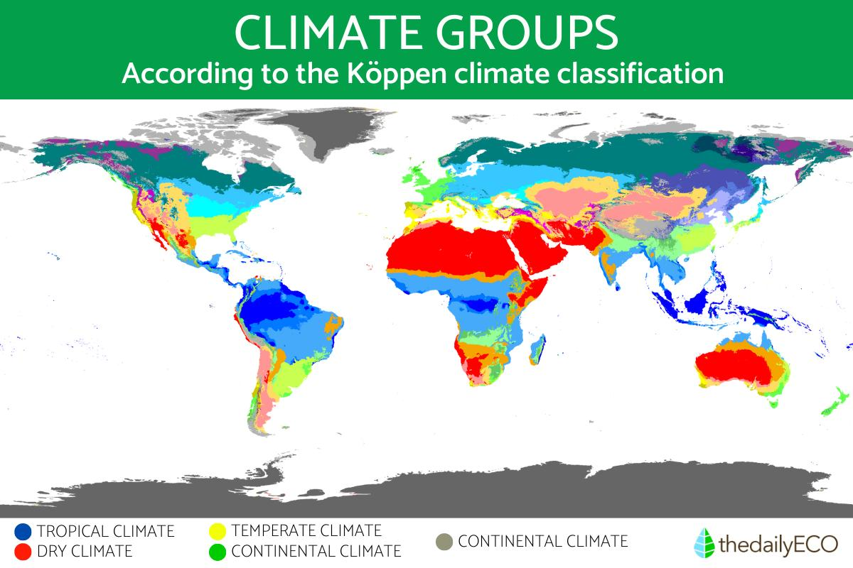
THE WORLD'S CLIMATE ZONES
The Köppen Climate Classification
S7 STS · Climate Change & Biodiversity · Period 1

Slide 7
A WORKING DEFINITION
What Is Climate Change?
• Climate change refers to long-term changes in Earth's temperature, weather patterns, and atmospheric conditions.
• The main cause: human activities such as burning fossil fuels, deforestation, and industrial processes.
• The mechanism: these activities emit greenhouse gases — including carbon dioxide (CO₂) and methane (CH₄) — which trap heat in the atmosphere and contribute to global warming.
S7 STS · Climate Change & Biodiversity · Period 1

Slide 8
THE SYLLABUS CORE IDEA
Earth's Energy Budget
• Earth's energy budget is, simply put, our planet's energy balance sheet: the balance between the solar energy entering Earth's system and the thermal energy that leaves and returns to space.
• Incoming energy: Earth receives energy only from the Sun, as short-wave radiation (mainly visible light and UV). Treat the energy reaching the top of the atmosphere as 100%.
• Reflection (≈29-30%): part of the radiation — the albedo — is reflected straight back to space by clouds, atmospheric particles, and light-coloured surfaces (ice, snow, deserts).
• Absorption (≈70-71%): the rest is absorbed by the atmosphere, oceans, and land — this is the energy that warms the planet, melts ice, evaporates water, and drives weather.
• Outgoing energy: to avoid overheating, Earth must eventually release the energy it absorbed — not as visible light (Earth is far colder than the Sun), but as long-wave, infrared radiation (heat).
S7 STS · Climate Change & Biodiversity · Period 1

Slide 9
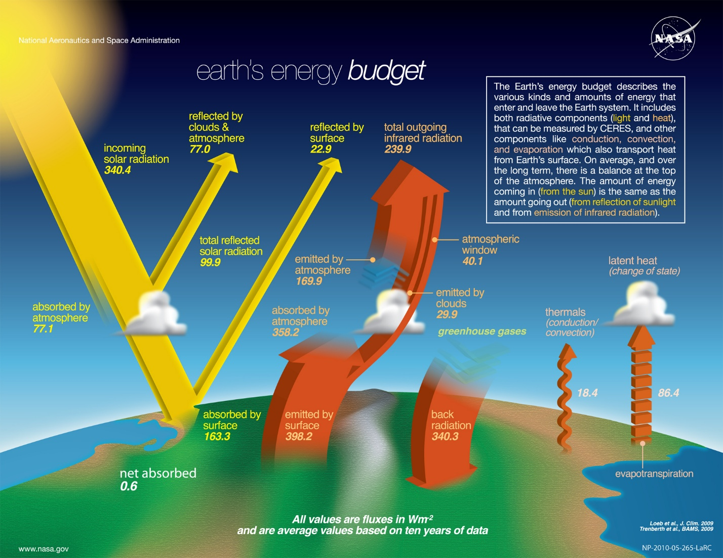
THE NUMBERS BEHIND THE BALANCE
Earth's Energy Budget, Quantified (NASA/CERES)
S7 STS · Climate Change & Biodiversity · Period 1

Slide 10
THE KEY TO CLIMATE CHANGE
The Role of Greenhouse Gases
• Gases such as carbon dioxide (CO₂), methane (CH₄), and water vapour (H₂O) act like “filters”:
• Transparent to incoming radiation: short-wave solar radiation passes through them largely unaffected.
• Opaque to outgoing radiation: but they absorb long-wave, infrared radiation trying to escape.
• The mechanism: through molecular vibration, they absorb this escaping heat and re-emit it in all directions — including back down toward Earth's surface. This is the Natural Greenhouse Effect, essential for life: without it, Earth's average temperature would be –18°C instead of +15°C.
S7 STS · Climate Change & Biodiversity · Period 1

Slide 11
WHY IT'S ESSENTIAL
The Benefits of the Natural Greenhouse Effect
• Keeps water liquid: raising the average temperature by 33°C (–18°C → +15°C) let water remain liquid — the solvent and setting for life's first chemistry.
• Smooths out temperature extremes: greenhouse gases act as a “thermal blanket.” Airless bodies like the Moon swing from +120°C by day to –130°C by night; Earth stays in a stable, life-friendly range.
• Powers biogeochemical cycles: trapped heat drives weather, the water cycle, and ocean currents — redistributing nutrients across the planet.
• Protects biodiversity: millions of years of climate stability let ecosystems evolve and diversify, from early photosynthesising organisms to complex mammals.
S7 STS · Climate Change & Biodiversity · Period 1

Slide 12
WHEN THE BALANCE SHIFTS
The Positive Balance (Radiative Forcing)
• When balanced: incoming = outgoing energy, and climate is stable.
• What's changed: human activities have dramatically increased greenhouse gas concentrations, so Earth now traps more energy than it emits back to space.
• The surplus: roughly 1 extra watt per square metre, globally — the balance is now “positive.”
• Where that extra energy goes: it warms the atmosphere, melts the cryosphere (glaciers and ice), and is absorbed by the oceans at about 90% — directly raising Ocean Heat Content, next lesson's topic.
S7 STS · Climate Change & Biodiversity · Period 1

Slide 13
KEY TAKEAWAYS
What You Should Walk Away With
• Climate ≠ weather: climate is the long-term average (30+ years, per the WMO), not any single event.
• “It snowed, so no warming” confuses a data point with a trend — a common but flawed argument.
• Earth's energy budget balances incoming solar radiation (~29-30% reflected, ~70-71% absorbed) against outgoing infrared radiation.
• The natural greenhouse effect adds about 33°C of warming (–18°C → +15°C) and is essential for liquid water, stable temperatures, weather cycles, and biodiversity.
• Human activity has pushed the balance “positive” (~+1 W/m²) — Earth now traps more energy than it releases.
NEXT LESSON
Period 2 — Ocean Heat Content: where ~90% of today's extra energy is going, and what it means for the planet.
S7 STS · Climate Change & Biodiversity · Period 1

