Slide 1
S7 SCIENCE, TECHNOLOGY & SOCIETY · SEMESTER 1 · PERIOD 3
Ocean Heat Content, Part 2:
Life in a Warming Sea
Climate Change and Biodiversity — what happens to marine life when the ocean's heat content keeps rising.
S7 STS · Climate Change & Biodiversity · Period 3

Slide 2
WHERE WE LEFT OFF
Not Just a Number in Physical Oceanography
• Last lesson: Ocean Heat Content (OHC) is accelerating — from ≈2 to ≈12 Hiroshima-bomb equivalents per second since 1980.
• Today's question: what does all that extra heat actually DO to life in the ocean?
• A rise in ocean heat content causes direct, measurable changes to the physiology, biochemistry, and distribution of marine life — not just a number on a graph.

Slide 3
MECHANISM 1
Speeding Up Metabolism
• The vast majority of marine organisms are ectotherms their body temperature matches their surroundings — unlike mammals and birds, they can't regulate it internally.
• What warmer water does: it speeds up their enzyme activity and basic metabolism.
• The consequence: ectotherms suddenly need more food and more oxygen just to keep their basic cellular functions running — even before anything else changes.

Slide 4
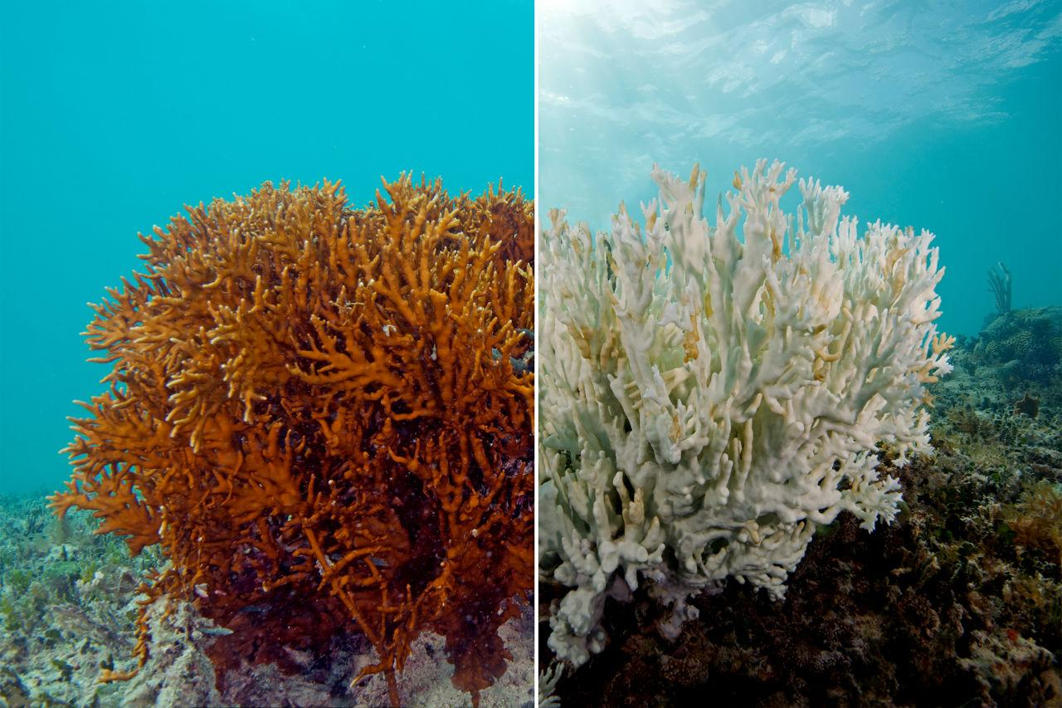
MECHANISM 2
When Coral Loses Its Colour
• The symbiosis: coral polyps host microalgae (zooxanthellae) in their tissue, which photosynthesise and feed the coral.
• Under heat stress: this partnership breaks down — the coral expels the algae, loses its colour, and starts to starve.
• The scale, right now: the 4th global bleaching event (2023–2025) hit heat-stress levels on 84% of the world's reef area — up from 21% (1998), 37% (2010), and 68% (2014–17). Each event has been bigger than the last.
S7 STS · Climate Change & Biodiversity · Period 3

Slide 5
Watch: What is coral bleaching?
https://www.youtube.com/watch?v=ELBrybrYrGo

Slide 6
MECHANISM 3
A Suffocating Ocean
• Warm water is lighter: so it forms a stable surface layer that resists mixing with colder, deeper water.
• The result — stratification: nutrients can't rise to feed surface phytoplankton, and dissolved oxygen can't sink to the depths.
• Add to that: warmer water simply holds less dissolved gas — so the deep ocean loses oxygen (hypoxia) on top of losing nutrient supply.
• The evidence: the ocean has lost over 2% of its oxygen in the last 50 years. Open-ocean oxygen-minimum zones have expanded by more than 4.5 million km² since 1950. Known coastal “dead zones” have grown from 45 sites in the 1960s to over 700 today.

Slide 7
CASE STUDY
The Blob: A Marine Heatwave in Action
• What happened: from 2014 to 2016, a massive marine heatwave (“The Blob”) gripped the Northeast Pacific, from the Gulf of Alaska down the US West Coast.
• Biological toll: fish stocks shifted location, toxic algal blooms spread along the coast, humpback whales became entangled in fishing gear in unusual numbers, and thousands of starving sea lion pups washed up on beaches.
• Economic toll: fisheries losses triggered official federal disaster declarations in the US, with costs exceeding $140 million — and a toxic algae bloom delayed the opening of the valuable Dungeness crab season.
• Why it matters here: this is what “biogeographic shifts” and “metabolic stress” actually look like in the real world, all at once.

Slide 8
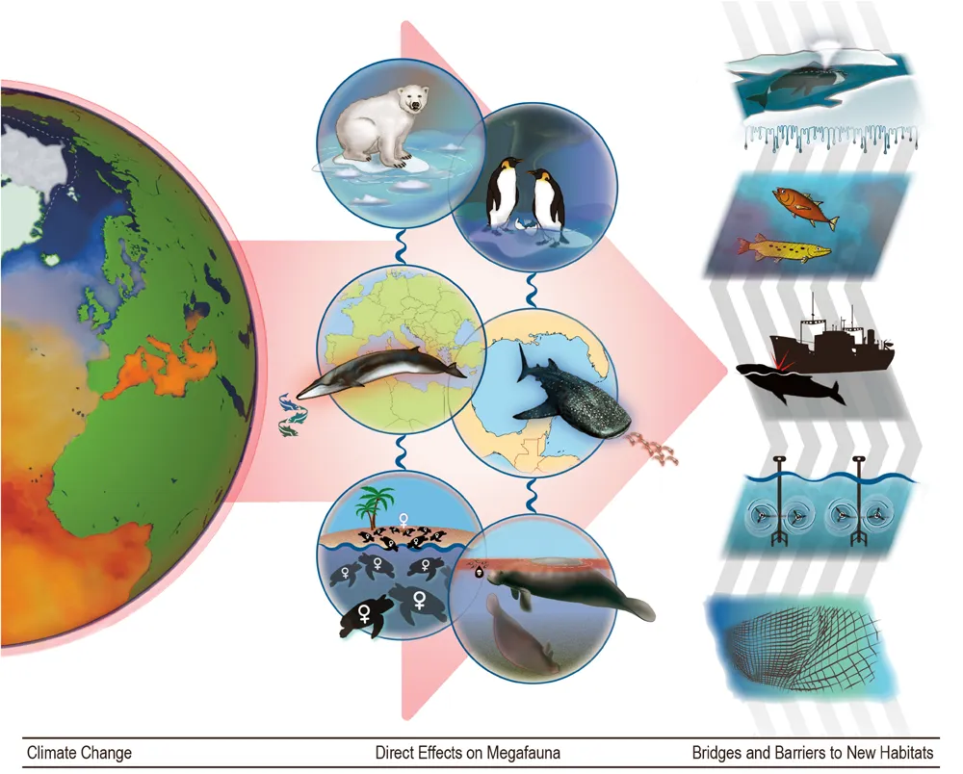
MECHANISM 4
On the Move
• Biogeographic shifts: to stay within their thermal limits, marine species migrate rapidly toward the poles or into deeper water.
• This reshuffles food webs and threatens species with nowhere left to go — especially endemic species.
• Megafauna examples: polar bears and emperor penguins lose their sea-ice habitat; whales and whale sharks lose access to prey; sea turtles and dugongs face disrupted development and higher toxin exposure.
S7 STS · Climate Change & Biodiversity · Period 3

Slide 9
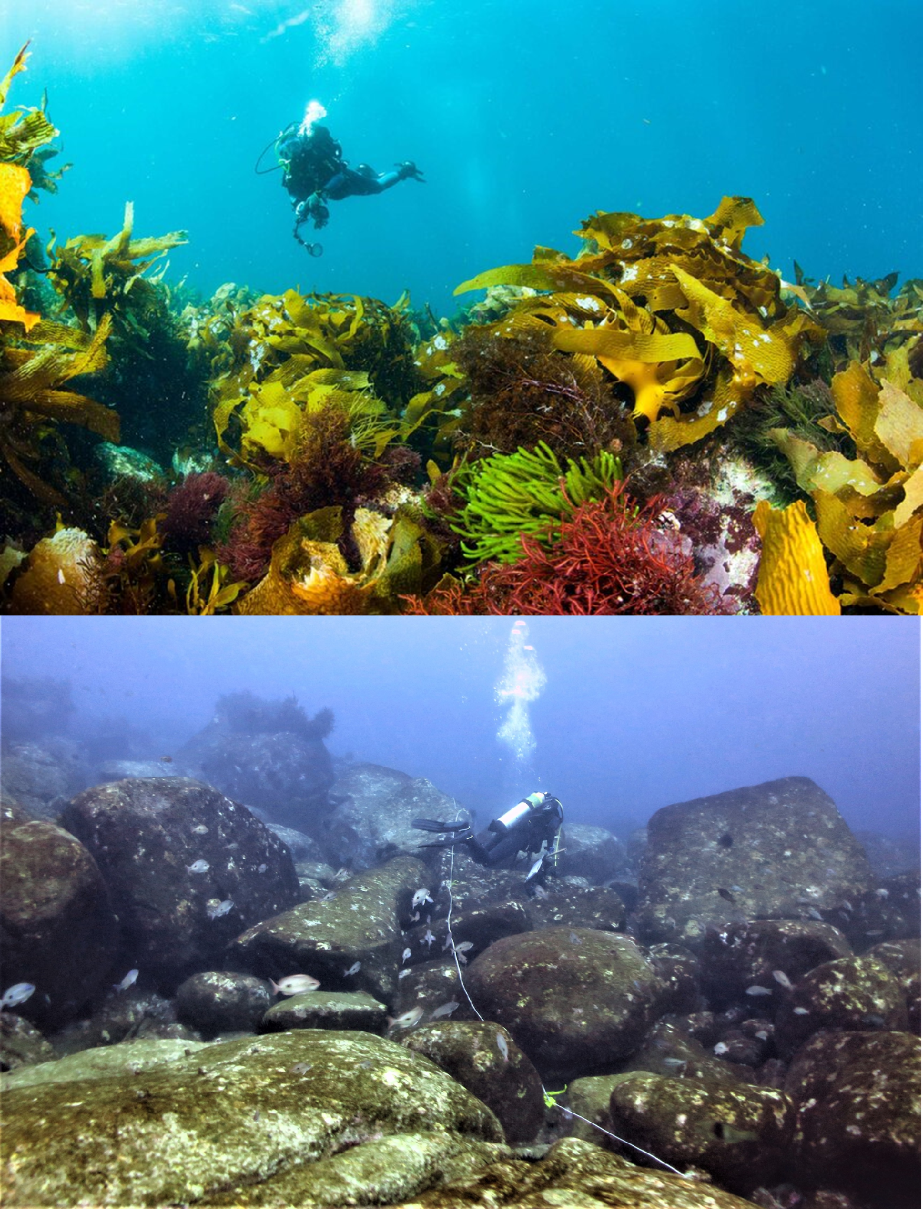
MECHANISM 5
Vanishing Underwater Forests
• Seagrass meadows have narrow thermal tolerances — marine heatwaves can wipe out large areas almost overnight.
• Kelp forests retreat as warming favours the sea urchins that overgraze them.
• Why it matters: losing these habitats removes critical food, shelter, and nursery grounds for hundreds of connected species.
S7 STS · Climate Change & Biodiversity · Period 3

Slide 10
KEY TAKEAWAYS
What You Should Walk Away With
• Ocean warming doesn't just change a number — it speeds up metabolism in most marine life, which are ectotherms.
• Coral bleaching is a breakdown of symbiosis (coral + zooxanthellae) under heat stress — and the 4th global bleaching event (2023–25) affected 84% of the world's reefs.
• Warming causes ocean stratification, cutting off nutrients and oxygen to different depths.
• Species are shifting poleward and deeper, reshuffling food webs and endangering species with nowhere to go — including whole underwater forests (seagrass, kelp).
NEXT LESSON
Period 4 — the other half of the story: what ocean heat does to sea level, ice, storms, and rainfall.
S7 STS · Climate Change & Biodiversity · Period 3

