Slide 1
S7 SCIENCE, TECHNOLOGY & SOCIETY · SEMESTER 1 · PERIOD 4
Ocean Heat Content, Part 3:
A Planet Reacts
Climate Change and Biodiversity — what ocean heat does to sea level, ice, currents, storms, and rainfall.
S7 STS · Climate Change & Biodiversity · Period 4

Slide 2
WHERE WE LEFT OFF
Two Kinds of Consequences
• The huge amount of heat the oceans absorb doesn't stay put — it constantly interacts with the atmosphere, ice, and land.
• Physical changes: direct changes to the water itself — expansion, melting, circulation.
• Climate/weather changes: what happens when all that released energy reaches the atmosphere.

Slide 3
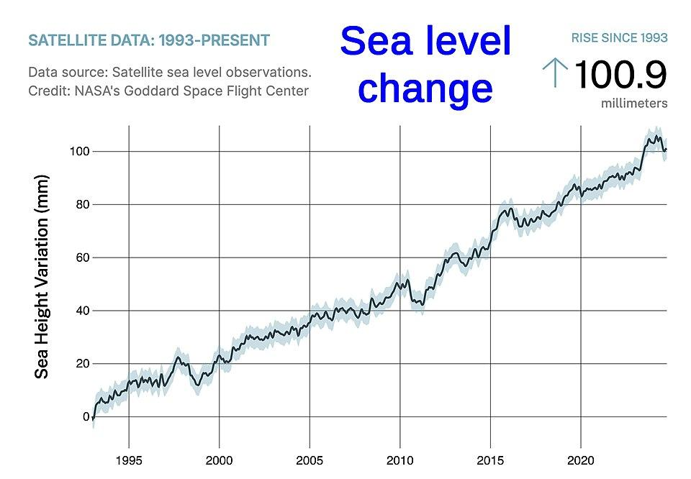
PHYSICAL IMPACT 1
Thermal Expansion: The Simplest Physics
• The mechanism: as water warms, its molecules gain kinetic energy, spread apart, and take up more volume — no ice or extra water needed.
• The scale: this simple physical process accounts for over 50% of the global sea level rise observed so far.
• The data: satellite measurements (NASA Goddard) show sea level has risen about 100mm since 1993 — and the rate is accelerating, not steady.
S7 STS · Climate Change & Biodiversity · Period 4

Slide 4
Watch: Watching Rising Seas From Space (NASA JPL)
https://www.jpl.nasa.gov/videos/video-watching-rising-seas-from-space/

Slide 5
PHYSICAL IMPACT 2
Melting From Below
• The mechanism: warmer ocean currents circulate underneath ice shelves in Antarctica and Greenland, melting them from below (“basal melt”).
• Why it's dangerous: this weakens the ice's support structure, causing faster collapse into the ocean — accelerating sea level rise further.
• The data: global glacier mass balance has gone from roughly stable in the 1980s to losing several hundred gigatonnes a year now — and the annual loss keeps getting bigger.
S7 STS · Climate Change & Biodiversity · Period 4

Slide 6
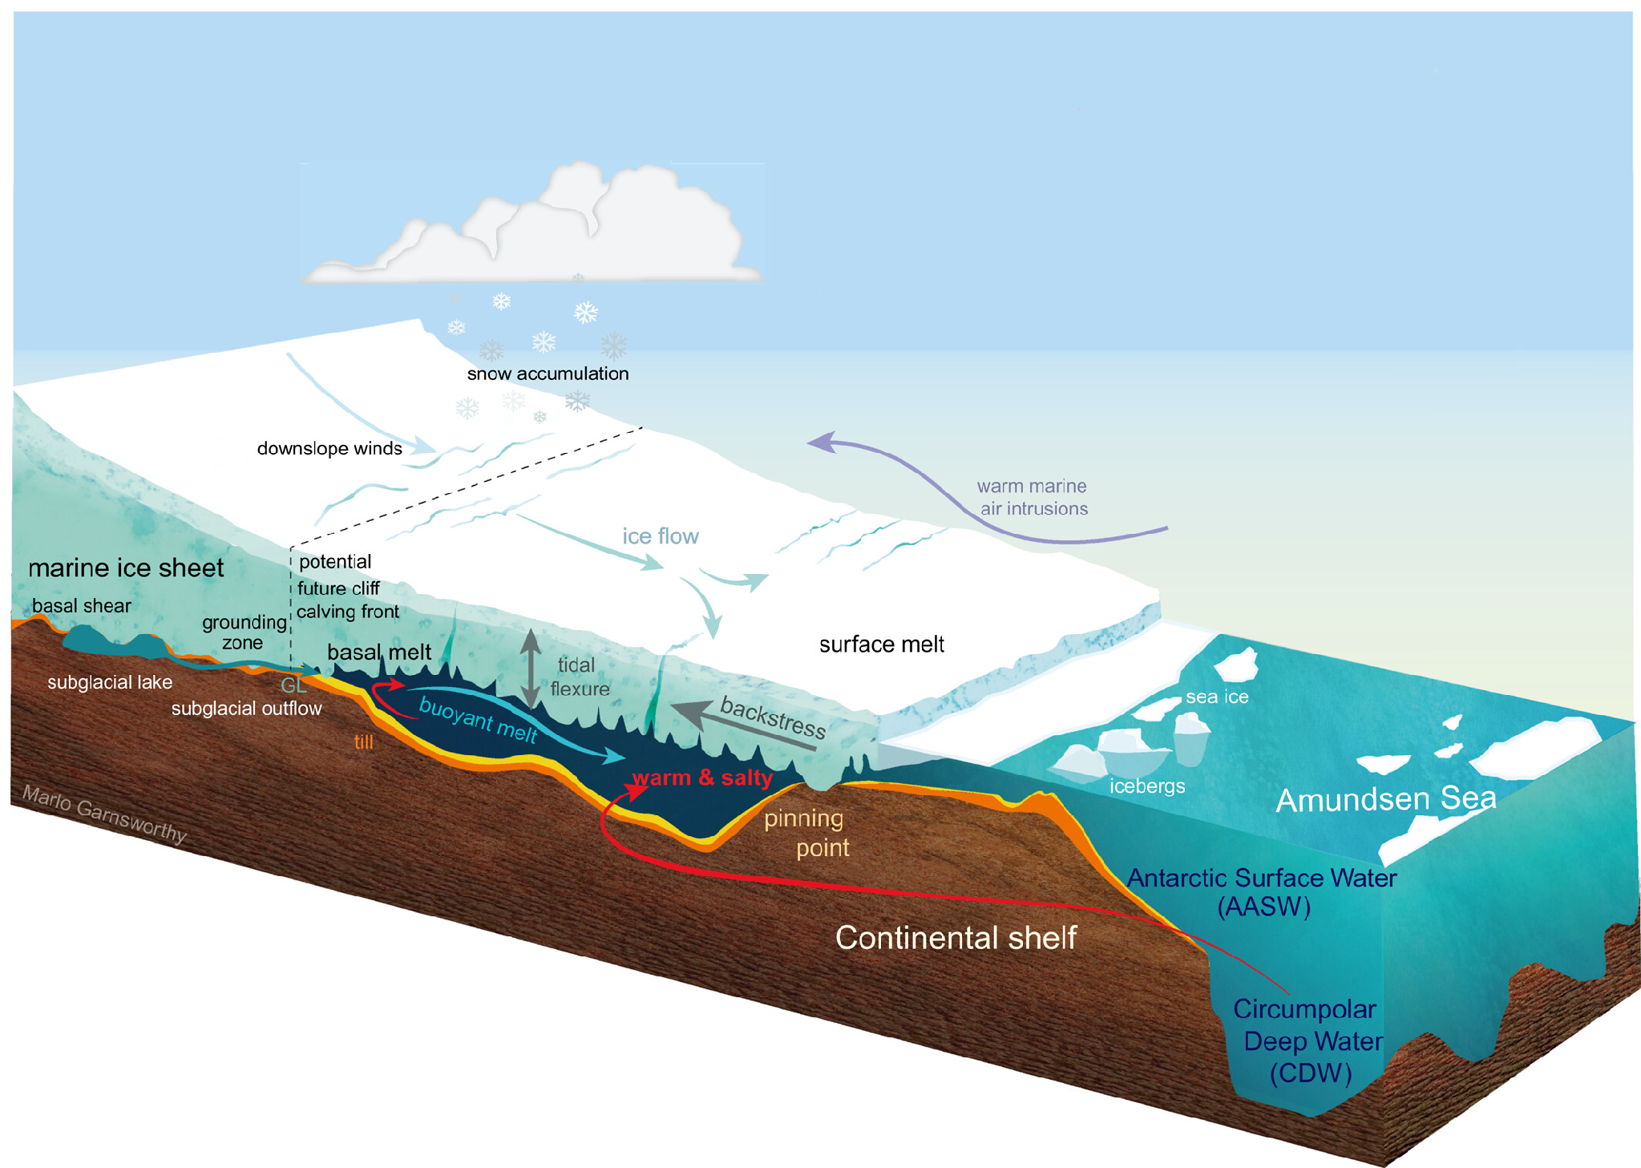

Slide 7
CASE STUDY
The “Doomsday Glacier”
• Thwaites Glacier, Antarctica: roughly the size of Florida, and already losing about 50 billion tonnes of ice a year — basal melt from warm ocean currents is a key driver.
• Current contribution: about 4% of global sea level rise comes from Thwaites alone, right now.
• If it collapsed on its own: sea level would rise by about 65cm.
• The bigger risk: Thwaites acts like a cork holding back a much larger part of the West Antarctic Ice Sheet. If it destabilises that ice sheet too, the unlocked potential is over 3 metres of global sea level rise.
• The nickname: “Doomsday Glacier” — not because collapse is guaranteed or imminent, but because of how much is riding on a glacier few people have heard of.

Slide 8
PHYSICAL IMPACT 3
A Weakening Current
• AMOC (Atlantic Meridional Overturning Circulation): a system of currents — including the Gulf Stream — that carries warm water north and cold water south in the Atlantic.
• The mechanism: warming surface water, plus fresh meltwater pouring in, makes North Atlantic water less dense — so it sinks less easily, slowing the whole circulation.
• The evidence: AMOC has weakened by about 10% since the early 2000s (continuously monitored only since 2004); some models project 50%+ weakening by 2100.
• Why it matters: a weaker AMOC could significantly reshape temperature and rainfall patterns across Europe and North America.

Slide 9
CLIMATE IMPACT 1
Supercharged Rain
• The mechanism: warm air above warm oceans holds more moisture — about 7% more for every 1°C of warming.
• The result: huge amounts of water vapour get transported over land in “atmospheric rivers,” producing catastrophic, fast-moving rainfall and flash floods.
• In short: a hotter ocean doesn't just mean hotter weather — it means a more intense water cycle overall.

Slide 10
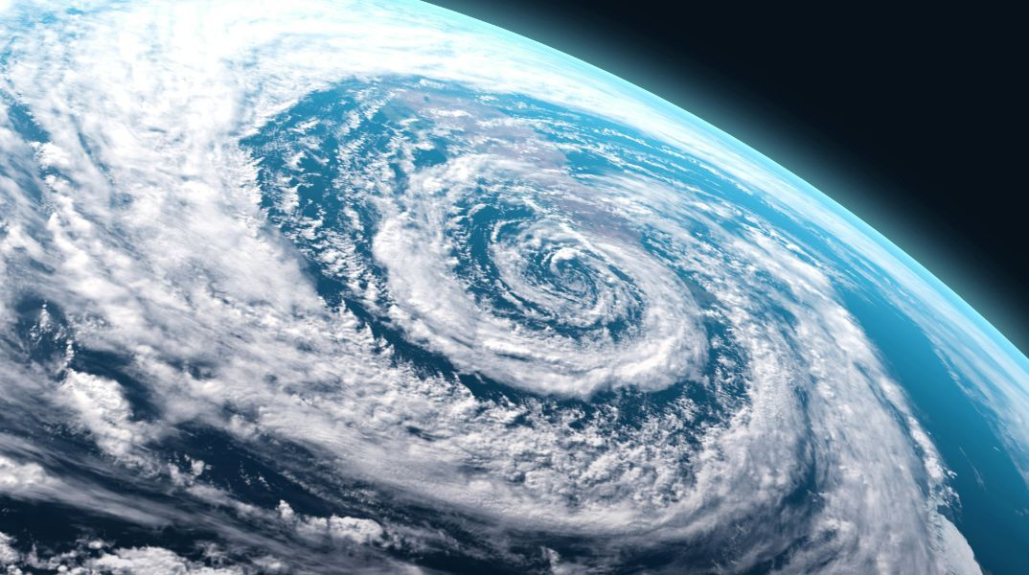
CLIMATE IMPACT 2
Stronger, Not Just More
• The mechanism: tropical cyclones draw their energy from evaporating warm seawater — a hotter ocean supplies more “latent heat.”
• The result: not necessarily more hurricanes, but much stronger ones, with faster rapid intensification.
• The evidence: ~80% of major hurricanes (Cat. 3–5) now undergo rapid intensification; Atlantic hurricanes are twice as likely to do so as 30 years ago; it's 50% more likely during a marine heatwave.
• A real example: Hurricane Milton (2024) intensified by 120 mph in under 36 hours, over water made 400–800 times more likely by climate change.
S7 STS · Climate Change & Biodiversity · Period 4

Slide 11
CLIMATE IMPACT 3
When the Ocean Gets a Fever
• Marine heatwaves: just like heatwaves on land, huge zones of the ocean can overheat for days to months at a time.
• The mechanism: these warm patches affect the weather systems above them, often “locking” high-pressure systems over nearby land.
• The result: prolonged droughts on land, driven by what's happening out at sea.

Slide 12
PUTTING IT ALL TOGETHER
The Cause-and-Effect Chain
Thermal expansion
→ Sea level rise
Marine heatwaves
→ Droughts on land
Basal ice melt
→ Sea level rise, faster
Rising Ocean
Heat Content
AMOC weakening
→ Shifting EU/NA climate
More latent heat
→ Stronger hurricanes
More evaporation
→ Extreme rain & floods
One root cause, many downstream effects — physical and climate impacts aren't separate problems, they're the same problem branching out.

Slide 13
KEY TAKEAWAYS
What You Should Walk Away With
• Thermal expansion alone accounts for over 50% of observed sea level rise — no melting required, just physics.
• Basal melt (warm currents melting ice shelves from below) is accelerating ice loss in Antarctica and Greenland.
• AMOC has weakened about 10% since the early 2000s, with much larger weakening projected by 2100.
• A hotter ocean supercharges the water cycle: more intense rainfall, faster-intensifying hurricanes, and marine heatwaves that lock in droughts on land.
NEXT LESSON
Period 5 — back to the evidence itself: average surface temperature, sea level, ocean acidification, and consilience.
S7 STS · Climate Change & Biodiversity · Period 4

