Slide 1
CLIMATE BRIEFING · ENSO 2026–27
El Niño is reshaping the tropical Pacific
A powerful ocean–atmosphere reorganisation is underway, shifting equatorial heat, altering jet streams, and driving global climate risks.
ATMOSPHERIC & OCEANIC ASSESSMENT
NOAA & WMO DIAGNOSTIC UPDATE · SEPTEMBER 2026 BASELINE
Notes:
Introduce the briefing: we are tracking an active, intensifying El Niño event that reorganises Pacific heat and alters climate risks around the globe.

Slide 2
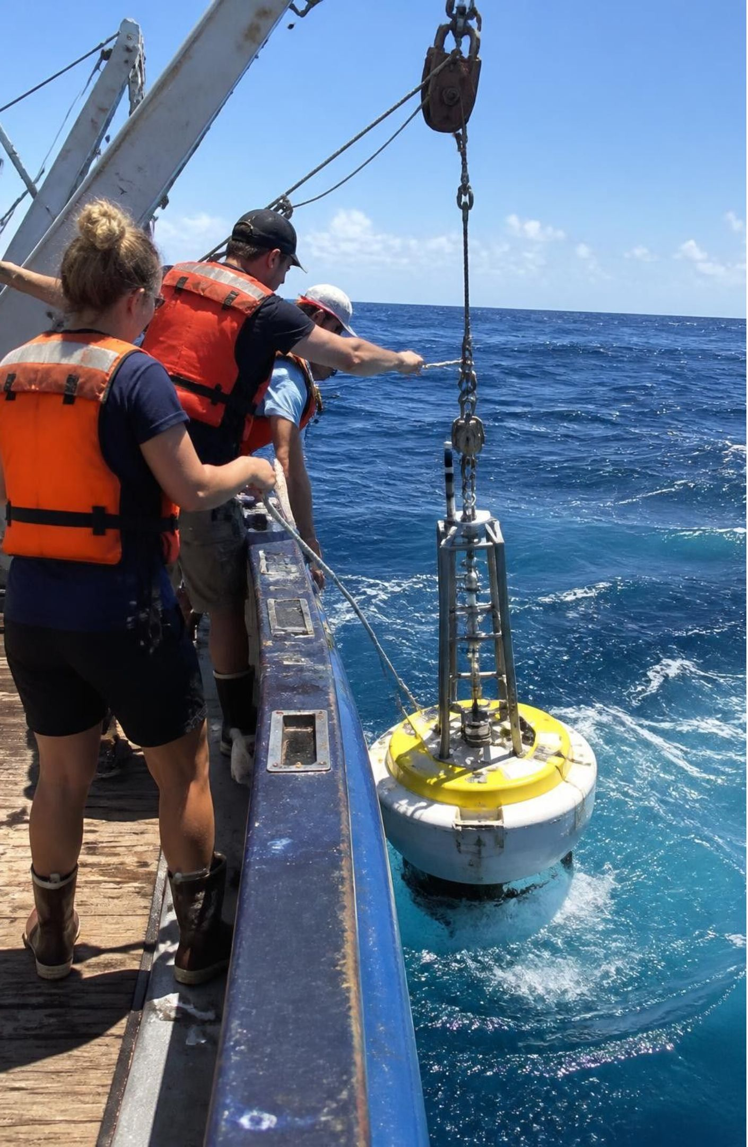
ENSO
El Niño is one half of the ENSO climate cycle
ENSO links ocean temperatures in the tropical Pacific with changes in atmospheric pressure, winds, rainfall, and jet streams.
El Niño is the warm phase; La Niña is the cool phase; neutral conditions sit between them.
These events are natural, but their effects now unfold on a warmer planet.
EQUATORIAL MOORED BUOY ARRAY · TAO NETWORK
Notes:
Explain the ENSO continuum. Emphasize that El Niño is not an isolated shock, but the warm phase of an ongoing natural coupled cycle now occurring on a warmer planet.

Slide 3
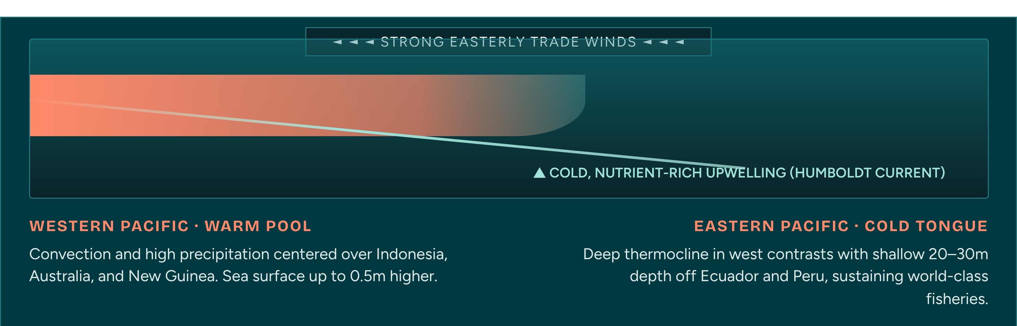
EQUATORIAL PACIFIC BASELINE · NEUTRAL WALKER CIRCULATION
Normal Pacific winds pile warm water toward Asia
Steady easterly trade winds push surface water west, maintaining a steep thermocline tilt across 15,000 kilometres of ocean.
Notes:
Trace the equatorial Pacific cross-section under normal conditions: trade winds drag warm surface water to the west, forcing rich cold water to upwell along South America.

Slide 4
PACIFIC CIRCULATION · BEFORE AND DURING
During El Niño, the warm pool shifts east
Pacific feature | Normal conditions | During El Niño
Trade winds | Blow from east to west across the equatorial Pacific. | Weaken or can briefly reverse.
Warm water | Gathers near Indonesia and Australia. | Moves toward the central and eastern Pacific.
Upwelling | Cold, nutrient-rich water rises near Peru and Ecuador. | Weakens near South America, changing marine ecosystems and fisheries.
Atmosphere: Heat and moisture released to the atmosphere reorganize rainfall and circulation.

Slide 5
PLANETARY TELECONNECTIONS · SEASONAL FOOTPRINTS
A Pacific anomaly becomes a global weather signal
Atmospheric wave trains known as teleconnections transmit the Pacific heat engine across oceans, shifting jet streams and altering seasonal risks worldwide.
The Americas
Indo-Pacific
Atlantic Basin
Africa & Asia
HEAVY RAIN & FLOODS
DROUGHT & FIRE RISK
CYCLONE SUPPRESSION
MIXED REGIONAL REGIMES
Subtropical jet intensifies. Elevated flood and storm risk across coastal Peru, Ecuador, southern US, and southern Brazil.
Convective drying over eastern Australia, Indonesia, and parts of South Asia. Forest fire, crop moisture deficits, and water stress rise.
Strong vertical wind shear across the Caribbean and tropical Atlantic limits hurricane development, while eastern Pacific activity rises.
Drier conditions across southern Africa; enhanced rainy seasons in eastern Africa. Local impacts depend on Indian Ocean coupling.
Notes:
Explain teleconnections: the Pacific is so vast that shifting its convective core bends the polar and subtropical jet streams, echoing into rainfall and drought anomalies on six continents.

Slide 6
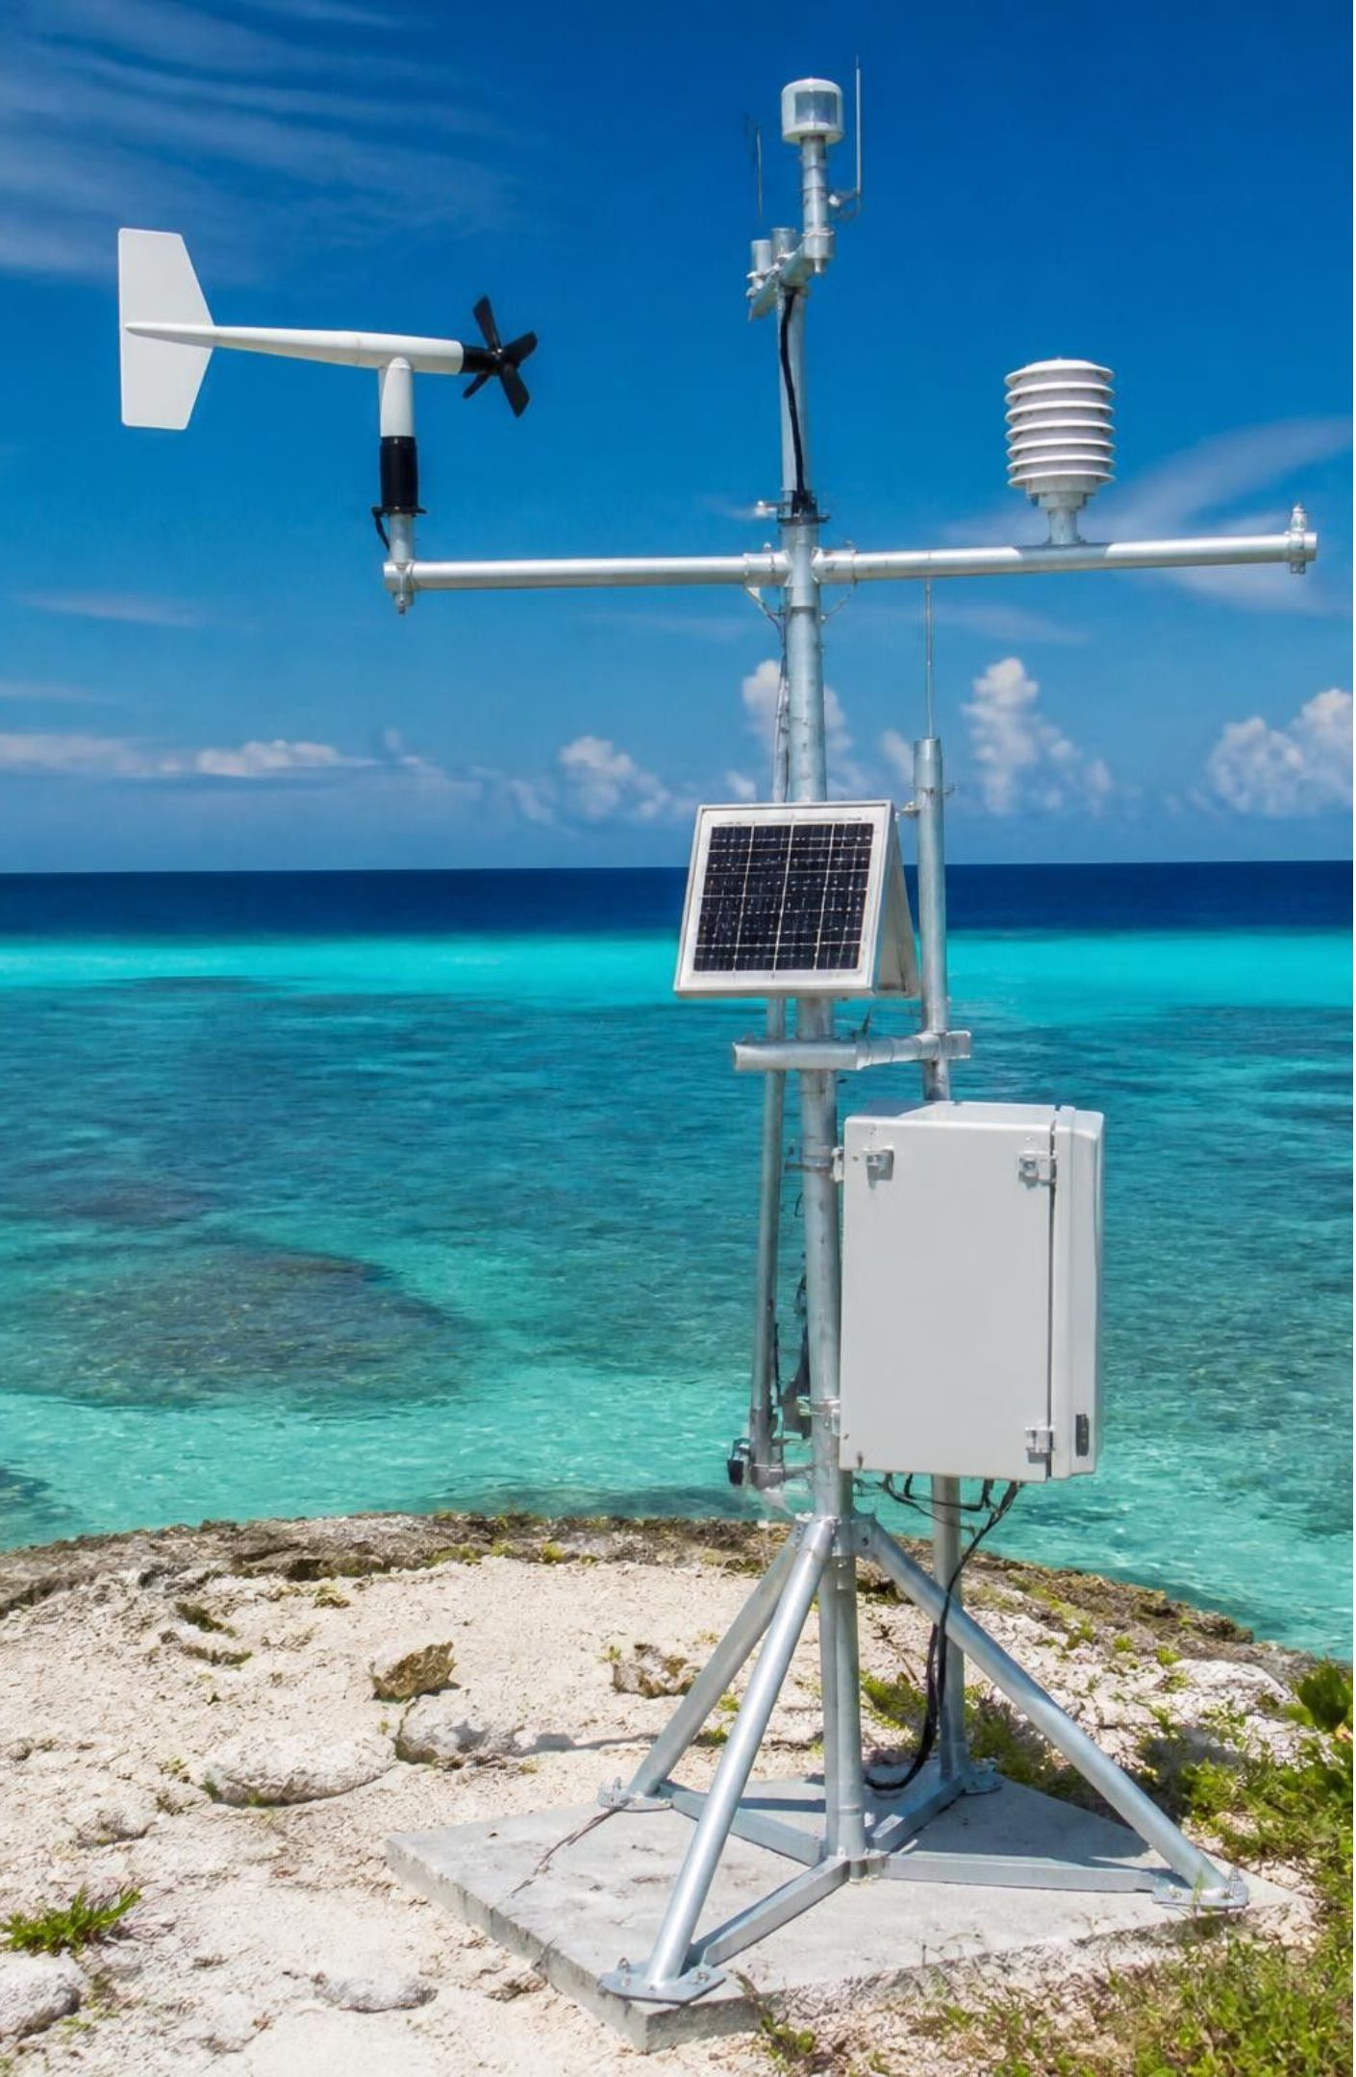
OCEAN–ATMOSPHERE HEAT TRANSFER
El Niño can lift global temperatures temporarily
Warm tropical Pacific waters release additional heat into the atmosphere, increasing the chance of record-hot global years.
MARINE ATMOSPHERIC BOUNDARY MONITORING
Warm tropical Pacific waters
Additional heat into the atmosphere
Increased chance of record-hot global years
El Niño alone does not cause long-term warming.

Slide 7
MID-2026 → EARLY 2027 · OBSERVATION → FORECAST
What is known about the 2026–27 event
10 September 2026
September 2026 → February 2027
NOAA diagnostic discussion
NOAA reported a strengthening El Niño, with eastern Pacific sea-surface temperature anomalies above +3.0°C and a greater than 90% chance of a very strong event during Northern Hemisphere fall and winter 2026–27.
WMO outlook
WMO reported that El Niño was firmly established, expected to intensify, and likely to persist through February 2027 with near-100% probability in its September outlook.
“Super El Niño” is a media shorthand for an exceptionally strong event, not a formal universal scientific category.
Notes:
Review the observation-to-forecast timeline. NOAA’s 10 September diagnostic discussion reported a strengthening El Niño and a greater than 90% chance of a very strong event; WMO’s September outlook gave near-100% probability through February 2027. “Super El Niño” is media shorthand, not a formal universal scientific category.

Slide 8
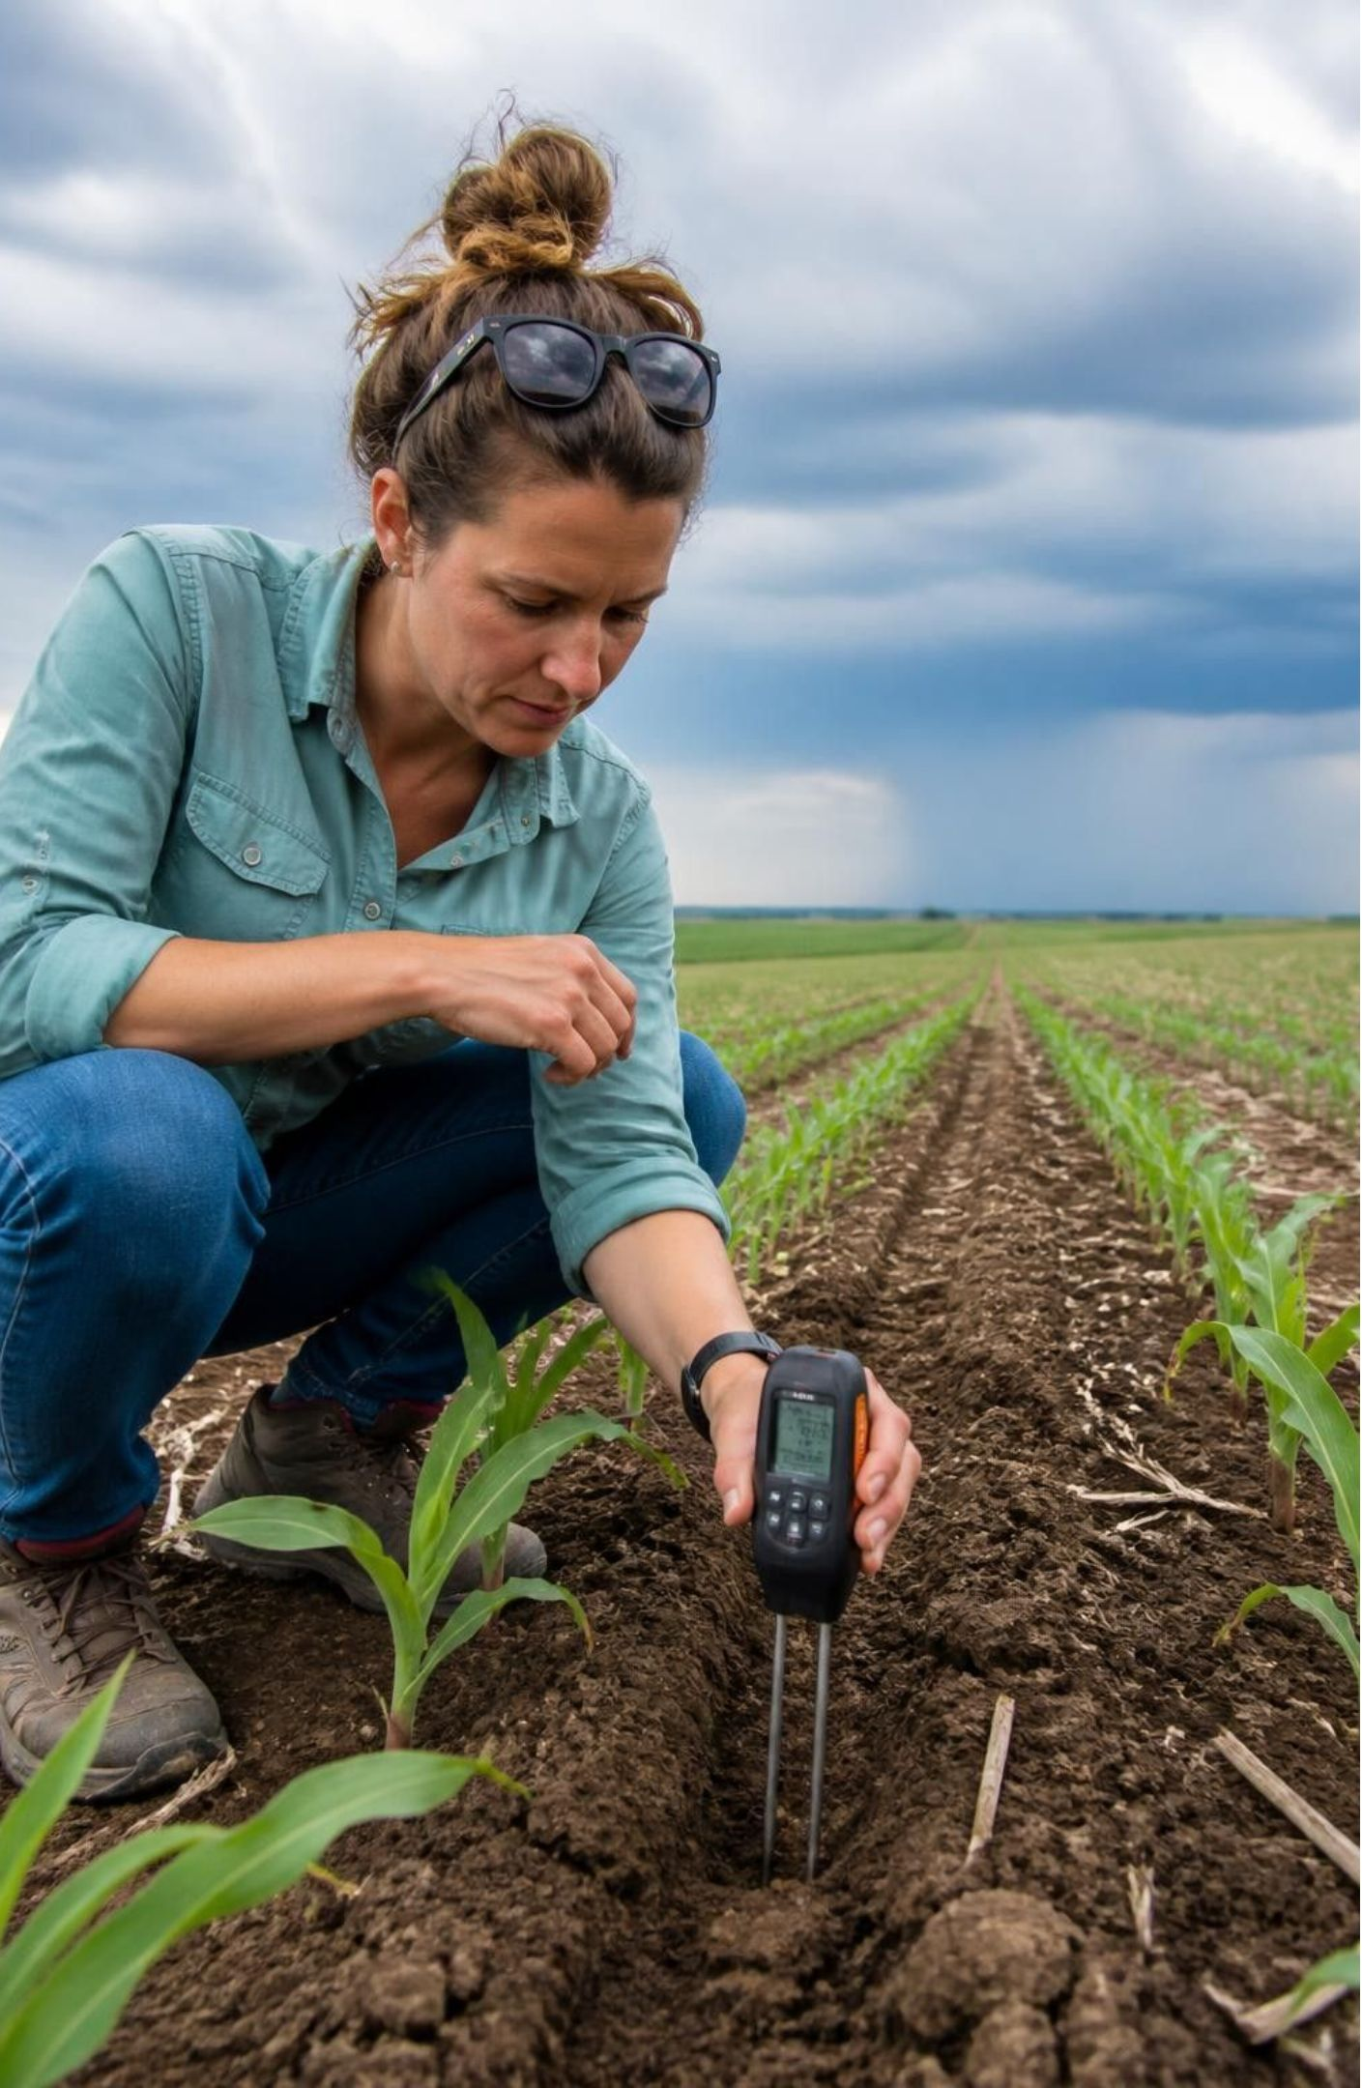
RISK MANAGEMENT & FORECAST LIMITS
Strong does not mean every prediction is certain
Forecast confidence is highest for the broad ENSO state and its seasonal risk pattern.
Local rainfall, flooding, drought, crop losses, and storm tracks remain uneven and probabilistic.
Do not present the supplied claims of +4°C, a new all-time record, hundreds of thousands of deaths, or exact crop losses as established facts without a specific verified source.
Preparedness works best when it follows local early-warning systems.
Risk, not destiny
Notes:
Emphasize calibration: strong events shift the odds, but local weather depends on chaotic regional dynamics. Dismiss unverified sensational estimates and reinforce reliance on official meteorological services.

Slide 9
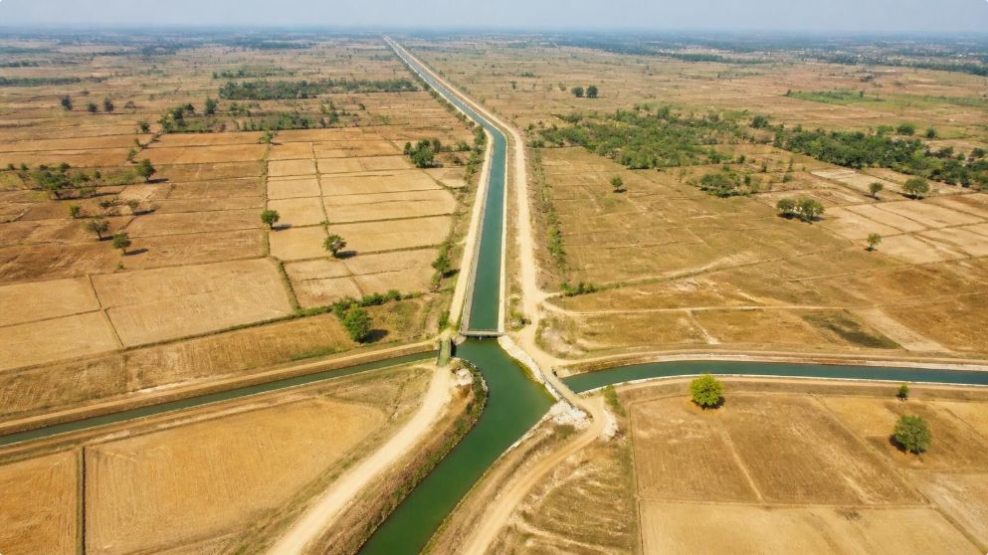
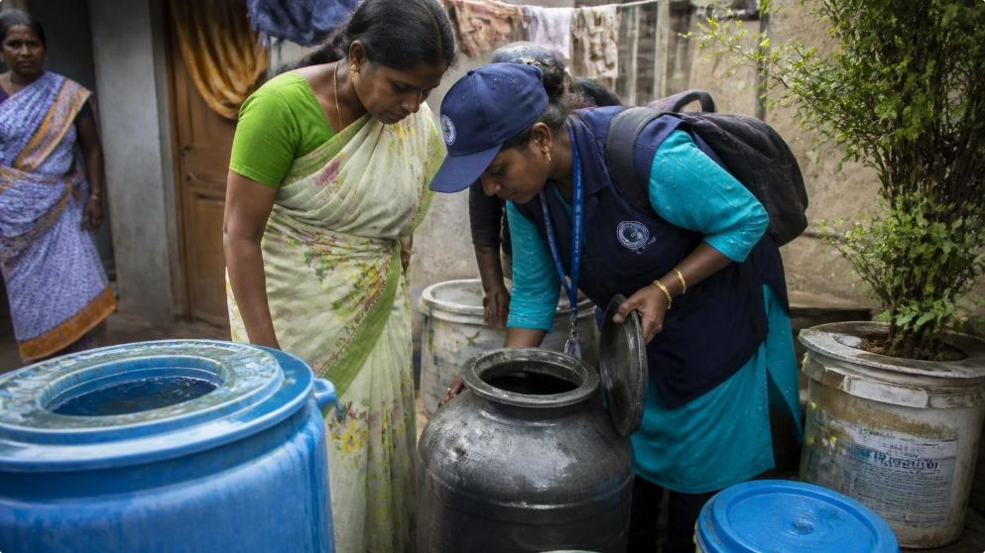
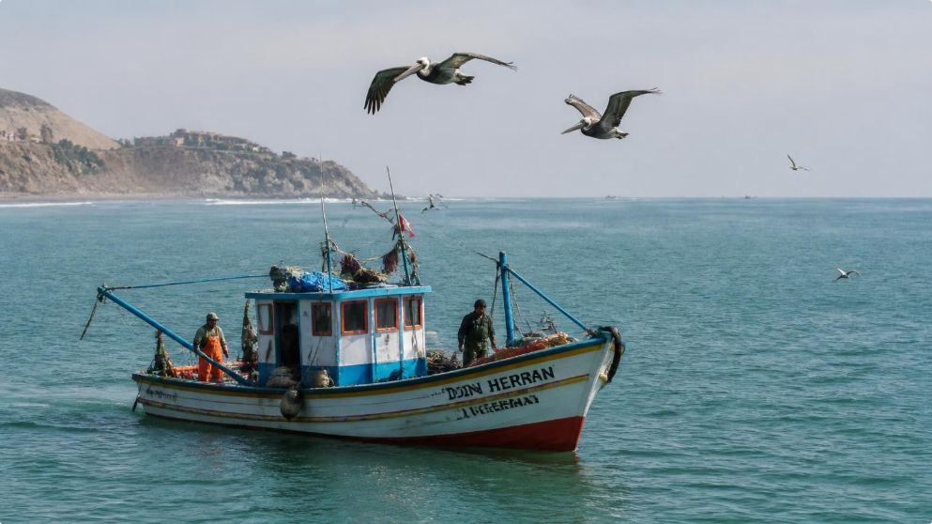
What could it mean for food, health, and ecosystems?
Farms
Public health
Marine life
Floods and drought can disrupt harvests, transport, water supplies, and food prices across connected markets.
Heat and humidity can increase health stress, while changing rainfall can affect disease patterns in some regions.
Weakened upwelling can reduce nutrient supply for marine food webs off western South America.
Final outcome depends on exposure, preparedness, and the background influence of climate change.
Notes:
Connect the physical drivers to real-world vulnerabilities across agriculture, public health, and ocean ecosystems, pointing out that impacts depend heavily on regional resilience.

Slide 10
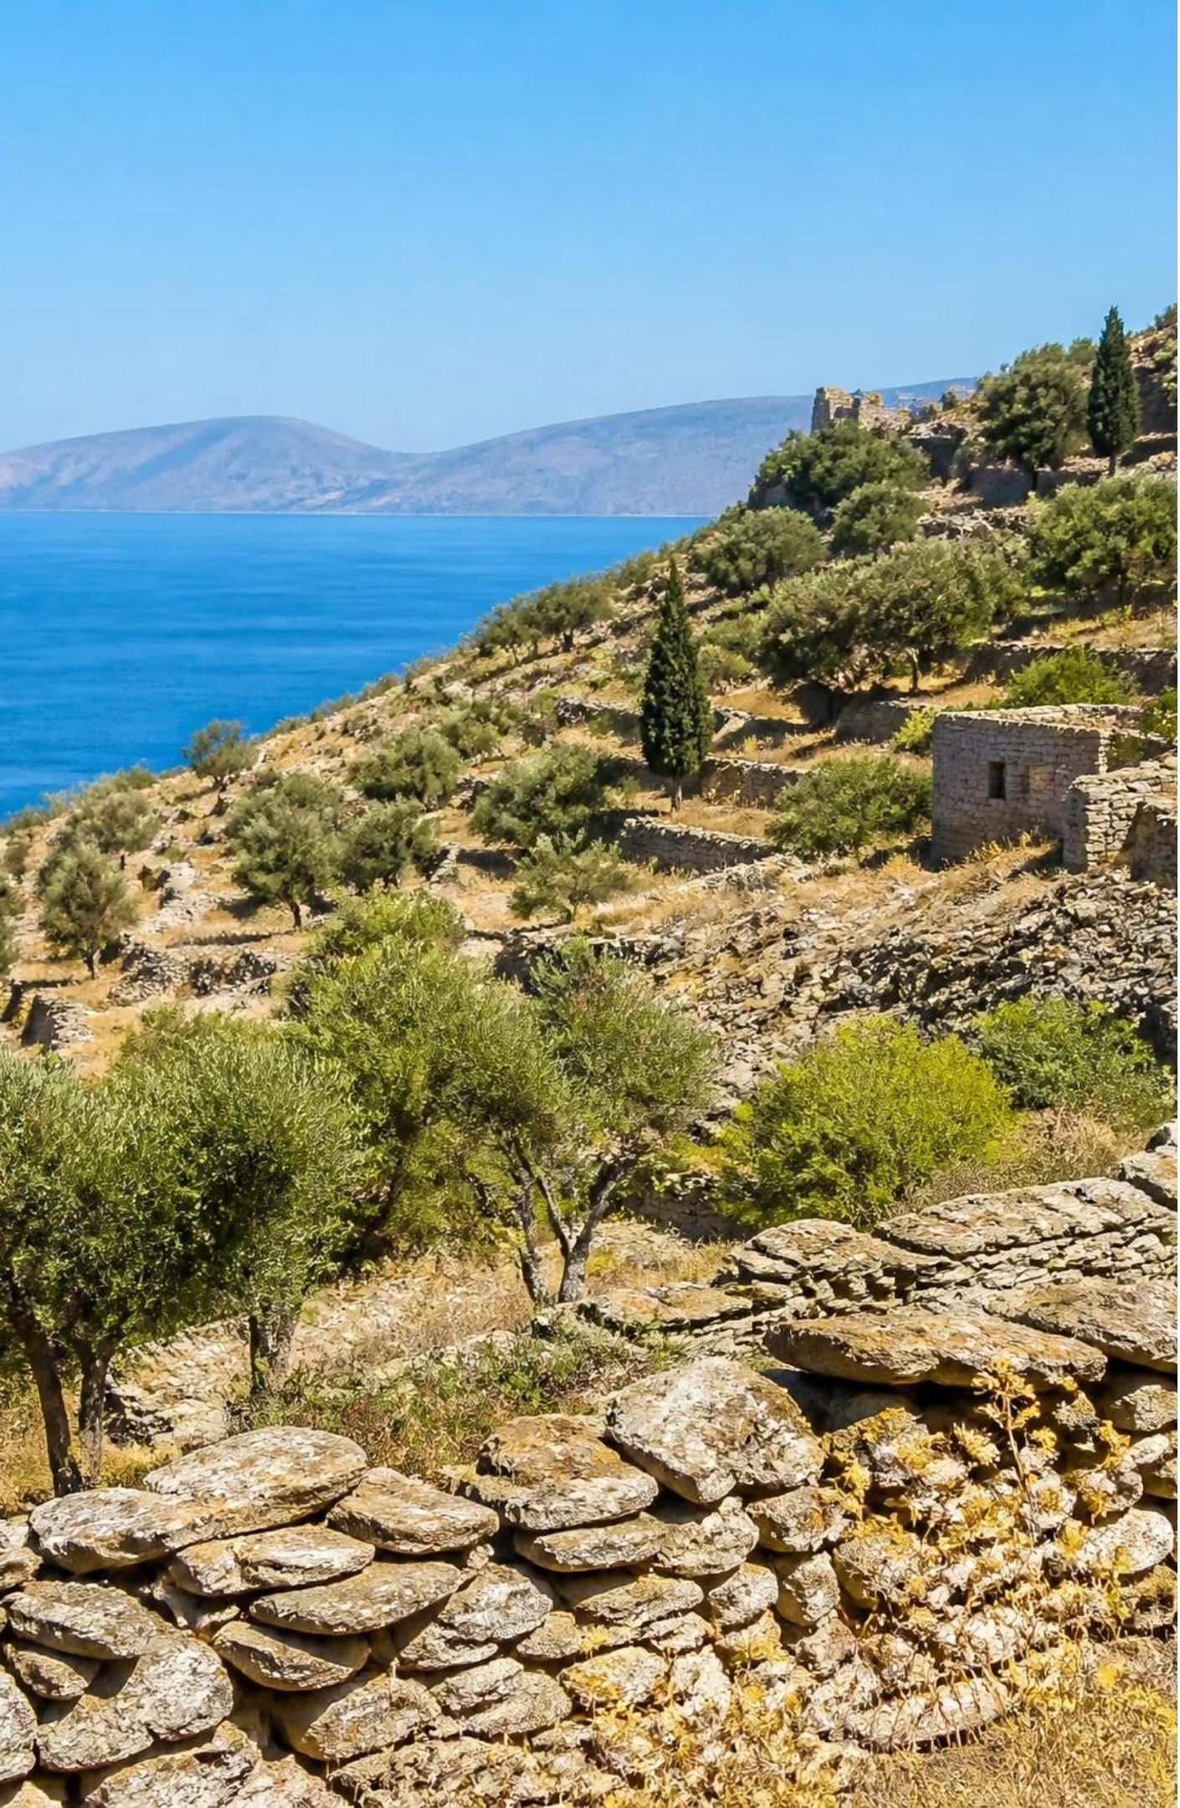
MEDITERRANEAN CONTEXT · SECONDARY SIGNALS
For Greece, the strongest signal is indirect
El Niño does not provide a reliable, direct forecast for Greek or Mediterranean weather; regional circulation patterns such as the North Atlantic Oscillation matter more.
Indirect effects may include global heat stress, disrupted commodity supply chains, higher food costs, and pressure on humanitarian response.
For Greece, the practical response is monitoring seasonal forecasts, water availability, heat risk, wildfire conditions, and food-market exposure.
MEDITERRANEAN BASIN SEASONAL MONITORING
Notes:
Conclude with clarity for Greece: debunk the idea of a direct El Niño rainfall switch in the Mediterranean, and direct attention to real transmission paths: global food markets, elevated heat baseline, and wildfire preparedness.

Slide 11
https://share.google/SazceZoqVXiTJfzvn

