Slide 1
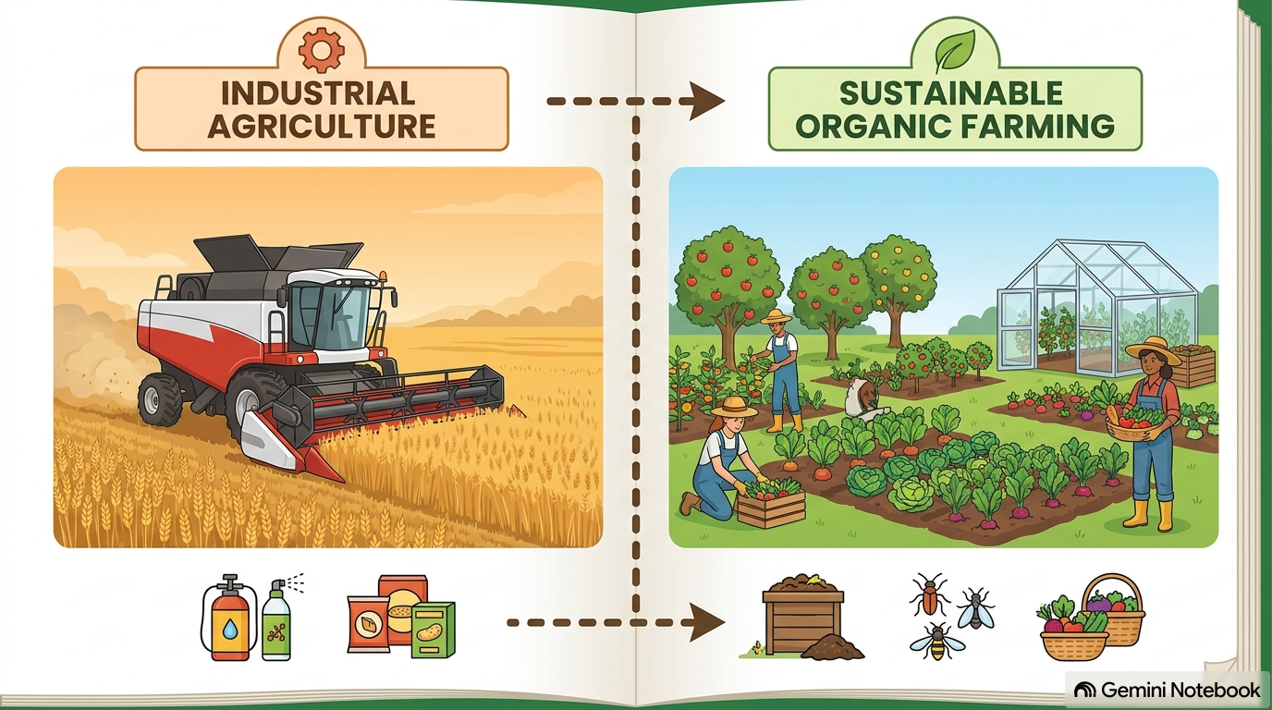
S6 | FOOD, NUTRITION & HEALTH
Comparing Farming
Methods
Which method feeds the planet, and at what environmental & social cost? A detailed comparison of the 4 production models.

Slide 2
S6 | FOOD, NUTRITION & HEALTH
Industrial-Scale Plant Production
Methods of industrial farming:
• innovation in agricultural machinery and cultivation methods,
• genetic technology,
• creating new markets for consumption,
• applying patent protection to genetic information and global trade.
These methods are widespread in developed nations and increasingly common worldwide.
Most of the meat, dairy, eggs, fruit, and vegetables sold in supermarkets are produced this way.

Slide 3
S6 | FOOD, NUTRITION & HEALTH
Industrial Agriculture: Advantages & Disadvantages
Advantages
• Cheap and abundant food
• Convenience for the consumer
• Contributes to the economy at many levels, from growers to harvesting companies, processors to retailers
Disadvantages
• Environmental and social cost
• Damage to fisheries
• Cleaning surface and underground water contaminated with animal waste
• Increased health risks from pesticides
• Increased ozone pollution from methane byproducts of livestock
• Global warming from heavy use of fossil fuels

Slide 4
S6 | FOOD, NUTRITION & HEALTH
1. Industrial Agriculture: Characteristics & Assessment
Definition & Advantages
• Definition: use of modern machinery, genetic technology & intensive inputs.
• Cheap & Abundant Food: high productivity per unit of land.
• Convenience for consumers & a major boost to the economy.
Environmental & Social Cost
• Water Pollution: from excessive use of synthetic fertilisers & pesticides.
• Greenhouse Gas Emissions: high energy use & carbon footprint.
• Biodiversity Loss: due to monoculture & soil degradation.

Slide 5
S6 | FOOD, NUTRITION & HEALTH
Traditional Plant Production
• Traditional farming can be defined as the original style of food production and cultivation.
• Its characteristics are:
1. Extensive use of local or indigenous knowledge, and of spiritual and superstitious beliefs, in agricultural decision-making
2. Heavy use of primitive or low-technology tools, such as the axe, hoe, and digging stick
3. Use of techniques such as fire and crop rotation
4. Fallowing
5. Absence of accountability or responsibility toward the environment
6. No surplus production — only enough for the farmer and their family. This is also known as subsistence farming
• It remains the dominant food-production practice used by half of the world's population today.

Slide 6
S6 | FOOD, NUTRITION & HEALTH
2. Traditional Agriculture: Subsistence Farming
Characteristics & Techniques
• An ancient style of production based on local & indigenous knowledge.
• Low technology: use of basic tools (axe, hoe, digging stick).
• Practices: slash-and-burn & crop rotation, fallowing.
• Subsistence Farming: no surplus production for trade.
Its Importance Today
• The Dominant Practice: the main method for 50% of the world's population.
• Low environmental footprint, but very low productivity.
• Requires a very high amount of human labour.

Slide 7
S6 | FOOD, NUTRITION & HEALTH
Small-Scale Plant Production
• Uses less machinery and more human labour.
• Typically uses more sustainable methods to maintain soil productivity and control pests:
1. Polyculture,
2. Reduced tillage,
3. Crop rotation,
4. Nutrient recycling (e.g. composting, …),
5. Biological pest control, and/or
6. Encouraging biodiversity, and reduced use of pesticides and fertilisers,
7. Mechanical cultivation and other techniques (e.g. mulching with dead leaves, …)
• Small-scale growers usually sell their products through small local markets.
• They often trade directly with consumers.

Slide 8
S6 | FOOD, NUTRITION & HEALTH
Small-Scale Farming: Advantages & Disadvantages
Advantages
• Reduced emissions from transport
• Food quality (fresher produce, less need for processing)
• Gastronomy (heirloom varieties)
• Polyculture and sustainable farming
• Boosts local economies
• Reduced energy consumption
Disadvantages
• Increased cost for the consumer
• Impact on countries that rely economically on food exports

Slide 9
S6 | FOOD, NUTRITION & HEALTH
Organic Plant Production
• Minimises or completely avoids the use of synthetic fertilisers and herbicides, plant growth regulators, hormones, and feed additives.
• Organic growers rely on:
1. Crop rotation (alternating crops for harvest),
2. Crop residues,
3. Fallowing,
4. Animal manure, and
5. Mechanical cultivation
to maintain soil productivity, enrich it with nutrients for plants, and control weeds, insects, and pests.

Slide 10
S6 | FOOD, NUTRITION & HEALTH
3. Small-Scale & 4. Organic Farming
Small-Scale Farming
• Less machinery, more human labour.
• Practices: polyculture, crop rotation, composting.
• Advantages: fewer emissions, fresher food, boosts the local economy.
• Disadvantage: higher cost for the consumer.
Organic Farming
• Completely avoids synthetic fertilisers, herbicides & hormones.
• Practices: animal manure, crop residues, fallowing.
• Protects the soil, human health & the ecosystem.

Slide 11
S6 | FOOD, NUTRITION & HEALTH
4. Comparison Table of the 4 Methods
Criterion | Industrial | Traditional | Small-Scale | Organic
Consumer Cost | Low | Varies | High | High
Environmental Footprint | High | Low | Low | Low
Productivity/Land Area | Very High | Low | Moderate | Moderate
Human Labour | Low | Very High | High | High

Slide 12
S6 | FOOD, NUTRITION & HEALTH
5. Exam Practice (B-Test / Extended Question)
Exam Question (12 Marks)
• “Compare industrial-scale agricultural production with small-scale agricultural production in terms of cost, productivity, and environmental impact.”
•
• Guidelines for Writing Your Answer:
• 1. Definition: briefly state the definition of each method (technology vs. human labour).
• 2. Comparative Data: analyse consumer cost (low vs. high) and productivity per unit of land.
• 3. Environmental Impact: contrast the pollution/greenhouse gases of industrial farming with the biodiversity/crop rotation of small-scale farming.
• 4. Conclusion: emphasise the importance of sustainability for the future.

