Slide 1
TOPIC 1: FOOD, NUTRITION & HEALTH — LESSON 3
Animal Production: Products, Ethics & Sustainability
Is animal farming a necessity for feeding the world — or a luxury?

Slide 2
DEFINITION
What Is Animal Production?
• Animal production: a core branch of agriculture — the systematic rearing of farm animals to produce animal products.
• Sits alongside: plant production and fisheries as the 3 branches of agricultural production (Lesson 1).
• Today: we'll look at what it produces, where it came from, and the debate around its costs and benefits.

Slide 3
OUTPUTS
Animal Products
Meat, milk, eggs
For direct human consumption
Wool, hide, manure
Raw material for industry
• Products can be destined for human food OR as raw material for industrial production.

Slide 4
THE BIG PICTURE
Plant & Animal Production: A Two-Way Relationship
• Plants feed animals: agriculture is the main source of feed for livestock.
• Animals feed the soil: manure enriches and revitalises the land.
• The result: a balanced cycle — necessary for sustainable, ecological production.

Slide 5
STRUCTURE
Branches of Animal Production
Livestock
Cattle farming
Sheep & goat farming
Pig farming
Poultry farming
Other branches
Aquaculture
Small farm animals (e.g. rabbits)
Fur animals
Sericulture (silkworms)
• Beekeeping sits at the boundary between animal and plant production.

Slide 6
HISTORY
Domestication: From Wild to Farm
• Wild ancestors: wild sheep, wild horses, wild goats, wild boars roamed free before domestication.
• Timing: animal domestication happened alongside plant domestication, in the Neolithic era (~8,000–12,000 years ago).
• Why it mattered: raising animals and growing crops gave far more security than hunting, fishing and gathering alone.
• New tools: the plough, the saddle, the wheel, and wool processing all laid the foundations for farming and animal husbandry.
• Knock-on effects: division of labour, trade, and the growth of culture, technology and science.

Slide 7
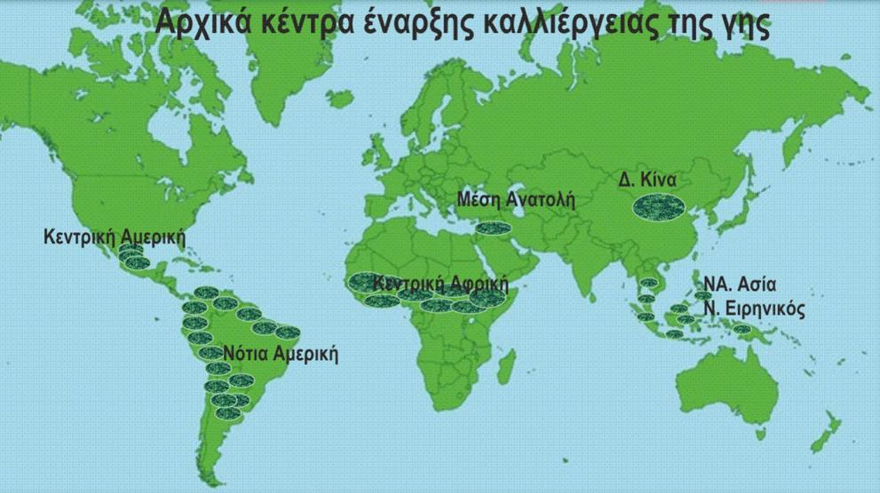

Slide 8
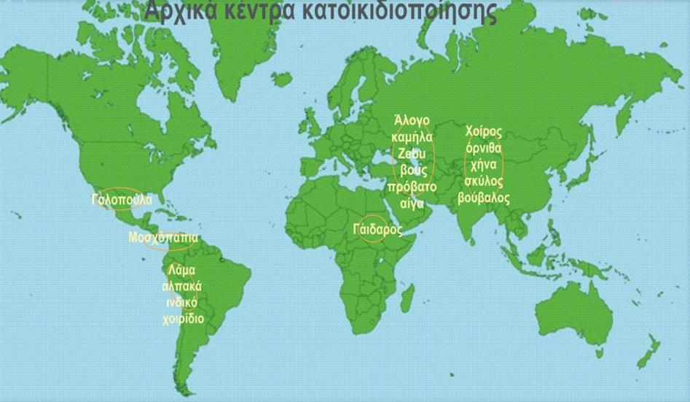

Slide 9
HISTORY
Where It Began: Early Centers
Early Plant Cultivation
Middle East (Fertile Crescent)
Central America
South America
Central Africa
Western China
SE Asia & South Pacific
Early Animal Domestication
Middle East/Turkey: horse, camel, cattle, sheep, goat
China: pig, chicken, goose, dog, buffalo
Central America: turkey
South America: llama, alpaca, guinea pig
Africa: donkey

Slide 10
FACTORS
What Determines How Much (and How Good)?
• Genetics: the animal's genetic potential (e.g. Holstein cattle bred for milk; Angus cattle bred for meat).
• Environment: the animal's living conditions.
• Economics: socio-economic conditions prevailing in the market.

Slide 11
BENEFITS
High Biological Value Food
• High biological value: meat, milk and eggs are rich in protein, vitamins, minerals and trace elements.
• Essential amino acids: the body cannot make these 8 amino acids itself — they must come from food.
• Nitrogen balance: missing even ONE essential amino acid causes a negative nitrogen balance, with serious health consequences.

Slide 12
THE NUMBERS
How Far Does 1 kg of Milk Go?
Nutrient need | Coverage from 1 kg of milk
Essential amino acids | Meets/exceeds 100% of need for 6 of the 8 essential amino acids (100–162%); the two exceptions are phenylalanine (77%) and methionine, the lowest at 36%
Calcium (Ca) | 0.5 kg of milk alone covers ~75% of daily need
Vitamin B12 | ~84% of daily need
Vitamin B2 (Riboflavin) | ~90% of daily need
• (Reference: 70 kg adult male, age 25, normal activity — Bogner & Koegel, 1984)

Slide 13
THE OTHER SIDE
The Cost of Going Without
• In developing countries: insufficient consumption of animal products is linked to increased child mortality, delayed mental and physical development, and reduced adult productivity.
• Open questions: Is turning resources into animal products efficient? Is there too much food competition between humans and animals? Is animal production a luxury?

Slide 14
Animal vs. Plant Production: How Efficient Is It?
Let's discuss it next lesson!

Slide 15
EFFICIENCY
What Does “Efficient” Mean Here?
• Inputs: feed, housing, veterinary care, labour.
• Outputs: animal products (meat, milk, eggs, etc.).
• Efficiency ratio: outputs ÷ inputs — e.g. protein or energy produced per unit of feed/energy consumed, or protein produced per hectare of land.
• The finding: the efficiency with which farm animals convert available resources into food is relatively low.
• Unit reminder: 1 hectare (ha) = 10,000 m².

Slide 16
EFFICIENCY
Animal vs Plant Production: Output per Input
• Efficiency: output ÷ input — protein or energy produced per unit of feed/energy consumed.
• The pattern: plants convert land and resources into food far more efficiently than animals do.
Product | Protein (kg/ha/yr) | Energy (MJ/ha/yr)
Corn (plant) | 430 | 83,700
Potatoes (plant) | 420 | 100,460
Wheat (plant) | 350 | 58,600
Rice (plant) | 320 | 87,900
Rabbits (animal) | 180 | 7,400
Poultry (animal) | 92 | 4,600
Lamb (animal) | 43 | 4,800
Cattle (animal) | 42 | 7,900
Protein production (kg) and energy (MJ) per hectare of land per year from plant and animal products (from Spedding & Hoaxey, 1975)

Slide 17
THE NUMBERS
How Many People Could 1 Hectare Feed for a Year?
Product | From protein | From energy
Soybean | 14 | 5
Rice | 7 | 14
Wheat | 6.3 | 8.4
Corn | 5.2 | 10.4
Potatoes | 9.5 | 10.5
Milk | 3 | 2.5
Poultry meat | 2.5 | 1
Pork | 1.4 | 2
Beef | 1 | 1
• (Spedding, 1979)

Slide 18
THE NUMBERS
The Energy Cost of Food Production
Product | Energy (MJ) in liquid fuel per kg of protein produced
Feed beans | 6
Wheat | 42
Potatoes | 59
Milk | 121
Poultry meat | 165
Pork | 268
Beef* | 326
• * Semi-intensive fattening

Slide 19
THE BIG QUESTION
Animal Production & the Global Food Problem
• Feed competition: animals eat food that humans could eat directly.
• Conversion losses: 100 calories of cereal become: 100% as bread, but only 33% as pork, 25% as eggs, 20% as milk, 10% as beef, 8% as poultry.
• At scale: in 2001, over 680 million tonnes of cereal went to livestock worldwide; in developed countries ~60% of cereal production is fed to animals (Denmark and the US use only 8% and 13% for direct human food).
• Meanwhile: people in developing countries get by on ~161 kg of cereal a year — under 0.5 kg a day.
• The paradox: global food supply is enough for 2,700 kcal/person/day — yet ~850 million people are undernourished. The problem is distribution, not total production.

Slide 20
THE BIG QUESTION
Where Undernutrition Is Concentrated
Region | Undernourished population (millions, 1999–2001)
India | 214
Sub-Saharan Africa | 198
Asia & Pacific | 156
China | 135
Latin America & Caribbean | 53
Near East & North Africa | 41
Countries in transition | 34
Industrialized countries | 10
• (UN, 2003)

Slide 21
THE DEBATE
Should We Shrink Animal Production?
The case FOR shrinking it
Plants use resources far more efficiently (see the tables).
Less livestock could ease the global food problem.
The case AGAINST / complications
>25% of Earth’s land is pasture unsuitable for crops.
Ruminants turn useless vegetation & crop byproducts into high-value food — no competition with humans there.
In developing countries, mixed farms rely on animals for soil fertility, labour & transport.
Expanding cropland into marginal land risks erosion & more pesticide use.

Slide 22
ENVIRONMENT
Other Environmental Concerns
• Overgrazing damages land.
• Intensive pig & poultry farming pollutes surface and groundwater with manure.
• Huge water footprint: ~4,000 litres of water per kg of beef produced.
• Intensification reduces biodiversity.
• Responsible for around 14% of all human-caused greenhouse gas emissions.

Slide 23
ONE MORE QUESTION
Could Humans Live Without Animal Products?
• In principle, yes — survival without animal foods is possible, IF plant foods are carefully combined to meet all nutritional needs.
• That requires good nutrition knowledge and a well-educated population — not a simple swap.

Slide 24
HOMEWORK
Your Turn: The Essay
• The task: pick a side and write a 150–200 word essay defending it — are you for or against maintaining animal production?
• Base it on: today's class discussion plus your own research on scientific websites.
• Food for thought: economic, social, ecological/environmental, and nutritional pros and cons.
• Tip: structure your arguments scientifically — claim, evidence, reasoning.

