Slide 1
TOPIC 1: FOOD, NUTRITION & HEALTH — LESSON 5
Food Supply Chains: From Field to Shelf
The Power of Supermarkets and Short Supply Chains — S6

Slide 2
INTRODUCTION
Every Meal Has a Journey
• Food supply chain: every step a food takes from the farm to your plate — and every business that takes a share of the price along the way.
• A supermarket tomato may pass through four or five separate companies before you ever touch it. None of them is the farmer.
• Keep one question in mind all lesson: who actually decides the price — the person who grew the food, or the shop that sells it?

Slide 3
THE CHAIN
The Five Links
Producer
Grows or rears the food. Carries the weather, disease and price risk.
Processor
Washes, cuts, mills, bakes, cans, packs. Adds value — and cost.
Distributor
Stores, refrigerates and transports. Often a wholesaler you never see.
Retailer
Supermarket, grocery or market stall. Sets the shelf price.
Consumer
You. The last link — and the only one who can change the chain.
• Every link adds real work — and takes a share of the final price.
• As a rule: the more links between the field and the shelf, the thinner the producer’s slice of what you pay.

Slide 4
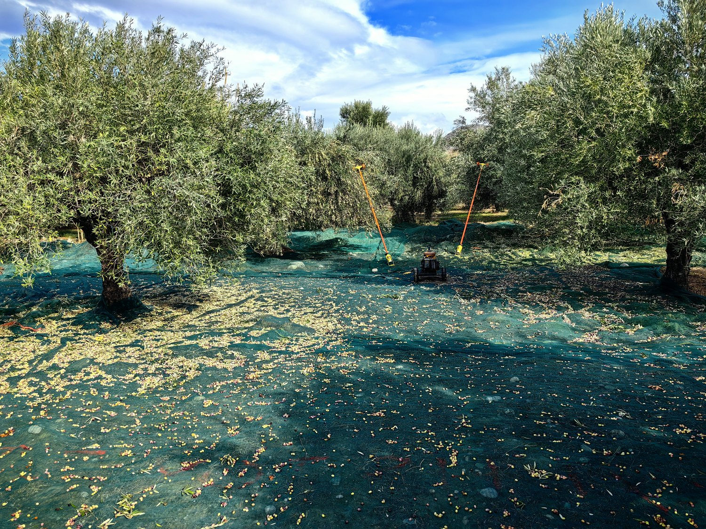
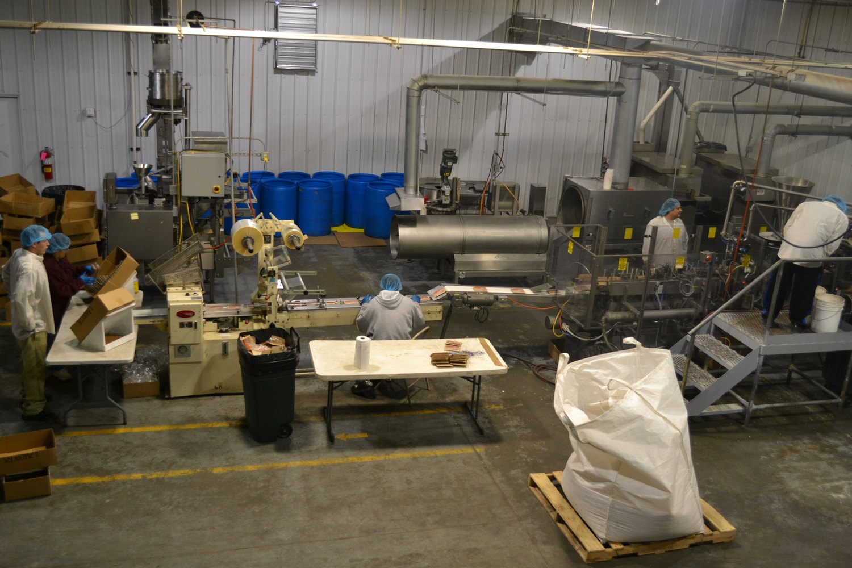
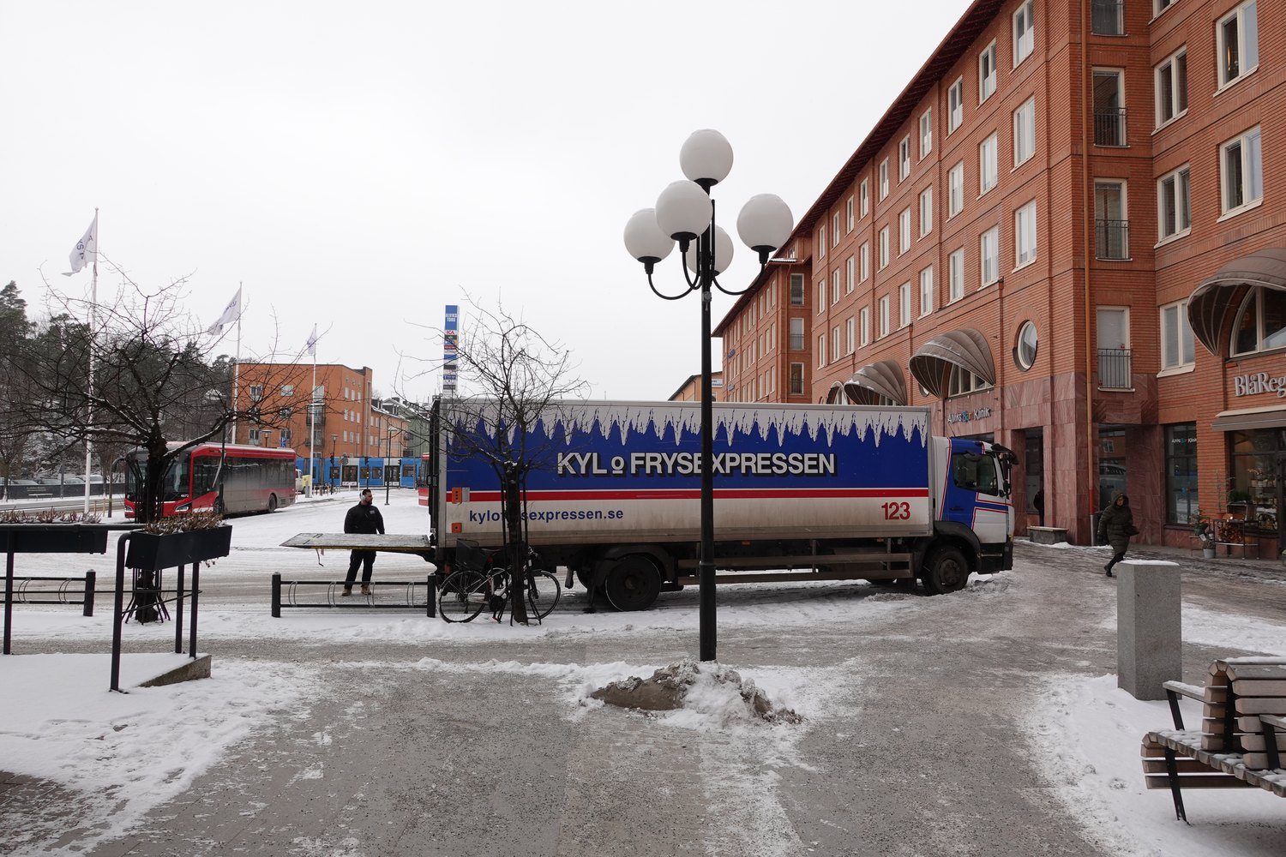
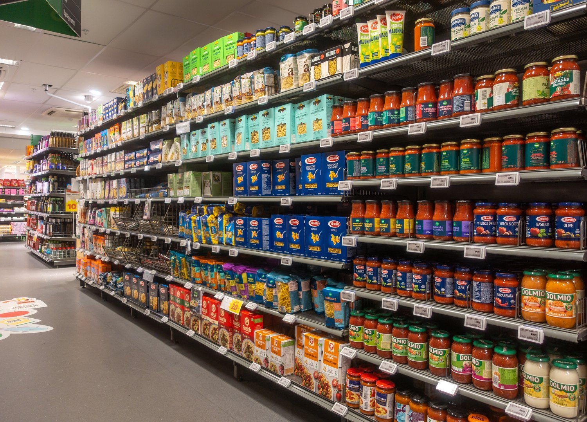
THE CHAIN
The Chain in Pictures
1. Producer — olive harvest, Sitia, Crete
2. Processor — packing line
3. Distributor — refrigerated delivery
4. Retailer — supermarket shelves
Photos: Petro Stelte (CC BY-SA 4.0) · U.S. Department of Agriculture (CC BY 2.0) · "G och J" (CC BY 4.0) · Frankie Fouganthin (CC BY-SA 4.0), via Wikimedia Commons

Slide 5
THE MONEY
Who Gets the Money?
• About 25%: across the EU, farming captures roughly a quarter of the value added in the whole food chain. The other three quarters are created after the food leaves the farm.
• And falling: that share is slowly declining — even though the farm carries most of the risk.
• 61% vs 9%: agriculture's share ranges from about 61% in Romania to about 9% in Luxembourg. The more industrialised the food system, the thinner the farmer’s slice.
• The same tomato is worth more once it is washed, graded, packed, branded, refrigerated and placed at eye level.
Source: Eurostat, key figures on the food chain — agriculture’s value added.

Slide 6
POWER
The Power of Supermarkets
• An hourglass: millions of farmers at one end, millions of consumers at the other — and only a handful of large buyers in the middle. Whoever stands in the narrow part sets the terms.
• Concentration: EU-wide the top five grocery groups hold about 31% of the market, but in Finland and Sweden the top four hold close to 90%. Farmers sell in a national market, not an EU-wide one — so losing one buyer can mean losing everything.
• Buyer power in practice: pressure on price, own-brand products competing with the supplier’s own, payments demanded for shelf space and promotions, orders cancelled at short notice.

Slide 7
POLITICS OF FOOD
What the EU Banned
Directive (EU) 2019/633 on unfair trading practices sets a minimum list of practices a big buyer may no longer impose on a supplier.
Banned practice | Why it hurt the supplier
Paying later than 30 days for perishable food (60 for the rest) | The farmer had already paid for seed, feed and labour.
Cancelling an order for perishable food at short notice | Harvested food cannot wait for a new buyer.
Changing the terms of the agreement unilaterally | The price agreed was no longer the price paid.
Charging the supplier for stocking, adverts, marketing or staff | The cost of selling was pushed back down the chain.
Threatening commercial retaliation for a complaint | Fear of losing the contract kept abuses invisible.

Slide 8
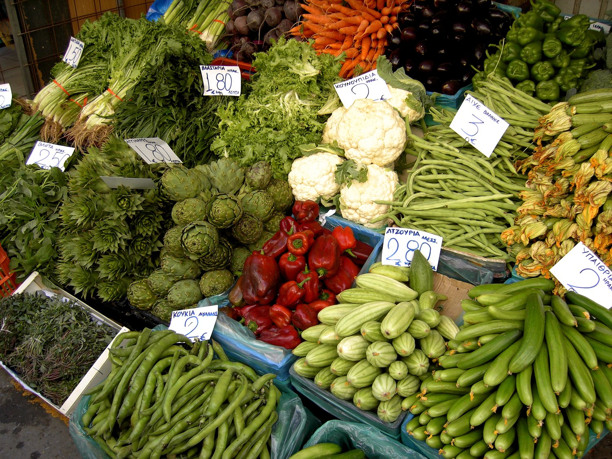
THE ALTERNATIVE
Short Supply Chains
• EU definition: a chain with no more than one intermediary between farmer and consumer (Regulation 1305/2013).
• Forms: farm-gate sales, the Greek λαϊκή αγορά and other farmers’ markets, vegetable box schemes, community-supported agriculture, producer cooperatives.
• A Greek original: λαϊκές αγορές were set up under Venizelos precisely so that producers could sell without middlemen — which is why the stalls still distinguish a παραγωγός from an επαγγελματίας, with the origin hand-written on every price card.
• Gains and limits: a bigger share of the price to the grower, fresher food, money kept in the local economy, a seller you can question — but small volumes, strictly seasonal, and not always cheaper for the buyer.
λαϊκή αγορά, Heraklion
Photo: Hans Hillewaert (CC BY-SA 3.0), via Wikimedia Commons.

Slide 9
THINK CRITICALLY
Is "Local" Always Greener?
• 5–6%: transport — all of it, from farm to processor to shop — accounts for only about 5 to 6% of the greenhouse gases from our food.
• Where the emissions really are: before the food ever moves: land-use change, fertiliser, and methane from ruminant animals.
• And most transport emissions come from lorries on short domestic journeys, not from the ships and planes people picture.
• So: what you eat matters more than how far it travelled. The strongest case for short chains is economic, social and about freshness and transparency — not automatically carbon.
Source: Crippa et al. (2021), via Our World in Data, "Environmental impacts of food production".

Slide 10
https://www.youtube.com/watch?v=fzpma5RbvCY

Slide 11
WRAP-UP
We Don’t Forget
• A food supply chain is every step and every business between the farm and the plate — and each one takes a share of what you pay.
• Farming captures only about a quarter of the value added in the EU food chain, while a few large retailers stand at the narrow point of the chain and set the terms.
• Short supply chains (at most one intermediary) return more of the price to the producer — but shorter does not automatically mean lower-carbon.
NEXT LESSON
Food processing: domestic, artisanal and industrial — what actually happens to food between the field and the packet.

