Slide 1
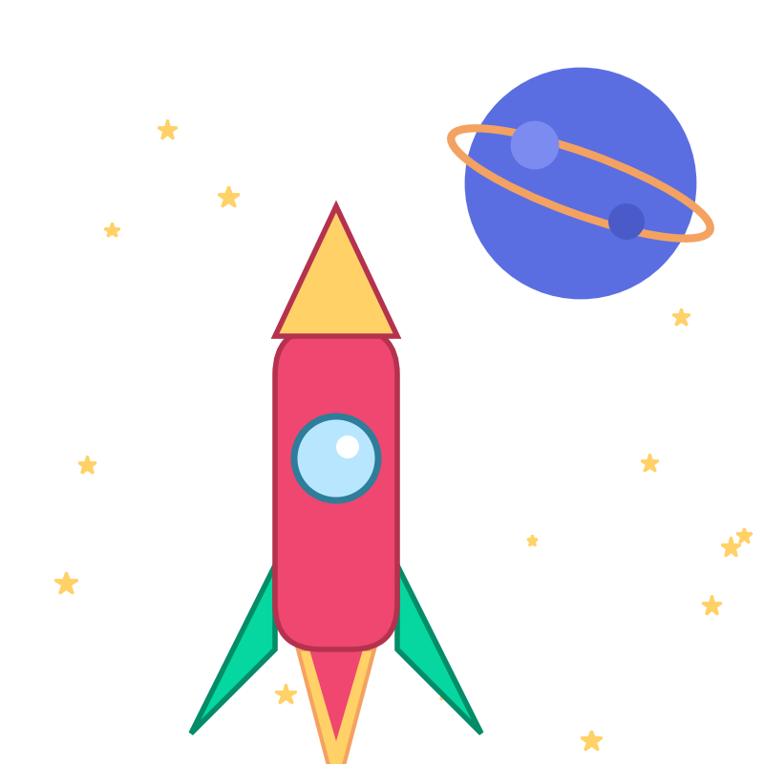
UNIT 1 · OUR PLACE IN THE UNIVERSE · LESSON 1
Our Cosmic
Address
Planet Earth, Solar System, Milky Way, The Universe.
Where exactly do you live?

Slide 2
THE HOOK
How Big Is Space, Really?
⬤ Imagine the Sun shrunk down to the size of a basketball.
⬤ On that scale, Earth would be a peppercorn — about 24 metres away.
⬤ Neptune, the farthest planet, would be nearly three football fields away.
⬤ And the nearest star beyond our Sun? On this same scale, it would be over 6,700 km away — roughly the distance from here to the other side of the world.

Slide 3
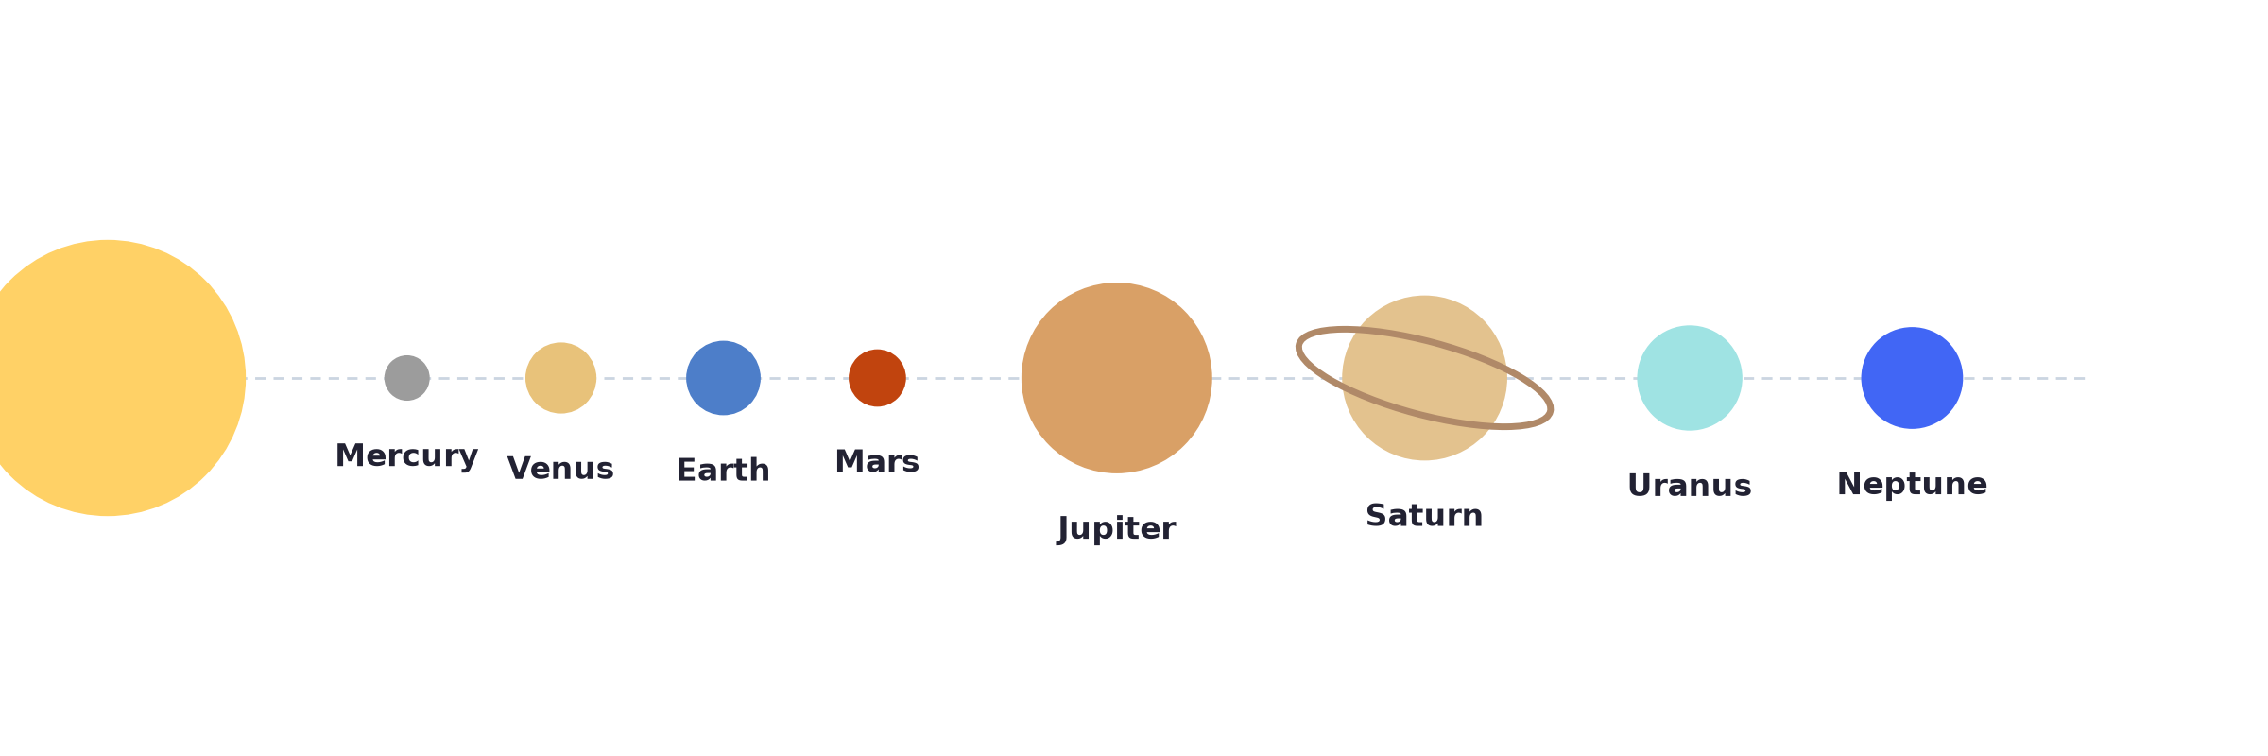
THE SOLAR SYSTEM
Meet Your Neighbourhood
8 planets orbit the Sun. The closer ones (Mercury–Mars) are small and rocky; the farther ones (Jupiter–Neptune) are huge balls of gas.

Slide 4
DEFINITIONS
What's a Planet, Anyway?
⬤ Star a giant ball of burning gas that makes its own light. (Our Sun is a star.)
⬤ Planet a large body that orbits a star, and has cleared its orbit of other debris.
⬤ Moon (satellite) a body that orbits a planet, not the Sun directly.
⬤ Asteroid a small, rocky body orbiting the Sun — too small to count as a planet.
⬤ Comet a small, icy body that grows a glowing tail when it passes near the Sun.

Slide 5
EARTH IN MOTION
Why Do We Have Day and Night?
⬤ Rotation Earth spins on its own axis once every 24 hours.
⬤ The result whichever side faces the Sun has day; the other side has night.
⬤ Fun fact you're moving at about 1,670 km/h right now, just from Earth's spin — you just can't feel it!

Slide 6
EARTH IN MOTION
Why Do We Have a Year?
⬤ Revolution Earth orbits (travels all the way around) the Sun once every 365¼ days — that's one year.
⬤ That extra quarter-day is why we add a leap day every 4 years (29 February).
⬤ Coming up if Earth's axis is tilted while it orbits... what does that do to our seasons? We'll find out next lesson.

Slide 7
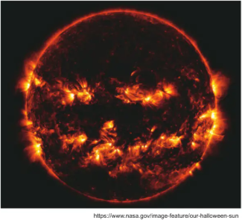
POWERING IT ALL
The Sun: Our Energy Source
⬤ Almost all the energy on Earth — sunlight, wind, the food you eat — traces back to the Sun.
⬤ The Sun is so large that about 1.3 million Earths could fit inside it.
⬤ It's been shining for about 4.6 billion years, and has enough fuel left to keep going for billions more.

Slide 8
HOW DOES IT REACH US?
From Fusion to Your Skin
⬤ Deep inside: the Sun makes its energy through nuclear fusion — tiny particles smashing together under incredible heat and pressure, deep in its core.
⬤ The journey: that energy takes about 8⅓ minutes to cross the 150 million km to Earth, travelling as light at the speed of light itself.
⬤ The solar wind: besides light, the Sun also blasts out a stream of particles called the solar wind — it's what causes auroras (the “northern lights”) when it hits Earth's atmosphere.

Slide 9
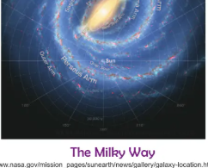
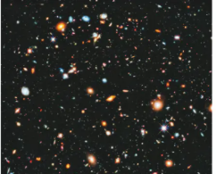
DID YOU KNOW?
Zooming All the Way Out
⬤ Our Solar System is just one tiny speck in the Milky Way galaxy, which has over 100 billion stars.
⬤ And the Milky Way is just one of hundreds of billions of galaxies in the universe.
⬤ The universe itself is about 13.8 billion years old — and it's still expanding, right now, in every direction.

Slide 10
DID YOU KNOW? (PART 2)
Even More Mind-Blowing Facts
⬤ Closer to home: Greece is actually one of the best places in the world to see the Milky Way with your own eyes, thanks to its clear, dark skies.
⬤ Looking into the past: starlight takes so long to reach us that some stars you see tonight may have already died — you're looking at light that left thousands of years ago.
⬤ Not a star at all: a “shooting star” isn't a star — it's a tiny piece of space rock (a meteoroid) burning up as it falls through our atmosphere.

Slide 11
Watch: How Big Is the Universe?
https://www.youtube.com/watch?v=pSHVbLPWA28

Slide 12
Next Time...
Why does Earth's tilt give us seasons? And why do we always see the same face of the Moon?

