Slide 1
UNIT 1 · OUR PLACE IN THE UNIVERSE · LESSON 2
Seasons & the
Same-Faced Moon
Two everyday mysteries, one elegant explanation each.

Slide 2
QUICK RECAP
What We Already Know
⬤ Earth rotates on its axis once every 24 hours — that's day and night.
⬤ Earth revolves around the Sun once every 365¼ days — that's one year.
⬤ Today's two questions: why do we have seasons, and why does the Moon always show us the same face?

Slide 3
A COMMON MYTH
“It's Closer to the Sun in Summer” — True or False?
⬤ Sounds logical — but it's FALSE.
⬤ The proof: the amount of energy the Sun gives off is the same all year round, and Earth's distance from the Sun barely changes.
⬤ The real clue: when it's summer in the Northern Hemisphere, it's winter in the Southern Hemisphere — at the exact same distance from the Sun. Distance can't explain that.

Slide 4
THE REAL REASON
Earth's Axial Tilt
⬤ The tilt: Earth's axis is tilted 23.5° — and that tilt stays pointed the same direction in space all year, as Earth orbits the Sun.
⬤ The effect: for half the year, the Northern Hemisphere tilts toward the Sun (more direct sunlight = summer); for the other half, it tilts away (less direct sunlight = winter).
⬤ The 4 turning points: spring equinox , summer solstice, autumn equinox, winter solstice — mark the Earth's position in its yearly journey.
- 20 March — Spring begins; day and night are equal length
- 21 June — Summer begins; the longest day of the year
- 22/23 September — Autumn begins; day and night are equal length again
- 21/22 December — Winter begins; the shortest day of the year

Slide 5
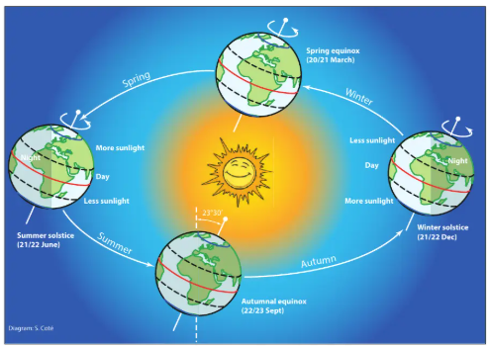

Slide 6
Watch: What Causes the Seasons? (NASA)
https://science.nasa.gov/eclips/videos/what-causes-seasons/

Slide 7
TRY IT YOURSELF
A Live Home Demo
⬤ What you need: a globe (or a ball), a desk lamp or torch, and a darkened room.
⬤ What to do: tilt the globe 23.5° the way Earth really is, shine the lamp at it from one side, and slowly walk it in a circle around the “Sun.”
⬤ What to notice: watch how the Northern and Southern Hemispheres take turns facing the light — that's the whole mechanism, in your hands.

Slide 8
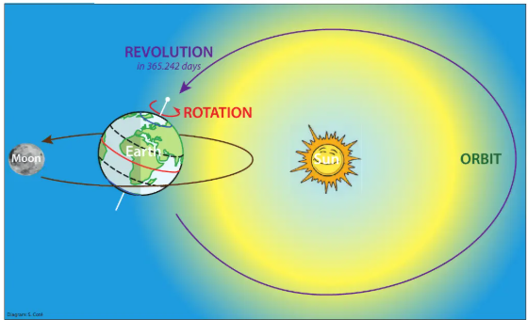
NOW, THE MOON
Revolution = Rotation
⬤ The Moon orbits Earth once every 27.3 days (its revolution).
⬤ The Moon also spins on its own axis — and it takes exactly the same 27.3 days to complete one spin (its rotation).
⬤ The result: because these two times match exactly, the Moon always shows the same face to Earth — this is called tidal locking.

Slide 9
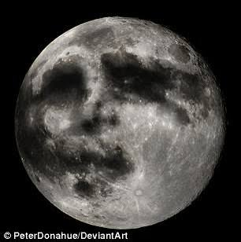
The side we see has big dark patches called maria ("seas") and lighter, bumpy areas full of craters. The dark patches are old, flat, hardened lava — that's why the Moon looks like it has a face!

Slide 10
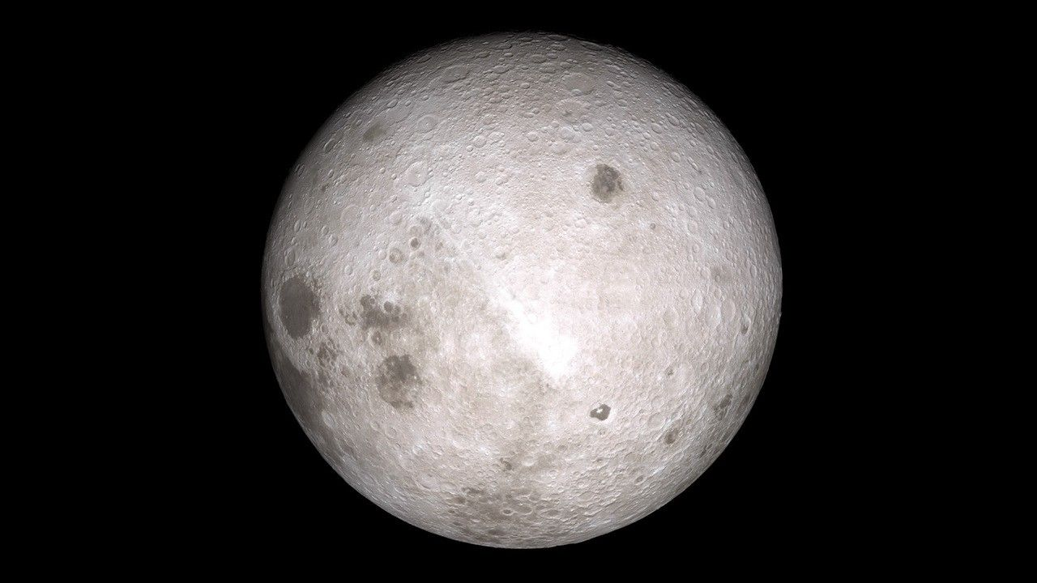
THE REVEAL
A Face You've Never Seen
⬤ This is the Moon's far side — real photo, taken by NASA's Lunar Reconnaissance Orbiter.
⬤ No human has ever seen this view with their own eyes from Earth — only spacecraft have.
⬤ Notice it looks different from the familiar Moon: far fewer of the large dark patches (“maria”) that you can usually spot from your garden.

Slide 11
BONUS FACTS
The Moon Keeps Surprising Us
⬤ Moving away: the Moon drifts about 3.8 cm farther from Earth every year — too slow to notice, but measurable using lasers bounced off mirrors astronauts left on the surface.
⬤ Moonquakes: the Moon has its own version of earthquakes, caused by Earth's gravity pulling on it — weaker than ours, but some last up to half an hour.
⬤ More than ocean tides: the Moon's gravity doesn't just pull on Earth's oceans — it very slightly stretches the solid ground too, in a tiny “rock tide.”
⬤ Water on the Moon: there's frozen water hidden in craters near its poles, in spots so permanently shadowed that the ice never melts.

Slide 12
Watch: Why Do We Always See the Same Side of the Moon?
https://www.youtube.com/watch?v=6jUpX7J7ySo

Slide 13
Next Time...
Light: how it travels, how shadows form, and how telescopes and microscopes let us see what our eyes alone can't.

