Slide 1
UNIT 1 · OUR PLACE IN THE UNIVERSE · LESSON 3
How Do We Know
Earth Is Round?
And how a librarian, 2,000 years ago, used nothing but shadows and geometry to measure its exact size.

Slide 2
QUICK RECAP
Where We've Been
⬤ We've covered the Solar System, day/night, the year, the Sun, seasons, and the Moon's same-faced mystery.
⬤ Today's question: how do we actually KNOW Earth is round — and how big is it?

Slide 3
A BIT OF HISTORY
The Old Idea: A Flat Earth
⬤ Ancient civilisations like the Babylonians and Egyptians generally believed Earth was a flat disk — that's simply what it looks like when you stand on it.
⬤ The first doubter: the Greek philosopher Pythagoras, around the 6th century BCE, noticed that the Moon and Sun were both spherical — and reasoned that Earth, part of the same cosmic family, probably was too.
⬤ The proof was still missing: a good guess isn't the same as evidence. That's where our hero comes in.

Slide 4
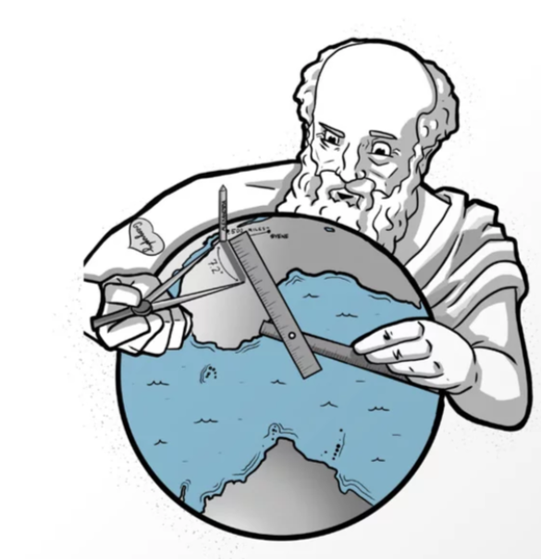
MEET THE SCIENTIST
Eratosthenes of Cyrene
⬤ Born in 276 BCE in Cyrene (modern-day Libya), Eratosthenes lived and worked in Alexandria, Egypt.
⬤ His job: chief librarian of the Library of Alexandria — one of the greatest centres of knowledge in the ancient world.
⬤ His claim to fame: around 2,000 years ago, he became the first person in history to calculate the size of the Earth — using nothing but shadows, geometry, and a very clever idea.

Slide 5
THE EXPERIMENT
Two Cities, One Day
⬤ The cities: Eratosthenes picked Alexandria and Syene (modern Aswan), about 800 km apart in Egypt.
⬤ The day: the Summer Solstice (around 21 June) — the longest day of the year, when the Sun reaches its highest point in the sky.
⬤ Why that day: he knew that in Syene, at noon on that exact day, the Sun was directly overhead — vertical objects cast NO shadow at all.

Slide 6
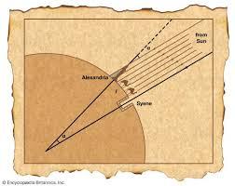
THE KEY OBSERVATION
Shadows Tell the Story
⬤ In Syene: at noon, a vertical rod cast no shadow — the Sun was exactly overhead.
⬤ In Alexandria: at the very same moment, a vertical rod DID cast a shadow.
⬤ The puzzle: if Earth were flat, the Sun's angle would be identical in both cities. It wasn't — so Earth's surface must be curved between them.

Slide 7
THE CLEVER MATHS
From an Angle to the Whole Planet
⬤ The angle: by measuring the shadow in Alexandria, Eratosthenes calculated the Sun's angle there was about 7.2° away from straight overhead.
⬤ The fraction: 7.2° is exactly 1/50th of a full circle (360°) — so the 800 km between the two cities must be 1/50th of Earth's whole circumference.
⬤ The multiplication: multiply 800 km by 50...

Slide 8
THE RESULT
Astonishingly Close
⬤ His estimate: about 40,000 km around the Earth.
⬤ The real answer (measured by satellites today): 40,075 km.
⬤ Let that sink in: over 2,000 years ago, with no satellites, no computers — just two shadows, a known distance, and geometry — Eratosthenes got within 0.2% of the true answer.

Slide 9
Meet Eratosthenes of Cyrene
https://www.youtube.com/watch?v=I7UbiDVXoyo

Slide 10
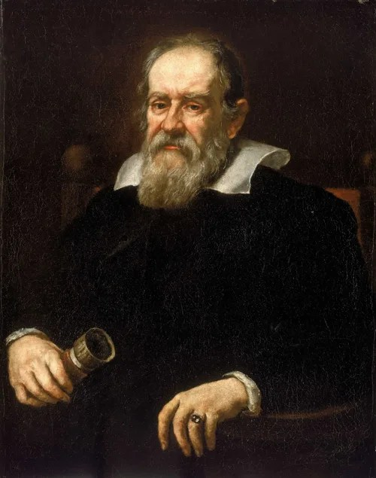
A SECOND HERO OF ASTRONOMY
Meet Galileo Galilei
⬤ Eratosthenes measured the Earth using shadows and geometry. About 1,800 years later, an Italian scientist named Galileo Galilei (born 1564) changed astronomy again — this time with a brand-new tool.
⬤ The tool: in 1609, Galileo built his own improved version of the newly-invented telescope — and became the first person ever to study the sky through one.
⬤ Why it mattered: what he saw through it would challenge what almost everyone believed about our place in the universe.

Slide 11
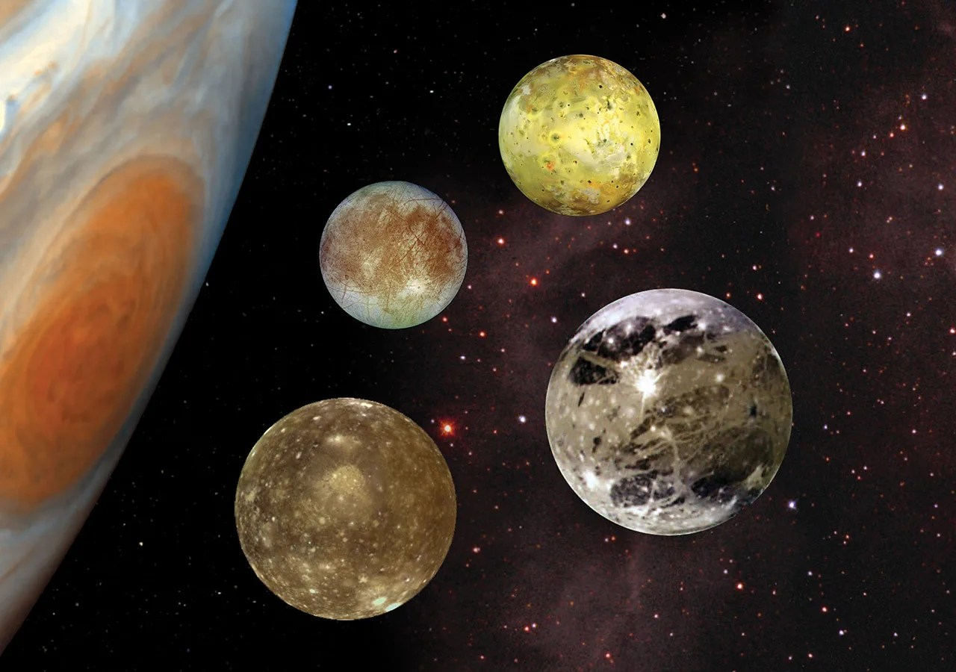
THE DISCOVERIES
What Galileo Saw
⬤ The Moon: up close, it wasn't a smooth sphere — it had mountains and craters, just like Earth.
⬤ Jupiter's moons: four tiny “stars” next to Jupiter turned out to be moons, orbiting Jupiter — proof that not everything in the sky orbits Earth.
⬤ Venus's phases: Venus changed shape like the Moon does — which only made sense if Venus orbits the Sun, not Earth.
⬤ Sunspots: even the Sun had dark blemishes on it — it wasn't a perfect, unchanging ball of light.

Slide 12
Meet Galileo Galilei
https://www.youtube.com/watch?v=BVo6neZ1-tg

Slide 13
Next Time...
Shadows again — but this time, we'll explore exactly how light has to travel to make them happen.

