Slide 1
UNIT 1 · OUR PLACE IN THE UNIVERSE · LESSON 5
Putting It All
Together
A recap day — no new facts, just games, maths, and discussion to make sure Lessons 1-3 have truly sunk in before we move on to Light.

Slide 2
QUICK RECAP
What We've Covered So Far
⬤ Lesson 1: our cosmic address — the Solar System, the 8 planets, star/planet/moon/asteroid/comet, the Sun as our energy source, the Milky Way, the expanding universe
⬤ Lesson 2: why we have seasons (Earth's tilt) and why the Moon always shows us the same face
⬤ Lesson 3: how Eratosthenes proved Earth is round AND measured its size — and how Galileo's telescope proved Earth is not the centre of everything
⬤ Today: no new facts. Just making sure it is all locked in before we move on.

Slide 3
QUICK-FIRE ROUND
Test Your Memory (1/2)
1. What is a star?
2. Difference between an asteroid and a comet?
3. How many planets orbit the Sun?
4. True or False: almost all of Earth's energy comes from the Sun.
5. What galaxy is our Solar System part of?

Slide 4
QUICK-FIRE ROUND
Test Your Memory (1/2)
1. What is a star?
A giant ball of burning gas that makes its own light.
2. Difference between an asteroid and a comet?
An asteroid is small and rocky; a comet is small and icy, and grows a glowing tail near the Sun.
3. How many planets orbit the Sun?
8.
4. True or False: almost all of Earth's energy comes from the Sun.
True.
5. What galaxy is our Solar System part of?
The Milky Way.

Slide 5
QUICK-FIRE ROUND
Test Your Memory (2/2)
6. True or False: the universe stays exactly the same size forever.
7. What does rotation cause? What does revolution cause?
8. Who first measured the size of the Earth, and how?
9. Name one thing Galileo discovered with his telescope.
10. True or False: the Milky Way is the only galaxy in the universe.

Slide 6
QUICK-FIRE ROUND
Test Your Memory (2/2)
6. True or False: the universe stays exactly the same size forever.
False — it is expanding, right now, in every direction.
7. What does rotation cause? What does revolution cause?
Rotation (spin, every 24h) = day/night. Revolution (orbit the Sun, every 365¼ days) = one year.
8. Who first measured the size of the Earth, and how?
Eratosthenes — using shadows and geometry, comparing the same moment at two Egyptian cities.
9. Name one thing Galileo discovered with his telescope.
The Moon's mountains/craters, Jupiter's four moons, Venus's phases, or sunspots on the Sun.
10. True or False: the Milky Way is the only galaxy in the universe.
False — there are hundreds of billions of galaxies.

Slide 7
HANDS-ON ACTIVITY
Shrinking the Solar System
⬤ In Lesson 1 we imagined the Sun shrunk to the size of a basketball (24 cm across) — and on that scale, Earth is a tiny peppercorn sitting 24 metres away.
⬤ Today, YOU calculate where the other planets would be.
The Method
Scaled distance = (planet's real distance from Sun ÷ Earth's real distance from Sun) × 24 m

Slide 8
HANDS-ON ACTIVITY
Real Distances From the Sun
Planet | Real distance (million km)
Mercury | 57.9
Venus | 108.2
Earth | 149.6
Mars | 227.9
Jupiter | 778.3
Saturn | 1,427
Uranus | 2,871
Neptune | 4,497
Worked Example: Mercury
57.9 ÷ 149.6 × 24 m ≈ 9 metres
Your Turn
Calculate the scaled distance for:
Jupiter, Saturn, Uranus, and Neptune.

Slide 9
HANDS-ON ACTIVITY
The Big Reveal
Planet | Scaled distance
Mercury | ≈ 9 m
Venus | ≈ 17 m
Earth | 24 m
Mars | ≈ 37 m
Jupiter | ≈ 125 m
Saturn | ≈ 230 m
Uranus | ≈ 460 m
Neptune | ≈ 720 m
Punchline
If our basketball-Sun sat at the front of the classroom and Earth's peppercorn was 24 metres away, Neptune would be over 700 metres away — about seven football pitches end to end!
Even though Mercury, Venus, Earth, and Mars feel close together, the outer planets are spread across a huge, mostly empty distance.

Slide 10
DID YOU NOTICE?
Why This Matters
⬤ The four rocky planets (Mercury-Mars) are all bunched close to the Sun.
⬤ The four gas giants (Jupiter-Neptune) are spread across vastly bigger distances.
⬤ Space is almost entirely empty — even within our own "small" Solar System.

Slide 11
HANDS-ON ACTIVITY
The Cosmic Calendar
⬤ The universe is 13.8 billion years old. That's such a huge number it's almost meaningless — so let's squeeze the ENTIRE history of the universe into a single calendar year and see where things land.

Slide 12
HANDS-ON ACTIVITY
One Year, All of Time
Event | Real time ago | On the Cosmic Calendar
Big Bang | 13.8 billion years | 1 January, 00:00
First stars & galaxies form | ~13.4 billion years | mid-January
Milky Way takes shape | ~13 billion years | March
Our Sun & Solar System form | 4.6 billion years | 31 August
Earth forms | 4.5 billion years | 1 September
First simple life appears | ~3.8 billion years | 21 September
Dinosaurs go extinct | 66 million years | 30 December
First humans appear | ~300,000 years | 31 Dec, 11:52 pm
All of recorded human history | a few thousand years | the last seconds of 31 Dec

Slide 13
Let’s watch how it started: THE BIG BANG THEORY
https://www.youtube.com/watch?v=rXER39AEE9k

Slide 14
HANDS-ON ACTIVITY HOMEWORK
Your Timeline
⬤ Draw a straight line across your page. Label the left end 'Big Bang — 13.8 billion years ago' and the right end 'Today.'
⬤ Now mark where these four events belong: the Sun/Solar System forming, Earth forming, the first life appearing, and the first humans appearing.
Punchline
Notice how almost nothing happens for most of the line — and then everything we would call 'history' is squeezed into a tiny sliver at the very end.

Slide 15
CLASS DISCUSSION
Earth-Centred or Sun-Centred?
⬤ For most of human history, almost everyone — including brilliant scientists — believed Earth was the centre of everything, with the Sun, Moon, and stars all circling around us. This was called the geocentric model.
⬤ We now know the heliocentric model is correct: Earth and the other planets orbit the Sun. Let's look at the evidence, the same way scientists had to.

Slide 16
CLASS DISCUSSION
Talk It Through
⬤ Before Galileo's telescope, was it unreasonable for people to believe in geocentrism? Why or why not?
⬤ Which of Galileo's four observations do you find the most convincing, and why?
⬤ Can you think of a modern example where something "looks" obviously true — the way the Sun circling us looked true — but turns out not to be?

Slide 17
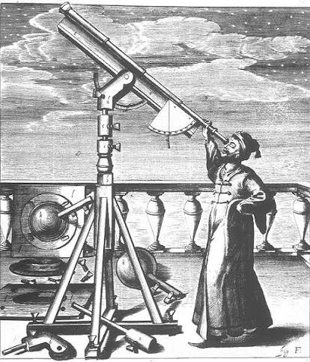
⬤ Before Galileo's telescope, was it unreasonable for people to believe in geocentrism? Why or why not?
The Evidence of the Senses: To the naked eye, the Earth feels completely still while the Sun, Moon, and stars visibly move across the sky every day.
The Lack of "Wind": People believed that if the Earth were spinning rapidly, objects thrown straight up would land far away, and we would feel a constant, violent rushing wind.
The Stellar Parallax Problem: If the Earth traveled around the Sun, the positions of the stars should visibly shift. Because the stars are too far away for the naked eye to see this shift, astronomers assumed the Earth wasn't moving.

Slide 18
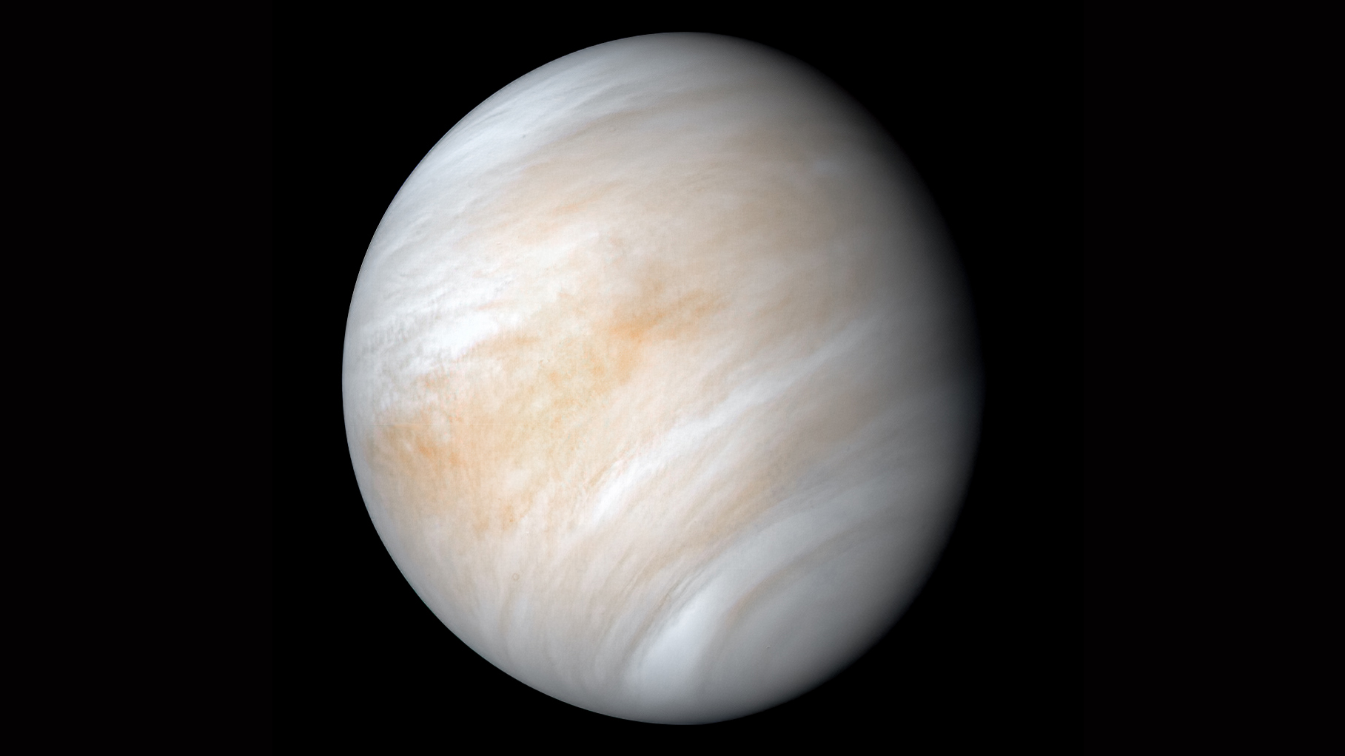
⬤ Which of Galileo's four observations do you find the most convincing, and why?
The Old Idea: People believed Venus always stayed between the Earth and the Sun, meaning we should only ever see it as a thin crescent.
Galileo's Discovery: He saw that Venus goes through a full set of phases—just like the Moon—including a "full" phase.
The Proof: Venus could only look "full" if it traveled completely behind the Sun, proving it orbits the Sun, not the Earth.

Slide 19
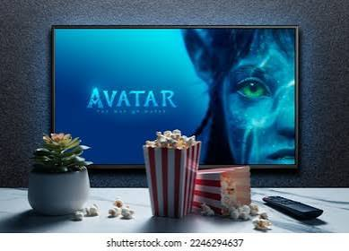
⬤ Can you think of a modern example where something "looks" obviously true — the way the Sun circling us looked true — but turns out not to be?
A movie playing on a screen.
The Illusion: When you watch a movie, you see smooth, continuous motion—like a car driving or a person running.
The Reality: There is no actual movement on the screen. It is just a fast sequence of thousands of still, frozen photographs flashing before your eyes. It only looks alive because your brain cannot process the gaps between the frames.

Slide 20
CLASS DISCUSSION
The Evidence, Side by Side
A — Why People Believed Earth Was the Centre
B — Galileo's Evidence for the Sun-Centred Model
• Venus's phases: only make sense if Venus orbits the Sun, not Earth.
• Jupiter's moons: four objects clearly orbiting Jupiter, not Earth.
• The Moon's mountains and craters: a rocky world like Earth.
• Sunspots: even the "perfect" Sun has blemishes.
• The ground feels completely still — we don't feel ourselves moving.
• Every day, the Sun, Moon, and stars rise in the east and cross the sky, exactly as if circling us.
• For thousands of years, nobody had evidence strong enough to prove otherwise.

Slide 21
📌 WE DON'T FORGET
Our Place in the Universe (So Far)
⬤ Our Solar System has 8 planets, all orbiting the Sun. The four closest (Mercury, Venus, Earth, Mars) are small and rocky; the four farthest (Jupiter, Saturn, Uranus, Neptune) are huge balls of gas.
⬤ A star makes its own light (like our Sun); a planet orbits a star; a moon orbits a planet; an asteroid is a small rocky leftover; a comet is small, icy, and grows a glowing tail near the Sun.
⬤ Earth's spin (rotation, every 24 hours) gives us day and night. Earth's orbit around the Sun (revolution, every 365¼ days) gives us one year.
⬤ Almost all of Earth's energy — sunlight, wind, even the food we eat — ultimately comes from the Sun.

Slide 22
📌 WE DON'T FORGET
Our Place in the Universe (Continued)
⬤ Our Solar System is just one tiny part of the Milky Way galaxy (100+ billion stars), itself just one of hundreds of billions of galaxies in the universe.
⬤ The universe is about 13.8 billion years old, and it is still expanding in every direction, right now.
⬤ About 2,000 years ago, Eratosthenes proved Earth is round and calculated its circumference (about 40,000 km — astonishingly close to the real value of 40,075 km) using nothing but shadows, geometry, and the distance between two Egyptian cities.
⬤ In 1609, Galileo Galilei became the first person to study the sky through a telescope. What he saw — the Moon's mountains, Jupiter's four moons, Venus's phases, and sunspots — gave the first real evidence that Earth is NOT the centre of everything; the Sun-centred (heliocentric) model is the correct one.
⬤ Common mix-up to avoid: "rotation" and "revolution" sound similar but mean different things — rotation is Earth spinning on itself (day/night); revolution is Earth travelling all the way around the Sun (the year).

Slide 23
NEXT TIME...
We leave the planets behind and dive into Light itself: how it bends when it hits water or glass, and what that has to do with a pencil that looks bent in a glass of water.

