Slide 1
UNIT 1 · OUR PLACE IN THE UNIVERSE · LESSON 4
Light: Straight Lines
& Shadows
A new topic, but it starts with something you already understand perfectly — your own shadow.

Slide 2
QUICK RECAP
From Seasons to Light
⬤ We've covered the Solar System, day/night, the year, the Sun, seasons, and the Moon's same-faced mystery.
⬤ Today's new topic: Light — how it travels, and how it creates the shadows you see every day.

Slide 3
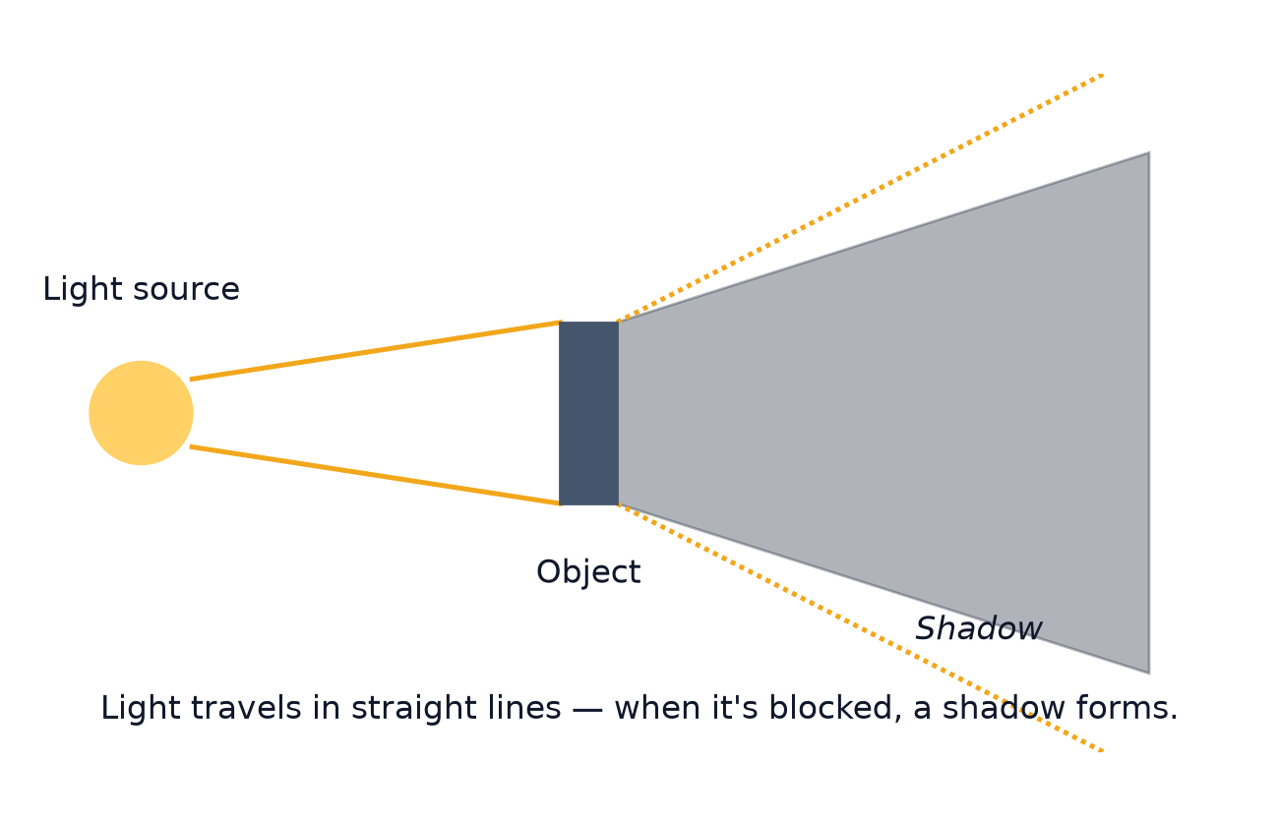
THE BIG IDEA
Light Travels in Straight Lines
⬤ The rule: light always travels in straight lines — it never bends or curves on its own.
⬤ The result: if something solid blocks those straight lines, the light can't get past it — and a shadow forms exactly where the light couldn't reach.

Slide 4
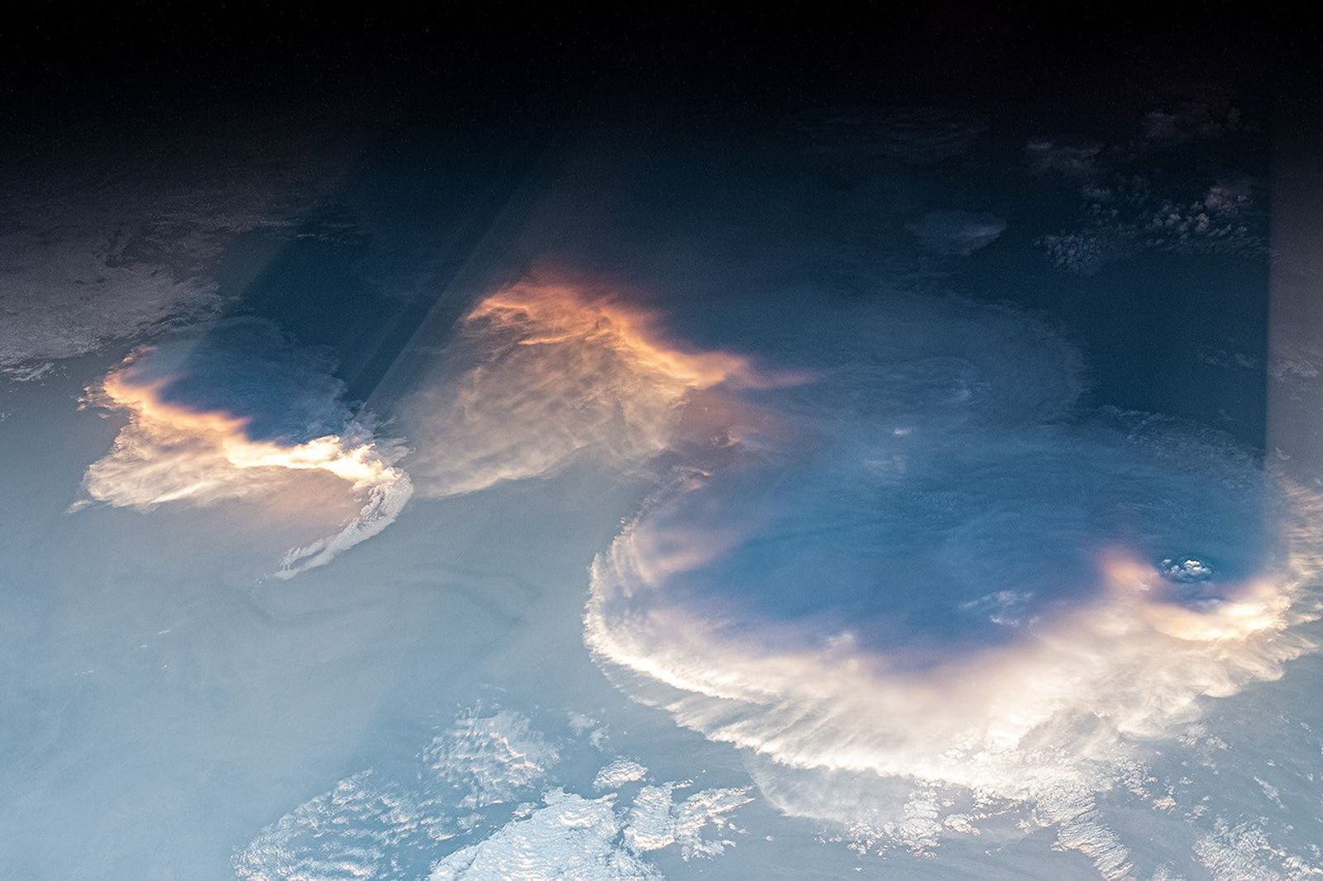
REAL PROOF
You Can Actually See It
⬤ This real photo was taken from the International Space Station.
⬤ Clouds are blocking sunlight, and you can clearly see the straight dark shadow-bands stretching out behind them — exactly like our diagram, but real and enormous.

Slide 5
TRY IT YOURSELF
Track Your Own Shadow
⬤ What you need: a sunny day, a piece of chalk (or a small object and a ruler), and a friend.
⬤ What to do: mark the tip of your shadow first thing in the morning, then again at midday, then again in the late afternoon.
⬤ What to notice: your shadow is long in the morning and evening, but short around midday — can you connect this to Earth's rotation from Lesson 1?

Slide 6
DID YOU KNOW?
Shadow Facts
⬤ At the Equator on certain days, the Sun can be almost directly overhead at noon — making your shadow nearly disappear underneath you.
⬤ Sundials use exactly this idea — they tell the time just from the length and direction of a shadow.
⬤ Shadow puppetry is an ancient art form, thousands of years old, that uses nothing but a light source, a screen, and this one simple rule of light.

Slide 7
Next Time...
What happens when light hits a mirror, or passes through water? Reflection and refraction — two more rules that explain a lot more than you'd think.

