Slide 1
INTEGRATED SCIENCE
KALLIOPI ZEINAKI
European School of Heraklion
2026-27

Slide 2
WHAT I WILL NEED
A 2 SUBJECT NOTEBOOK
A DOSSIER FOR PHOTOCOPIES

Slide 3
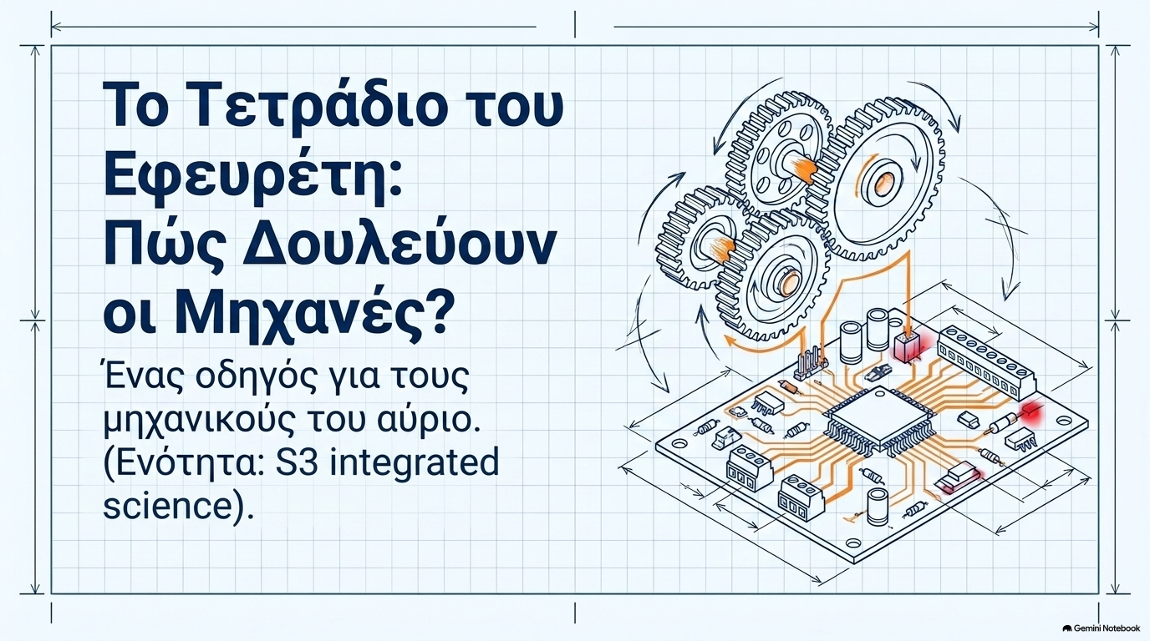

Slide 4


Slide 5
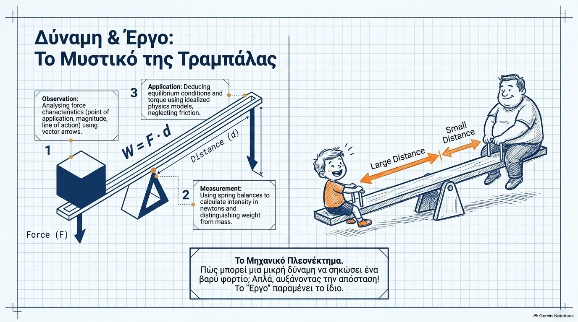

Slide 6
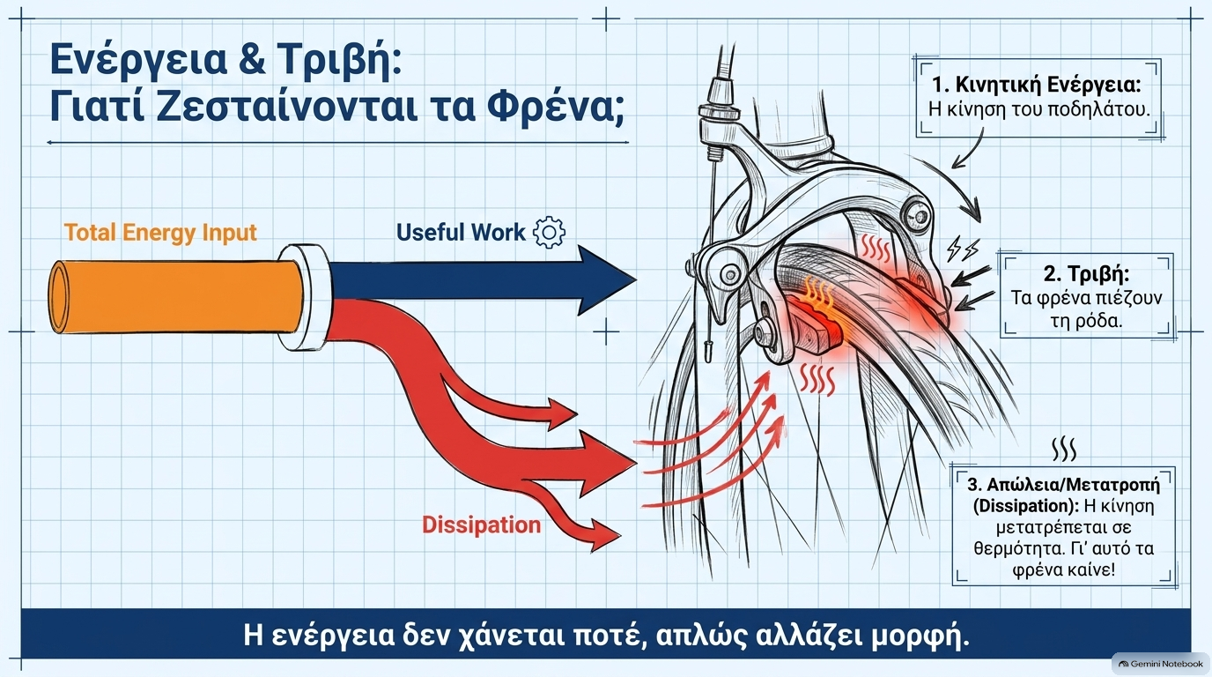

Slide 7
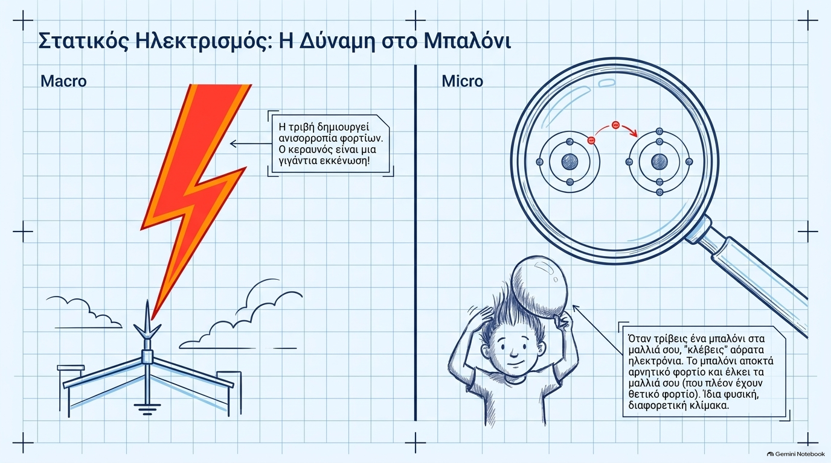

Slide 8
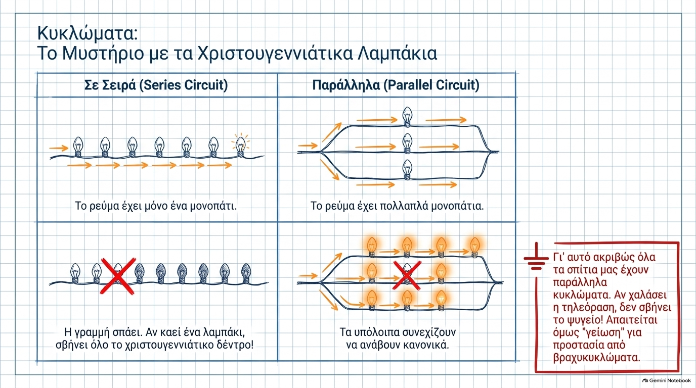

Slide 9
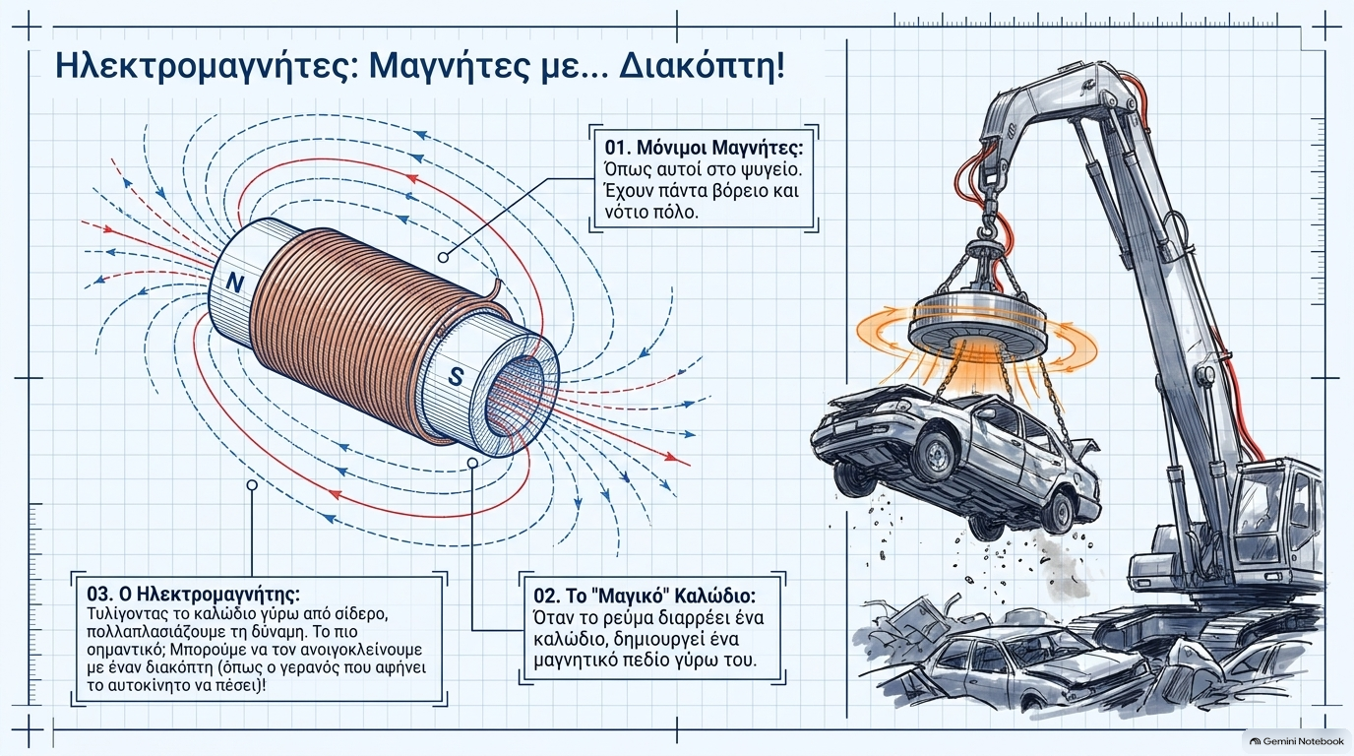

Slide 10
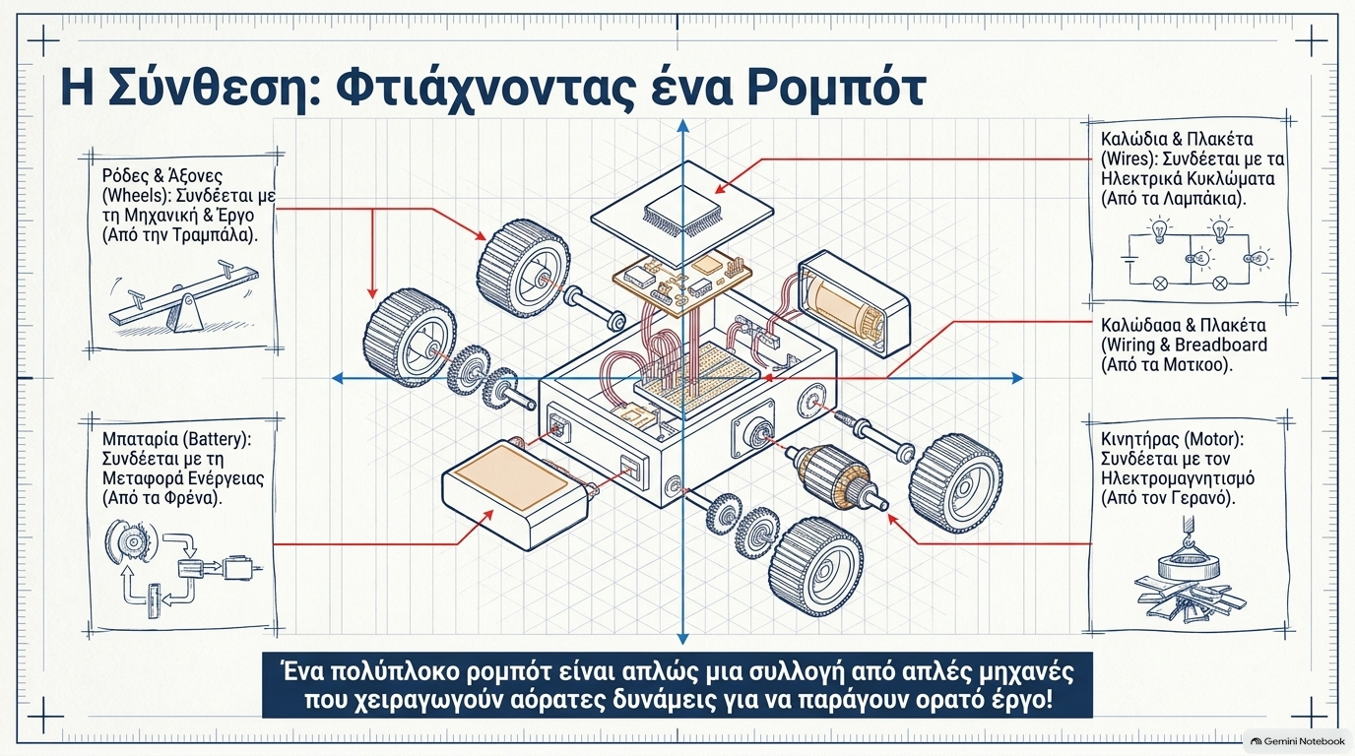

Slide 11
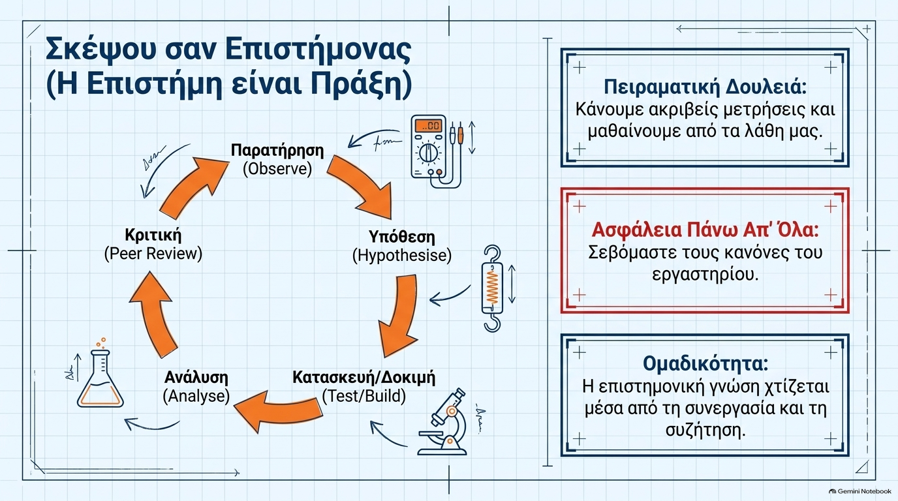

Slide 12
