Slide 1
S7 SCIENCE, TECHNOLOGY & SOCIETY · SEMESTER 1 · PERIOD 2
The Enhanced Greenhouse Effect,
and Where the Heat Goes
Climate Change and Biodiversity — from last lesson's energy imbalance to the ocean's rising heat content.
S7 STS · Climate Change & Biodiversity · Period 2

Slide 2
WHERE WE LEFT OFF
The Enhanced Greenhouse Effect
• Last lesson: Earth's energy balance has a natural, stable state — when incoming solar energy equals outgoing infrared energy, the climate is stable.
• What's changed: human activities have added extra greenhouse gases on top of the natural baseline, so Earth now traps slightly more energy than it releases — a surplus of about +1 W/m², globally.
• The name for this: scientists call it the Enhanced Greenhouse Effect — “enhanced” because it's the same natural mechanism from last lesson, just intensified by human emissions, not a different phenomenon.
• Where the extra energy goes: it warms the atmosphere, melts the cryosphere (glaciers and ice) — and about 90% of it is absorbed by the oceans.

Slide 3
TRACKING THE EVIDENCE
Parameter 2: Ocean Heat Content
2
• The syllabus lists several independent parameters that, together, build the case for climate change:
• ✓ Parameter 1 — Earth's Energy Budget: covered last lesson.
• → Parameter 2 — Ocean Heat Content: today's focus.
• Still to come: average surface temperature, sea level, ocean acidification, and how scientists combine all of this evidence (consilience).
S7 STS · Climate Change & Biodiversity · Period 2

Slide 4
THE EVIDENCE
What Is Ocean Heat Content?
• Ocean Heat Content (OHC) is the total amount of thermal energy stored in Earth's oceans.
• Measured in: joules — and considered the most reliable, critical indicator for tracking global warming.
• The result: the ocean acts like a “shield,” absorbing the vast majority of the excess heat trapped by greenhouse gases — the same ~90% from last lesson.
S7 STS · Climate Change & Biodiversity · Period 2

Slide 5
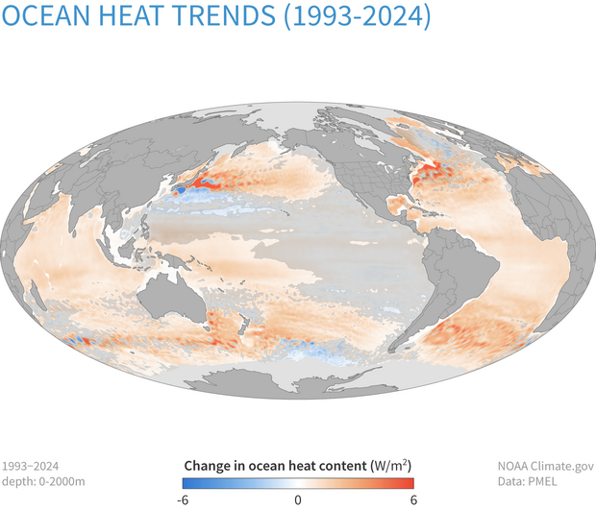

Slide 6
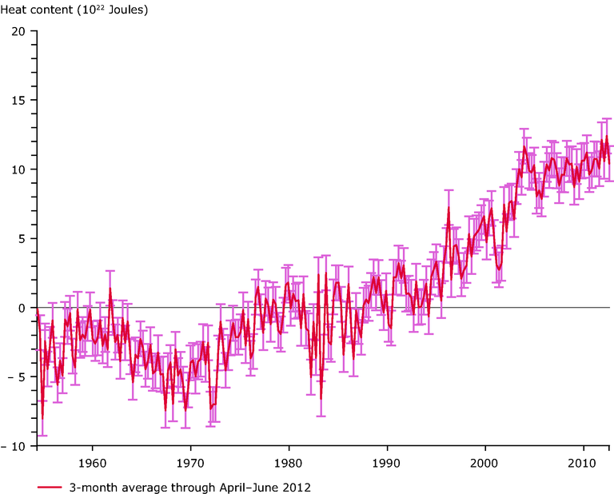

Slide 7
Why the oceans absorb so much:
water has an enormous specific heat capacity, so the oceans act as the planet's largest heat reservoir. It takes a huge amount of energy to raise the ocean's temperature even by a fraction of a degree.
Water molecules link together through strong hydrogen bonds.
Energy absorption: When you add heat, much of the energy breaks these bonds instead of speeding up the molecules.
Slow temperature change: Because energy goes into breaking bonds first, water heats up and cools down very slowly.

Slide 8
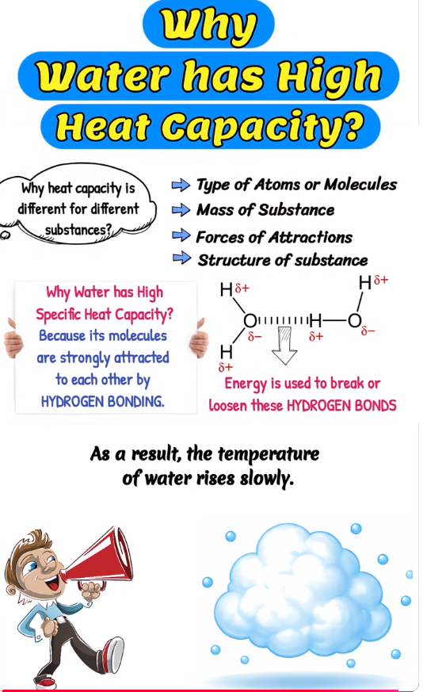
https://www.youtube.com/shorts/HOqKztNeUdE

Slide 9
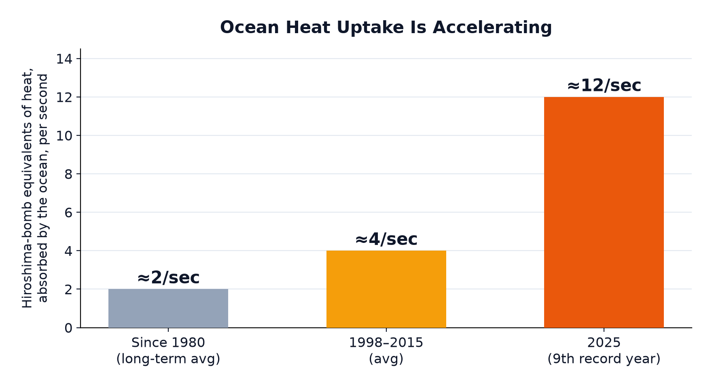
NUMBERS TOO BIG TO PICTURE
The Scale of Absorption
• To grasp numbers this large, scientists use zettajoules (ZJ) — one zettajoule equals 10²¹ joules (a 1 followed by 21 zeros).
• The pattern: ocean heat uptake isn't just large — it's accelerating, as the chart below shows.
Since 1980 (long-term average): The oceans absorbed approximately 2 bomb equivalents per second.
1998–2015 (average): The rate doubled to approximately 4 bomb equivalents per second.
2025 (9th record year): The rate tripled from the previous period, reaching approximately 12 bomb equivalents per second.
S7 STS · Climate Change & Biodiversity · Period 2

Slide 10
WHY IT MATTERS
A Planet-Scale Buffer — With Limits
• This ocean buffering has protected us from even faster atmospheric warming — but it isn't free.
• The cost: absorbing that much heat already drives thermal expansion of seawater (contributing to sea level rise), marine heatwaves, and coral bleaching.
• The buffer isn't limitless: the ocean's capacity to keep shielding the atmosphere doesn't disappear — but the consequences of all that stored heat compound, year after year.
S7 STS · Climate Change & Biodiversity · Period 2

Slide 11
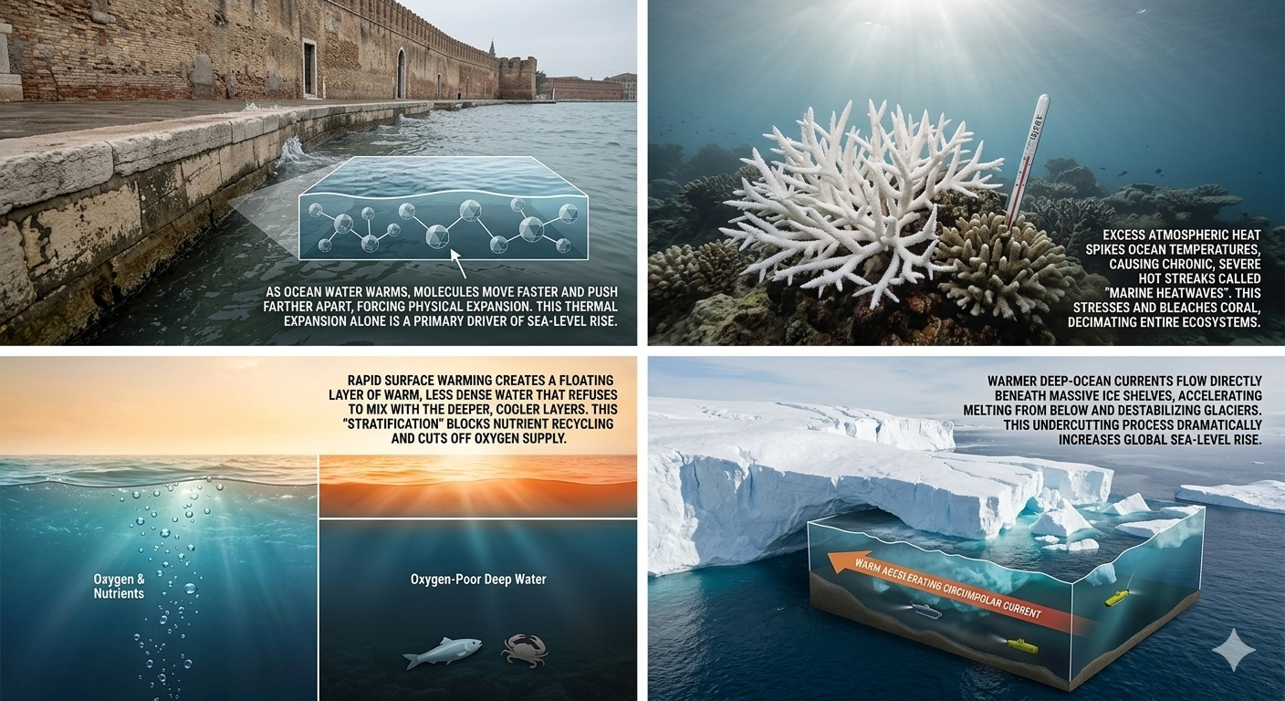

Slide 12
And a video that sums everything up:
https://science.nasa.gov/resource/video-oceans-of-climate-change/

Slide 13
KEY TAKEAWAYS
What You Should Walk Away With
• The Enhanced Greenhouse Effect is the same natural mechanism from last lesson, intensified by human-added greenhouse gases — not a separate phenomenon.
• Ocean Heat Content (OHC) — the total thermal energy stored in the oceans — is the most reliable indicator of global warming, measured in zettajoules (10²¹ J).
• About 90% of the planet's current energy surplus is absorbed by the oceans, thanks to water's huge heat capacity.
• Ocean heat uptake is accelerating: from ≈2 bomb-equivalents/second historically, to ≈4 (1998–2015), to ≈12 in 2025 — the 9th consecutive record year.
NEXT LESSON
Period 3 — more to the consequences..
S7 STS · Climate Change & Biodiversity · Period 2

