Slide 1
Streams
Calvin D’Souza
Nihar Buliya

Slide 2
What are streams?
Streams are one of the fundamental concepts that power Node.js applications. They are data-handling method and are used to read or write input into output sequentially.
Streams are a way to handle reading/writing files, network communications, or any kind of end-to-end information exchange in an efficient way.
What makes streams unique, is that instead of a program reading a file into memory all at once like in the traditional way, streams read chunks of data piece by piece, processing its content without keeping it all in memory.
This makes streams really powerful when working with large amounts of data

Slide 3
Types of Streams
Writable: streams to which we can write data. For example, fs.createWriteStream() lets us write data to a file using streams.
Readable: streams from which data can be read. For example: fs.createReadStream() lets us read the contents of a file.
Duplex: streams that are both Readable and Writable.
Transform: streams that can modify or transform the data as it is written and read. For example, in the instance of file-compression, you can write compressed data and read decompressed data to and from a file.

Slide 4
Events present in streams
Each stream is basically a Event Emitter instance which emits and throws different events at different times.
data − This event is fired when there is data is available to read.
end − This event is fired when there is no more data to read.
error − This event is fired when there is any error receiving or writing data.
finish − This event is fired when all the data has been flushed to underlying system.

Slide 5
Writable Streams

Slide 6
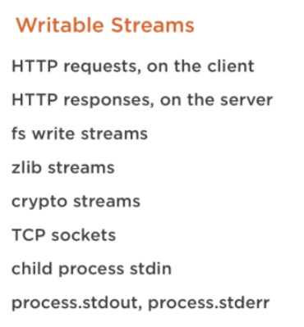
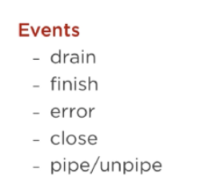
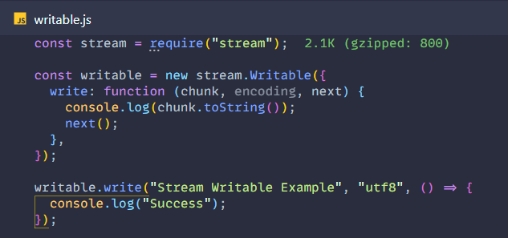
What are they?
A Writable stream represents the destination to which we write the data.

Slide 7
Readable Streams

Slide 8
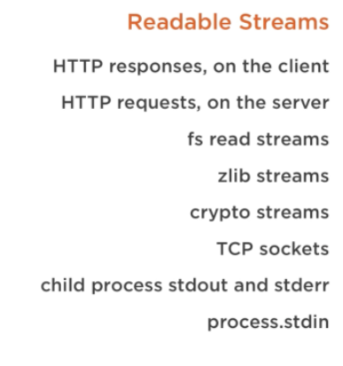
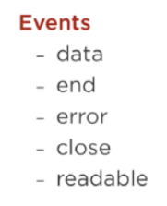
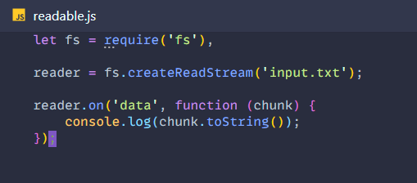
What are they?
Readable streams produce data that can be fed into a writable, transform, or duplex stream by calling .pipe()

Slide 9
Duplex Streams

Slide 10
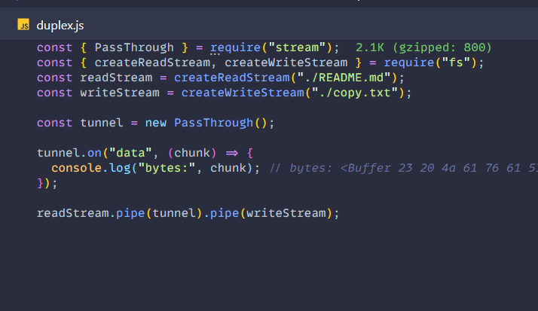
What are they?
Duplex streams are a mixture of both the readable and writable streams where both streams are independent of each other.
They can be used for implementations such as TCP socket connection where you just send and receive data.

Slide 11
Transform Streams

Slide 12
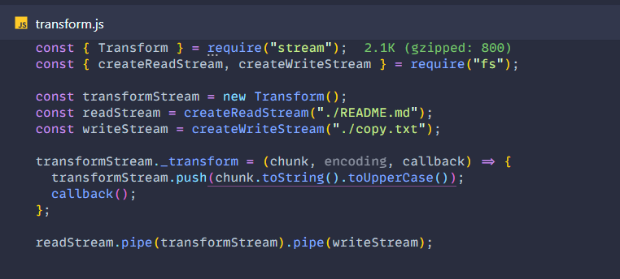
What are they?
Transform streams are a certain type of duplex stream (both readable and writable). The distinction is that in Transform streams, the output is in some way calculated from the input.
You might also hear transform streams referred to as "through streams".
Through streams are simple readable/writable filters that transform input and produce output.

