Slide 1
JET FLIGHT AVIATION 14 JUNE 2024
Aviation Accident Database & Synopses, up to 2023
Analysis by: James Kamau

Slide 2
Overview
This project analysis dataset is from Aviation Accident Database & Synopses, up to 2023.
It contains information from 1962 and later about civil aviation accidents
The most equitable actions can be taken to produce quality analysis for a start-up business like Jet Flight by looking at historical data.

Slide 3
Business Understanding
Jet Flight Aviation is expanding into new industries to diversify its portfolio but have no idea about this business:
Type of problem to solve
Factors to consider
Risks of Aircraft
Initial aircraft purchase

Slide 4
Data Understanding
Dataset Used
Aviation Accident Database & Synopses, up to 2023
Measures Used
From 1974 up to 2022
Aircraft Make, Weather Condition, Aircraft Service

Slide 5
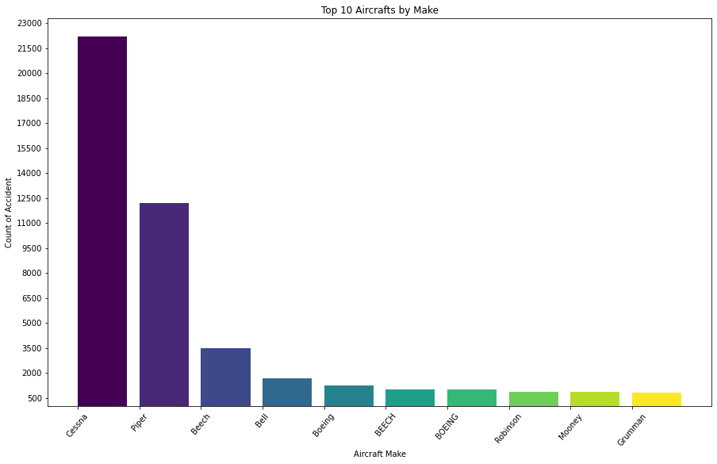
Top 10 Aircrafts by Make The top 10 aircraft by make that were highly involved in the recorded accidents.

Slide 6
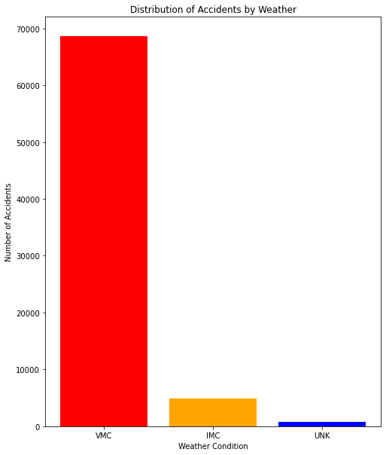
Weather Condition The contribution of weather conditions to aircraft accidents.

Slide 7
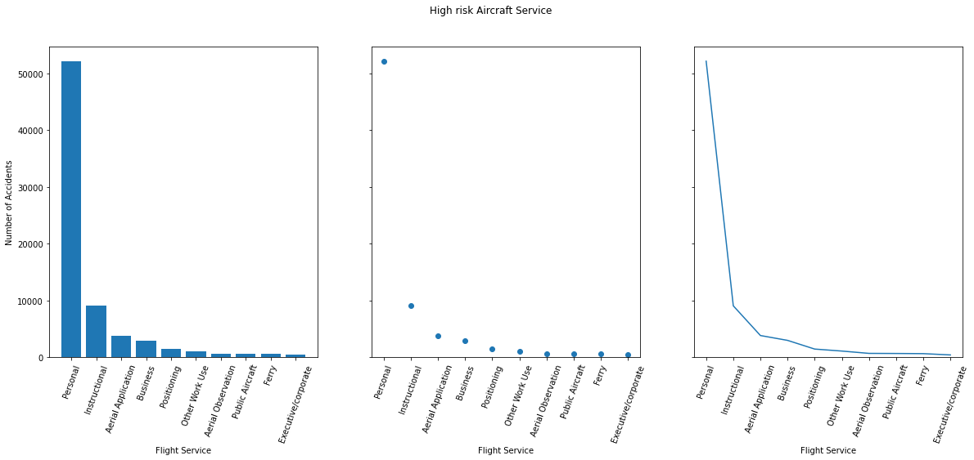
Flight Service Top 10 flight service at risk

Slide 8
Conclusion
Recommendation
Consult Aviation Authorities about top rated Aircrafts
Target Global audience to overcome weather conditions impact on business.
Venture into services that have low risk towards the business.

